Slide 1

What can parents do to help their children succeed in school?
Stuart McNaughton
2012

Slide 2

Focus in this talk
Title came from an OECD report
One area of school ‘success’ achievement (literacy, NCEA)
But NZ curriculum specifies…
  Values
  Competencies
  Learning areas
  Principles

Slide 3
Focus in this talk
Parenting in 3 high ‘impact’ areas
  Reading
  Talking
  Engaging
‘Help’ is no guarantee, just one influence and….
  inoculation is not a good model
  both near and far success
  So…more of a life course view

Slide 4
1. Reading with children
Prevalence
Significance
How (what matters)
Why

Slide 5
Many of us read with children- often
GUPNZ Reading to children
@ 9 months
75% of mothers report several times a week or more (singing or telling stories higher)
Later?

Slide 6
Significance: before school
‘Often reading’ before school related to early success in reading–up to half a year gain (experimental evidence)
‘Often reading’ also related to comprehension at 15 years, half a year gain compared with little or no reading (14 countries OECD)- NZ even greater differences

Slide 7
Success in ‘school readiness’
What do children know¹ on entry to school
(related to early success)?
  Concepts about print (around 10)
  Letter identification (around 20)
  Retelling (narrative) sequence
  Writing (1-2 words)
  Know that speech has units (phonological awareness)
  Recitation ?
  ¹averages with wide variation

Slide 8
What “matters”
Frequency
Early -may have a snow ball effect
Style different with age and types
  Early labelling (eg picture books)
  Discussion/ elaboration (eg story books)
  Language play (eg rhyming)
  Recitation (eg poems, favourites)
  All of the above

Slide 9
What “matters” (before school) cont.
‘Fit for purpose’- child’s pace, interest, parent’s pace, interest, goals
  Stories or information books-depends
  Grammatical or not – depends
  Scary or not- depends
  With words or only pictures – depends
  Print books or digital - depends
  Critical (literacy) or not – depends
  Language - depends

Slide 10

Building into everyday activities

Slide 11
Should we teach concepts, alphabet, sounds, writing?
Think of teaching on a spectrum
(explicit to embedded)
Child interest should drive
Importance of play eg emergent writing (play, direct teaching and figuring out all involved)
Discussion point:
  Alphabet games not directly related to
  later comprehension

Slide 12
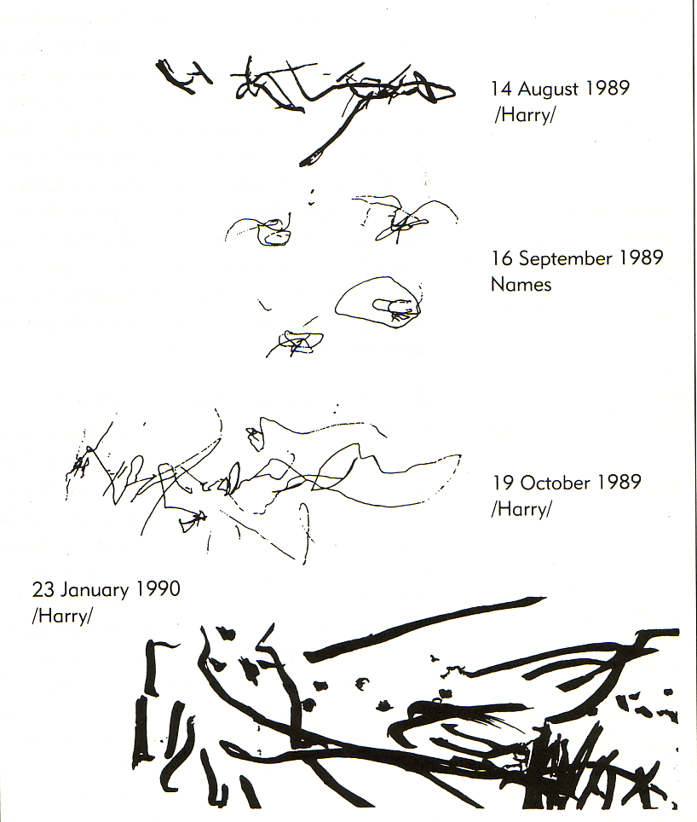
Child ‘play’ writing at 2 years
Is that writing?

Slide 13
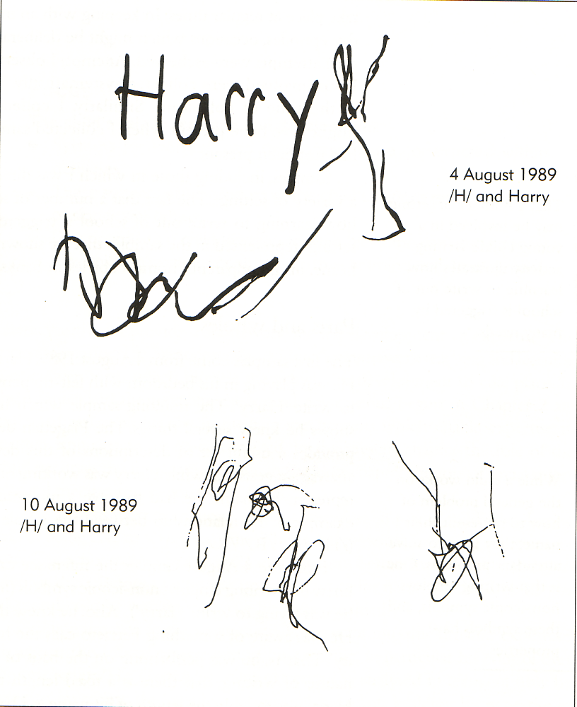

Slide 15
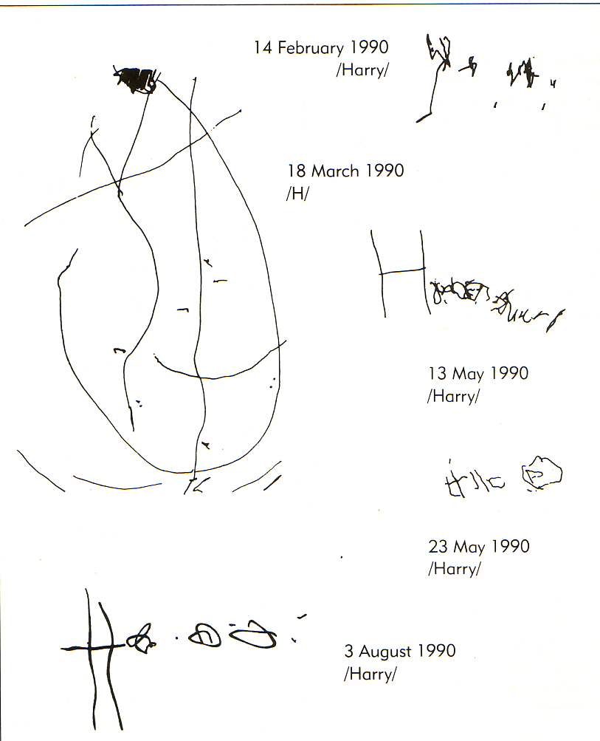

Slide 16
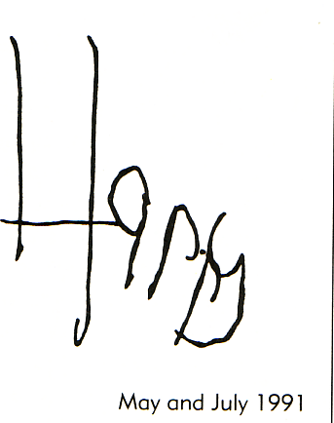

Slide 17
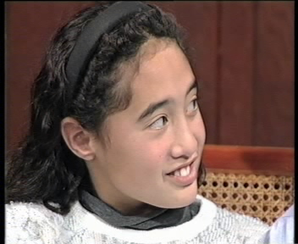
Specific guidelines possible

Slide 18
What to discuss elaborate?
Some pointers
  What you find interesting, amusing, curious, related to shared events including other books (intertextuality)
  What your child finds interesting amusing, curious, related to shared events including other books
  May not be the same

Slide 19
Why? Learning:
About books (concepts about print)
About comprehension (narrative, characters, prediction, taxonomies…)
Language – sounds (phonemic awareness)
Language- vocabulary (size, high and low frequency, patterns…)
‘Literate’ language

Slide 20
And by the way can promote
Close parent child relationships
Aspects of cognitive development
  perspective taking
  self regulation / attention
(depending on style, purpose, cultural values)

Slide 21
2. Talking with children
Prevalence
Significance
How (what matters)
Why

Slide 22
Many of us talk with children- often
GUPNZ Reading to children @ 9 months-
  75+% of mothers report several times a week
  or more singing or telling stories
Later?

Slide 23
Significance to ‘success’ (like reading)
‘Often talking’ before school related to early success in learning to read
  from books, events during the day…
‘Often talking’ at 15y as strongly related to secondary comprehension
  Discuss issues, books, films or TV, school, when eating meals together …
  Similar relationships in Te Reo Māori for success in Māori medium at Y6.

Slide 24
M: Where did we go and see Grandad the other day?
C: I don ti. [19 month old]
M: Where was Grandad?
C: Upital.
M: Hospital. And what what was he have, what was he getting fixed?
C: Ahh, somefing.
M: Did he have a sore back? He did? And what did he have at the hospital that you liked? What were you eating at the hospital?
C: I nand.
M: Bananas?
C: Nah.
M: And some grapes. Did you have some grapes? And a lolly?
C: Mmmmm.
Reese, E. and Farrant, K. (2003) in R. Fivush and C. A. Haden (eds.) Autobiographical Memory. Erlbaum.

Slide 25
What “matters” and why
Same general ideas as reading to children (high elaboration style, literate / academic language)
But note also the significance of vocabulary development

Slide 26
3. Engagement with school
At home ‘success’ through:
  Positive relationships including expectations (and for secondary)
  Complementary experiences (eg library, museum etc..)
  Complementary learning (homework mixed impact; more specific ‘tutoring’ in primary has high impact, including for those with difficulties)

Slide 27
Engagement cont…
Involvement at school (including trips etc..)?
  Mixed impact unless related to each of the above…
  The role of feedback sessions
    emerging Starpath evidence for the need at secondary for support and guidance from teacher and parent

Slide 28
Secondary discussion points
What should children know / be able to do from entry?
  knowledge and skills indexed by appropriate curriculum levels (at or above standards)
  developing self motivation, expectations of success, self regulation

Slide 29
Secondary discussion points
What should students have access to?
  ‘Effective’ teaching (what is it)?
  Navigation aids for NCEA
  Positive relationships with and support from parents and teachers
  Resources (texts…digital technology?)
  Parents can help also by advocating for success (of teachers, of schools)

Slide 30
Resources
McNaughton, S. (1995). Patterns of emergent literacy: Processes of development and transition. Auckland, New Zealand: Oxford University Press.
McNaughton, S. Educational outcome in adolescence for Maori and Pasifika students. In P. Gluckman, (2011). Improving the transition: Reducing social and psychological morbidity during adolescence. (pp 97-110). Wellington: Office of the Prime Minister’s Science Advisory Committee.
http://www.minedu.govt.nz/Parents.aspx
Madjar, I. & McKinley, E. (2011). Understanding NCEA: A relatively short and very useful guide for secondary school students and their parents. (NZCER Press).

