Slide 1
Challenges and opportunities for the transport system Energy Spotlight 24 Nov 2022
Dr Selena Sheng, Energy Centre, UoA

Slide 2
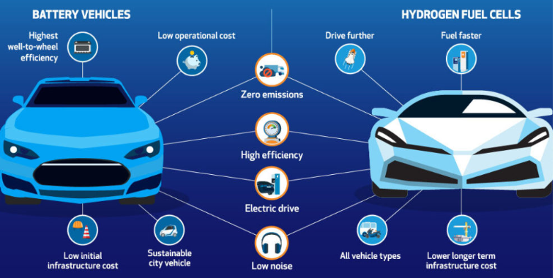
Electric Vehicles and H2 Vehicles

Slide 3
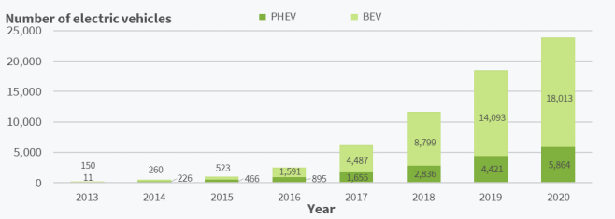
Electric Vehicles
The overall 1%+ is still tiny
Barriers: Range anxiety factor & high upfront purchase cost ($ of batteries) etc.
11,635 (2018) vs 23,877 (2020) vs 38,117 (2022)
Fig. 1. Electric Vehicle Fleet Statistics, 2013-2020 (Ministry of Transport, 2021)

Slide 4
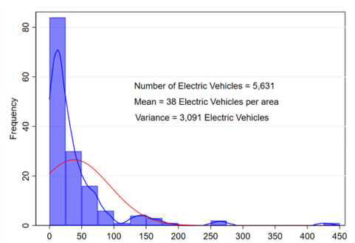
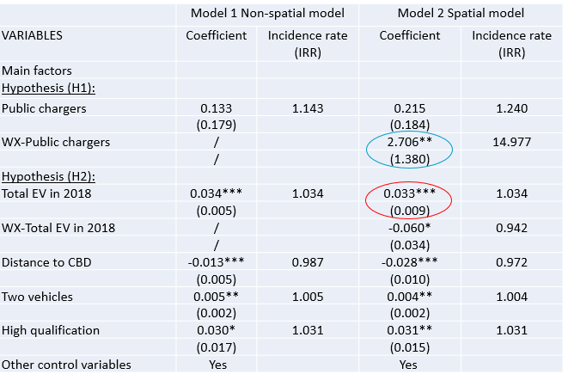
Main Drivers of Electric Vehicle Uptake in NZ
- Sheng, M.S., Wen, L., Sharp, B., Du, B., Ranjitkar, P and Wilson, D. (2022). A Spatio-Temporal Approach to Electric Vehicle Uptake: Evidence from New Zealand. Transportation Research Part D, 105, 103256.
Key Contributions and Findings
EV charging infrastructure in neighbouring areas, early adoption, higher educated people, & a household that owns two vehicles positively affect subsequent technology adoption.
Fig. 2. Number of EV Adoptions in Auckland 2020 (Own illustration).
Research Project UOAX1711, Development of IPT roadway charging systems, MBIE Endeavour Fund 2017 – 2022

Slide 5
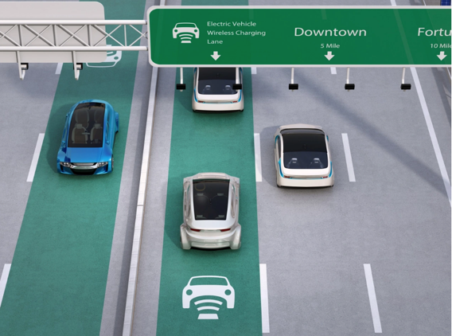
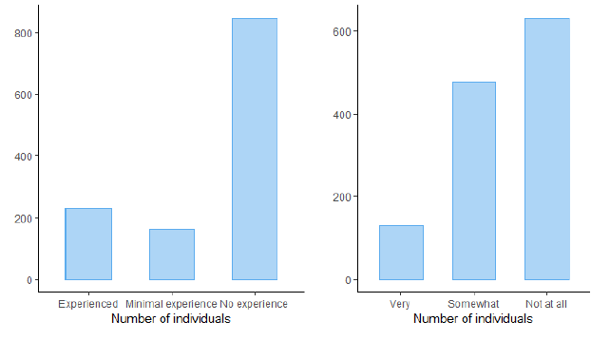
Impact of the Dynamic Wireless Charging on EV choice
- Simunic, M., Sheng, M.S., Wen, L., Du, B., Sharp, B., Ranjitkar, P., Wilson, D., Majhi, R. and Kieu, M. (2023). Economic & environmental benefits of the wireless roadway charging system for electric vehicles - A consumer's perspective. Working paper.
Key Contributions
Understanding the perceived economic & environmental benefits
of DWC technology, and how that might impact EV adoption
(AA/UoA/NZ EV Facebook group)
Key Findings
80% of respondents strongly agree/agree with DWC enabling the
EV driver to travel further distances
About 86% of respondents strongly agree/agree with DWC
min the inconvenience of having to plug in to charge
Dynamic charging capability has a significant positive impact
on EV choice - DCMs
Experience driving and charging EVs
Awareness of DWC
Research Project UOAX1711, Development of IPT roadway charging systems, MBIE Endeavour Fund 2017 – 2022

Slide 6
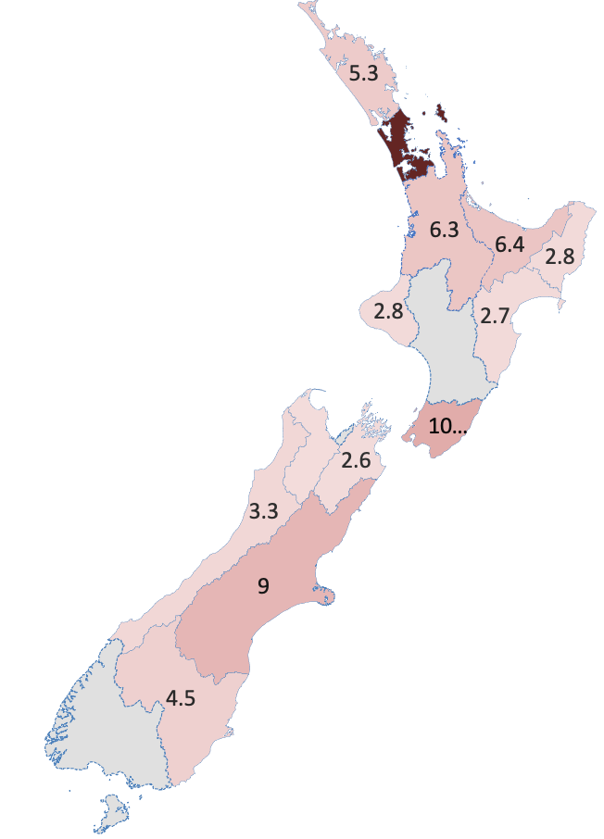
DWC acceptance among existing and prospective EV users
- Majhi, R. et al. (2023). Understanding user’s acceptance of dynamic wireless charging for electric vehicles: A logistic regression-based approach. Working paper.
Geographical distribution of respondents
Willingness to pay for DWC facilities
26.9
Home charger cost | Public fast charger cost
$3 for 100km range | $10 for 100km range
0.5
0.2
Male respondents
Female respondents
Research Project UOAX1711, Development of IPT roadway charging systems, MBIE Endeavour Fund 2017 – 2022

Slide 7
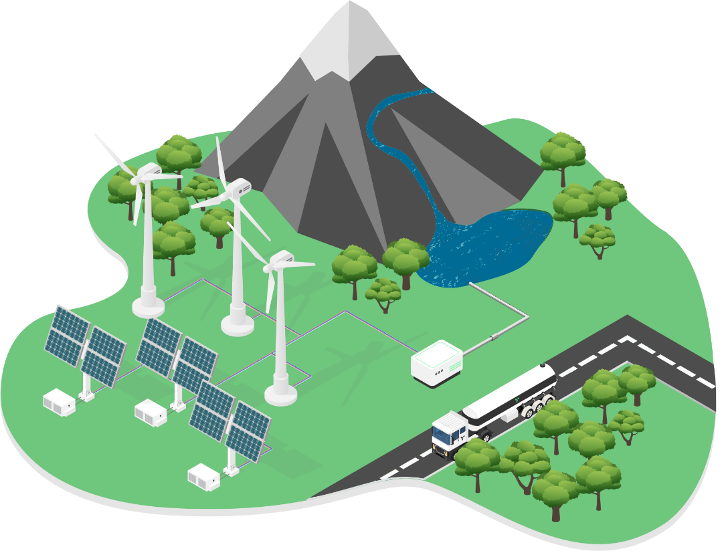
H2 technologies adoption for Aotearoa NZ
Four scenarios
H₂ Heaven
Industry niche
Regional/rural/remote use
Steady State
Green H₂ is a key fuel and energy carrier for a decarbonised NZ by 2050.
It is widely adopted by the public
Used by industry in a wide variety of applications
Green H₂ becomes a replacement feedstock for a variety of industrial processes and fuels
Large carbon emitters have transitioned to H₂ over carbon based fuels
Acknowledges that there are parts of the country where H₂ can play a larger role
This is where H₂ isn’t adopted widely as a potential fuel, energy storage or energy carrier in NZ
e.g., Taupo, Southland or Taranaki
H₂ takes advantage of regional assets and regional government investment
Research Project C05X2004, Powering NZ’s Green-Hydrogen Economy, MBIE Endeavour Fund 2020-2024

Slide 8
Optimal Replacement period for Diesel Truck with H2 Truck
Research Plan: Based on the total cost of ownership (TCO) at any given time
A truck user can buy an H₂ truck or wait after year 1 if the TCO of waiting for one year is less than the TCO of owning an H2 truck
This process continues until the user finds buying an H₂ truck is more feasible than waiting for more
The maximum number of years is fixed, e.g., 14 years based on the average scrappage age of diesel trucks
Min of (TCO_{Diesel_Truck} , TCO_{H2_Truck})
Diesel Trucks
Current Stage
H₂ Trucks
Wait
Year 1
H₂ Trucks
Wait
Year 2
H₂ Trucks
Wait
Year N
Research Project C05X2004, Powering NZ’s Green-Hydrogen Economy, MBIE Endeavour Fund 2020-2024

Slide 9
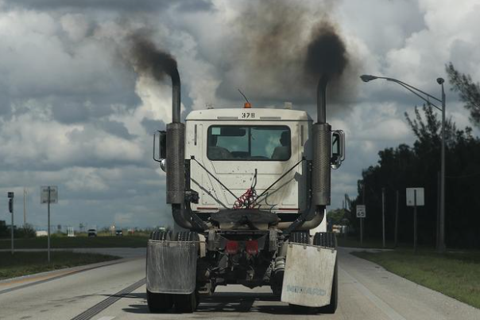
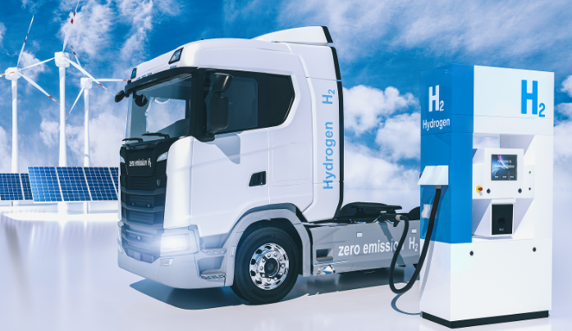
Optimal Replacement period for Diesel Truck with H2 Truck
TCO of an H2 Truck
TCO of a Diesel Truck
Initial purchase cost
Resale value
Insurance cost
Govt. tax
Operation and maintenance cost
Fuel cost
Initial purchase cost
Subsidy
Insurance cost
Govt. tax
Operation and maintenance cost
Fuel cost
Research Project C05X2004, Powering NZ’s Green-Hydrogen Economy, MBIE Endeavour Fund 2020-2024

Slide 10
Where to from here?
How can green H2 in urban systems help to fulfil
NZ’s net-zero carbon goals? And in local industries?
Can H2 provide competitive long-term storage?
Can green H2 help achieve zero-carbon
transport, both in and outside cities? What modes?
What are the environmental impacts/benefits of H2 in an integrated energy system?
What opportunities does green H2 open to our local
communities? Can it improve energy poverty and equity?
And…….what about the uncertainties from future H2 tech costs??
Research Project C05X2004, Powering NZ’s Green-Hydrogen Economy, MBIE Endeavour Fund 2020-2024 (University of Canterbury)

