Slide 1
Looking ahead:
Moving to City Campus
Presented by Mark Barrow
Dean of the Faculty of Education and Social Work

Slide 2
Background
Initial estimates were that the faculty would begin teaching on City Campus in Semester 1, 2021.

Slide 3
Purpose of the move
To continue adapting to provide our students with an excellent learning, teaching and study environment in the City, with access to:
Support services
Student clubs and societies
City Campus amenities

Slide 4
Planning process:
Test of fit:
Requirements gathered from teaching and operations staff.
Analysis to ensure the space on City Campus was adequate for student/staff numbers, and the specialist teaching spaces needed.
A detailed assessment of each City Campus building designated for the faculty was also undertaken.

Slide 5
Confirmed time frame
The scale of the works required to accommodate the faculty on City Campus was larger than foreseen. For example, infrastructure changes (e.g. seismic strengthening) and compliance with heritage-building regulations.
As a consequence of the complex building requirements, the faculty will now be moving in late 2023.
Students will begin lectures at City Campus in early 2024.

Slide 6
Activities moving to
City Campus
All teaching, learning and research activities
Student support services
Faculty operations
Faculty marae

Slide 7
Activities not moving to
City Campus
Kohia Centre
International Short Courses
Early Childhood Education (ECE) Centres
  Number 28
  Te Puna Kōhungahunga

Slide 8
Sylvia Ashton-Warner Library
Library services will continue to be provided on Epsom Campus until the faculty moves.
The Sylvia Ashton-Warner Library and Information Commons’ collections will be consolidated into the General Library at the City Campus.
Low-use items will be housed off-site in the On-Demand Collection.
Options to retain the Sylvia-Ashton Warner name for a relevant collection in the General Library, as well as the possibility of a permanent display about Sylvia Ashton-Warner, will be explored in consultation with relevant stakeholders, including students and staff of the faculty.

Slide 9
Early childhood education (ECE) centres
Neither of the Epsom ECEs will remain as University centres after the faculty has departed.
University is committed to maintaining the overall current level of ECE places allocated to University students and staff.
University will explore an expansion of places at the City Campus Kohanga Reo as an alternative to, or alongside, replacement of the current Kōhungahunga student and staff places.

Slide 10
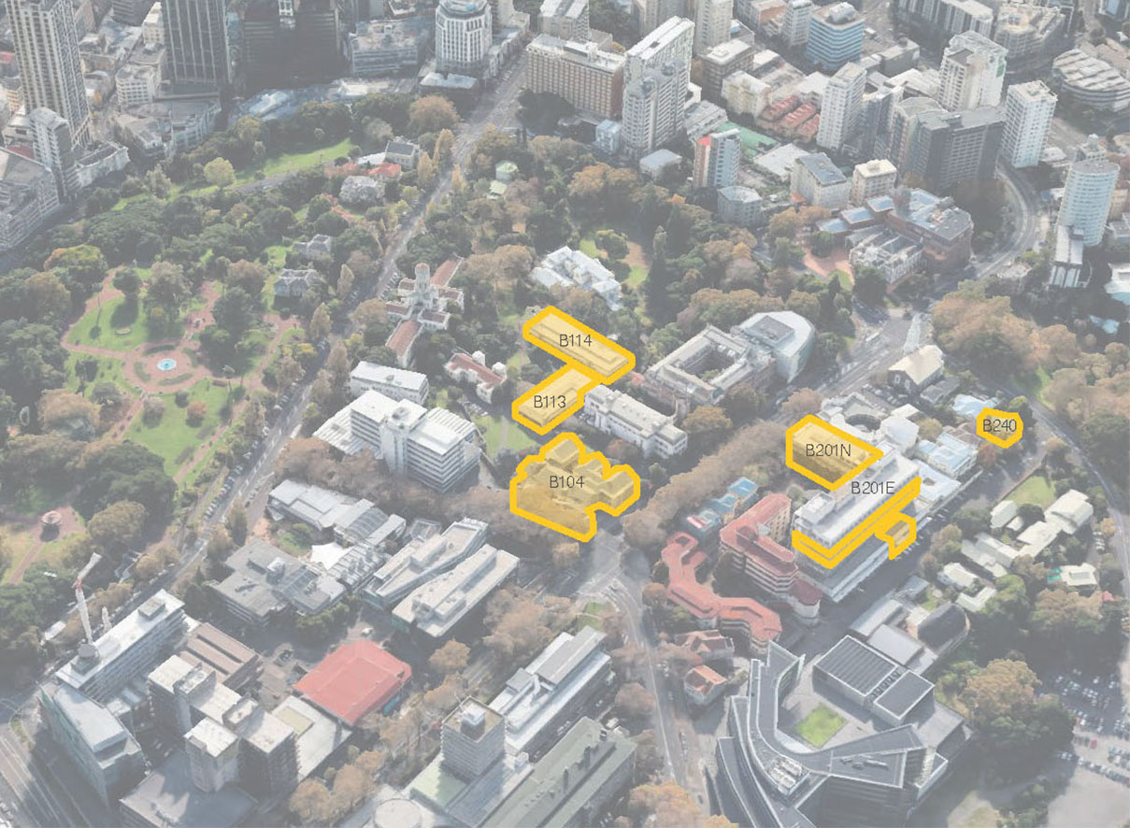
City campus locations
Commerce A
5 Alten Road
Elam B
Social Sciences Building
Old Choral Hall
Notes:
Now focusing on the Faculty of Education and Social Work

Slide 11
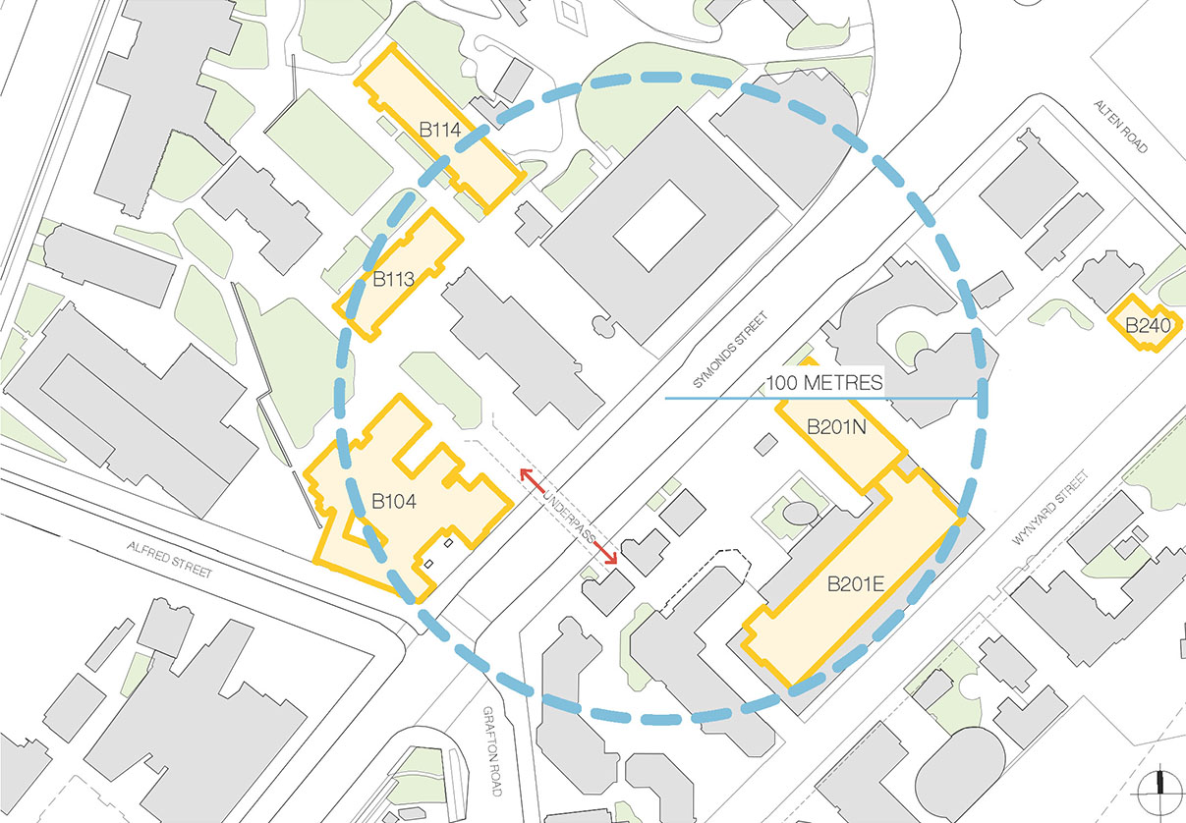
Building location and proximity

Slide 12
Buildings and activities

Slide 13

What has to be done?
Faculty briefing and user-group process
Architectural, services and structural design, and documentation
Council consenting
Pricing and appointing contractors
Demolition and asbestos removal
Construction
UoA fit-out works
Furniture, fixtures and equipment installation
IT and AV installation
Faculty equipment and resources relocated
Staff relocations
Artwork and taonga relocation and installation

Slide 14
What does this mean for students?
It’s business as usual for teaching and research….
The vast majority of current students will finish their qualification, during or before 2023, at Epsom Campus.
We will continue to review, update and enhance the faculty’s current programmes and services at Epsom Campus

Slide 15
Why does this matter for students?
You will always be part of the Faculty of Education and Social Work whānau, even after you’ve left the University.
Although you may have graduated by the time we move, you will always be welcome to come back – you may return to study or come back for alumni and networking events at our new space.

Slide 16
Student involvement
Closer to the time, we will include students in the planning process, through the Student-Staff Consultative Committee and membership of other forums and groups.
We will consult with ESSA, PGSA and other student representatives.

Slide 17
In the meantime
Depending on your current programme of study, you can take courses at City Campus.
You can use the facilities and support services at City Campus (as well as at Epsom and South Auckland Campuses).
The University is now looking at making a selection of improvements to Epsom Campus facilities – we will keep you informed.

