Slide 1
The ‘Rise of the Robots’ and the
Future of Taxation
University of Auckland
25 February 2025
Univ.-Prof. DDr. Georg Kofler, LL.M., WU Vienna

Slide 2
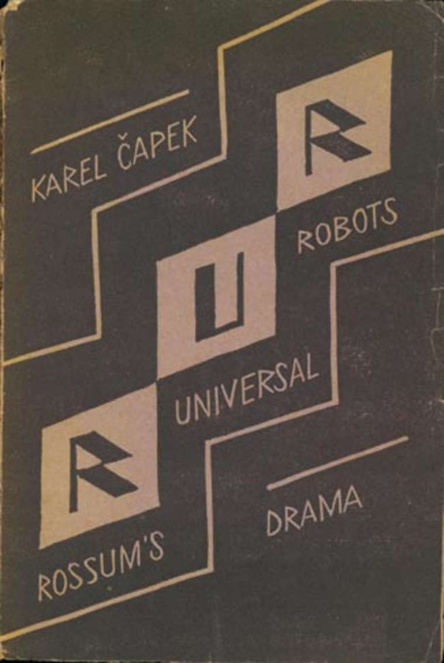
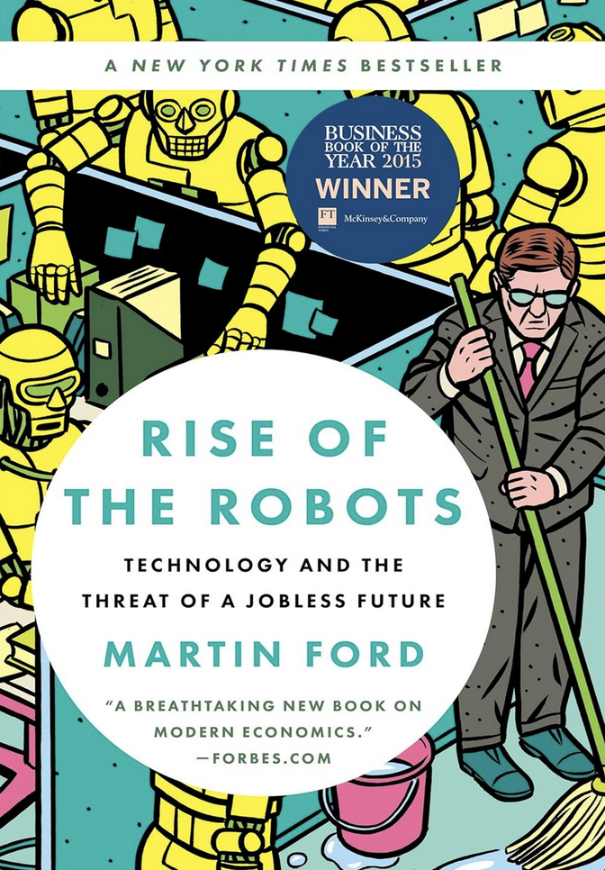
Overview
Part I – Impact of Automation on the Labor Market
Part II – Implications for Taxation
Part III – Utopia or Dystopia?
Part IV – Summary
1920
Note: Bibliography at https://koflerge.org/docu/artificial-intelligence/
2015

Slide 3
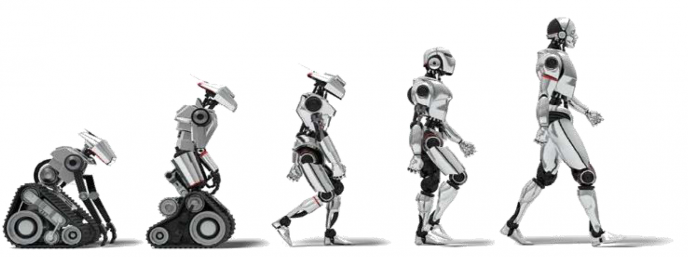
Part I
Impact of Automation on the Labor Market

Slide 4
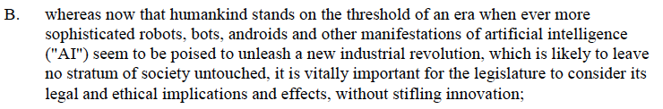
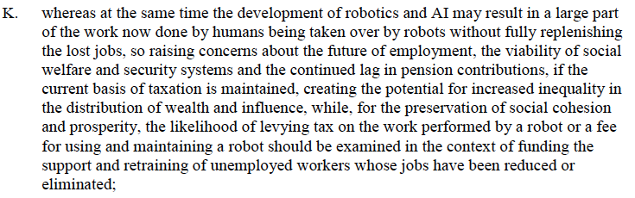
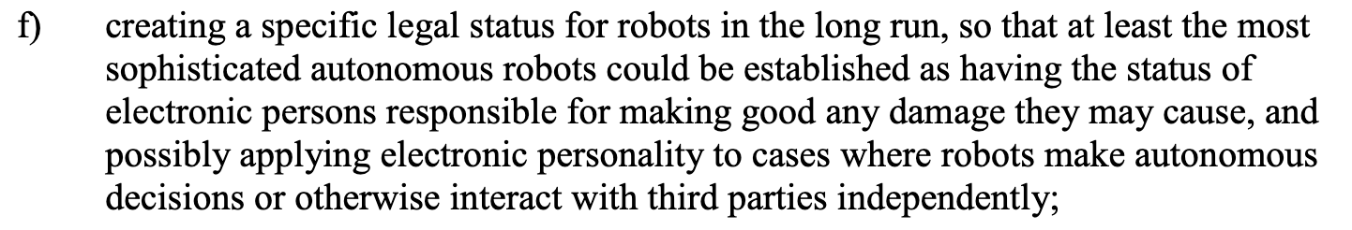
Introduction | Rise of the Robots
One starting point of the current tax discussion → Intro Pts B, K of the Draft Report by the European Parliament’s Committee on Legal Affairs on Civil Law Rules on Robotics, A8-0005/2017 (27 Jan. 2017). – Not included in the final European Parliament resolution of 16 February 2017, P8_TA(2017)0051 (16 Feb. 2017).
“Robot tax“ versus
“tax on robots/robot use“

Slide 5
Automation and Labour | Anxieties
Anxieties over technology (e.g., Mokyr et al, 2015) → “The Pessimist’s Fears” versus “The Optimist’s Complaint”
  Concern #1: Technological progress will cause widespread substitution of machines for labor, which in turn could lead to technological unemployment and a further increase in inequality in the short run, even if the long-run effects are beneficial → Technological unemployment “due to our discovery of means of economising the use of labour outrunning the pace at which we can find new uses for labour” (Keynes, 1930)
  Concern #2: Moral implications of technological process for human welfare, historically the dehumanizing effects of work (particularly the routinized nature of factory labor), currently the elimination of work itself is the source of dehumanization
  Concern #3: Insufficient technological progress (economic and productivity growth) in the face of “headwinds” facing western economies (e.g., slow productivity and population decline)
Taxonomy → Human versus machine
  Physical Strength → Industrial Robots → Exposed for decades (and impact on labor markets reasonably well researched) → Low-skilled occupations most exposed to robots (Webb, 2020)
  Manual Skills (in unstructured environments) → Humanoid Robots → Currently least exposed
  Cognitive Skills → AI (LLMs, GPTs) → Rapid transformation → High-skilled occupations most exposed to AI (Webb, 2020; Brollo et al, 2024) (IMF))

Slide 6
Automation and Labour | Analytical Framework
Jobs versus tasks? → Initial jobs/occupation-focused framework (Frey & Osborne, 2013) has been replaced by a task-oriented framework (Wynne & Derr, 2025), but “[t]ask simplification could merely be a stepping stone toward total automation” (Frey & Osborne, 2024; Trammell, 2026)
Skills versus routine? → Older “skill-biased technological change” (SBTC) hypothesis (that technology simply favors educated workers over uneducated ones) has been largely replaced by the “routine-biased technological change” (RBTC) framework (focusing tasks that are routine and codifiable) (Autor et al, 2003; Autor & Dorn, 2013) and moves to a “slicing by cognitive ability“ hypothesis (affecting people with certain intrinsic cognitive properties, irrespective of training/skills) (Amodei, 2025)
Manual versus cognitive/creative? → Older assessment that the bottlenecks of automaton are social intelligence, creative intelligence, and perception/manipulation (Frey & Osborne, 2013) (potentially) replaced by newer bottlenecks such as the impact of hallucination, social intelligence, creative novelty (Frey & Osborne, 2024) → Rule of thumb: If a task can be done remotely, it can potentially be automated by AI (Frey & Osborne, 2024)

Slide 7
Automation and Labour | Augmentation?
Augmentation/complementation versus replacement/substitution: The Historical Pattern
  All tasks can be performed by labor and automated tasks can be performed by either labor or capital.
  Historically, automation takes over tasks previously performed by humans (reducing labor demand for those tasks) (“displacement effect”), but technology makes pieces of a given human job more efficient (“productivity effect”) (AI-induced productivity growth of 2-3%/year; Briggs & Kodnani, 2023) or creates new jobs (task creation) (“reinstatement effect”) (Acemoglu & Restrepo, 2017) → Displacement versus productivity/reinstatement
  60% of workers today are employed in occupations that did not exist in 1940, implying that over 85% of employment growth over the last 80 years is explained by the technology-driven creation of new positions (Autor, 2022)
  Evidence from Anthropic/Claude → Currently, 57% of AI usage suggests augmentation of human capabilities (e.g., learning or iterating on an output) while 43% suggests automation (e.g., fulfilling a request with minimal human involvement) (Handa et al, 2025 (Anthropic))

Slide 8
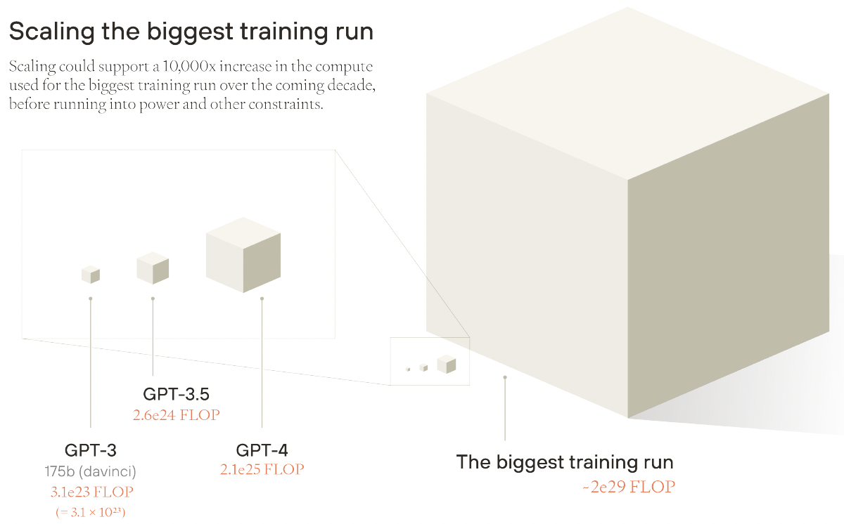
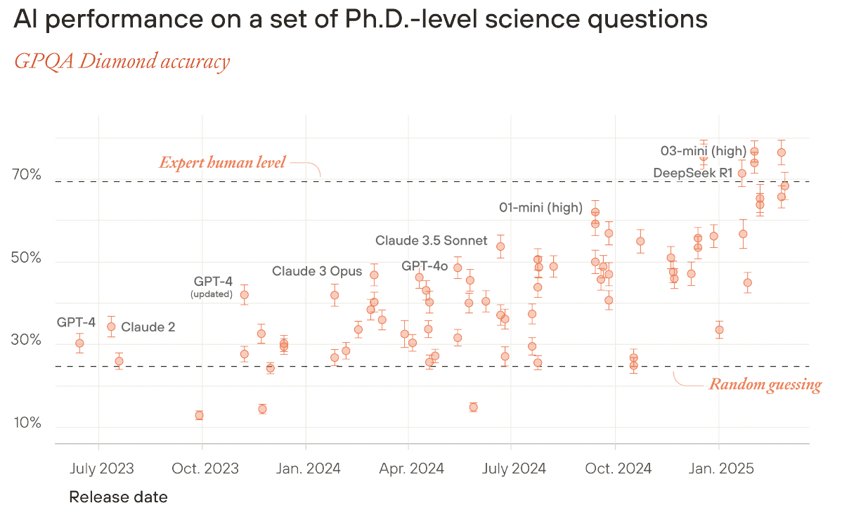
Automation and Labour | Replacement?
Augmentation/complementation versus replacement/substitution: Is AI Different?
  Is AI different? (Amodei, 2025) → Astounding progress since 2023/24, cognitive breadth, slicing by cognitive ability, rate of AI adoption (nearly 40% of Americans report using generative AI; Tomlinson et al, 2025) → “Intelligence Explosion” (MacAskill & Moorhouse, 2025), rapid last-step automation of full workflows (Trammell, 2026)

Slide 9
Automation and Labour | Replacement?
Augmentation/complementation versus replacement/substitution: Is AI Different?
  Likely Differentiated Displacement
    Occupational heterogeneity in exposure to AI (Spencer et al, 2021 (EU): 38% collapsing occupations; Felten et al, 2023)
    Different impact of replacing automation on inexpert tasks (reduces occupational employment but increases occupational wages) and on expert tasks (opposite) (Brynjolfsson et al , 2025)
    Entry-level pipeline vs experienced workers (Brynjolfsson et al , 2025)
    Differences between developed and emerging economies (OECD, 2019; Briggs & Kodnani, 2023)
    Effects on wages depend on a race between automation and capital accumulation (Korinek & Suh, 2024)
    Absent complementary institutional investments, technological innovation alone will not generate broadly shared gains (Autor, 2022)
    AI expertise could shrink the performance gap between low- and high-skilled workers (i.e., AI could reduce income inequality; Agrawal et al, 2023; Tomlinson et al, 2025; Bloom et al, 2025), but AI has the potential to reduce labor demand through automation, leading to a decoupling of productivity gains from employment and wages (Lane & Saint-Martin, OECD 2021; Autor, 2022; Minniti et al, 2025)

Slide 10
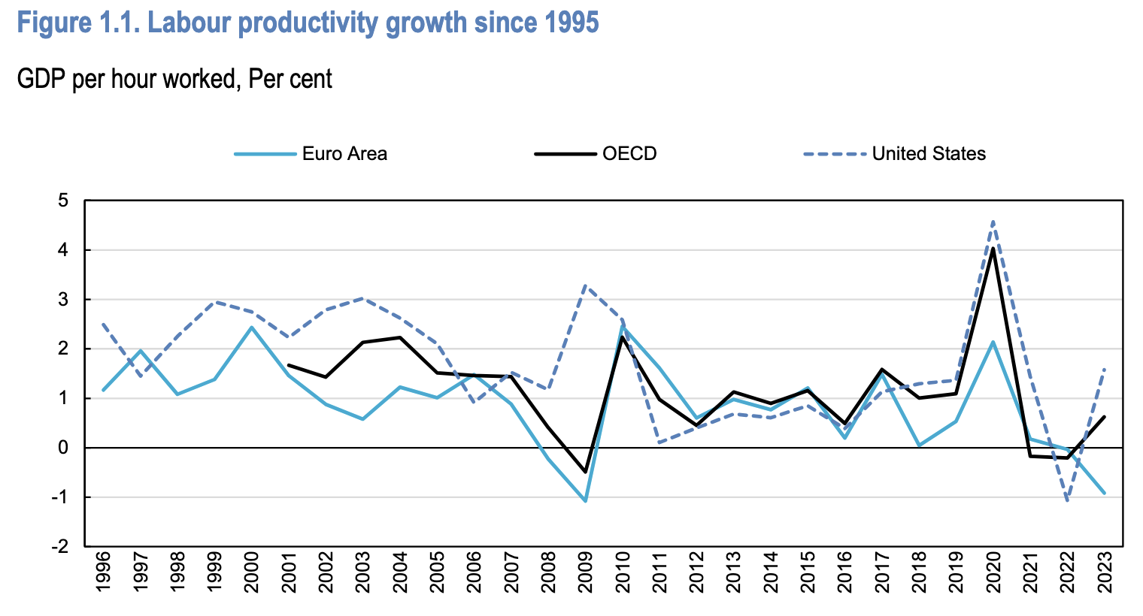
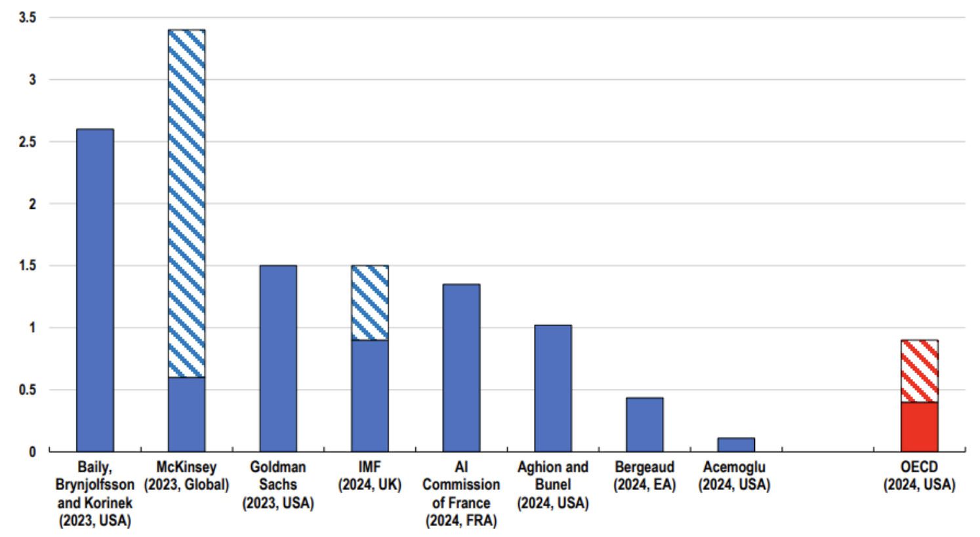
Automation and Labour | Productivity
Transformative productivity gains through AI?
  Core question → Size of the “economic pie“ and “technological redistribution” of income (Korinek & Stieglitz, 2017)
  AI’s predicted annual labour productivity gains over the next ten years in the G7 across studies between 0.2 to 1.3pp (OECD, 2025) → Lagged? Mismeasured? Inexistent? – Overall unclear productivity path (Filippucci et al, 2024 (OECD))
  GDP-level growth estimates range from a modest 0.93–1.56% cumulative gain over ten years (Acemoglu, 2024) to 7% (Briggs & Kodnani, 2023), with AGI scenarios projecting up to 100% (Korinek & Suh, 2024)
  If AI generates large productivity gains, it may increase wages even though it reduces the labor share (Acemoglu and Restrepo, 2018; Brollo et al, 2024 (IMF))
  But: ”So-So Technologies” = Capital deepening without much TFP growth, resulting in displacement without the compensating productivity dividend (Acemoglu et al, 2020)

Slide 11
Automation and Labour | Productivity
Transformative productivity gains through AI?
  “Productivity Paradox”, i.e., technological capability visibly accelerating while measured productivity growth stagnates or declines (Brynjolfsson et al, 2017) → Broadly declining labor productivity growth (OECD, 2025)
  Possible reasons
    Implementation lags for general-purpose technologies (e.g., electricity, computers, AI). → Optimist
    Mismeasurement through GDP and productivity statistics, which were designed for a goods-producing economy and do not adequately capture quality improvements, free digital goods, and consumer surplus from IT. (~)
    Capital deepening “So-So Technologies”, where robots/AI do the same tasks humans did, just cheaper. → Productivity gains are real but narrow (they accrue to capital owners and high-skill workers). → Pessimist
    Diffusion slowdown and concentration effects, with highly productive “frontier” firms (“superstars”) versus the laggard majority. → Taxation?

Slide 12
Automation and Labour | Impact?
Study/Source | Estimate | Scope
Frey & Osborne (2013) | 47% of occupations at high risk of computerization – For Europe: 54% (Bowles, 2014), for Germany: 42% (Bonin et al, 2015) | US occupations (jobs)
Arntz et al (2016) (OECD) | 9% of jobs are automatable | OECD occupations (jobs)
Elliott, 2017 (OECD) | 82% of current US employment is potentially automatable | US
Acemoglu & Restrepo (2017) | 1 additional robot/thousand workers → Reduction of employment rate by 0.18-0.34pp (-6.5 jobs per robot) and wages by 0.25-0.5% | US
Nedelkoska & Quintini, 2018 (OECD) | 14% of jobs at high risk of automation and 32% medium risk | OECD occupations (jobs)
Chiacchio et al (2020) | 1 additional robot/thousand workers → Reduction of employment rate by 0.16-0.20pp, no significant associaton with wages | EU
Eloundou et al (2023) | 80% of workers have ≥ 10% of tasks exposed to GPTs, and 19% have > 50% exposed | US tasks (GPT)
OECD (2023) | 27% of employment at highest risk of automation | OECD
Briggs & Kodnani (2023) | 18% of work globally could be automated, share of work exposed to generative AI 15-35% | Global
Brollo et al (2024) (IMF) | Exposed jobs: 60% in advanced economies, 40% in emerging markets economies, and 26% in low-income countries | Global employment
Acemoglu (2024) | 19.9% tasks exposed to AI | US
World Economic Forum (2025) | +170m, −92m = net +78m | Global jobs by 2030
Brynjolfsson et al (2025) | 16% relative employment decline of young workers in the most AI-exposed occupations | US (since 2024)
Minniti et al (2025) | Each doubling of AI innovation reduces labor share by 0.5% to 1.6% | Europe
Guarascio et al (2025) | Minimal impact of robotization on employment and wages (but severe distributional effects) | Meta analysis

Slide 13
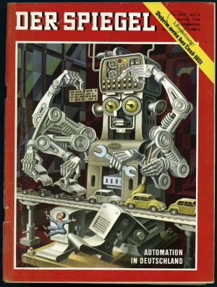
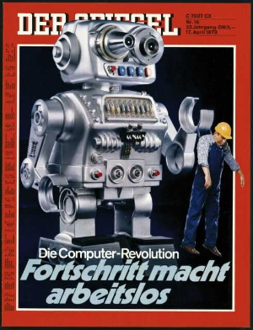
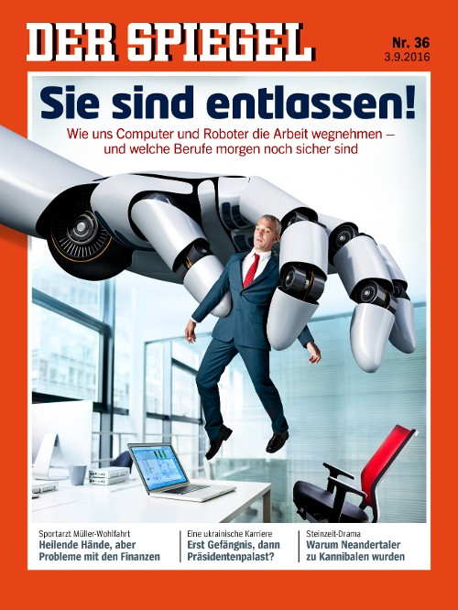
Evidence | Direct and Indirect Effects
1964
1970
2016

Slide 14
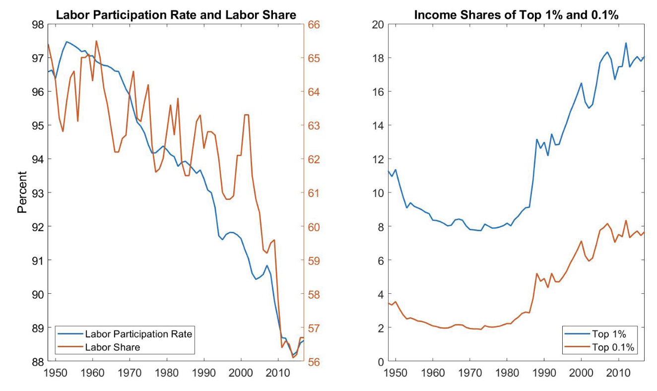
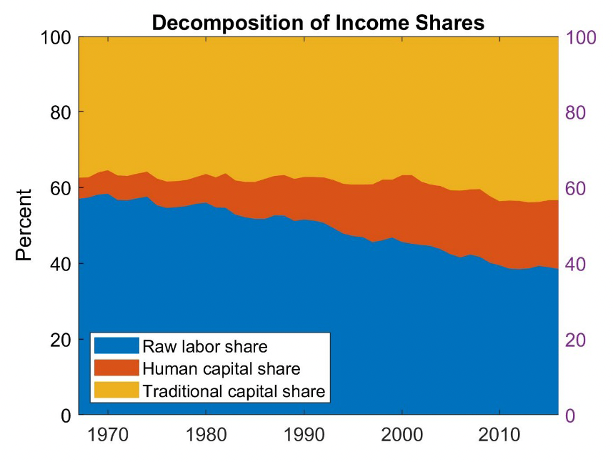
Evidence | Labor Market
Labor market developments
  Labor force participation rate
    US prime-age men (25–54) → Fell from 98% to 89% since WWII (Korinek, 2019) → Long-run structural decline
    OECD working-age population → Stable at 74% in 2024, highest since 2008 (OECD, 2025) → No aggregate decline
  Labor income share of the economy → Fell by 1.6pp between 2004 and 2024, under the influence of several structural shifts (e.g., capital-augmenting technology, automation, globalization, decline in bargaining power of workers (ILO/OECD, 2025), large decline in the US (66% to 58%, post-war to 2019; Korinek, 2019), overall declining but largely inconclusive (Bastani & Waldenström, 2024)
  Raw-labour income share of the economy → Fell from 57% → 40% in the US (1967–2017; Korinek, 2019) – Conversely: Human capital share of the economy → Rose from 5.6% → 18.2% in the US (1967–2017; Korinek, 2019)
  Wage growth versus productivity growth → Average real wage of regular workers declined over past 4 decades, a period in which total US income nearly tripled (Korinek, 2019)
  Income share → Doubled to ~20% for top-1% and triple to ~10% for top-0.1% (post-war to 2019; Korinek, 2019)

Slide 15
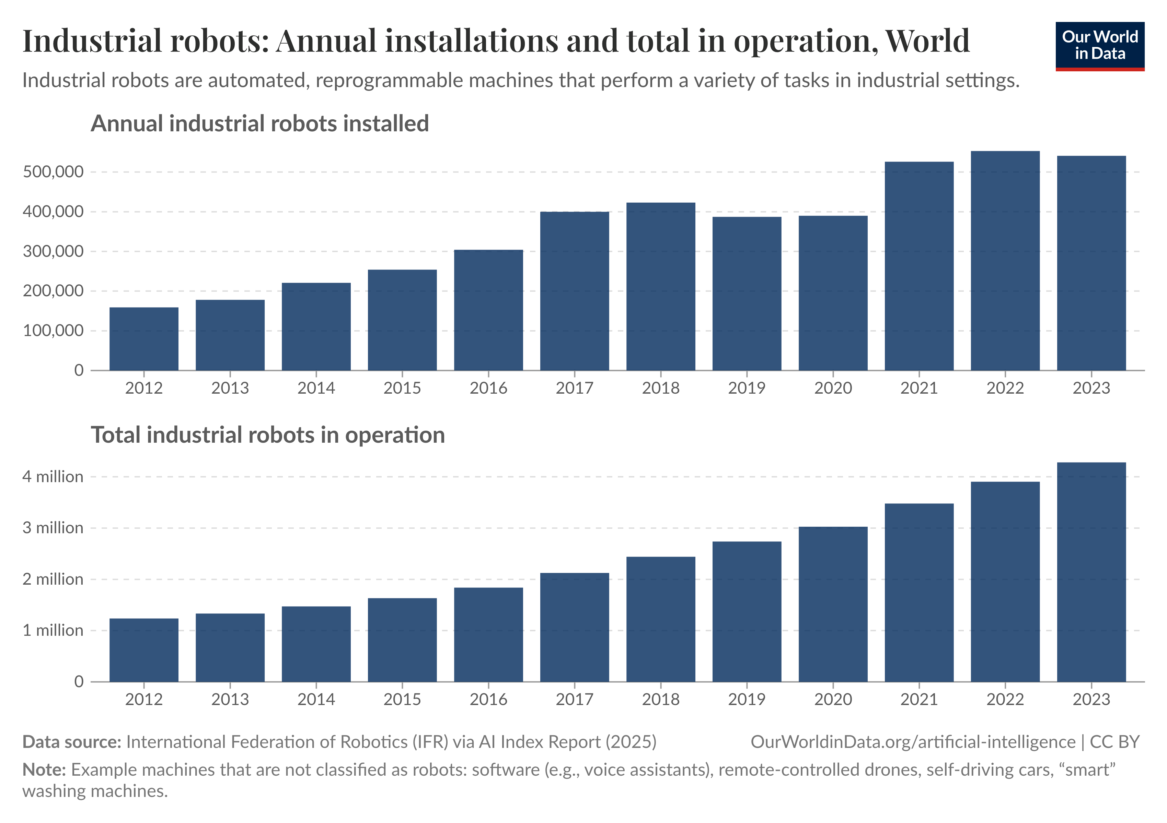
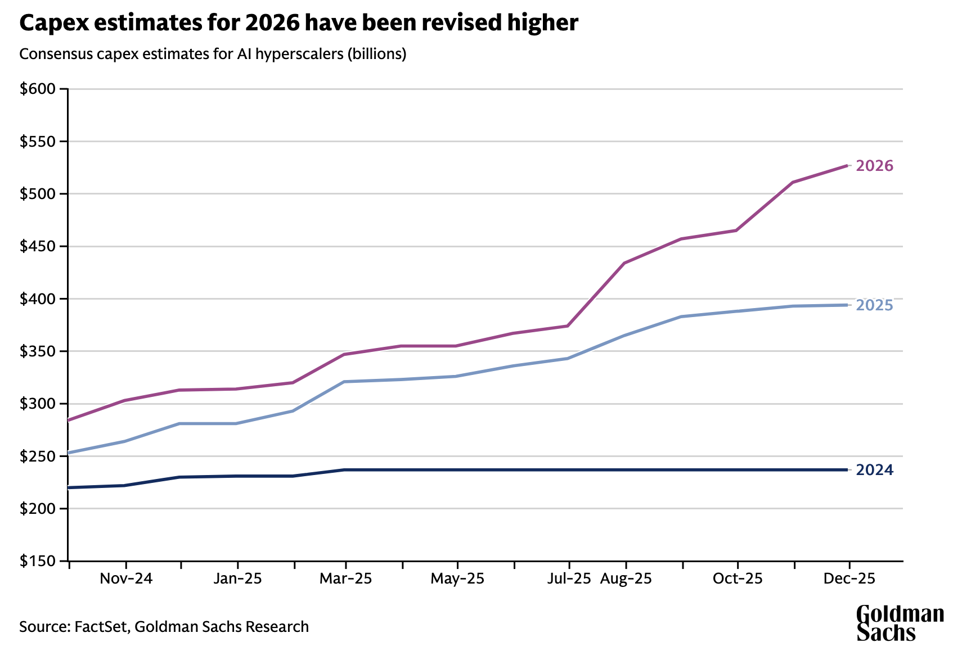
Evidence | Automation
Automation developments
  Global stock of industrial robots grew from 400,000 (1993) to 1.75m (2014), 4.5–6m by 2025/26.
  Massive investments in AI ($500bn for 2026: Goldman Sachs, 2025; for the EU27: Fonteneau, 2025)

Slide 16
Evidence | Robots
Empirical data on non-AI automation (e.g., industrial robots)
  Displacement versus productivity/reinstatement
    Overall unclear picture whether robot adoption is overall labor replacing (and wage reducing) or if displacement effects are canceled out by reallocation effects.
      Theory that robots substitute for human labor (e.g., Frey & Osborne, 2013; Acemoglu & Restrepo, 2020; Akar et al, 2023; Bonfiglioli et al, 2024; Giuntella et al, 2024; Bessen et al, 2025) …
      … versus theory that robots complement human workers by enhancing productivity and creating new employment opportunities without reducing overall employment levels (Autor, 2015; Graetz & Michaels, 2018; for Germany: Dauth et al, 2021, showing impact on entry-level).
    New empirical evidence that robots substitute for human labor (Korean firm-level evidence: Holtmann et al, 2025) vs. meta-analysis finding minimal impact of robotization on employment and wages (Guarascio et al, 2025)

Slide 17
Evidence | Robots
Empirical data on non-AI automation (e.g., industrial robots)
  Why do we not see a larger drop in labor force participation, massive wage reductions and unemployment, tumbling labor share etc? (Lane & Saint-Martin, OECD 2021)
    Composition of employment has shifted (hollowing out of middle-skill, middle-wage jobs, replaced by high-skill, high-wage jobs on one end and low-skill, low-wage service jobs on the other) (Autor et al, 2006; Autor et al, 2008; Goos & Manning, 2007)
    Wage and income effects (raw-labor share versus human capital share)
    Account for the counterfactual that, without automation, ageing societies and demographic tightening (i.e., labor scarcity) should see higher wages, labor share
    Multiple factors relevant, distorting clear cause-effect relationships (e.g., export markets, labor institutions)

Slide 18
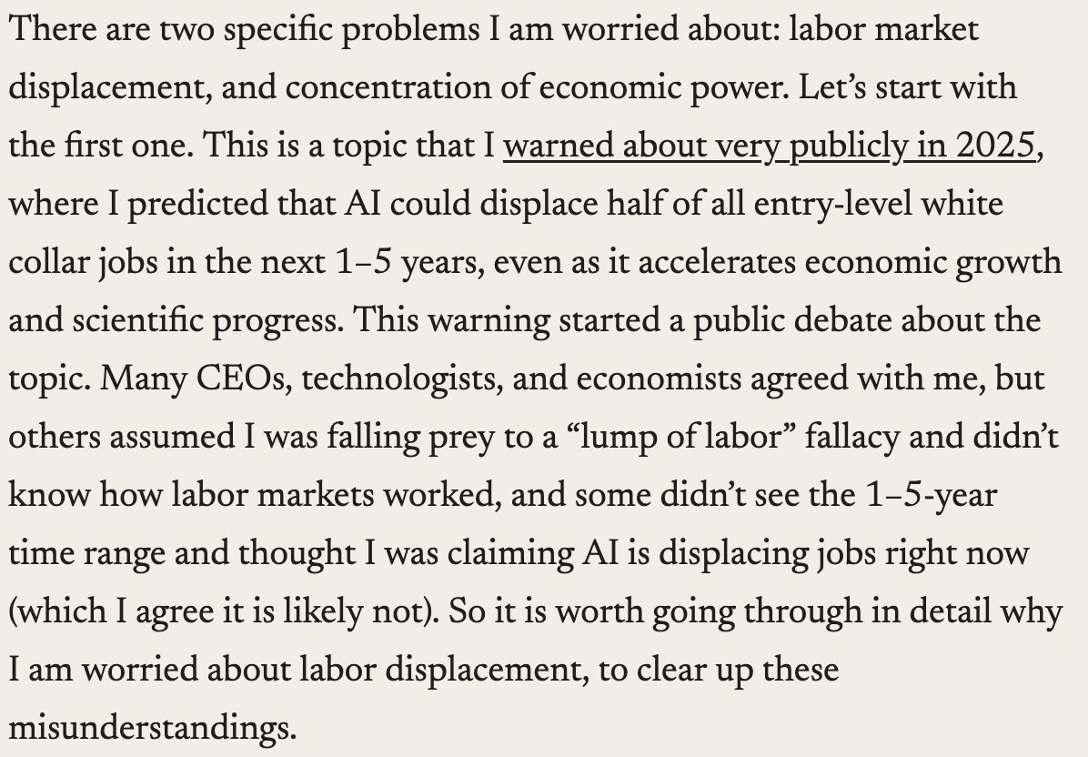
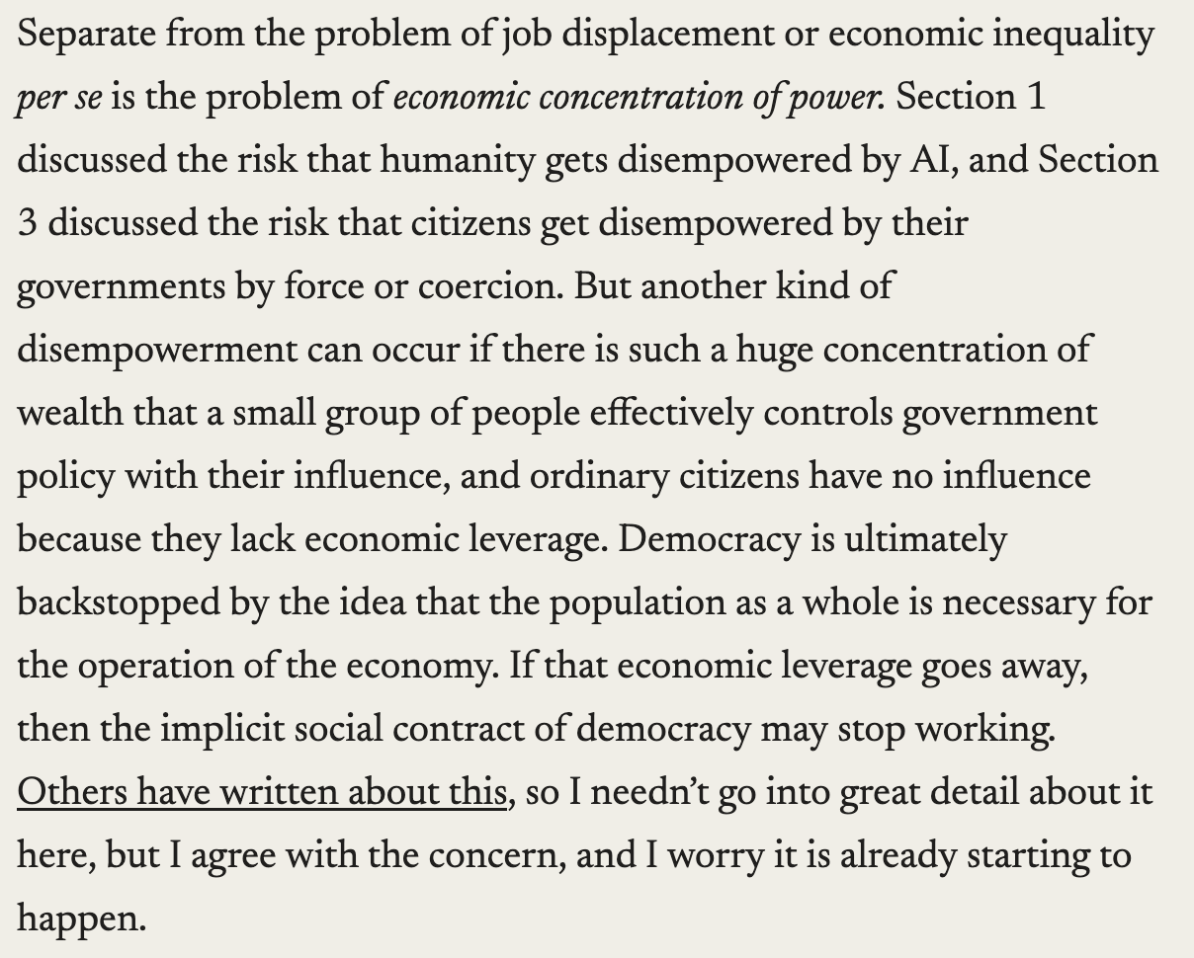
Evidence | AI
Early empirical data on AI (LLMs, GPTs, agentic AI)
  Little evidence of AI's impact on the labor market (OECD, 2023; Gimbel at al, 2025) and unclear causation/correlation relationships (May & Badawy, 2026)
  AI as a general-purpose technology that affects all levels of production (Eloundou et al., 2023: “GPTs are GPTs”)
  Data on entry-level hiring: -16% (Brynjolfsson et al, 2025: “Canaries in the Coal Mine?”)
  Task-automation might lead to rapid automation of full workflows (Trammell, 2026)
  Labour market/economy outlook by Altman, 2021 (OpenAI) and Amodei, 2025 (Anthropic)
  Overall concern: Capital deepening effect → Capital substitutes for labor, output per remaining worker rises, but the gains flow disproportionately to capital owners.
  Amodei, 2025
  (Anthropic)

Slide 19
Part II
Implications for Taxation

Slide 20




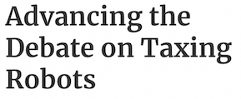












Slide 21
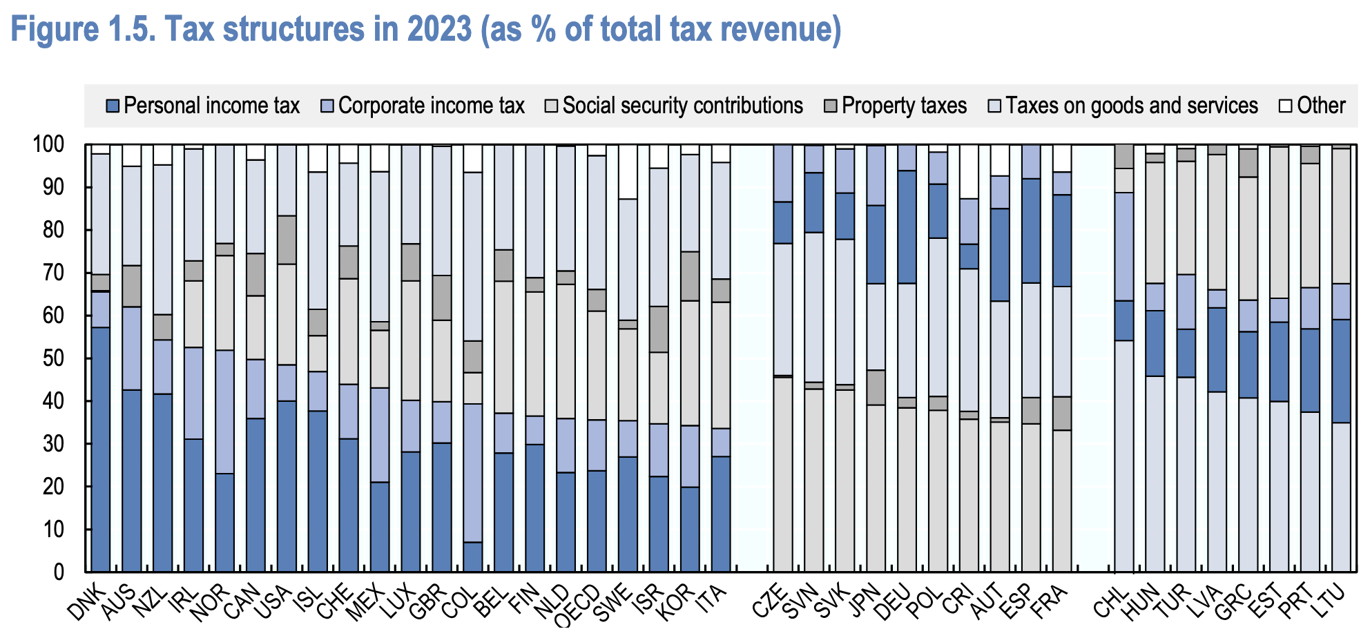
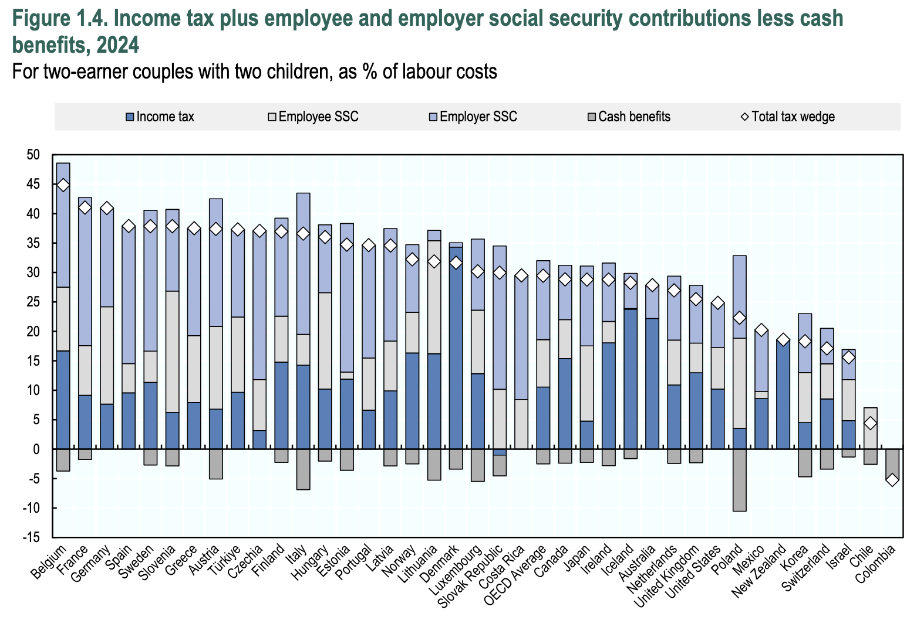
Introduction | Framework
Assumption → At least short-term disruption of the labor market and a transition of the workforce in almost all sectors of production and services.
”Doubly Whammy”
  Decreasing wage tax revenues/social security contributions (which are a large part of government revenues) …
  … and (!) increased expenditure for public social nets (e.g., unemployment support, retirement funding).
Potential decrease in government revenue, as labor is generally more heavily taxed than capital (both, at the personal and the firm levels; Hoerani et al, 2023 (OECD); Hemel, 2019; Kovacev, 2020), unclear offset by, e.g., corporate or VAT/consumption taxation
Displacement, readjustment and inequality (e.g., capital share, declining middle-class, wage pressure etc) (OECD, 2019)
Note: Non-tax regulation and policies (e.g., technological regulation, reskilling, labor market institutions, adult education, social protection policies, income support policies, welfare programs, UBI) (Spencer et al, 2021; EU/US study 2022).

Slide 22
Introduction | Framework
Some Initial Thoughts
  Taxation goals and tools? → Revenue? Inequality? Distortions?
    Fiscal Rationale → Automation erodes the labor tax base, creating a revenue shortfall that must be recovered elsewhere.
    Distributive Rationale → Productivity gains accrue disproportionately to capital, warranting more progressive taxation of capital and high incomes. → “Neutrality”? Incentives?
    Corrective Rationale → Where automation substitutes for labor without generating commensurate productivity gains (“so-so technologies”) firms do not internalize the social costs of displacement, creating a case for Pigouvian-style intervention to slow adoption, while taxing automation that does generate genuine productivity gains might be self-defeating. → Competitiveness? ”Winner takes it All”? Would slowing adoption be welfare-improving?
  International dimension? → “If local jobs are automated away while the profits pile up in California, Seattle, or Shenzhen, who exactly is going to fund their citizens’ income?“ (Hertz, 2025)
  Lack of profits of “Superstar Firms”? → Longer phases of losses until immense market power (and market capitalization) (Bearer-Friend & Polcz, 2025)? Commercialization of AI as a good/service and in the production process? → Only very few AI “frontier companies” (e.g., Anthropic, DeepMind, OpenAI, Meta, xAI, Mistral AI), others build on their models.
  “Who-Owns-the-Robots-Rules-the-World”-Thesis? → Employees/public as shareholders? Labor Income → Capital Income?

Slide 23
Tax Concepts | Input and Output
(Excise) Taxes on automation/AI-intensive inputs, e.g.,
  energy (Hertzfeld, 2025; Ilieva, 2025)
  data (e.g., customer/user data, behavioural tracking data, health/medical data, financial data, biometric data, location data, and derived insights from aggregation) (Cordell, 1996, and Cordell et al, 1997: “bit tax”; Lucas Mas & Junquera-Varela, 2021 (World Bank): digital data tax (DDT) on the international supply of Internet bandwidth to access digital markets; Marian, 2022: data-flow” tax) → Note: Discussion of value-added taxation of barter transactions concerning “free” services in “exchange” for data (EU Commission, 2025)
  land (Altman, 2021: 2.5% annually of the value of all privately-held land)
  robots (Oberson, 2017)
  automation equipment (e.g., electronic cashiers; Kovacev, 2020)
  compute (e.g., tax on chips, training infrastructure)
  Taxation of AI-driven outputs (e.g., DSTs)

Slide 24
Tax Concepts | Production
Automation Taxes (e.g., “robot taxes”, preferences for capital)
  General ideas → E.g., bring disappearing labor tax base back into the tax system, restore neutrality between human and automated work, slow down labor-substituting automation, limit (other) harmful effects
  “Robot Tax” → Imputation of a hypothetical salary to labor-replacing “robots” either to the robot’s owner or the robot itself (“status of electronic persons”) (e.g., Oberson, 2017; Oberson, 2019; Oberson, 2021; for a critical assessment Dimitropoulou, 2024)
  “Autonomous Artificial Intelligence (AAI) Tax” → AAI (tax) personhood and subject to income tax (Elkins & Eyal, 2025) or with tax rate on the income of the AAI based on harmfulness indices (Avi-Yonah et al, 2025)
  “Automation Taxes” → E.g.,
    reduction of incentives for investments in (labor-substituting) automation (Dimitropoulou, 2020; Dimitropoulou, 2024; Holtmann et al, 2025)
    taxation of “robots” as intermediate goods in the generation of profits and rents (Daubanes & Yanni, 2019; Oberson, 2017: fee/object tax on robots)
    denial of corporate tax deductions for “automated workers” (Abbott & Bogenschneider, 2018)
    taxation that targets the ratio of automation (worker replacement), where tax increases as revenue-per-employee-ratio grows (e.g., Abbott & Bogenschneider, 2018; D’Orlando, 2018: tradeable permits where quotas of human employment can be bought and sold)
    offsetting tax preferences for human workers to make automation relatively more expensive (Abbott & Bogenschneider, 2018)
    higher VAT/denial of input deduction for acquisition of “robots” (Mitha, 2017)

Slide 25
Tax Concepts | Production
Automation Taxes (e.g., “robot taxes”, preferences for capital) (contd.)
  Limited economic models on the optimal taxation of “robots” for redistributive purposes from (complementable) non-routine work to (substitutable) routine work through wage compression (e.g., Thuemmel, 2018; Guerreiro et al, 2022; Thuemmel, 2023) and, conversely
  Criticism → E.g., definitions (“robot”, “AI”, “AAI” etc), innovation, investment, offshoring production, reclassifying capital, restructuring, neutrality, ability-to-pay, insurance principle, international competition (see, e.g., Englisch, 2019; Barros, 2019; Spencer et al, 2021 (EU); Chand et al, 2021; Bastani & Waldenström, 2024)
  Also: Obvious push for public/private AI investments (e.g., US: $500bn “Stargate Project”; EU: €200bn “InvestAI”; Canada: $2.4bn; China: $47.5bn semiconductor fund; France: €109bn; India: $1.25bn; Saudi Arabia: $100bn “Project Transcendence”).
Specific “AI Tax” on firms with ownership of a specific type of AI (Bearer-Friend & Polcz, 2025: one-time tax, payable in shares; for the international dimension Bearer-Friend, 2025, one-time payment of equity by non-resident companies in order to sell AI services to customers within their respective countries)

Slide 26
Tax Concepts | Outcomes
Adjustment of the “Tax Mix”
  Increased taxation of capital (higher share of GDP, complementary to high-skill work, economic rents), potentially including higher corporate taxation, windfall taxes on excessive profits of AI companies (Abbott & Bogenschneider, 2018; Mazur, 2019; Spencer et al, 2021; Bastani & Waldenström, 2024; Mazur, 2024; Olbert & Savva, 2026)
  Global progressive capital tax (and taxation of inheritances) as a way to prevent inequality from growing extreme (Trammell & Patel, 2025; critical discussion, e.g., by Albrecht, 2026)
  More progressive schedule for taxation of high incomes (“productivity dividend”) (combined with capital taxation to prevent “mimicking”; Bastani & Waldenström, 2024), perhaps reduced taxation of low incomes
Taxation of Market Capitalization of (Large) Companies (Altman, 2021: 2,5% annually, payable in shares) → “American Equity Fund”

Slide 27
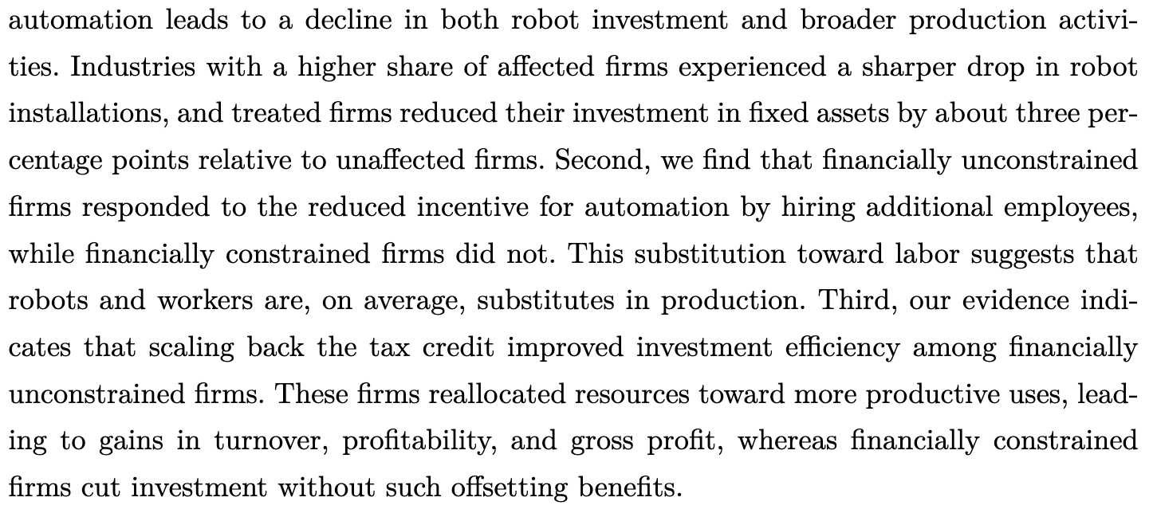
Case Study | Korea
Evidence of a “quasi-robot tax” → Holtmann, et al, Investment effects of a quasi-robot tax: Evidence from South Korea, arqus Discussion Paper No. 308 (2025) (firm-level study)
      South Korea was an early adopter of industrial robots (with 5,462 of them newly installed in 1993), leading country with with 1,000 robots per 10,000 employees in 2021 (Germany: 397 robots per 10,000 employees)
      2002: Tax credit for productivity-enhancing investments (new investments in automated systems, including industrial robots), credit of 7% for small firms, 5% for medium-sized firms, and 3% for large entities
      2018: Reduced tax credits for automation investments for medium-sized firms to 3% and for large entities to 1% → Not a “robot tax”, but a “quasi robot tax”, as both increase the after-tax cost of robots

Slide 28
Tax Concepts | International Dimension
Geographic Concentration → AI development and value creation are heavily concentrated geographically (Stanford AI Index Report, 2025):
  In 2024, U.S. private AI investment grew to $109.1bn (nearly 12 times China’s $9.3bn and 24 times the U.K.’s $4.5bn).
  In 2024, U.S.-based institutions produced 40 notable AI models (compared to China’s 15 and Europe’s 3).
  Fundamental allocation problem: Where should AI income be taxed? → “If local jobs are automated away while the profits pile up in California, Seattle, or Shenzhen, who exactly is going to fund their citizens’ income?“ (Hertz, 2025) → Analogous to the discussion about the taxation of the “digitalized economy” and Pillar One?
Distortions through unilateral measures? → AI adoption/automation inevitable? Unilateral taxation of inputs/outputs/production?
Multilateral solutions necessary? → E.g., “Global Internet Tax Agency” (Lucas Mas & Junquera-Varela, 2021 (World Bank)), destination-based taxation, market-access taxation, market capitalization taxation etc

Slide 29
Part III
Utopia or Dystopia?

Slide 30
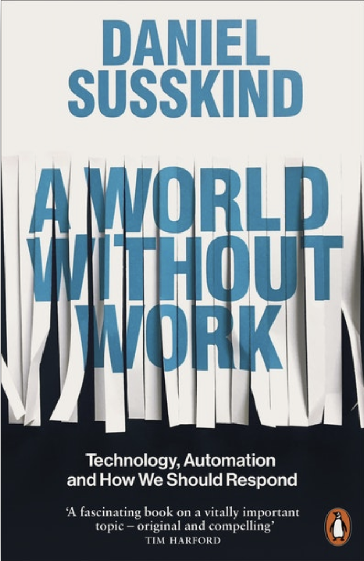
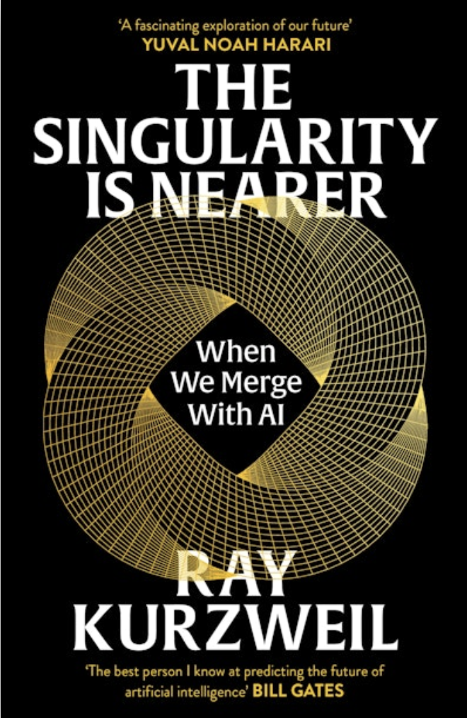
Introduction | Some Basics
Serious, but not hopeless? Hopeless, but not serious? Serious and hopeless?
Some Terminology
  Artificial General Intelligence (AGI) → AI that matches human-level intelligence across all domains
  Artificial Superintelligence (ASI) → AI far exceeds human cognitive capabilities
  Singularity → AI self-improvement triggers an "intelligence explosion“, creating an ASI that develops at a pace beyond human comprehension.
  Alignment Problem → Are ultimate goals of AI beneficial for humanity?
Complex and unclear economic adjustments (e.g., Korinek, 2023; Korinek & Suh, 2024; Trammell & Korinek, 2025; Restrepo, 2025; Korinek & Lockwood, 2026)

Slide 31
Dystopia or Utopia | Zero Labor
Dystopia or Utopia: Post-Labor Society
  Extreme outcome could be that all – or nearly all – occupations become fully automated and taken over by AI, rendering human labour obsolete and dispensable in economic terms thus leading to mass unemployment (Korinek & Juelfs, 2022; Acemoglu and Lensman, 2023; Filippucci et al, 2024 (OECD); Restrepo, 2025: relevance of scarce compute; Krier, 2026: assumptions extreme, fragile, and demanding)
  Humans become (nearly) irrelevant as economic actors, labor’s share of income will go to zero → As AI replaces human labour across sectors, two trends converge …
    … production costs collapse toward zero as AI and robotics provide labor at marginal cost …
    … and human wage income disappears as the source of purchasing power
  Paradox
    If AI ownership remains concentrated, capital owners‘ consumption is insufficient to sustain demand, causing a broader economic breakdown (economic value of AI outputs approaches zero, capital returns disappear, “power” determined by scarce resources, e.g., AI systems, compute, energy, land, water)
    Taxation limited or irrelevant as a revenue-mechanism, but rather to steer behavior, manage scarcity, and limit concentrated power
    “It should lead to incredible productivity and therefore prosperity for society. [If distributed fairly], we should be in an amazing world of abundance for maybe the first time in human history, where things don’t have to be zero sum.” (Hassabi, 2025 (Google’s DeepMind))

Slide 32
Dystopia or Utopia | Transition?
Three Possible Phases
  Near-term (2026–2035): Augmentation Era → AI complements human labour (task exposure, displacement, modest productivity gains, growing wage inequality), but labor retains significant value. → Policy window, e.g., taxation, social protection systems (social insurance, labor market programs, social assistance; Brollo et al (2024) (IMF))
  Medium-term (2035–2055): Substitution Era → AI capabilities surpass most cognitive tasks (massive inequality, declining labor share, accelerating capital concentration)
  Long-term (2055+): Post-Labour Era → Labour share goes to 0, most human work becomes obsolete. → As the consumption base collapses under extreme concentration, traditional profit-making breaks down. → Products/services at near-zero marginal cost, traditional money economy breaks down, profits disappear, nobody has income. → Post-scarcity allocation systems? What remains to be taxed and why?

Slide 33
Part IV
Summary

Slide 34
Key Takeaways | Part I: Labor Market
Part I – Impact of Automation on the Labor Market
  AI might be very different from previous automation waves → Industrial robots displaced low-skilled routine work, AI targets cognitive tasks, with high-skilled occupations most exposed.
  Empirical evidence on job exposure is wide-ranging (9%–82%), but the distributional picture is clearer → Declining labor income share, wage-productivity decoupling, hollowing out of middle-skill jobs, uneven income distribution.
  Historically, augmentation offset displacement → 85%+ of employment growth since 1940 driven by technology-induced job creation, but AI may break this pattern through rapid advances, substitution of high-skilled work, and workflow automation.
  Potentially offsetting productivity gains are real but uncertain and unevenly distributed → Estimates range from ~1% over 10 years to 7% per year GDP growth → But: Risk of “so-so-technologies” (displacement without the compensating productivity dividend).
Part II – Implications for Taxation
Part III – Utopia or Dystopia?

Slide 35
Key Takeaways | Part II: Taxation
Part I – Impact of Automation on the Labor Market
Part II – Implications for Taxation
  Automation might create a fiscal “doubly whammy” → Decreasing wage tax revenues/social security contributions and increased expenditure for public social nets → Labor more heavily taxed than capital, with any corporate or VAT/consumption tax offset limited and uncertain.
  Three distinct rationales, each pointing to different tax instruments → Fiscal (recover lost revenue through tax mix adjustment), distributive (progressive capital/income taxation), corrective (Pigouvian-style intervention, but only sensible for “so-so technologies”, as taxing genuinely productive automation might be self-defeating.
  International dimension → AI value creation heavily concentrated geographically (US: 40 notable AI models in 2024; Europe: 3) → Unilateral measures risk distortion/circumvention/competitive disadvantages, multilateral solutions might be necessary (analogous to attempts for Pillar One), but politically fragile.
  South Korea → Real-world quasi-experiment for a “robot tax” → Reduction of automation tax credits demonstrably reduced robot investment and increased employment.
Part III – Utopia or Dystopia?

Slide 36
Key Takeaways | Part III: Utopia or Dystopia
Part I – Impact of Automation on the Labor Market
Part II – Implications for Taxation
Part III – Utopia or Dystopia?
  Near-term (2026–2035) is potentially the critical policy window → AI still largely augments rather than replaces, labor retains significant value, but displacement is beginning → Window for adjustment of tax systems, social protection, and institutions.
  Extreme endpoint: Post-Labor Society → If AI ownership remains concentrated, collapse of wage income erodes the consumption base, eventually undermining even capital returns → “Power” determined by scarce resources (compute, energy, land, water) rather than money economy.
  Utopia or dystopia would then depend on ownership distribution, not technological progress → Broadly distributed AI ownership (through taxation, sovereign funds, employee ownership) would perhaps result in shared abundance, concentrated ownership in the paradox of breakdown.
  Taxation’s role likely transforms across phases → In the near term as a revenue and redistribution tool, in the medium term for managing accelerating inequality and capital concentration, and in the long-term for steering behavior and limiting concentrated power rather than raising revenue.

Slide 37
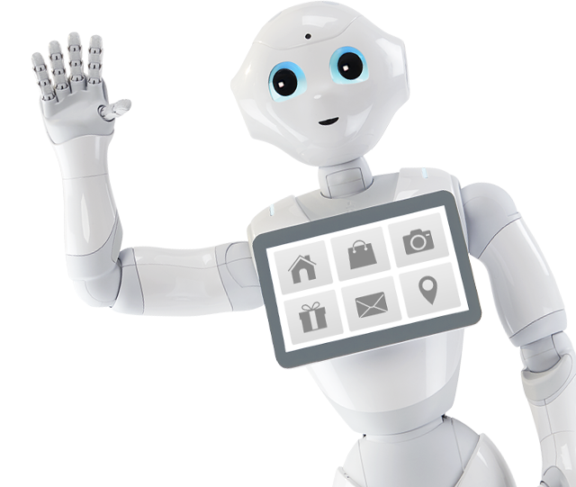
Thank you!

