Slide 1
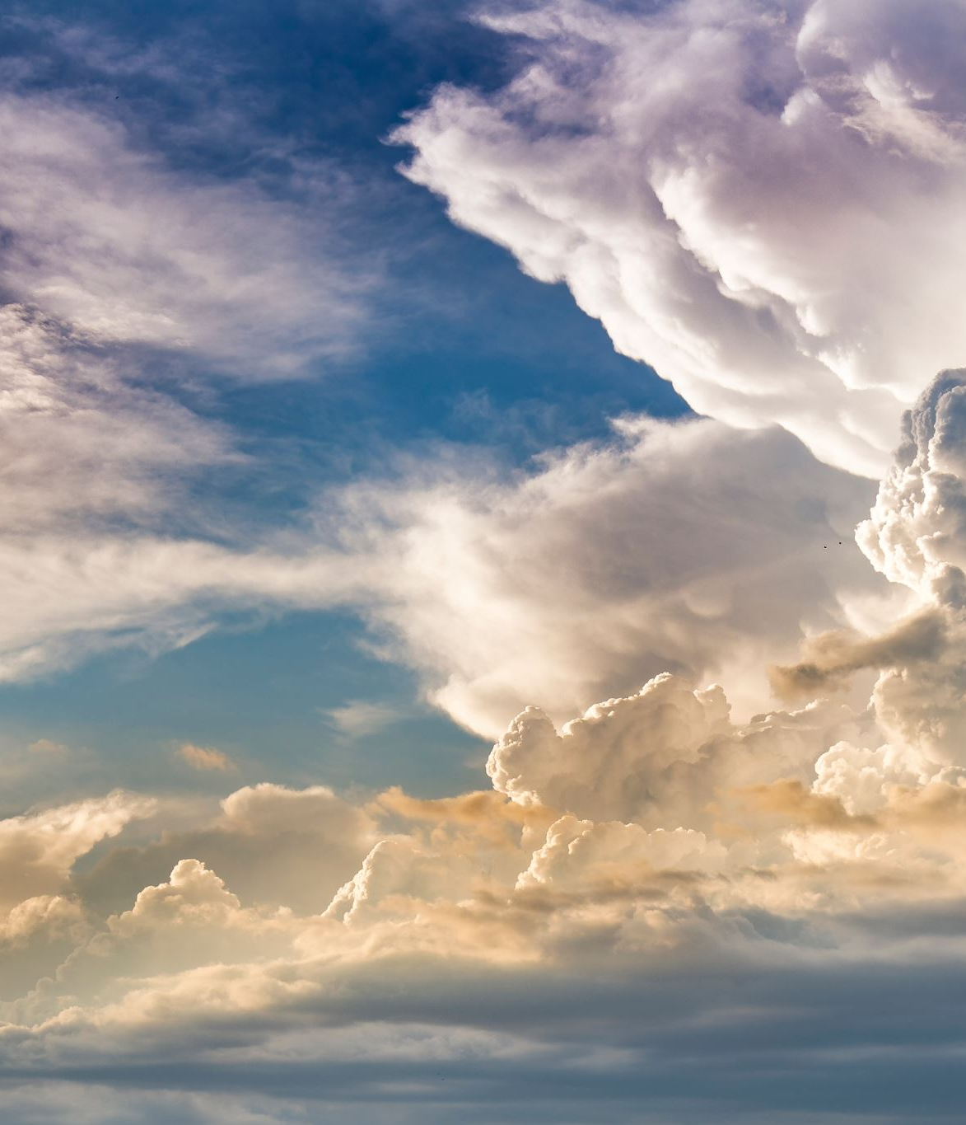
Indigenous Peoples’ Right to Self-Determination and Violence Against Indigenous Women, Girls and Gender Diverse people Tripartite Working Group on Violence Against Indigenous Women, Girls and Gender Diverse Mexico City 3 September 2024
Professor Claire Charters

Slide 2
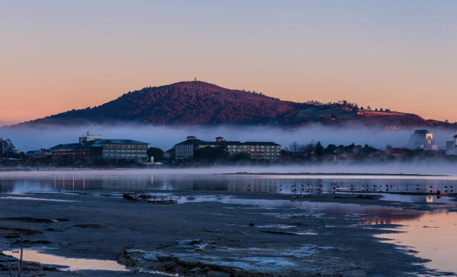
Ko wai au|who am i? Ko NgongotaHA TE MAUNGA Ko ROTORUA TE MOANA Ko TUNOHOPU TE MARAE Ko CLAIRE CHARTERS TŌKU INGOA TĒNA KOUTOU KĀTOA

Slide 3
The focus
Aotearoa New Zealand perspective: violence against our wāhine Māori within the movement for Māori self-determination;
Global perspective: with reference to developing international law and jurisprudence;
Some conclusions: that might support the crucial work needed to eliminate violence against Indigenous women, girls and all gender-diverse people, and support Indigenous peoples’ self-determination, across Aotearoa, Canada, US and Mexico

Slide 4
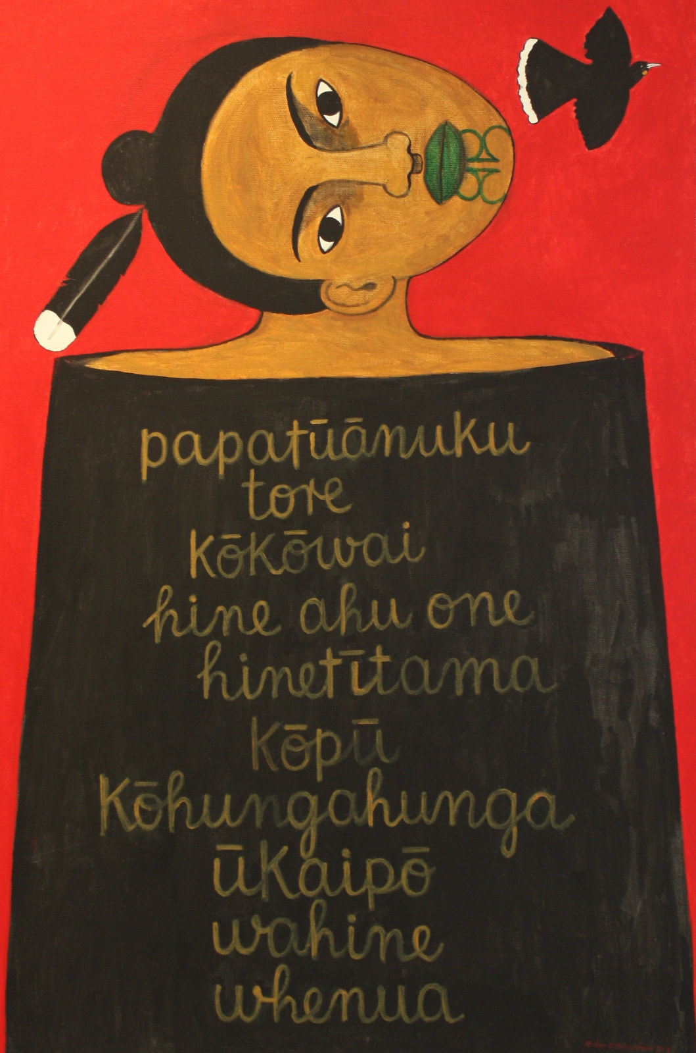
AOTEAROA | NEW ZEALAND
PERSPECTIVE

Slide 5
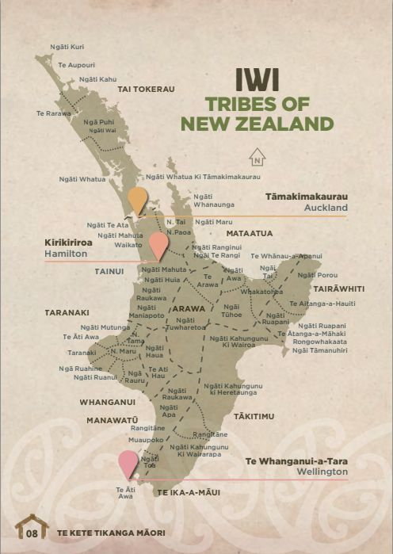
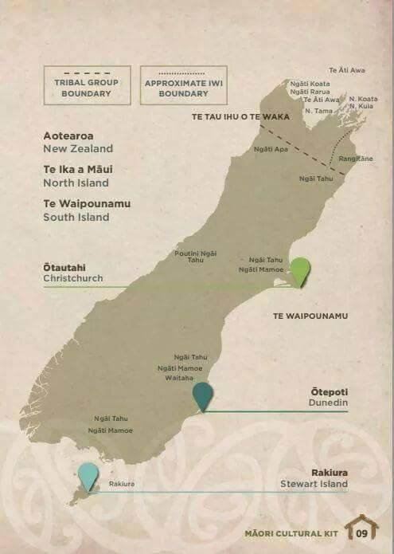
Notes:
Māori arrived in Aotearoa circa the 9th Century in waves of migration from Polynesia.
[We refer to ourselves as ‘tangata whenua’ meaning ‘people of the land’, in recognition that Papatūānuku – our Earth Mother – is our mother and giver of life. For Māori, our entire identity, spirituality, worldviews and laws arise from our relationship with the land. This meant the dispossession of land for Māori through colonisation was devastating spiritually, physically, psychologically and economically.]
Captain James Cook was the first European to land on the islands in 1769, and settlement began in earnest in the 1830s.
The Treaty of Waitangi was signed between the British Crown and some Māori chiefs in 1840. Māori retained sovereignty but the Crown was granted the right to govern settlers. It is considered the founding constitutional document of Aotearoa, even if it lacks any legal force and has been continuously breached within a few years of it being signed.

Slide 6
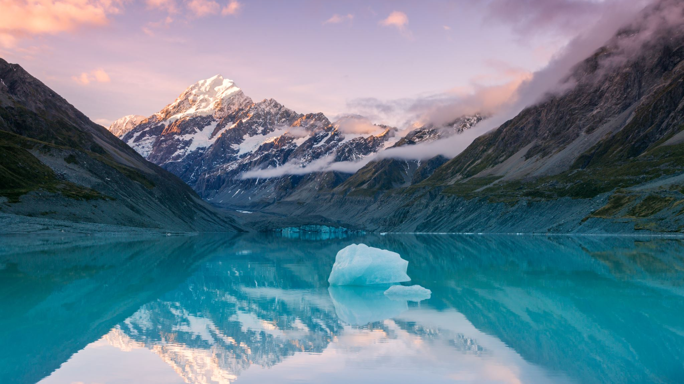
Doctrine of discovery English Westminster model : Parliamentary sovereignty and mono-legalism No written constitution, no strong-form review NZ Human Rights Act is subordinate to other legislation Te Tiriti o Waitangi: guaranteed Māori sovereignty|tino rangatiratanga but not honoured, and unenforceable in law Colonisation impact devastating/genocidal: loss of 96% of land, no sovereignty recognized Culture renaissance from 1970s but under threat (language)

Slide 7
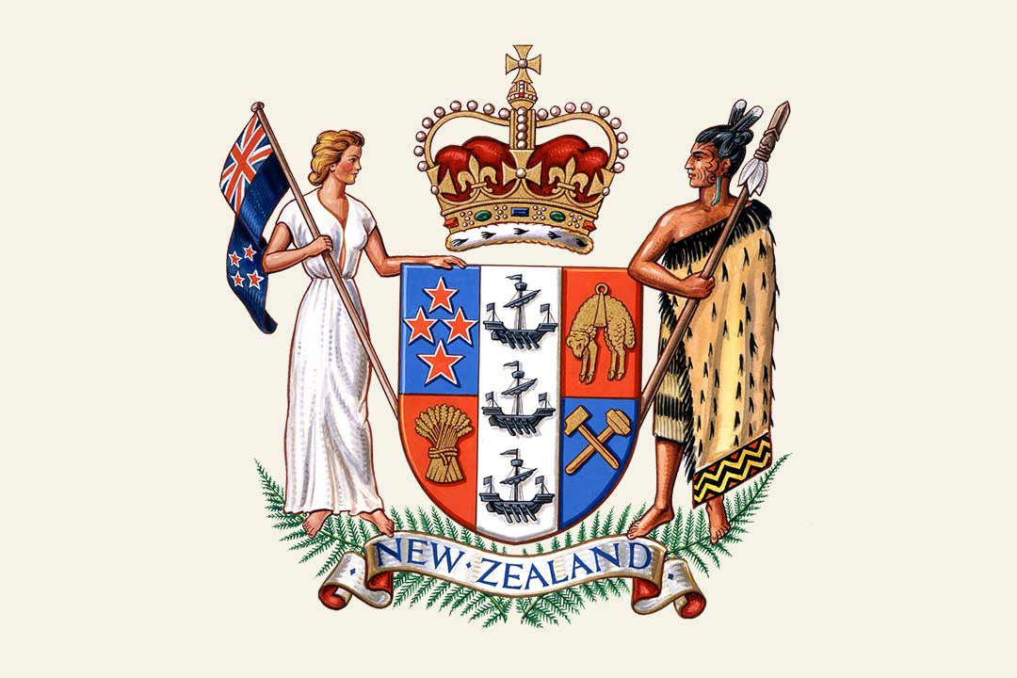
Devastating impact of colonisation on Māori women:
96% of all Māori land taken by the Crown;
Over 50% of all prisoners are Māori
Wāhine Māori make up 63% of women’s prisons
Up to 80% of Māori women have experienced some form of family violence
Māori women die, on average, 7 years younger than non-Māori women
Māori women experience greater discrimination and bias, including in the workplace where unemployment for Māori women is dramatically higher than the national rate
Notes:
The impact of colonisation on Māori has been devastating. Māori have lost – via confiscation, fraudulent land deals and the individualisation of collective property – 96% of out lands, most of it within the first 50 years of European arrival.
The British Crown assumed full sovereignty –by force – shortly after 1840. Under our inherited constitutional tradition, the Crown is the sole and absolute sovereign meaning there was, and is, no space for an recognition of ongoing Māori self-governance or self-determination, contrary to the Treaty of Waitangi. [Just last week, the Prime Minister made the claim that Māori ceded sovereignty, contrary to all accounts – legal, political etc – it beggars belief]
Today, Māori are the unhealthiest, the poorest, the least well accommodated, the least well-educated peoples in Aotearoa and experience ongoing discrimination. Over 50% of the prison population is Māori, in a country which incarcerates its people more than any other Western nation after the US.[1]
NZ History: https://nzhistory.govt.nz/media/interactive/maori-land-1860-2000

Slide 8
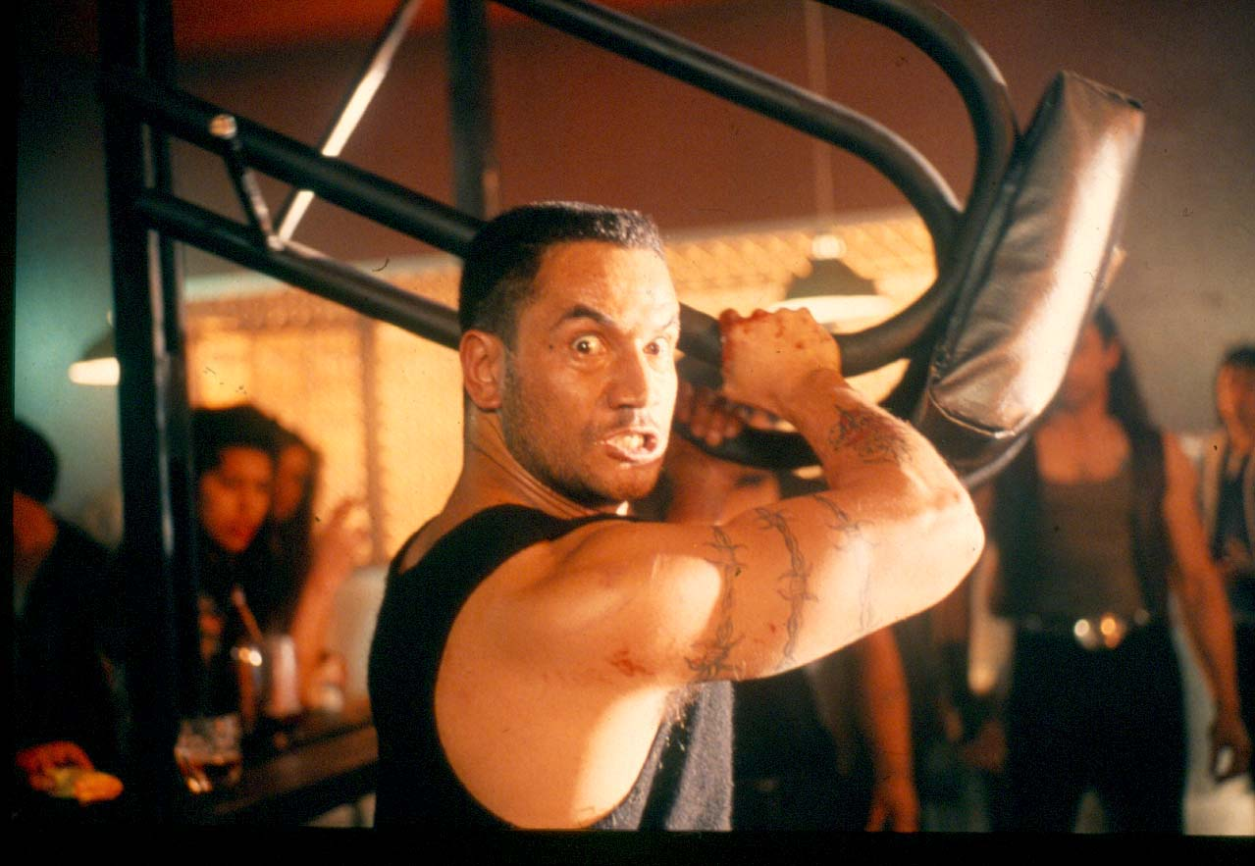
“There are layers of protections that are built up around abuse. Some of these are the rationalisation of violence as tikanga. Too many accept violence within the whānau as normal and valid. The irony is that violence is the most profound expression of powerlessness that is sustained by the entrenched belief that we cannot change the circumstances that lead to the perpetration of violence within ourselves.”
Picture: Jake ‘the Muss’ Heke from movie Once were Warriors (1994)

Slide 9
“The whānau was a woman's primary source of support. Her "marriage" did not entail a transferral of property from her father to her spouse. She remained a part of the whānau.
Even if she went to live with her husband's whānau, she remained a part of her whānau, to whom her in-laws were responsible for her well-being. They were to ensure that she was well-treated and to support her.”
Ani Mikaere (1994)

Slide 10
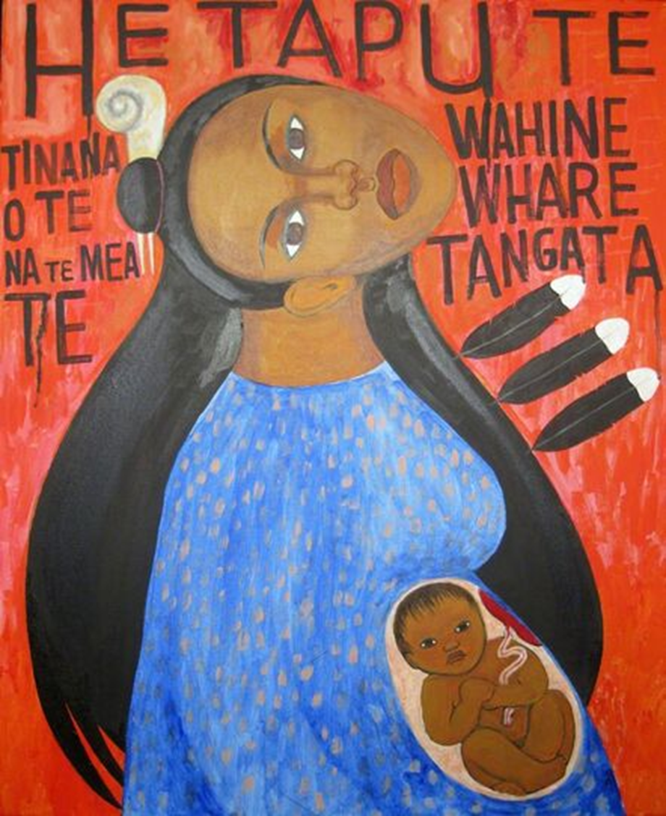
Waitangi Tribunal Mana Wāhine Inquiry (WAI2700)
Disproportionate Impact: Wāhine Māori face significant inequities across various sectors, including higher rates of violence, lower life expectancy, and barriers to education and employment.
Breach of Treaty Principles: The claim asserts that the Crown's actions or inactions have breached the principles of partnership, active protection, and equity under the Treaty, leading to the marginalization of Wāhine Māori.
Intersectionality: The claim highlights the unique position of Wāhine Māori, who experience discrimination not only as Māori but also as women, and how this dual disadvantage has been exacerbated by colonial policies.
Call for Redress: The claim seeks recognition of these breaches and calls for specific remedies to address the disparities and restore the mana (dignity, authority) of Wāhine Māori

Slide 11
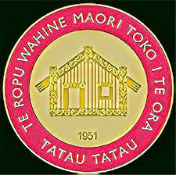
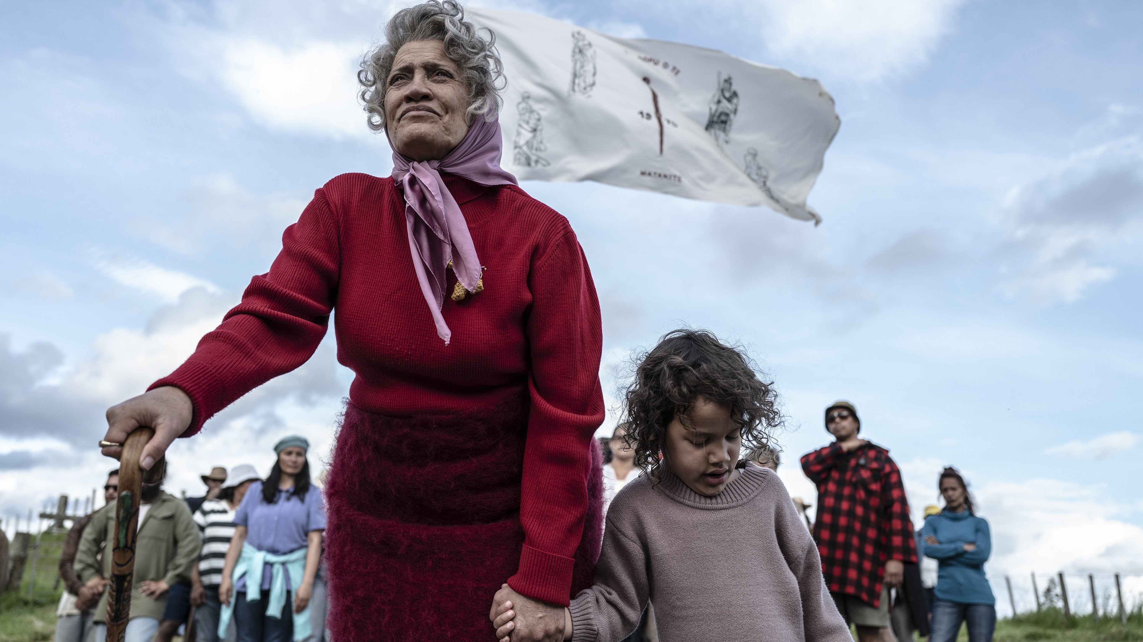
Māori Women’s Welfare League
Founded in 1951 in response to increasing poverty and violence faced by Māori women and families as they moved to the cities for work.
The League was established to draw together Māori women on a national basis, to address their own and their families' needs.
“Tatau Tatau”/ ”Let us be united”.
Picture: Dame Whina Cooper from the movie Whina (2022)

Slide 12
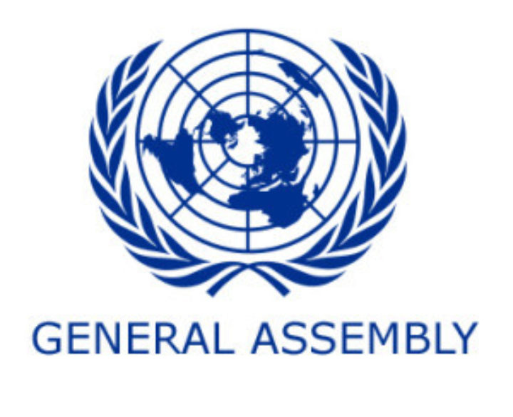
Challenges to NZ Government at 2024
UN Universal Periodic Review 2024 gave 259 recommendations, including several relating to addressing violence against women and the self determination of Māori people.
The Ministry of Women on Violence against Māori women report emphasized the need for action despite imperfect knowledge, stating:
"We can't afford to wait until we know everything. We are never going to know everything. We need to do something. Take action. Give it our best guess at the time. Our women are worth it. Our children are worth it."

Slide 13
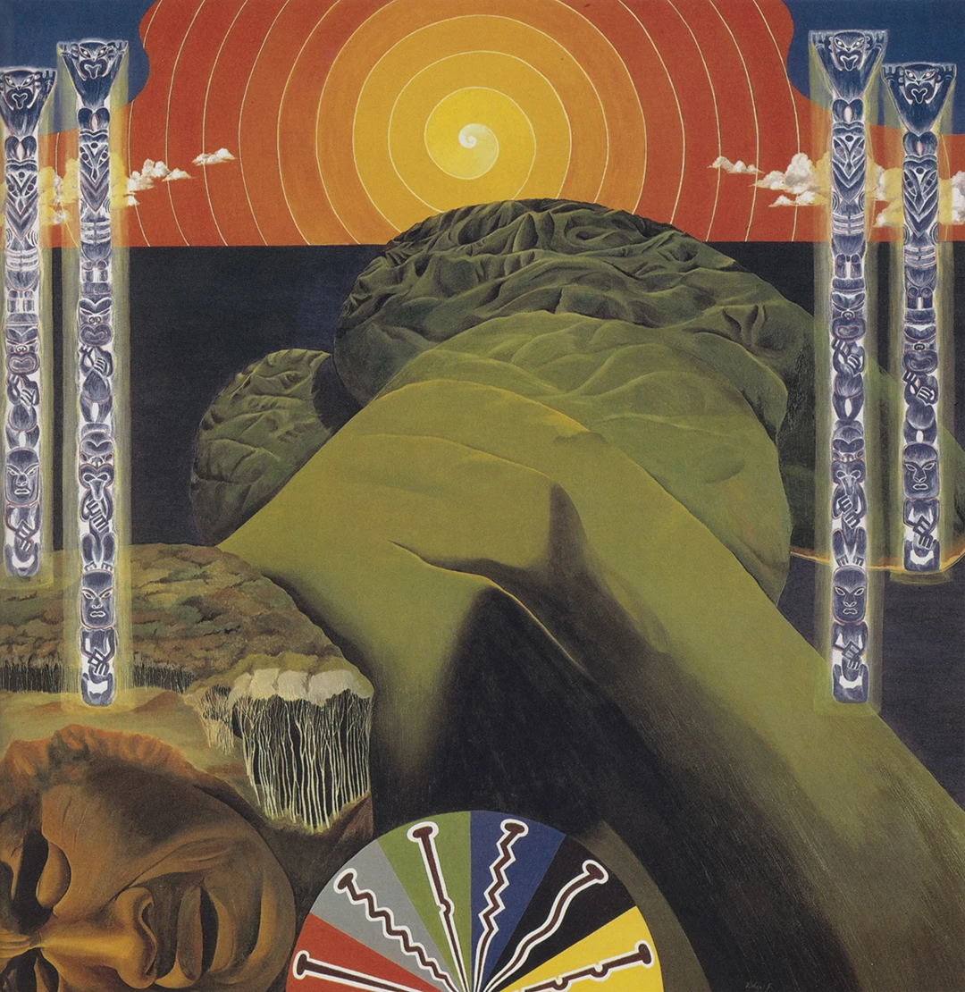
GLOBAL
PERSPECTIVE

Slide 14
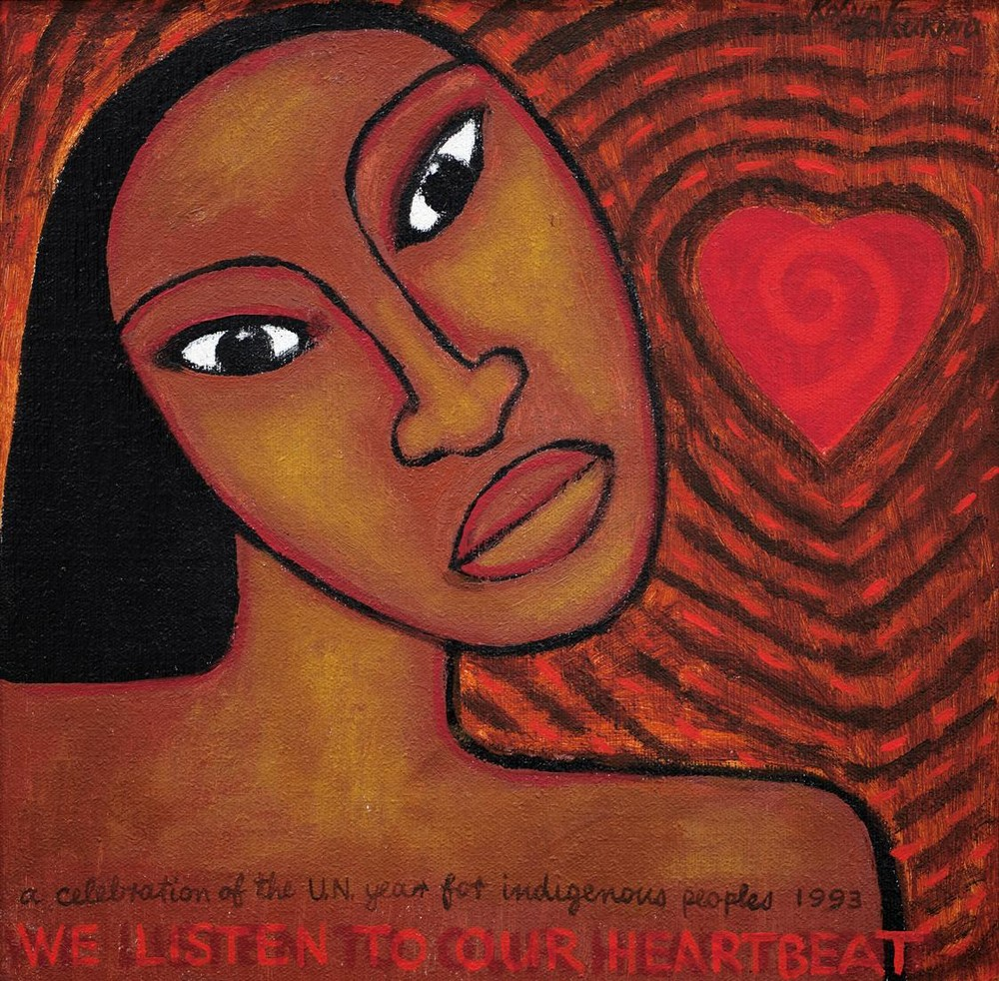
DRAWING CONCLUSIONS
FOR CANADA, USA &
MEXICO

Slide 15
TĒnĀ koutou katoa Thank you

