Slide 1

Planning your HRC proposal for Research Impact
Dr Cherie Lacey and Brittany Bennenbroek
Research Impact | Pānga Rangahau Research and Innovation Office | Te Puna Tiketike

Slide 2


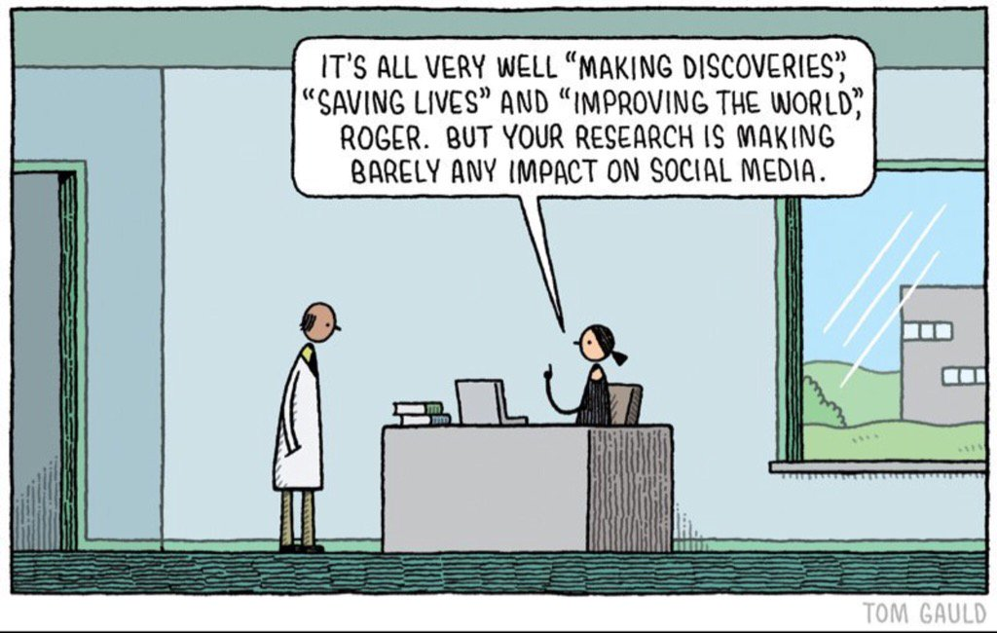
Today’s workshop
Setting the context
What is research impact?
Impact in HRC grant applications
Best practice for planning impact
Visualising your pathway to impact
Articulating your impact goal
Mapping and prioritising stakeholders
Developing an engagement plan
Developing an action plan

Slide 3

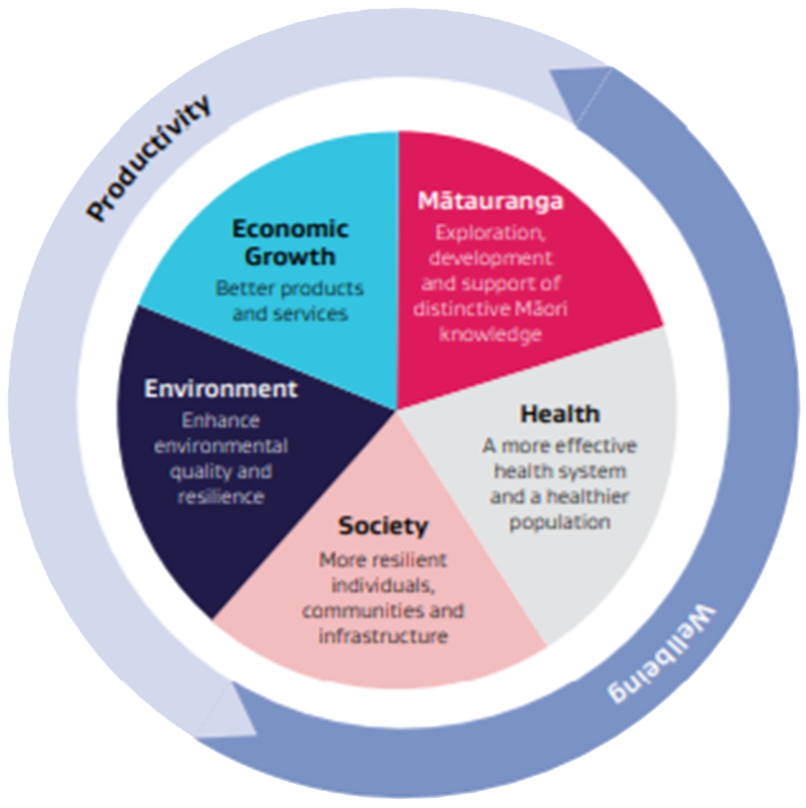
What is research impact?
UoA defines Research Impact as:
The contribution that research and creative practice makes to society, the environment and the economy.
HRC defines Research Impact as: The direct and indirect influence of excellent and innovative research on individuals, communities or society, including improvements to health and other social, economic, cultural or
environmental benefits for New Zealand.
Notes:
The HRC’s definition of research impact is focused on the creation of “real-world” benefits for non-academic end-users.
The inclusion of excellence and innovation signals our ongoing commitment to fund high-quality research, which is a prerequisite for research impact, but not sufficient to maximise the benefit derived from the research.
Their key message is that research impact is not created by researchers alone; but rather, requires communication, relationships and actions that connect academic research to people from organisations beyond academia.
Why must HRC proposals demonstrate impact from the research it funds?
The need to demonstrate return on investment has become a major policy issue for funders of research, both in New Zealand and internationally. As the primary agency for publicly funded health research in New Zealand, the HRC has a responsibility to use taxpayers’ money effectively, and to demonstrate to the public that health research can save lives and improve quality of life for all New Zealanders. In addition, it’s critical to demonstrate to government that our research can also reduce health care costs, generate revenue from innovation, and upskill our workforce.
HRC funding is underpinned by the principles and objectives of the New Zealand Health Research Strategy 2017-2027 (NZHRS). The Strategy aims to increase the impact of government investment in health research, ultimately creating a world-leading health research and innovation system that improves the lives of all New Zealanders.

Slide 4







Types of research impact
Health Gains: Research that contributes to improvements in health outcomes, particularly for those with the highest health need in terms of life expectancy, burden of disease, or quality of life.
Health System Change: Research that improves the accessibility, safety, effectiveness, efficiency, cost-effectiveness, cost-containment, or responsiveness of health services.
Economic Impact: Research that leads to the generation of revenue or cost savings, avoids costs, or enables commercial opportunities such as new businesses or technologies.
Environmental Impact: Research that supports positive outcomes for the environment, including conservation, sustainability, ecosystem health, and climate change mitigation, particularly where it intersects with health and wellbeing.
Social Impact: Research that delivers benefits for specific groups or society more broadly, such as improved equity, access to education, social cohesion, or human rights.
Cultural Impact: Research that promotes cultural understanding, inclusion, and change, particularly where it affirms the value of Māori, Pacific, and other cultural knowledge systems.
International Impact: Research that enhances New Zealand’s global reputation through leadership, collaboration, and contribution to international science or health outcomes.
Source: HRC Impact Assessment Slideshow 2024
Notes:
Health Gains
Research that contributes to improvements in health outcomes, particularly for those with the highest health need in terms of life expectancy, burden of disease, or quality of life. Includes health equity outcomes and measurable gains in physical, mental, or social wellbeing for individuals or communities.
Health System Change
Research that improves the accessibility, safety, effectiveness, efficiency, cost-effectiveness, cost-containment, or responsiveness of health services. Includes changes to health service delivery, policy, or infrastructure that enhance system performance.
Economic Impact
Research that leads to the generation of revenue or cost savings, avoids costs, or enables commercial opportunities such as new businesses or technologies. May include growing economic gains through private sector investment or enhancing the value of New Zealand’s innovation sector.
Environmental Impact
Research that supports positive outcomes for the environment, including conservation, sustainability, ecosystem health, and climate change mitigation, particularly where it intersects with health and wellbeing. Can also include research that addresses environmental determinants of health or supports sustainable healthcare practices.
Social Impact
Research that delivers benefits for specific groups or society more broadly, such as improved equity, access to education, social cohesion, or human rights. Focuses on broader wellbeing and quality of life improvements not captured under other categories.
Cultural Impact
Research that promotes cultural understanding, inclusion, and change, particularly where it affirms the value of Māori, Pacific, and other cultural knowledge systems. May include integration of mātauranga Māori, support for culturally appropriate health services, or strengthening cultural identity and values.
International Impact
Research that enhances New Zealand’s global reputation through leadership, collaboration, and contribution to international science or health outcomes. Includes advancing global knowledge, attracting international partnerships or investment, and building New Zealand’s competitive advantage.

Slide 5
HRC research impact criteria:
Describe how your research might be used and the anticipated benefits for New Zealand, your action plan to maximise the research’s use and benefits, and your team’s track record in transferring knowledge and achieving real-world impact.
Anticipated benefits for NZ (what types of benefits and who will benefit)
Action plan to maximise the research’s use and benefits (the how)
Team’s track record in transferring knowledge, including relevant relationships, networks, and examples of uptake
Notes:
1. What types of benefits are expected to arise from your research, and who will benefit?
Provide a realistic description of how your research findings could contribute to health or other societal benefits over time — outlining a clear ‘line of sight’ or pathway to impact. Importantly, describe both the immediate and longer-term benefits anticipated, and identify the key next users or end users of your research. The balance between short-term benefits and potential long-term impact will depend on the nature of your research, with emphasis placed on what is within your sphere of influence during the life of the project.
You may include research-related benefits such as capacity and capability gains for New Zealand, enduring benefits from collaborations, or influence on future research agendas. Also consider the geographical distribution of benefits — including how contributions to international research may ultimately benefit New Zealand.
Key resource here: The HRC’s Research Impact slideshow discusses elements that should be covered in this section, including the types of benefits and research users, and the geographical distribution of benefits (such as how contributing to international research efforts will benefit New Zealand).
2. What specific activities will you undertake, throughout the life of the research project, to maximise the use and benefits of your research?
Specify the activities you will undertake throughout the research project to increase the likelihood that your findings will be taken up and used. Describe any targeted actions that have been, or will be, taken to ensure that the next users or end users identified above can meaningfully contribute to, or benefit from, the research. These may include stakeholder engagement through co-design, co-production, or dissemination efforts at different stages of the project.
Include any planned dissemination activities intended to reach broader audiences, and identify who might enable the uptake of your research. Describe how these individuals or organisations are involved in your project, or how you intend to build those relationships. Where relevant, identify uncertainties, institutional or systemic barriers to uptake, and the mitigation strategies you plan to implement.
3. What elements of the team’s track record of knowledge transfer provide confidence in the likelihood of research uptake?
Summarise the research team’s experience in transferring knowledge and generating benefit from previous or similar research. This may include existing relationships, networks, or collaborations with relevant next users or end users; previous examples of knowledge mobilisation; or demonstrable outcomes such as changes in policy, practice, health outcomes, or other societal impacts.
This section provides confidence in your ability to realise benefits from your proposed research and is assessed relative to opportunity. Consider how your team’s prior experience supports your action plan and increases the likelihood of your research being used in meaningful ways.

Slide 6
Pathways to Impact

Slide 7
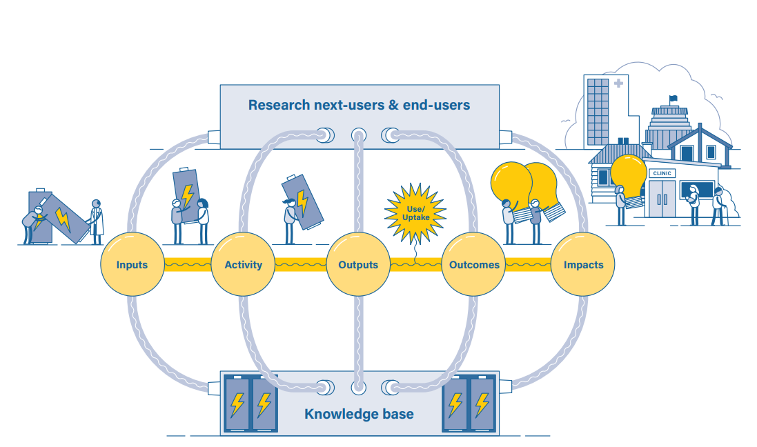
The HRC Pathway to Impact
Notes:
HRC’s definition of impact is to be used alongside their Pathway to Impact model, which describes how impact can be generated through a series of linked steps — from research inputs through to outputs, outcomes (interim benefits), and eventual impact.
This model recognises the importance of early and ongoing engagement with next users or end users of the research. Feedback loops throughout the pathway highlight the non-linear nature of impact and how research users should be meaningfully involved — including at the planning and scoping stages — to ensure the research is relevant, actionable, and maximised for real-world use.
These feedback loops also demonstrate how knowledge can return to and strengthen the broader research ecosystem, contributing to future research and agenda-setting.
Inputs: These include not only funding and institutional resources, but also the existing knowledge base and context that inform the research. Inputs may encompass discipline-specific knowledge, public/community/iwi knowledge, government priorities, clinical need, infrastructure, facilities, and importantly, the skills, relationships, and networks involved in the research.
Activity: The process of conducting research typically involves collaboration between researchers and research users (next-users or end users), and may include the training of postgraduate students, postdoctoral researchers, and non-academic contributors such as clinicians or community members involved in co-production.
Outputs: Outputs are the tangible deliverables that result from the research process, such as peer-reviewed publications, reports, presentations, hui, media engagement, software, prototypes, or datasets. Outputs also include less tangible results such as tacit knowledge shared through collaboration or the development of human capital.
Outcomes (Interim Benefits): These occur when research outputs are taken up, used, or implemented by identified users. Outcomes represent the early real-world influence of research and are critical transitional points along the pathway to impact.
Impact: The ultimate goal is the generation of long-term benefits for New Zealand. “The direct and indirect influence of excellent and innovative research on individuals, communities or society, including improvements to health and other social, economic, cultural or environmental benefits for New Zealand.”

Slide 8
The HRC Pathway to Impact
Notes:
Importantly, the HRC’s assessment of research impact focuses primarily on the latter part of the model — how research outputs are transformed into outcomes through uptake, adoption, or implementation. This step is central to realising the potential for tangible, meaningful benefits to New Zealanders.
This stage reflects the point at which research begins to create real-world influence — when findings are used to inform practice, policy, innovation, or community action. Moving from outputs (e.g. publications, reports, tools) to outcomes (e.g. changed decisions, behaviours, or services) requires more than dissemination; it requires deliberate planning, engagement, and responsiveness to user needs.
To support this, researchers are expected to develop a clear and credible action plan that outlines the steps they will take to maximise uptake and use. This includes:
Engaging with next users and end users early and meaningfully
Co-designing or co-producing research where appropriate
Identifying enablers and barriers to uptake, and strategies to address them
Implementing dissemination and knowledge mobilisation activities suited to intended audiences
The action plan forms a key part of HRC’s research impact assessment. It signals that researchers have considered not just what will be produced, but how it will be used, by whom, and to what effect.
Through thoughtful planning and genuine engagement, researchers can improve the likelihood that their work leads to interim outcomes — paving the way for broader impact and long-term value for Aotearoa New Zealand.

Slide 9
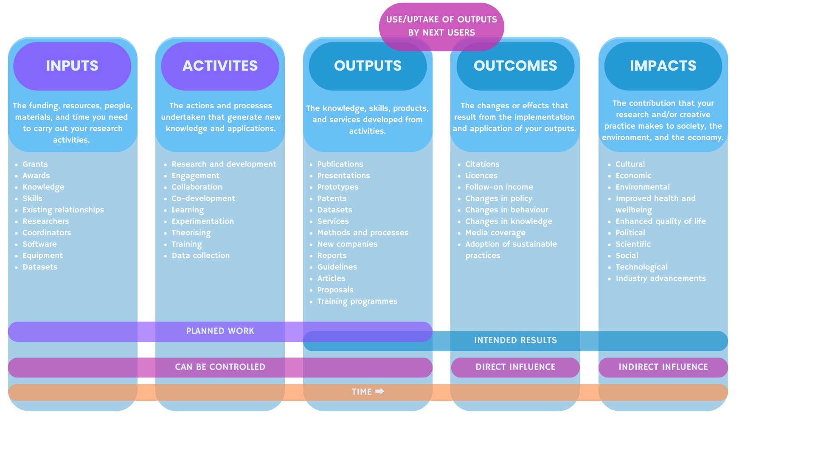
Results-chain framework
Notes:
Some practical categorisation of these elements….
Caveat - the pathway to impact is very rarely linear. This framework will help you broadly understand what the impact pathway may look like.

Slide 10
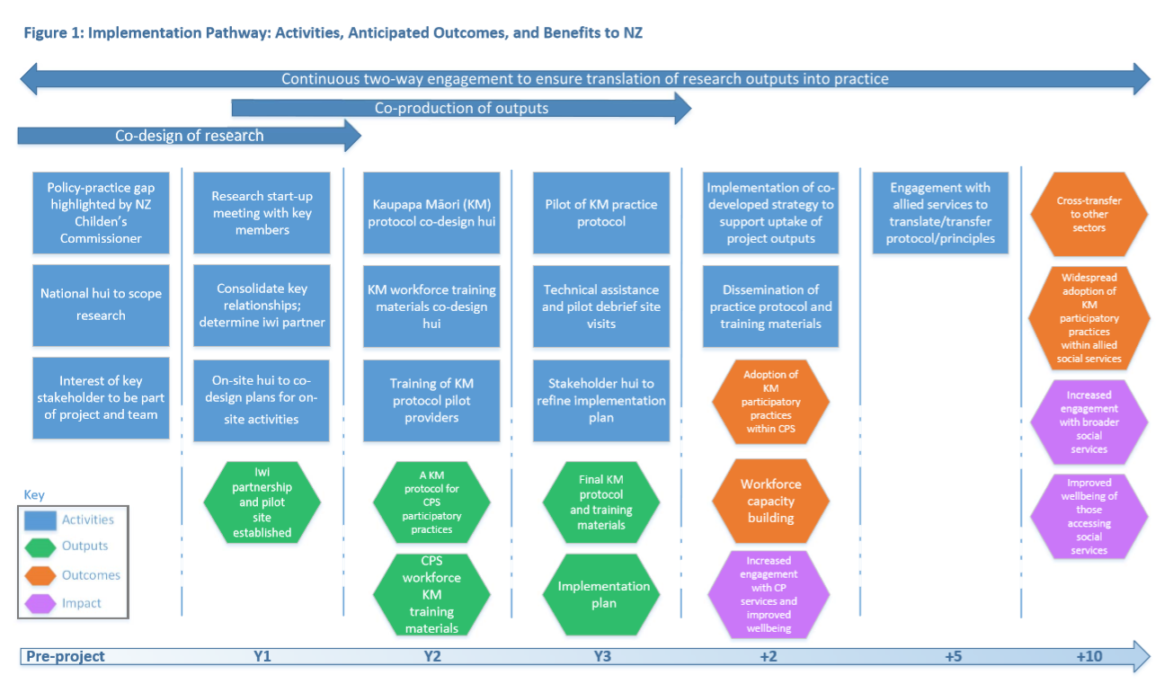
Results-chain framework in action
Notes:
Example of what this might mean in practice

Slide 11
Some things to keep in mind
Pathway to impact is rarely linear
Impacts may take many years to become apparent
Outcomes can be just as important as impacts
More basic research proposals where impact pathway is less obvious should also include consideration of research-related benefits e.g.
Building capacity and capability for a stronger research sector
Improve research capacity of health sector
Enduring benefits from international engagement
Enduring benefits from collaboration (national or international)
Generate resource of value for research community
Potential for research findings to influence the research field
Will there be opportunities for broader societal impacts (e.g. through public engagement?)
Notes:
Some things to keep in mind

Slide 12
Developing an Impact Goal and Relevant Engagement Plan

Slide 13
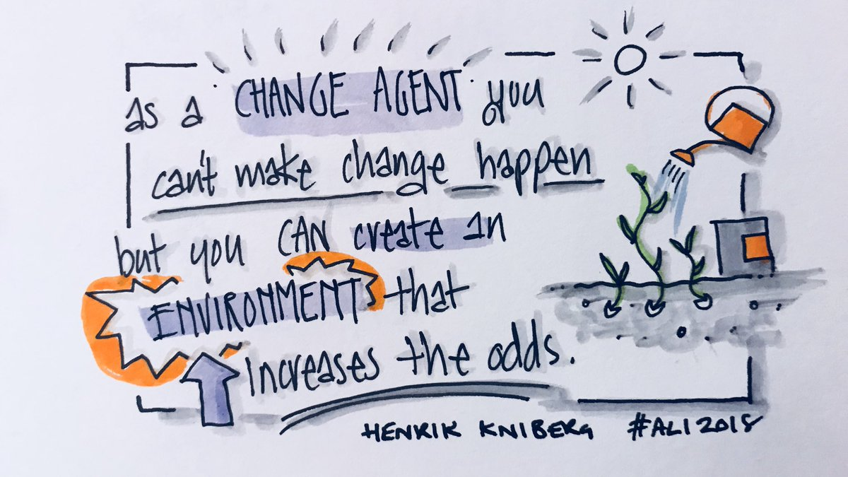
Notes:
I’ll start with this note. A caveat!
Whilst we may not have any control over the impact of our research, we can at least help to create an environment that increases the odds of impact occurring! This is the premise of having an implementation plan – we are increasing the odds of success!
The better your implementation plan, the more confident stakeholders and assessors will be that you can deliver.

Slide 14
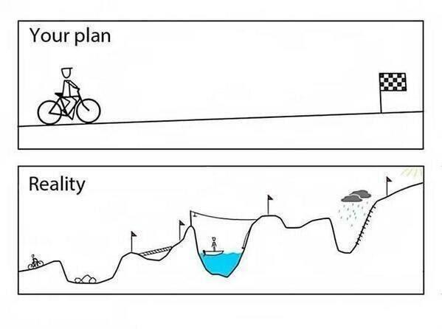
The planning process
Creating an impact goal
Mapping your stakeholders
Developing engagement plans
Creating an action plan
Notes:
Need to plan for impact.
In the following slides we will look at these four steps.

Slide 15
Creating an impact goal
Some questions to consider…
What is the challenge, opportunity, issue or gap in knowledge that your research addresses?
How big is the problem?
How many people, who is affected, and where is it? What extent of change are you looking to make?
How do you know this is a problem?
Look for evidence from government priorities, policy documents, media reports, testimonials etc.
How can your research help?
How is your research different to the existing research?
Imagine you’ve successful delivered a research project addressing the previously described challenge – what has been achieved?
What would your stakeholders say about how they have benefitted?
Notes:
Go through some ways you might go about creating an impact goal:
Some questions to consider…
What is the challenge, opportunity, issue or gap in knowledge that your research addresses?
How big is the problem?
How many people, who is affected, and where is it? What extent of change are you looking to make?
How do you know this is a problem?
Look for evidence from government priorities, policy documents, media reports, testimonials etc.
How can your research help?
How is your research different to the existing research?
Imagine you’ve successful delivered a research project addressing the previously described challenge – what has been achieved?
What would your stakeholders say about how they have benefitted?

Slide 16
Creating an impact goal
Some tips!
It can help by flipping the problem upside down!
E.g. Difficult to do [something] > faster or easier [something] within communities.
Impact goals should be SMART – Specific, Measurable, Achievable, Realistic and Time-bound
Specific – Be specific about the extent of your potential impact
Measurable – What evidence/indicators will prove you’re making progress
Achievable – Make sure you can reasonably accomplish your goal given your resources and any constraints
Realistic – Be realistic about what might be able to occur within your sphere of influence. Evidence of an impact plan will help your credibility
Time-bound - consider how long it will take to achieve your impact goal. This may be by the end of your research project, or in twenty years’ time! You can build in milestones to keep on track.
Notes:
Some tips…
It can help by flipping the problem upside down!
E.g. Difficult to do [something] within a community
Faster or easier [something] within communities
Impact goals should be SMART – Specific, Measurable, Achievable, Realistic and Time-bound
Specific – Be specific about the extent of your potential impact
Measurable – What evidence/indicators will prove you’re making progress
Achievable – Make sure you can reasonably accomplish your goal given your resources and any constraints
Realistic – Be realistic about what might be able to occur within your sphere of influence. Evidence of an impact plan will help your credibility
Time-bound - consider how long it will take to achieve your impact goal. This may be by the end of your research project, or in twenty years’ time! You can build in milestones to keep on track.
So we know what the research need is, and we know the potential impact. But we can’t achieve the impact alone. We need to engage with non-academic stakeholders to proactively make a difference.

Slide 17
Activity #1
Define your impact goal/s
Notes:
Some tips…
It can help by flipping the problem upside down!
E.g. Difficult to do [something] within a community
Faster or easier [something] within communities
Impact goals should be SMART – Specific, Measurable, Achievable, Realistic and Time-bound
Specific – Be specific about the extent of your potential impact
Measurable – What evidence/indicators will prove you’re making progress
Achievable – Make sure you can reasonably accomplish your goal given your resources and any constraints
Realistic – Be realistic about what might be able to occur within your sphere of influence. Evidence of an impact plan will help your credibility
Time-bound - consider how long it will take to achieve your impact goal. This may be by the end of your research project, or in twenty years’ time! You can build in milestones to keep on track.
So we know what the research need is, and we know the potential impact. But we can’t achieve the impact alone. We need to engage with non-academic stakeholders to proactively make a difference.

Slide 18
Mapping your stakeholders
Stakeholders may:
Be invested in the outcomes of your research
Be affected by your research (positively or negatively)
Benefit from your research findings
Want to use or implement your findings
Be fundamental to achieving impact
Co-design the research project or co-produce research outputs
Provide lived experience to improve research design and identify relevant outcomes or impact measures
Offer specific expertise or access to equipment, data, or other resources
Support dissemination through large or influential networks
Oppose, block, or challenge aspects of your research
Notes:
Identifying stakeholders is a key initial step in defining your impact goal. If your research is relatively fundamental, you may identify other researchers with an interest in your work. However, to really enrich the research process it is often useful to look beyond academia and identify stakeholders relevant to your area of research interest to understand the issues, opportunities, or gaps in knowledge that they face.
Stakeholders may:
Be invested in the outcomes of your research
Be affected by your research (positively or negatively)
Benefit from your research findings
Want to use or implement your findings
Be fundamental to achieving impact
Co-design the research project or co-produce research outputs
Provide lived experience to improve research design and identify relevant outcomes or impact measures
Offer specific expertise or access to equipment, data, or other resources
Support dissemination through large or influential networks
Oppose, block, or challenge aspects of your research

Slide 19
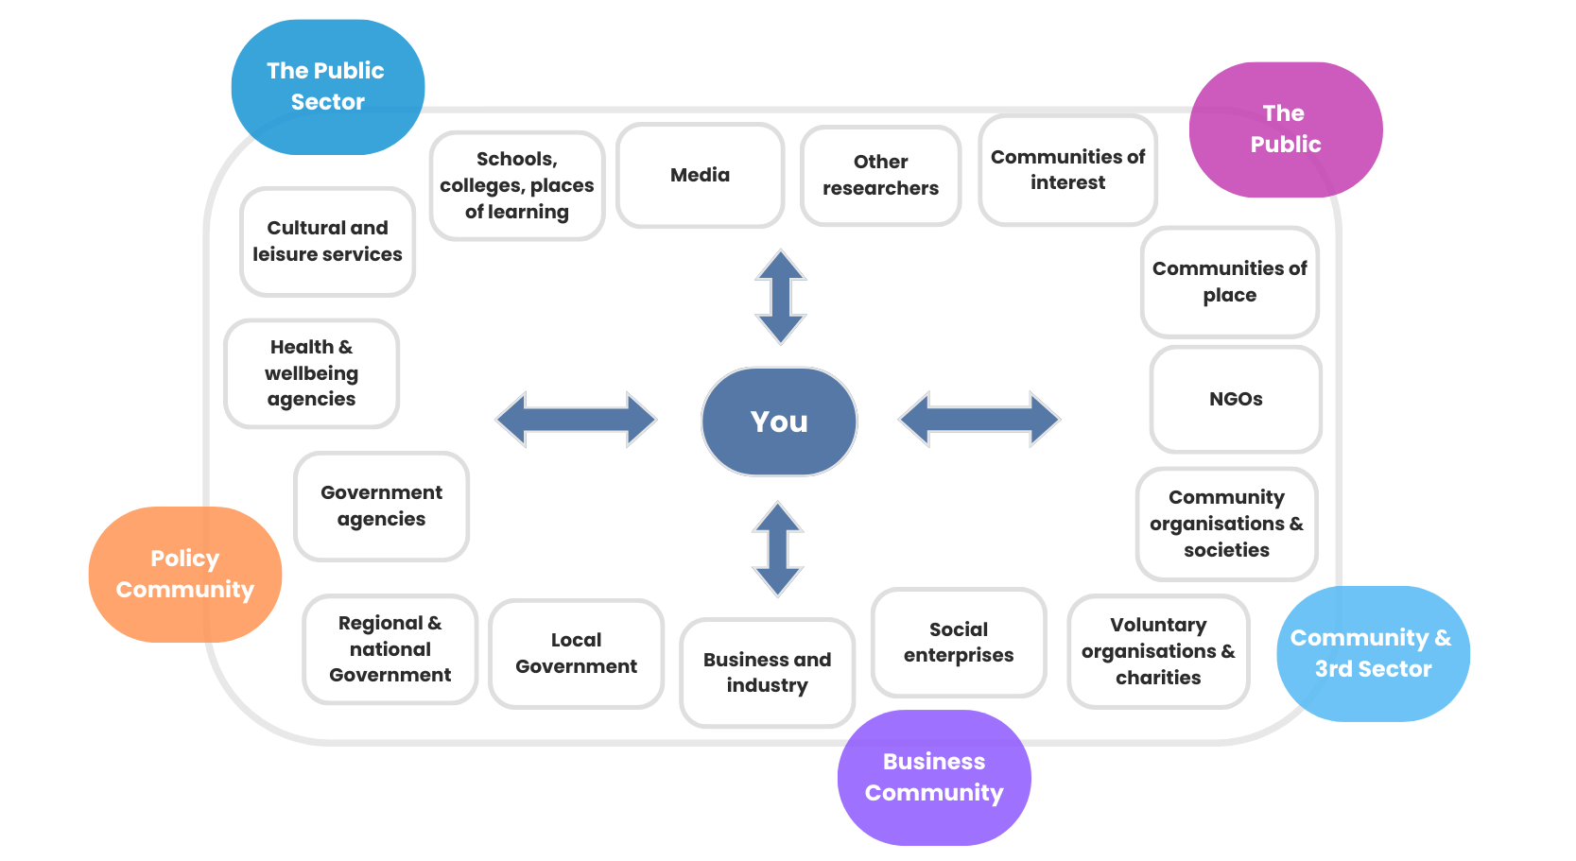
Mapping your stakeholders
Notes:
“Collaboration for Impact” is a central guiding principle for HRC.
Stakeholder mapping can help you to identify which individuals, communities, and organisations have a stake (or an interest) in your research. These can include those who will be directly affected by your research, or those who will be able to influence the impact of your research.
• Look widely across the science and health systems and work collaboratively across disciplines, institutions, communities, sectors and countries to capitalise on specialist skills and different perspectives.
• Involve communities, health consumers and disabled people in the research process.
• Harness interactions between professional practice, research and education.
• Form partnerships and develop cooperative arrangements.
• Foster public engagement on the implications of new knowledge, innovations and technologies on health for all New Zealanders.
Categories of stakeholders include the public sector, the policy community, the business community, the community and third sector organisations, and the public.

Slide 20
Activity #2
Mapping your stakeholders
Notes:
Some tips…
It can help by flipping the problem upside down!
E.g. Difficult to do [something] within a community
Faster or easier [something] within communities
Impact goals should be SMART – Specific, Measurable, Achievable, Realistic and Time-bound
Specific – Be specific about the extent of your potential impact
Measurable – What evidence/indicators will prove you’re making progress
Achievable – Make sure you can reasonably accomplish your goal given your resources and any constraints
Realistic – Be realistic about what might be able to occur within your sphere of influence. Evidence of an impact plan will help your credibility
Time-bound - consider how long it will take to achieve your impact goal. This may be by the end of your research project, or in twenty years’ time! You can build in milestones to keep on track.
So we know what the research need is, and we know the potential impact. But we can’t achieve the impact alone. We need to engage with non-academic stakeholders to proactively make a difference.

Slide 21
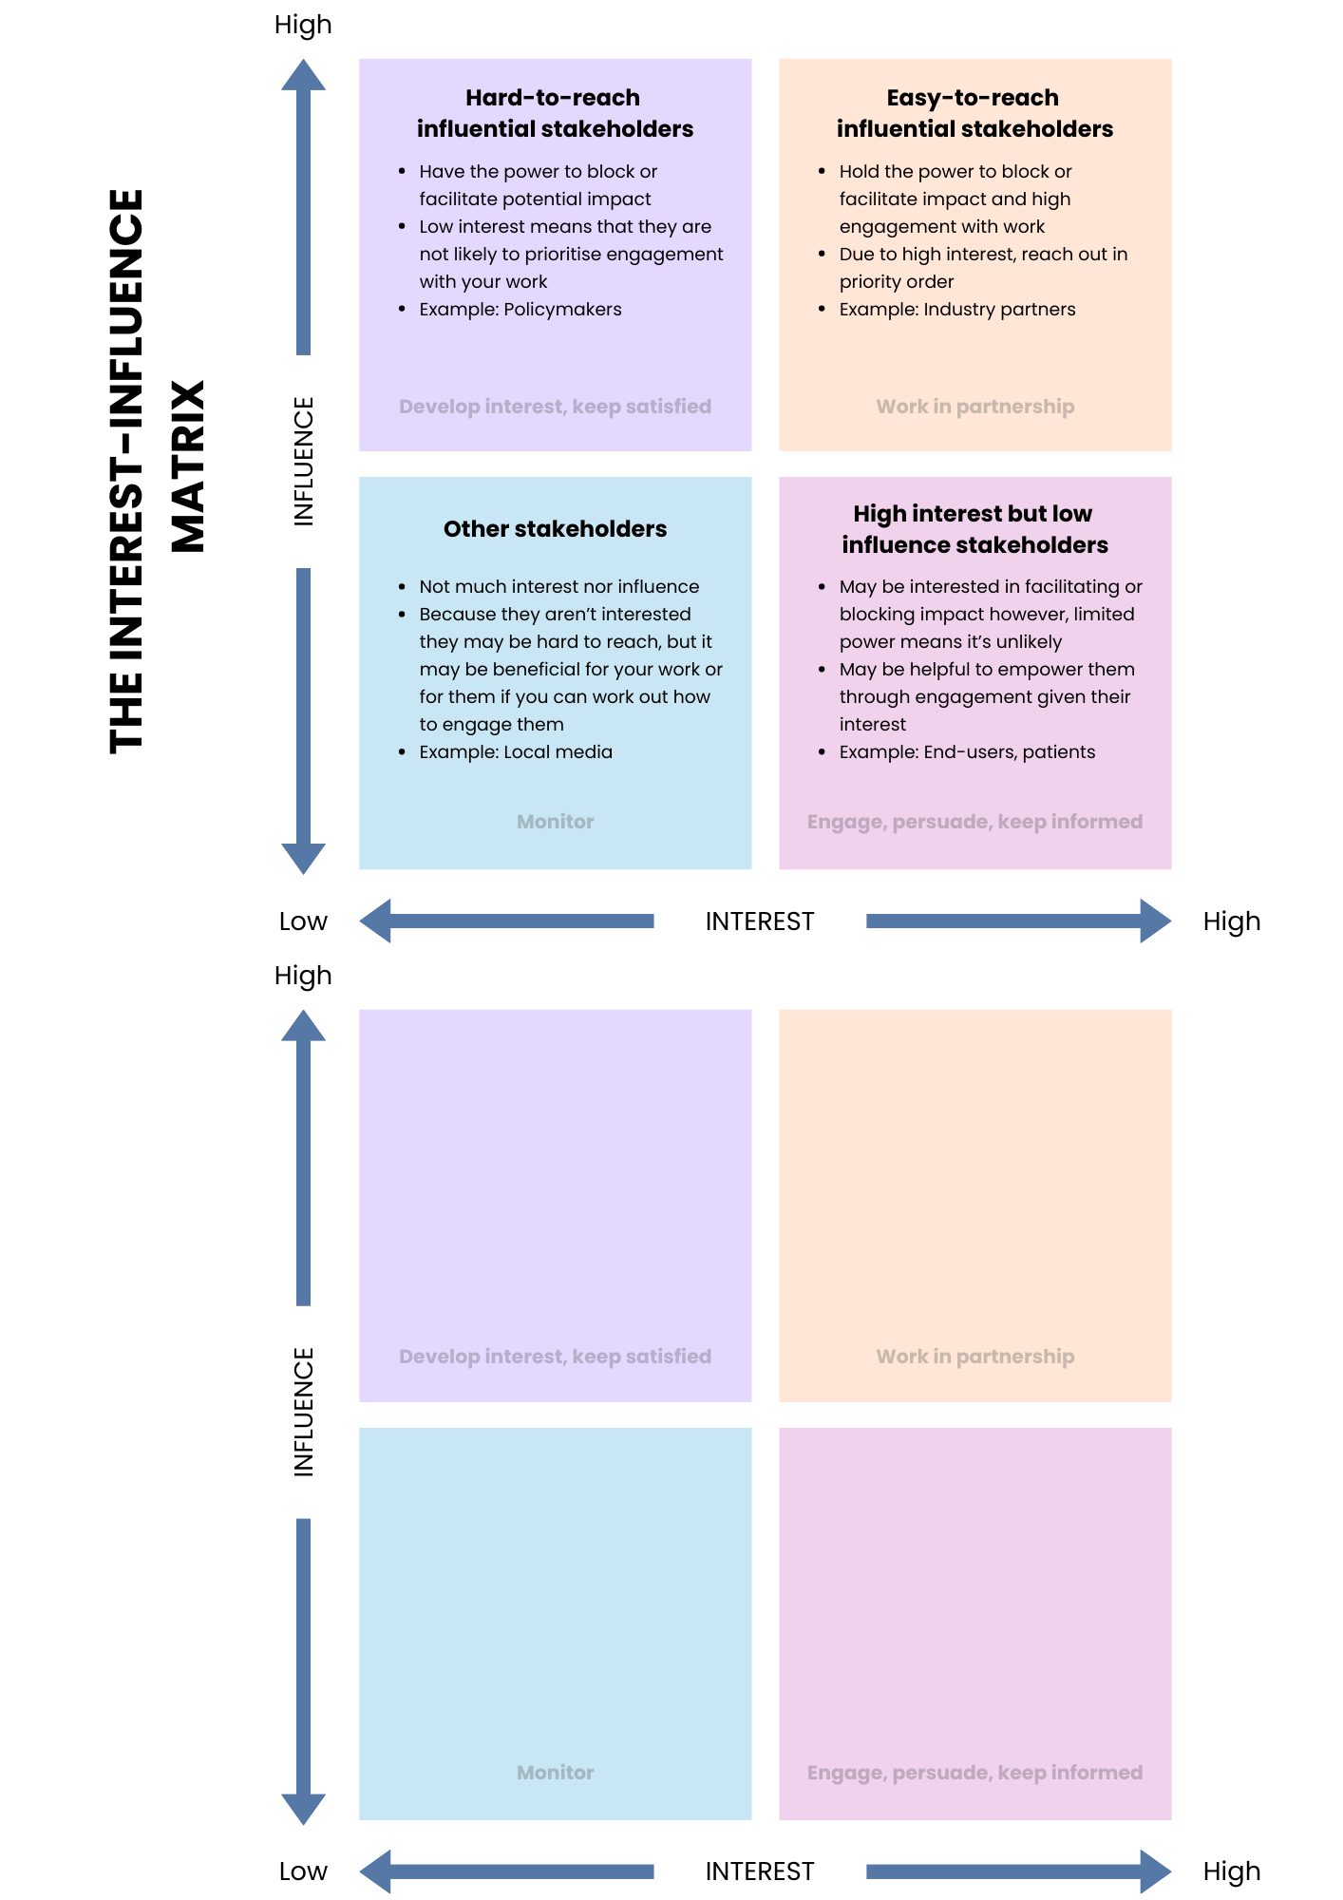
Prioritising your stakeholders
Notes:
You might find yourself already starting to prioritise your stakeholders while you are mapping them. For each of your stakeholders, think about whether they are already interested in your research, and whether they are likely to agree with your research. To do this, you can use the Alignment, Interest and Influence Matrix (AIIM) to help prioritise who to work with and how to work with them.
When thinking about Interest: Are they interested in the issue your research is addressing? Are they committing resources to the issue? Do they want to change? Are they speaking about the issue?
And with Influence: How important are they to making the change happen? Are they in a position of authority? Can they put pressure on the decision maker? Do they have money?!
You can also think about alignment: Is the research likely to lead to an outcome the stakeholders broadly agree with? Do they share the same sense of potential importance and agree with your approach?
Think about who is most influential in the area you are researching? How does change normally occur in this field and who leads it? What connections and networks already exist between stakeholders?
Are there actors who broker knowledge? People with significant roles in communities that can champion your work? Lobby groups, organisations, press or media who can help mobilise knowledge?
It can also be helpful to think about why you are engaging: Is it to
co-design the research project or co-produce the research outputs
provide information on lived experiences to improve research design and identify relevant outcomes and impact measures
provide specific expertise or access to equipment, data or other information
support communication via large or influential networks to help amplify the message or outputs of the research
use or implement the outputs of the research
Take the stakeholders from the spreadsheet and plot them onto the matrix.

Slide 22
Activity #3
Prioritise your stakeholders
Notes:
Some tips…
It can help by flipping the problem upside down!
E.g. Difficult to do [something] within a community
Faster or easier [something] within communities
Impact goals should be SMART – Specific, Measurable, Achievable, Realistic and Time-bound
Specific – Be specific about the extent of your potential impact
Measurable – What evidence/indicators will prove you’re making progress
Achievable – Make sure you can reasonably accomplish your goal given your resources and any constraints
Realistic – Be realistic about what might be able to occur within your sphere of influence. Evidence of an impact plan will help your credibility
Time-bound - consider how long it will take to achieve your impact goal. This may be by the end of your research project, or in twenty years’ time! You can build in milestones to keep on track.
So we know what the research need is, and we know the potential impact. But we can’t achieve the impact alone. We need to engage with non-academic stakeholders to proactively make a difference.

Slide 23
Developing engagement plans
Stakeholder
Purpose
Timing
Stakeholder engagement is essential for enabling the use and benefit of research. It supports the sharing of knowledge, insights, and perspectives, and helps ensure your research is relevant, meaningful, and fit-for-purpose — especially for those it aims to serve or influence.
For each stakeholder you have identified, consider:
Why are you engaging with them? (Purpose)
When should the engagement happen? (Timing)
Notes:
For each stakeholder/audience you have identified, you want to brainstorm the purpose and the timing for engagement.
Common Purposes for Engagement
Stakeholders may:
Co-design the research project
Co-produce knowledge or outputs
Provide data, expertise, or lived experience
Help communicate or amplify findings through networks
Use or implement your research outputs
Benefit from the research (as end-users or communities)
Engagement is a two-way relationship — it should be authentic, mutually beneficial, and respectful of your stakeholders’ needs and priorities. To be effective, you need to understand why they might want to engage with you, and how your research aligns with their interests or responsibilities.
When to Engage?
Timing matters. Ask yourself:
Do you need this stakeholder early to help shape the research?
Will their involvement be most effective during the project, to guide delivery or co-develop outputs?
Should you engage after the research to support uptake, implementation, or advocacy?
Planning early engagement — especially for partners, beneficiaries, and next-users — can improve relevance, build trust, and increase the likelihood of impact.
Engagement Tips
Building trust takes time
Expectations vary across communities, cultures, and organisations
Be mindful of equity, access, time, and cost barriers
Avoid reinforcing power imbalances
If unsure, ask stakeholders how and when they prefer to engage
Activity
Use the table provided to begin planning your engagement. Start by completing the first three columns: Stakeholder → Purpose of Engagement → Timing

Slide 24
Engagement activities
Co-design Workshops
Public Events
Webinars
Policy dialogues
Project Advisory Board
Secondments
Stakeholder conferences
Community hui
Training events
Activities
Outputs
Toolkit
Social Media
Media release
Videos
Policy briefing
Prototypes
Datasets
Methods & processes
Reports
Guidelines
Notes:
Prompts for ideas of activities and related outputs…
Once you have identified your stakeholders and the purpose for engaging with them, you can then determine the best types of engagement activities to undertake.
Different types of activities allow you to communicate and engage with your stakeholders in different ways, depending on what is required or most efficient.
And for the majority of activities you undertake, you will want to ensure there is an associated output.
Try to match your stakeholders to the type (or types) of activities that will be most appropriate for them, and think about what output you would expect to be generated from the activity.

Slide 25
Activity #4
Create your engagement plan
Notes:
Some tips…
It can help by flipping the problem upside down!
E.g. Difficult to do [something] within a community
Faster or easier [something] within communities
Impact goals should be SMART – Specific, Measurable, Achievable, Realistic and Time-bound
Specific – Be specific about the extent of your potential impact
Measurable – What evidence/indicators will prove you’re making progress
Achievable – Make sure you can reasonably accomplish your goal given your resources and any constraints
Realistic – Be realistic about what might be able to occur within your sphere of influence. Evidence of an impact plan will help your credibility
Time-bound - consider how long it will take to achieve your impact goal. This may be by the end of your research project, or in twenty years’ time! You can build in milestones to keep on track.
So we know what the research need is, and we know the potential impact. But we can’t achieve the impact alone. We need to engage with non-academic stakeholders to proactively make a difference.

Slide 26
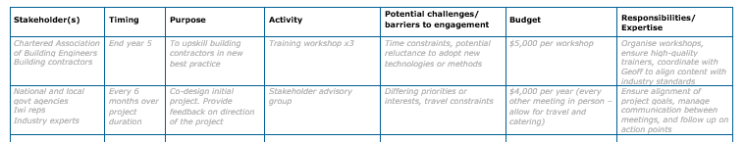
Piecing everything together to create your engagement plan
Stakeholder
Purpose
Timing
Activity
Output

Slide 27
Some additional things to consider
Roles and Responsibilities: Consider who is responsible for managing stakeholder relationships and engagement activities. Can you share the load with your wider research team?
Expertise: Do you need to bring in specialist expertise, e.g. a knowledge broker?
Budget and resources: A credible impact plan will include budget for resources such as staff time, event costs, honoraria, materials, expert support, etc. If funding for impact activities is limited or non-existent you can still develop an impact plan but will need to prioritise and think creatively about how best to support engagement and impact activities.
Timeframes: Where possible give yourself deadlines or targets for your activities and impacts. This could include milestone or deliverable reviews. Some timeframes may need to be negotiated with relevant stakeholders, particularly if you require their input. Include regular check-ins with your stakeholders and share progress of the research and impact plan.
Risks: Include a risk assessment of your intended impacts and impact plan and consider how you will mitigate them. What might go wrong or not work? Could there be any unintended consequences?
Evaluation: How will you know you have achieved your impact goal? Have a plan in place for how you will gather evidence of the impact of your research
Notes:
Some final things to consider include:
Roles and Responsibilities: Consider who is responsible for managing stakeholder relationships and engagement activities. Can you share the load with your wider research team? Do you need to bring in specialist expertise, e.g. a knowledge broker?
Budget and resources: A credible impact plan will include budget for resources such as staff time, event costs, honoraria, materials, expert support, etc. If funding for impact activities is limited or non-existent you can still develop an impact plan but will need to prioritise and think creatively about how best to support engagement and impact activities.
Timeframes: Where possible give yourself deadlines or targets for your activities and impacts. This could include milestone or deliverable reviews. Some timeframes may need to be negotiated with relevant stakeholders, particularly if you require their input. Include regular check-ins with your stakeholders and share progress of the research and impact plan.
Risks: Include a risk assessment of your intended impacts and impact plan and consider how you will mitigate them. What might go wrong or not work? Could there be any unintended consequences?
Evaluation - How will you know you have achieved your impact goal? Have a plan in place for how you will gather evidence of the impact of your research

Slide 28
Support and resources
The HRC Research Impact Slideshow
The Introduction to Research Impact (RSD001) module
There are additional online resources on the ResearchHub: https://research-hub.auckland.ac.nz/subhub/research-impact
Impact through Culture Change and Research Impact for Public Good webinar series
Impact Stories on the ResearchHub

