Slide 1
Marsden 2026 kick-off session
Benefit Section
Tues, 29 October
Dr Cherie Lacey

Slide 2

Key points
I will focus almost solely on the benefit section
Benefit = “quantifiable impact”
Key points I’ll touch on:
  2025 changes
  Nature of the fund (research excellence + quantifiable impact)
  Assessment criteria
  “Quantifiable benefit”
  The benefit statement
  Suggested template/format for your benefit statement

Slide 3
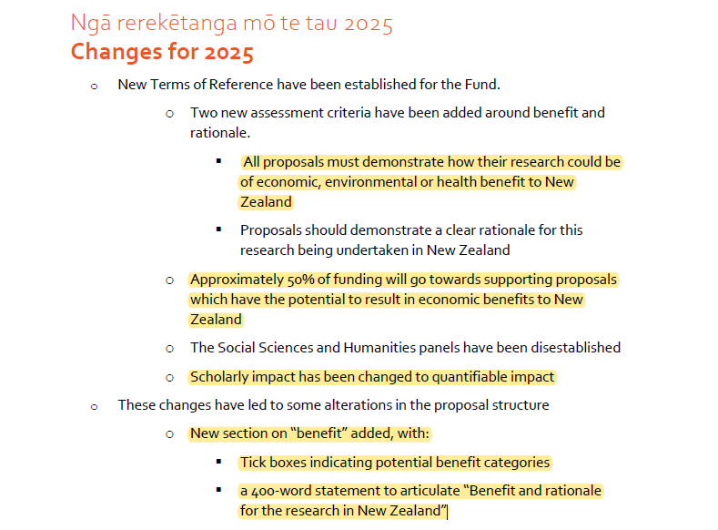
Outline of changes in 2025

Slide 4
Nature of the fund
Marsden remains NZ’s blue-skies research fund (for now)
But now needs to demonstrate why research could be of economic, environmental or health benefit to NZ
Approx. 50% of funds will go towards proposals that have the potential to result in economic benefit to NZ
So, your proposal will need to bring together excellent, blue-skies research and tangible (potential benefit) to NZ

Slide 5
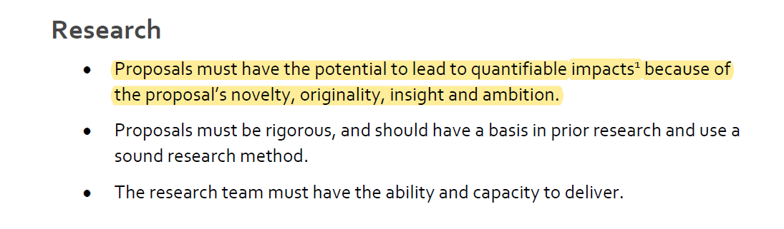
Assessment criteria

Slide 6
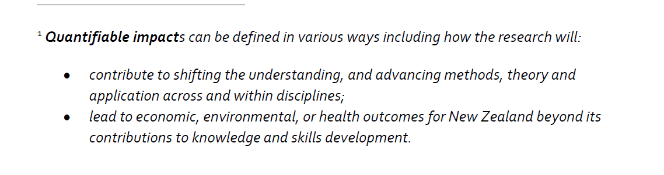
“Quantifiable Impact”
Covers both scholarly and ‘real-world’ benefit
Ideally, your proposal will demonstrate or evidence the potential real-world benefit, using a range of sources (I’ll expand on this in a moment)

Slide 7
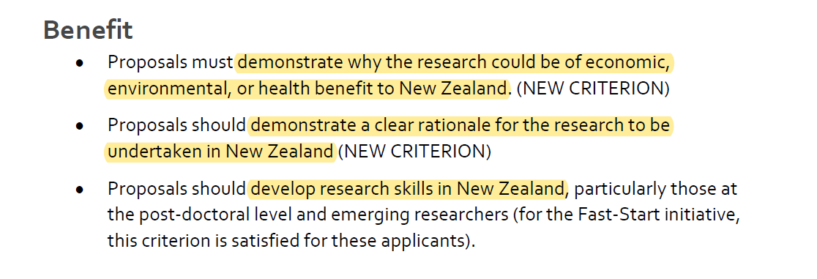
Assessment criteria (continued)
This is assessed based on your benefit statement (3d)

Slide 8
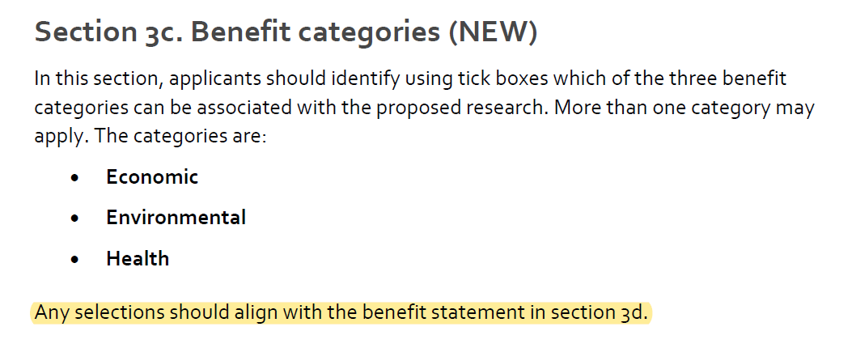
Application form: Benefit categories (3c)

Slide 9
Application form: Benefit Statement (3d)
400 words
Must align with the benefit categories ticked in (3c)
Your proposal must show a clear line-of-sight to societal benefit even if you won’t be directly involved in any real-world application yourself
Line-of-sight to impact/benefit means you can clearly articulate how your research will lead to real-world benefit

Slide 10
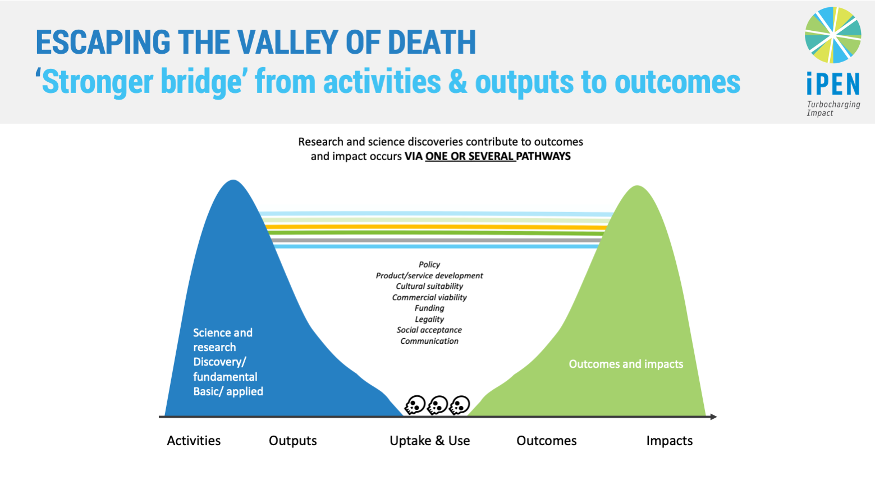
Application form: 3d

Slide 11
Suggested format for your benefit section
(1) Identify the problem/challenge/issue you’re addressing, using evidence; (2) flip this on its head to say how your research will fix/address it; this is your impact goal or goals, and they need to align with 3c. (3) Touch on the scale/reach of the impact for NZ, using metrics where possible (even if estimates). (4) Align impact goal/s with one or more area of “future additional value, growth, or critical need for NZ”, using evidence if possible. (5) Where relevant, identify the benefits for Māori (NB. If your project is Kaupapa Māori-based, you’ll likely want to weave this into the DNA of the benefit statement more closely).
(6) Briefly identify your pathway/s to impact (Kaupapa Māori, commercialisation, policy, health/clinical, public/social). (7) Indicate a timeframe for when you’re likely to see outcomes and impacts of your research (NB. You may want to indicate shorter-term outcomes or interim benefits that will occur along the pathway to impact).
(8) Clear rationale for conducting this research in NZ, and (9) why you/your team is best placed to do this work, citing previous success where relevant. (10) A really nice summary statement that will tie it all together and really make the case for how your research will benefit NZ.

Slide 12
Useful resources
UoA Impact Resources on Research Hub: https://research-hub.auckland.ac.nz/subhub/research-impact
iPEN’s impact resources: https://www.ipen.co.nz/
UoA’s Research Impact for Public Good webinar series: https://research-hub.auckland.ac.nz/research-impact/research-impact-for-public-good-webinar-series

Slide 13
Thanks

