Slide 1

Presenting research at seminars, events and conferences
Photo by Product School on Unsplash
Notes:
Ana
Li shares screen and gives control for Ana's sections
If you’re recording the session: record to the cloud and then put the recording in the workshop folder for Presenting. Let the students know that whilst we are going to record the session, all parts involving them, and their contributions will be edited out for their privacy

Slide 2

Please help us answering a survey

Slide 3
Kia ora and welcome everyone! This session will start shortly. While we wait, let us know where you fit in this graph!
Comfortable with presenting
Wing it
Follow a script
Nervous about presenting
Notes:
Ana

Slide 4
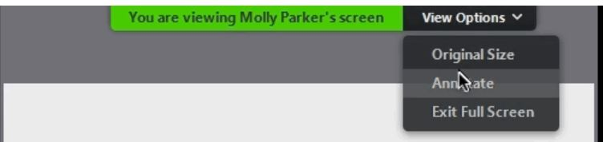
Whiteboard activity - how to annotate
Hover at the top of your screen to reveal the tool bar.
Click on View options and select Annotate.
Select the Text (T) tool from the annotate toolbar.
Notes:
Ana - also mention that these instructions are for laptop users but if they’re joining using another device, the annotate function may look different.

Slide 5

Think about a presentation or lecture you have attended.
What do you remember about it? Why?
Notes:
Ana - what are the memorable parts of that presentation? Topic? Presenter? Audience? Anything else? Maybe you remember how interesting and engaging it was, or perhaps the complete opposite. Maybe you had a late afternoon lecture on a topic you’re not interested in, and it was not very enjoyable.

Slide 6

Whiteboard activity: Your strategies
Plan
Practice
Prepare
Present
Notes:
Ana
Four Ps
Students to use whiteboard or chat to share experiences/examples.
Facilitators to prompt with some examples (bring flashcards, scope out the stage before your presentation, present to your cat, etc)
Students to use whiteboard or chat to share experiences/examples.

Slide 7
Planning your presentation
Where are you presenting?
What’s the purpose of your presentation?
Who is going to be there?
What do they already know?
Why do they care?
What’s your key message?
Notes:
Ana
Where – conference, department seminar, PhD confirmation year presentation, research group meeting…
Purpose – share your results or a new method you developed, find collaborators, get feedback, convince people to fund your research…
Who – academics in your field, researchers outside your field, funders, stakeholders, general public
Background knowledge – what do they already know? Shared knowledge
Why do they care – why are they attending your presentation? Supervisor, colleague, researcher, curiosity
Key message – what is one thing that they will take away

Slide 8
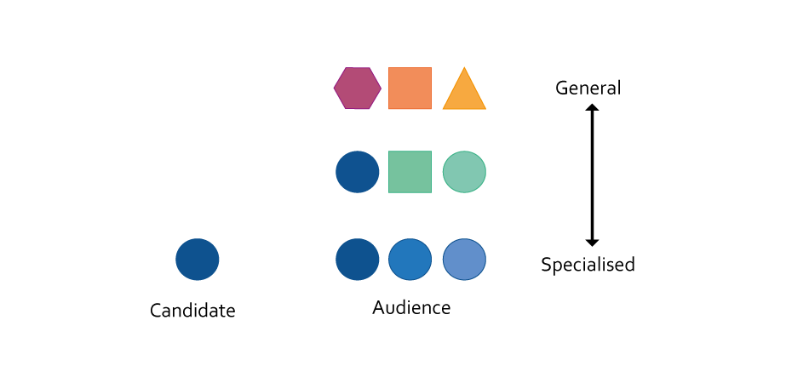
Audience
Making hydrogen fuel for green energy
Platinum nanoparticles electrodeposited on conducting polymer scaffolds
Notes:
Ana
Think about terminology and jargon – appropriate for specialist audiences but not for a general audience. background information important for a general audience to help give them context to your work
Ask if people have upcoming presentations – what’s the context? Who’s the audience?
*add own examples for specialised/general if you like
This example comes from the thesis topic of one of our ex-colleagues who was a research services adviser, and her topic was from science.

Slide 9
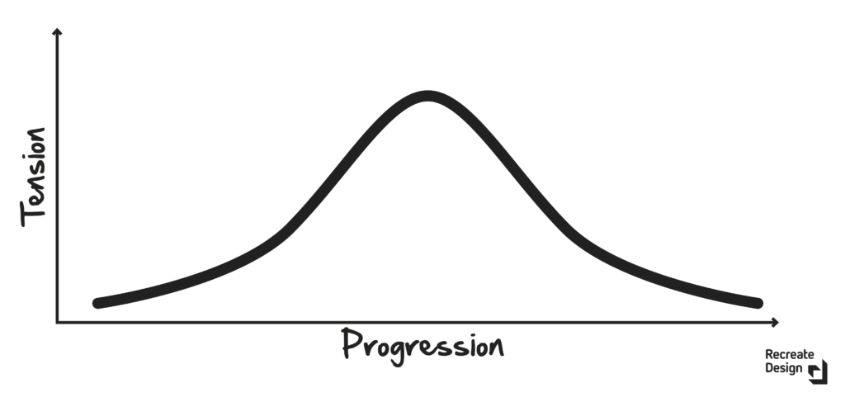
Structure follows a narrative arc
Conclusion
Methodology
& results
Summary
Context, research question
Take home
message
How to Pitch Perfect: Tell a Relatable Story - Recreate Design
Notes:
Ana
In stories – people remember the setup, the climax, and the ending. So make sure you emphasise those three points!
In this case, that means the question or research gap that you are trying to solve, whether you solved it (not the results – that’s evidence for your solution), and your take-home message (which is often how it relates to the big picture).
e.g. using the clean energy example:
Hydrogen fuel is a clean alternative to polluting fossil fuels, but it is expensive to make
I found a way to reduce some of that cost
Cheaper hydrogen fuel means that more people will use it instead of fossil fuels like oil.
The other details (method, results) are just to prove that I’m not making it up! So you don’t need to go into every little detail – just enough for your audience to get a feel for what you’re doing.

Slide 10
Structuring your presentation
Beginning
Hook – grab their attention
Explain the context - set the scene
Describe the specific problem
Outline how you will solve/have solved the problem
Middle
Discuss the main points of your research - aim for 3-5 key objectives or findings
Focus on the details that your audience will be interested in
End
Summarise the presentation
Deliver your take home message
Lead the audience to the next steps
See: Academic presentation structure (University of Hull)
Notes:
Ana
(Probably don’t need to spend too long explaining this slide, most of them know the general structure)
Just another quick emphasis on the three main points during your presentation
The hook
The development
The conclusion

Slide 11

Discussion and questions
Notes:
Ana
Pause for a minute to ask any questions or add any points in to the conversation.

Slide 12
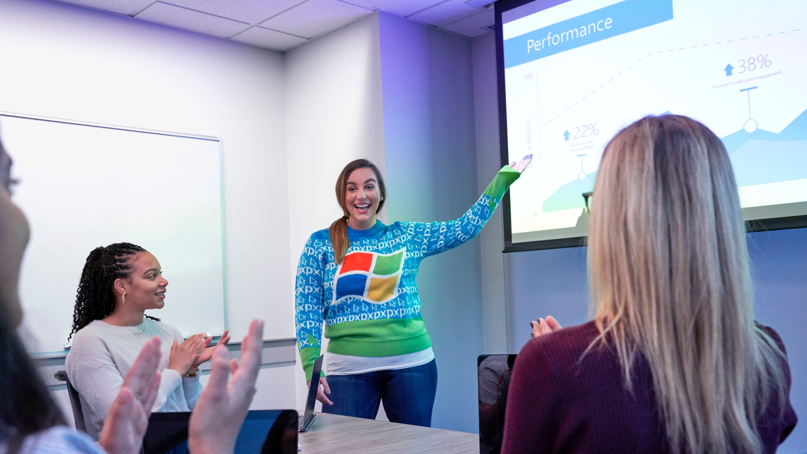
Delivering an engaging presentation
Photo by Windows on Unsplash
Notes:
Dawn - start here

Slide 13
Keeping your audience engaged
How can you keep people interested in your presentation?
How do you know your audience is engaged?
Notes:
Dawn
Discussion prompts
Verbal tricks – relevance, humour, storytelling, clear presentation structure to help people follow along
Visual cues – slide design, graphics, props, (your appearance?)
Interactivity – audience participation, handouts
Body language – stance, movement, eye contact
Vocal – varying your voice, talking slowly, emphasis, pausing

Slide 14
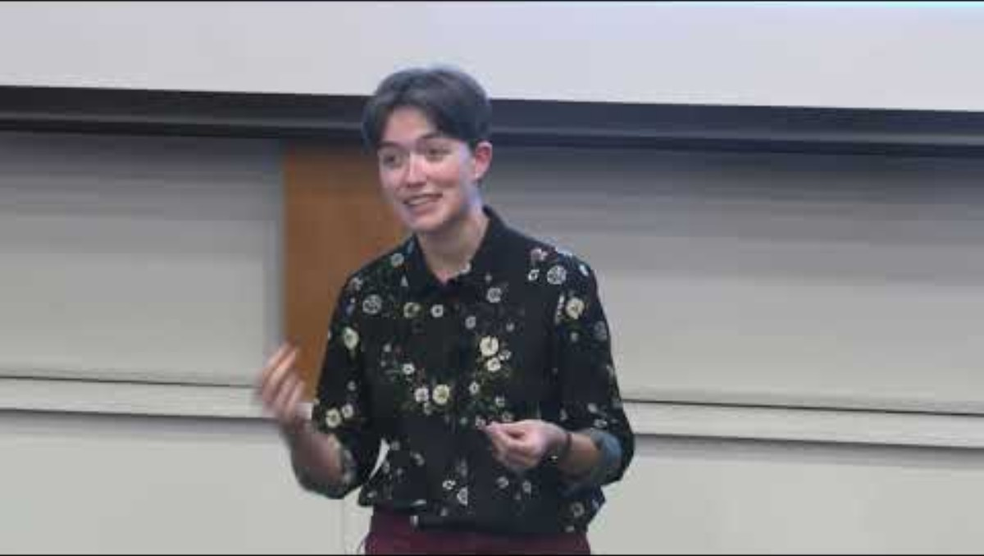
Cam Hoffbeck | UoA 3MT Doctoral Winner 2023
Cam Hoffbeck – University of Auckland 3 Minute thesis 2023 Winner
Notes:
Dawn
Remember that Cam has spent a lot of time working on this talk for the 3 Minute Thesis competition. Your first few tries probably won’t sound so polished!
Get students to give feedback on next slide

Slide 15
What did Cam do well?
Notes:
Dawn

Slide 16

Answering questions
https://pixabay.com/no/sp%C3%B8rsm%C3%A5l-font-hvem-hva-hvordan-2245264/
Notes:
Li
Remember, your audience is interested in your research, not trying to catch you out!
Consider questions that are likely to come up, and how you might answer them. It can help to practice with a friend and see what questions they ask.

Slide 17
Answering questions
Approaching questions!
I know the answer!
I’m glad you asked! The answer is…
We did consider that, but...
I don’t know the answer!
WTF??
That’s a good point! We haven’t looked into that yet…
I don’t know that off the top of my head, but my guess is that…
That’s definitely something to keep in mind…
Perhaps we can meet up afterwards and discuss this?
I’m sorry, I didn’t quite catch that. Are you asking …?
I’m afraid that’s a little outside the scope of this talk...
Notes:
Dawn
Some potential ways to answer questions.
If you need some time to think about the answer, pause and take a breath, or repeat their question.
Remember, “I’m not sure” is an acceptable answer! It’s better to admit you don’t know something, than to make up an answer. Can also hedge if you’re not certain - “I think/believe that…”

Slide 18

Dealing with nerves
Practise, practise, practise
Get there early
Exposure e.g. teaching, join the theatre.
Breathe and pause
Your audience is on your side - look for friendly faces :)
Smile!
See Using your Nerves https://methods-sagepub-com.ezproxy.auckland.ac.nz/book/presenting-your-research/i535.xml
Notes:
Dawn
Even experienced presenters get nervous! Use these tips to help calm your nerves before and during your presentation

Slide 19
Please help us answering a survey

Slide 20

Your research presentation
Photo by Ben White on Unsplash
Notes:
Dawn

Slide 21
Drafting your research presentation
Jot down answers to these questions:
What is your hook?
What background information does your audience need to know?
What question or knowledge gap are you trying to answer?
What have you found? What do you hope to find?
Take-away message - what’s the one thing you want people to remember?
Notes:
Dawn –
Will allow screen sharing in breakout rooms – you can find a website or image to talk to if you like ☺
We’ll answer questions during this time.

Slide 22
Your presentation
Your (long) elevator pitch:
Present your research topic to a peer in a breakout room.
3 minutes to present, followed by 2 minutes for constructive feedback
Constructive feedback:
What they did well
What could make it better?
Notes:
Li – talk to the slide
Ana sets up breakout room
Set up breakout rooms – allow screen sharing if they want. Allow extra minute for prep/handover- 16–17-minute breakout rooms
Zoom:
Get people to think about their research pitch based on the questions the answered prior to the session
Put them into breakout rooms where they are to pitch their research topic to 1 other person (in 3s)
Feedback: I like, I wish. I wonder - may be useful for students?
After breakout rooms, we spend around 5 min in the general room to discuss what they did

Slide 23
Discussion and questions
Notes:
Li
End of the slides for presentation: Li – Ana
Pause for a minute to ask any questions or add any points in to the conversation.

Slide 24

Let’s Talk!
Language learning groups
Improve your English fluency and listening comprehension by talking to people in a friendly welcoming environment!
Our English Language Enrichment facilitators run multiple sessions each week, online and in person.
Register for a Let’s Talk session
Notes:
Dawn

Slide 25
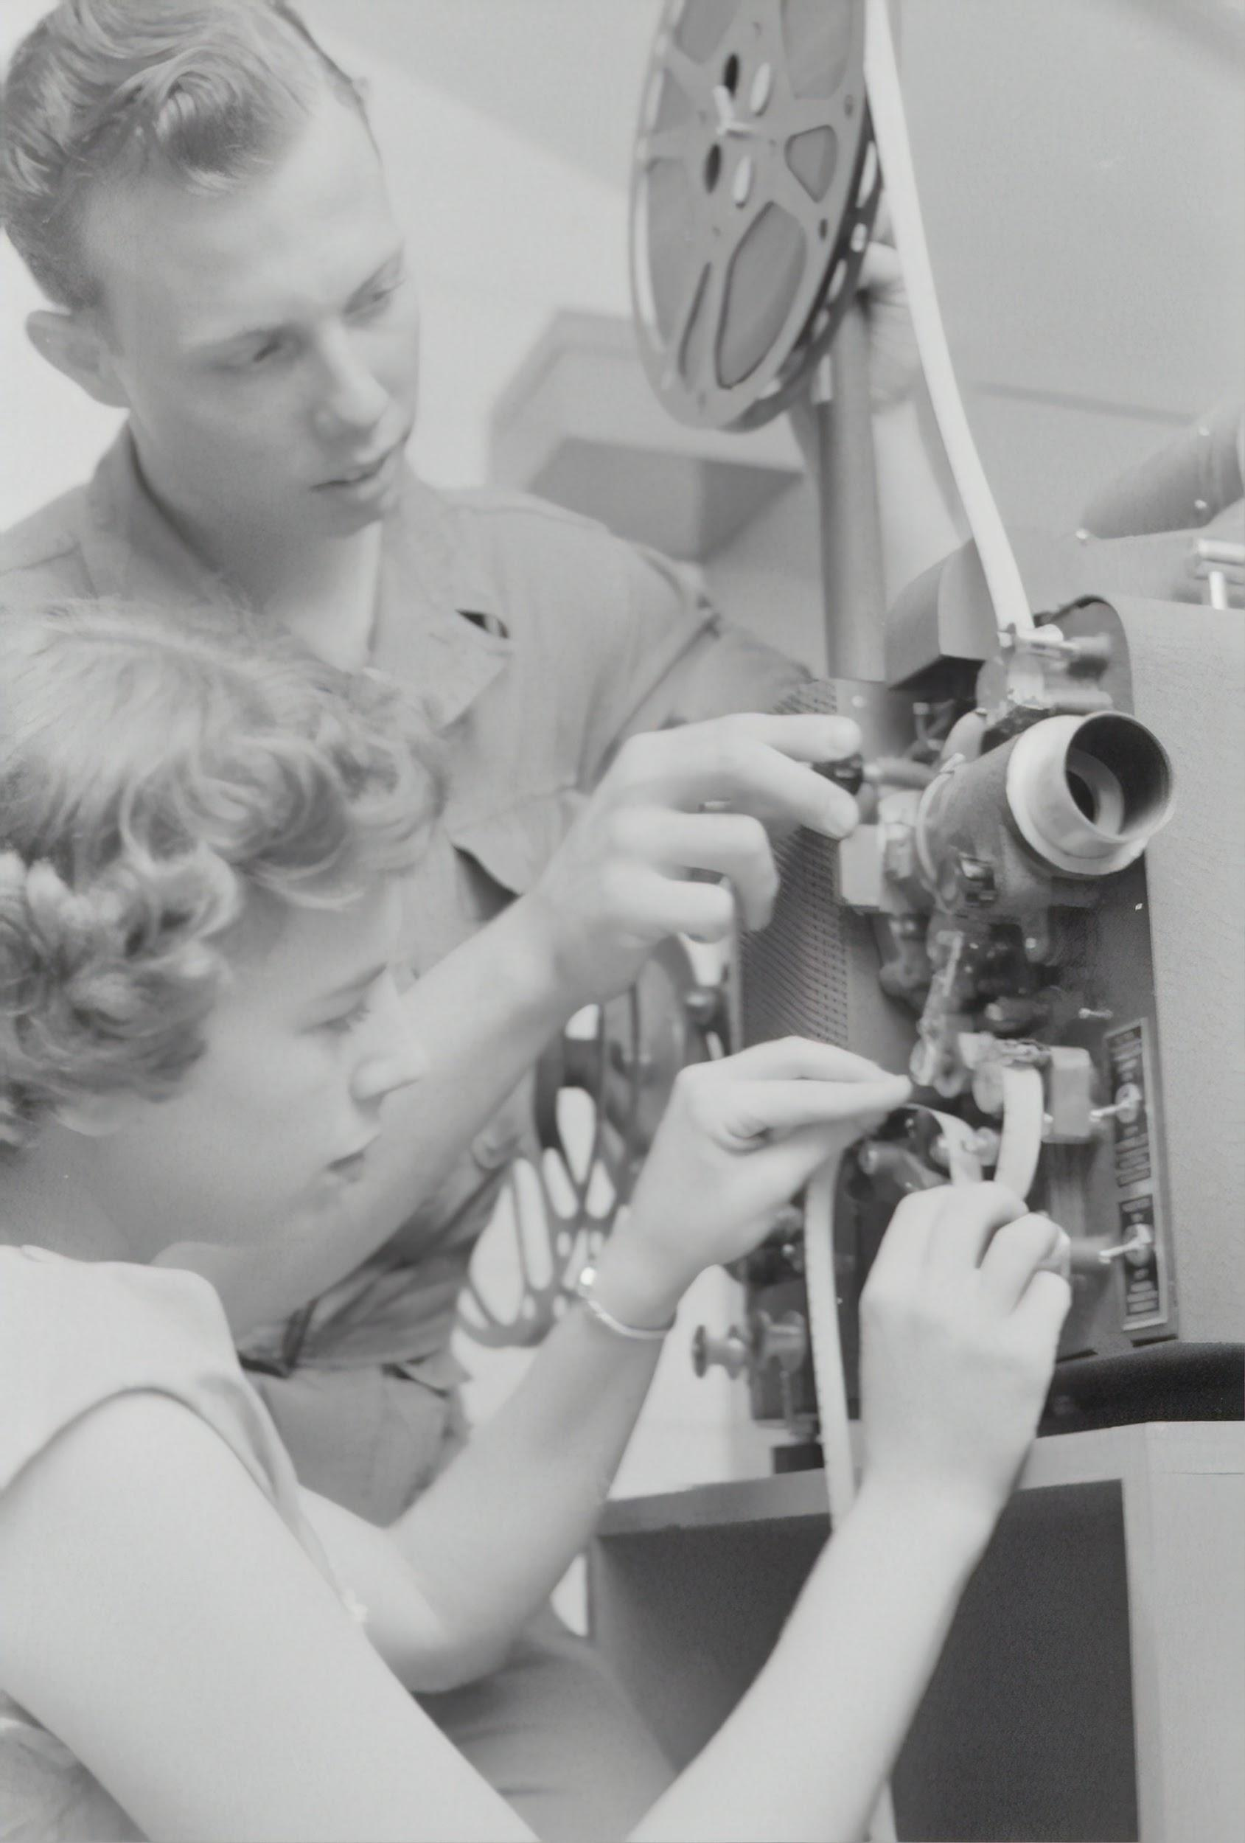
Video resources
Duarte, N. (2011, November). The secret structure of great talks [video]. TED Conferences. https://www.ted.com/talks/nancy_duarte_the_secret_structure_of_great_talks?language=en
TEDx. (2017, June 15 ) . Nat Kendall-Taylor: How words change minds [video] https://www.youtube.com/watch?v=Y8wol2nGSpY
TEDx. (2018, March 18). Will Storr: The Science of storytelling [video]
https://www.youtube.com/watch?v=P2CVIGuRg4E
TEDx. (2020, April 14). Karen Eber: Why storytelling is more trustworthy than presenting data [video]
https://www.youtube.com/watch?v=Ez5yS4Q5ASA
Austrian National Library on Unsplash
Notes:
Ana –
Finally, we want to share with you some interesting and useful resources that we think can be helpful when you’re planning your presentation.

Slide 26
Online/printed resources
Books
Resonate [ebook] and Data Story by Nancy Duarte
Beyond Bullet Points by Cliff Atkinson
Tips for Making Beautiful PowerPoint Presentations
https://www.shutterstock.com/blog/tips-on-how-to-make-effective-beautiful-powerpoint-presentations
Postgraduate Research Skills module
https://canvas.auckland.ac.nz/courses/69130/pages/communicating
ELE (English language Enrichment)
https://www.library.auckland.ac.nz/services/student-learning/ele
Using Te Reo Māori – common phrases and pepeha
https://www.auckland.ac.nz/en/engineering/about-the-faculty/matauranga-maori/te-reo.html
Notes:
Ana

Slide 27
Places to get feedback/experience
Practice with friends/colleagues
Let’s Talk! English Language Enrichment sessions
University events
School of Graduate Studies Research Showcase
Three Minute Thesis competition (3MT)
Faculty seminars and competitions
Teaching and outreach events
Toastmasters
Ingenio Toastmasters
BizTalk Toastmasters
Varsity Toastmasters
Social clubs
e.g. debate teams, improv theatre, roleplaying games…
Notes:
Ana

Slide 28
Free images for your slides
Unsplash
https://unsplash.com/
Pixabay
https://pixabay.com/en/
Pexels
https://www.pexels.com/
Britannica ImageQuest (access through the Libraries and Learning Services website)
https://quest-eb-com.ezproxy.auckland.ac.nz/
Noun Project
https://thenounproject.com/
Notes:
Ana

Slide 29
Thank you!

