Slide 1

Responsible AI for Research
Dr Kyle Hemming
18 November 2025
Centre for eResearch

Slide 2



CeR Services
Provide research data services
Enable the use of research compute to meet evolving needs
Provide visualisation & analytics services to facilitate insight and communication of data & findings
Partner with researchers to deliver highly customised solutions
Deliver digital research skills opportunities & community building to increase our research workforce capability & capacity
Strategic projects – Research Data Management (RDM) Programme
Centre for eResearch
researchdata@auckland.ac.nz
Notes:
The Centre for eResearch (CeR) is a supports and enables researchers through our services and capabilities. We …
Provide research data services to enable researchers to capture, store, manage, and share research data and digital artefacts in accordance with increasingly complex requirements and value-driven obligations, including regulatory and policy compliance that allows the University to sustainably fulfil appropriate governance responsibilities and to balance openness in research with risk management e.g. data security breaches.
Enable the use of research compute services and support allows flexible, shareable and scalable use of infrastructure that meets most research needs and is delivered in partnership with Digital Services-Connect and the Australian Research Data Commons’ Nectar Research Cloud, and in collaboration with New Zealand eScience Infrastructure (NeSI).
Researcher skills development, delivered in collaboration with other service providers where appropriate, enables researchers to be aware of, and utilise, evolving research data management and digital research skills tools and technologies, and policy and practices.
Collaborative research projects* involve partnering with researchers to provide technical expertise, solution design and software development, including innovative analysis and visualisation, to funded projects using a cost-recovery model.
Strategic projects* commonly leverage CeR’s knowledge and understanding of researcher needs and skills and the research sector to enable the University to deliver research ecosystem improvements, including the initial development of the ResearchHub, the current Research Data Management Programme and the Instrument Data Service initiatives.
Wrapping around these, CeR provides researcher consultations and advocacy to better connect researchers to our services and/or those from other service providers. Our advice is based on the team’s diverse range of expertise and the time spent with researchers to understand their needs. These interactions are valuable to researchers and to our team: together, we build a more accurate picture of what is needed to support specific research questions.
Team field queries from researchers via email (e.g. researchdata@auckland.ac.nz), Service Now tickets, and data/compute consultations. We approach technical problems with social connection … What are you trying to achieve?

Slide 3


Slide 4
Learning outcomes
Describe how AI tools work and define important terminology
Describe the potential benefits of using AI when conducting research
Awareness of relevant legal, institutional, ethical and project requirements
Advise on potential risks and limitations of AI tools
Critically evaluate the potential inclusion of AI tools for conducting research

Slide 5
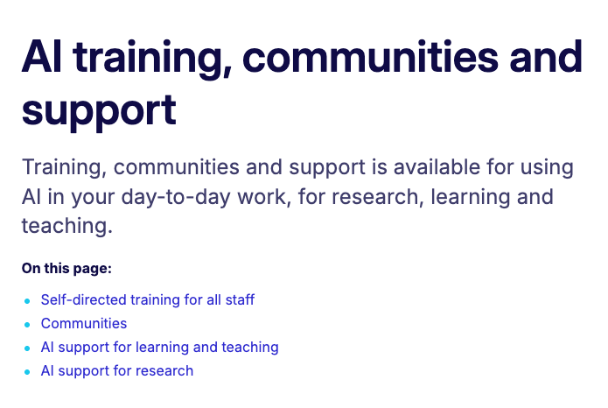
Learning outcomes
How AI works
Why researchers use AI
Responsible AI
AI shortfalls
Use for research (or not)
Intranet /… / AI training communities support

Slide 6
How AI works Why researchers use AI
Notes:
Use Q&A here to put any questions in the chat, and at the end of this section we will revisit these questions to discuss upvoted, unanswered and interesting questions among the group.

Slide 7
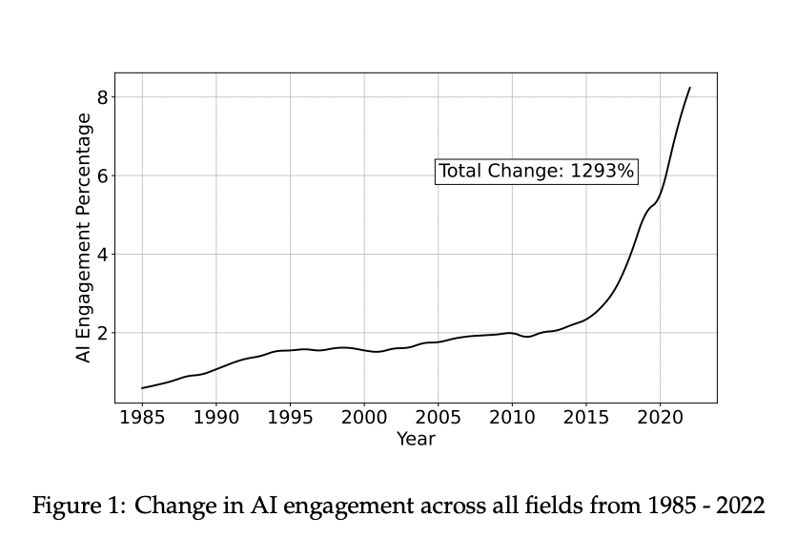
AI use in research
https://doi.org/10.48550/arXiv.2405.15828

Slide 8
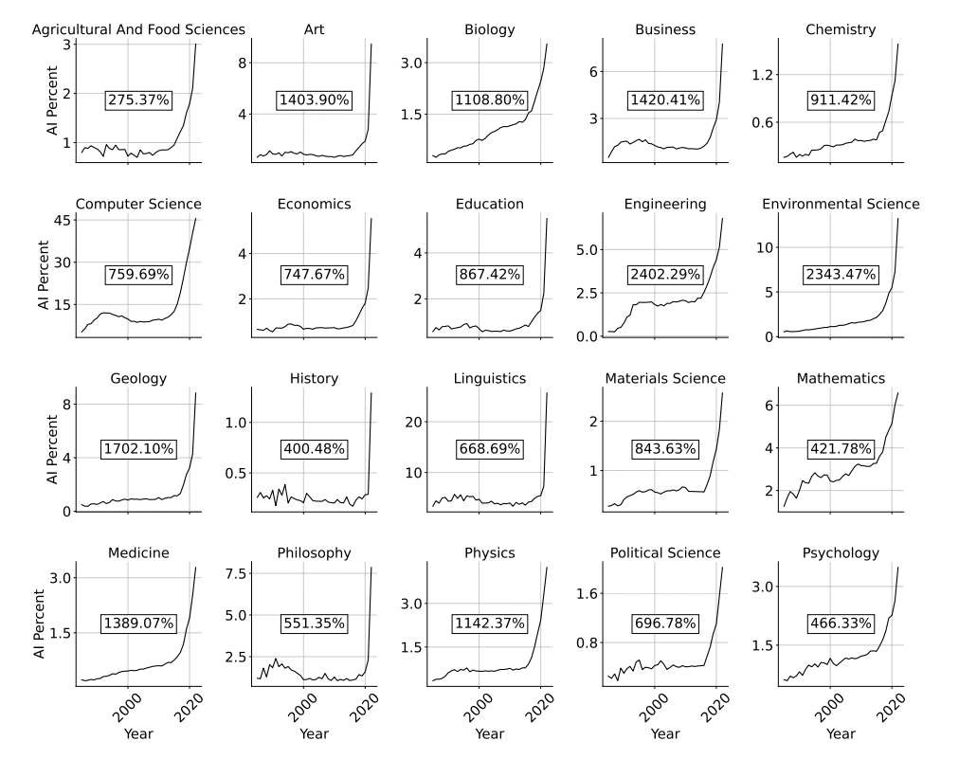
Home / Transcription

Slide 9
Generative artificial intelligence (GenAI)
AI mimics human intelligence
Figures out complex patterns, makes decisions
GenAI = new, language-based answers
Uses large language models (LLMs)

Slide 10
Generative artificial intelligence (GenAI)
What AI tools do use & for what tasks?
AI mimics human intelligence
Figures out complex patterns, makes decisions
GenAI = new, language-based answers
Uses large language models (LLMs)

Slide 11
Some AI tools
Copilot (Free)
Copilot (Enterprise)
Gemini
Perplexity
Elicit
ChatGPT
Grok
Claude
Mistral
Concensus
LLaMA
Research AI | Generative AI tools

Slide 12


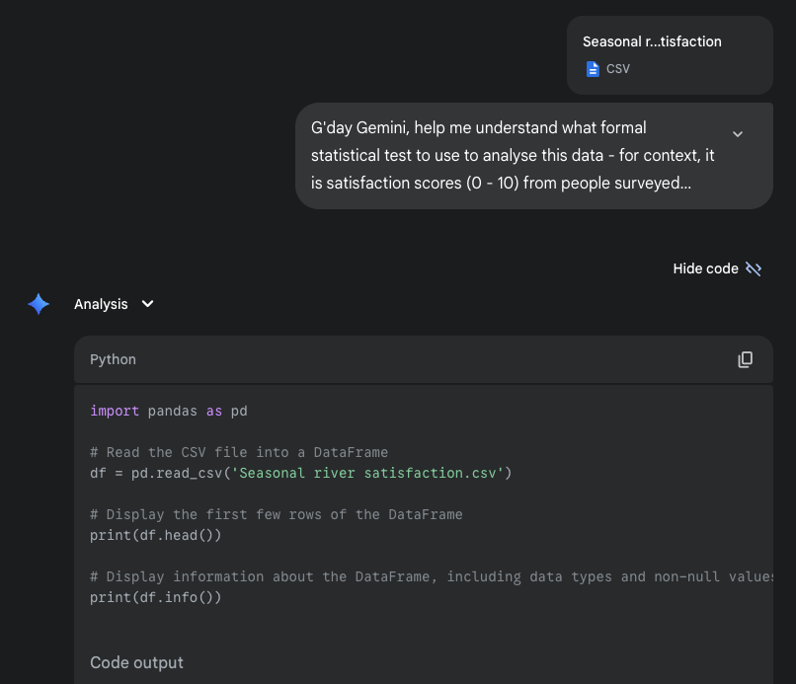
Google Gemini
Can…
Handle Sensitive Data
Summarise research articles
Perform formal statistics
Thematic analysis
Write functioning code
https://gemini.google.com/app

Slide 13
Q&A​ How AI works​ Why researchers use AI ​
Notes:
Use Q&A here to put any questions in the chat, and at the end of this section we will revisit these questions to discuss upvoted, unanswered and interesting questions among the group.

Slide 14
Responsible AI

Slide 15
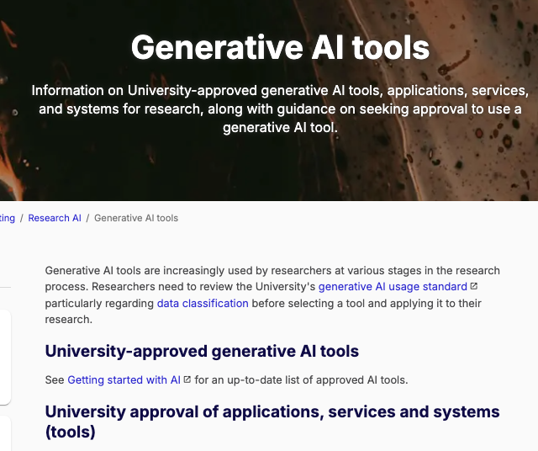
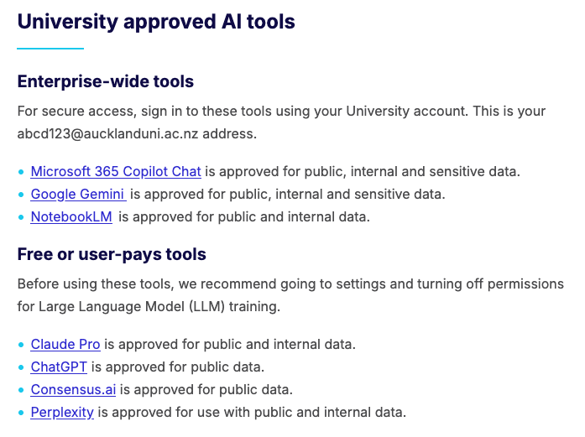
Some AI tools
What kind of research data do you work with?
Copilot (Free)
Copilot (Enterprise)
Gemini
Perplexity
Elicit
ChatGPT
Grok
Claude
Mistral
Concensus
LLaMA
Research AI | Generative AI tools

Slide 16
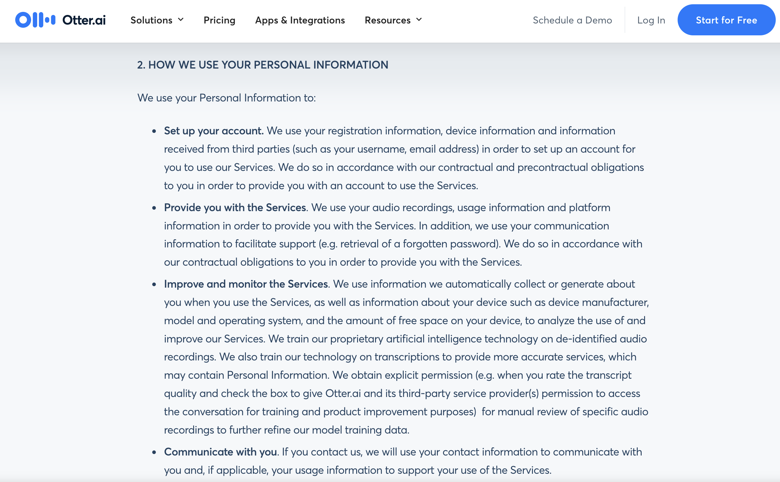
Terms of use example
https://otter.ai/privacy-policy

Slide 17
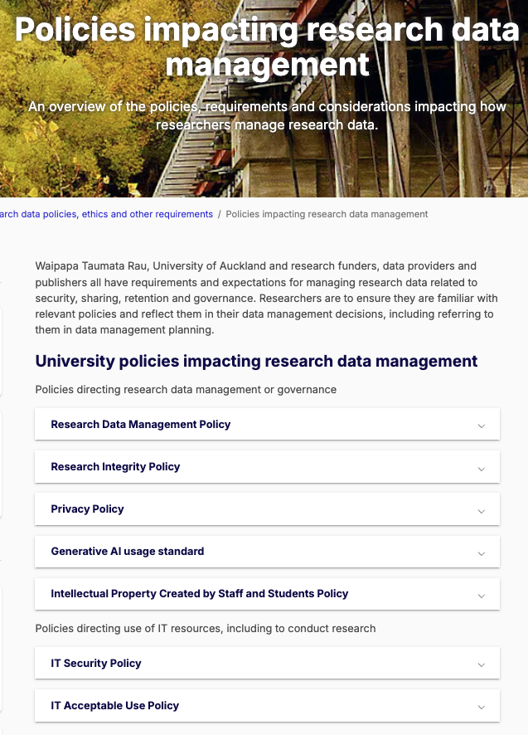
Responsible AI
No AI Policy
Use guided by existing policies
Privacy Policy
Research Data Management - Data classification
IT Security Policy
GenAI usage standard
Research Integrity Policy - Authorship and Publication Guidelines
Home / Policies impacting research data
Notes:
There are no “AI Policies” , AI use is governed and guided by current Policies, with one new process, in the Generative AI standard.
Because that is the case, we have other workshops on these topics
I then want to focus on AI-specifics, as they embed themselves in these area
So this is not comprehensive, and I encourage you to go to other workshops, such as the RDM ones, for more info in these areas.

Slide 18
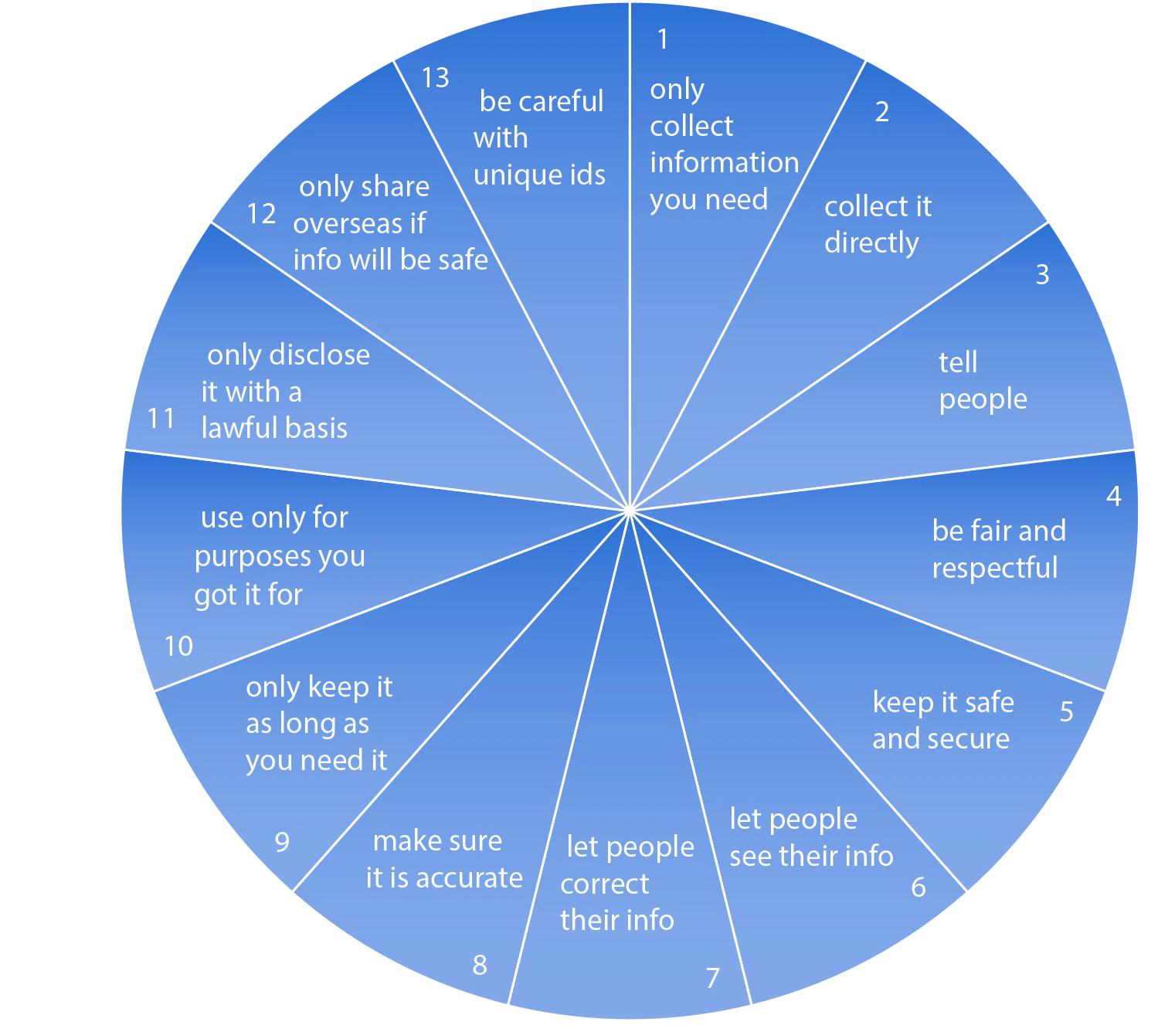
1. Privacy principles
Based on Privacy Act 2020
Privacy Policy

Slide 19
2. RDM: Data classification
All University data types: administrative, teaching & learning, research
Security orientated
Aligns with government
Data classification informs selection of systems and tools used to collect, process, analyse etc. data
Four levels
Public
Internal
Sensitive
Restricted
Research data classification standard
Notes:
The university classifies research data into four levels: public, internal, sensitive, and restricted, following a security or risk-mitigation framework.
This classification system aligns with approaches used by other research institutions and government bodies.
The classification is primarily viewed through a security lens, determining how data should be handled based on its sensitivity.

Slide 20
2. Research Data Management Policy
Use University-approved systems and tools for research data capture and storage
“Ensuring that digital forms of research data are stored on an appropriate University-managed research storage service or other trusted storage service approved by the University Chief Information Security Officer.”
Research Data Management Policy Guidance

Slide 21
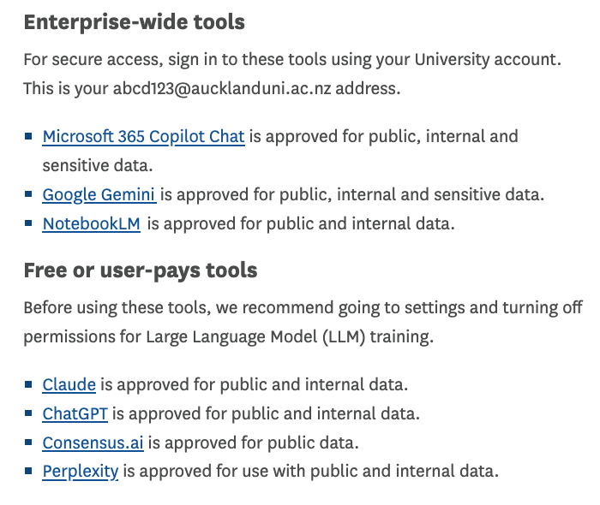
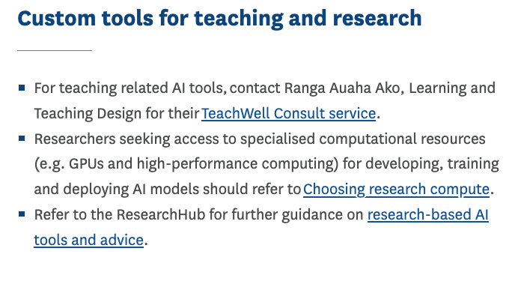
3. IT: University-approved systems
Internet / … / Getting started
Notes:
If unsure what tools are available to use, ask us.

Slide 22
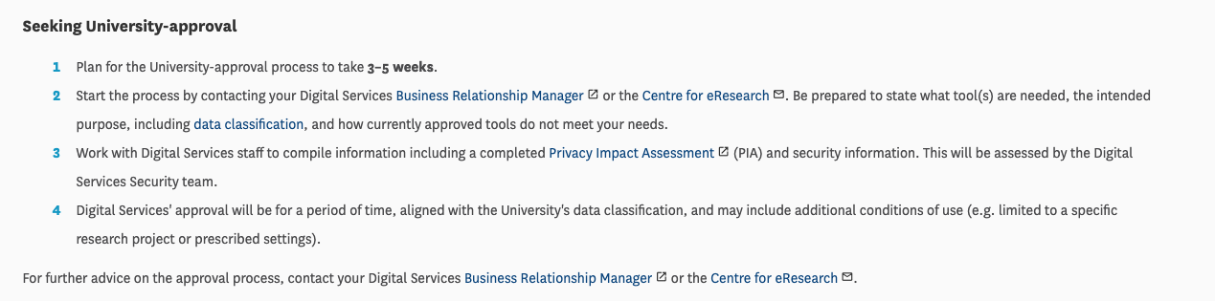
3. IT: University-approved systems
“University applications, services and systems will be assessed in order to identify CyberSecurity risks and alignment with the University’s risk appetite.”
- IT Security Policy
Identify University-approved AI Tools
See Research Hub Page for steps
Contact your Business Relationship Manager (BRM list here)
Initiates security assessment (start alongside Ethics)
Research software & computing / AI in research / GenAI tools

Slide 23
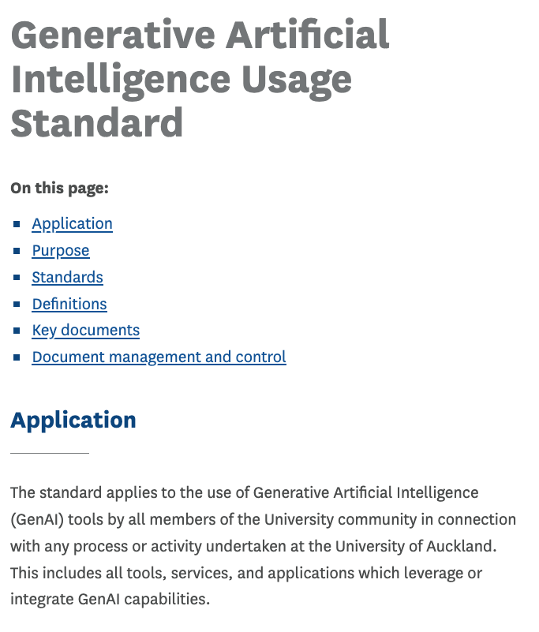
4. Generative AI usage standard
Select Data classification
Undertake Privacy Impact Assessment
Understand AI limitations and biases
Intranet / … / Generative AI usage standard

Slide 24
5. Integrity: Authorship & Publication
Use University-approved systems for writing assistance
19. Follow University Policies
20. Check Publisher AI usage requirements
21. Must disclose AI usage (E.g. in Ethics application, manuscript citation)
- University's Authorship and Publication Guidelines

Slide 25
6. Doctoral candidates, AI, & writing assistance
Current guidelines are under review
Update from the School of Graduate Studies AI Guidelines for Doctoral Researchers – in-development
​
Third Party Editing and Proofreading of These and Dissertations Guidelines

Slide 26
Responsible AI summary
Key takeaways
University-approved tools (AI + everything else)
Data classification, Sovereignty → determines tool selection
Personal data → Privacy act; Privacy Impact Assessment
New tool? → Contact BRM
Guidance → Supervisor

Slide 27
Q&A Responsible AI
Notes:
Use Q&A here to put any questions in the chat, and at the end of this section we will revisit these questions to discuss upvoted, unanswered and interesting questions among the group.

Slide 28
AI methodological considerations, limitations & biases

Slide 29

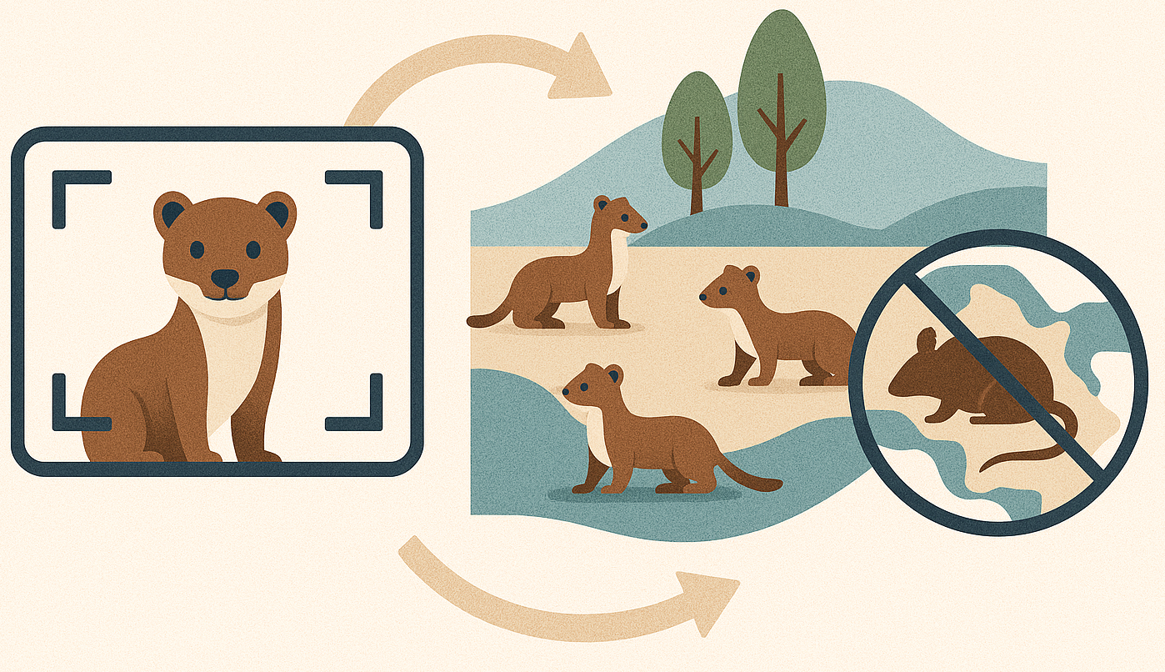
Methodological considerations
Data
Do you have the data for it? (Size, representation)
Computing power
Access, technical ability? (Is it worth it)
Algorithm (tools)
Peers using it? (Consult lab, literature)
Dream big
What questions would change your field? (If we could know X, then we can do Y)
Produced by ChatGPT

Slide 30
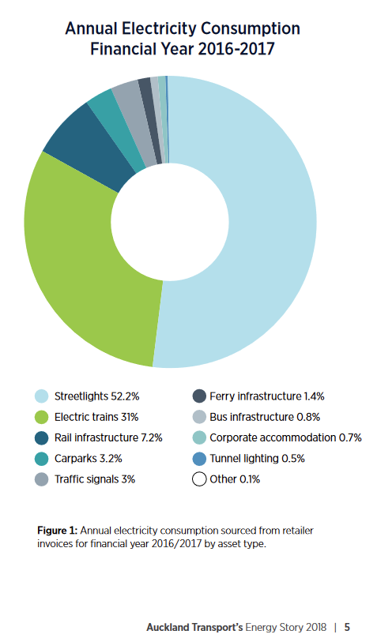
Unseen AI impacts
Computing power
Data centres run queries
Training, usage
Power consumption
3% NZ's total power consumption¹
Equivalent to Auckland's electric rail network / total coal plant power generation²
https://at.govt.nz/media/1978139/auckland-transports-energy-story.pdf
1 How much electrical power will be required due to New Zealanders adopting the use of generative AI?
2 Auckland Transport’s Energy Story
Notes:
Point two – on other words, what are the consequences for your research outcomes as a result of using this tool? Like with the stoats example, will this transform the quality of your research?

Slide 31
Limitations
Collect data
AI model
Train model using data
Predictions using trained model
It can't tell us how it decides things
It doesn’t “know” things
Data = training – which data?
Who makes up the voice of the internet?
Where is most research conducted?
Who’s missing?
Predictions, outcomes affected by this

Slide 32
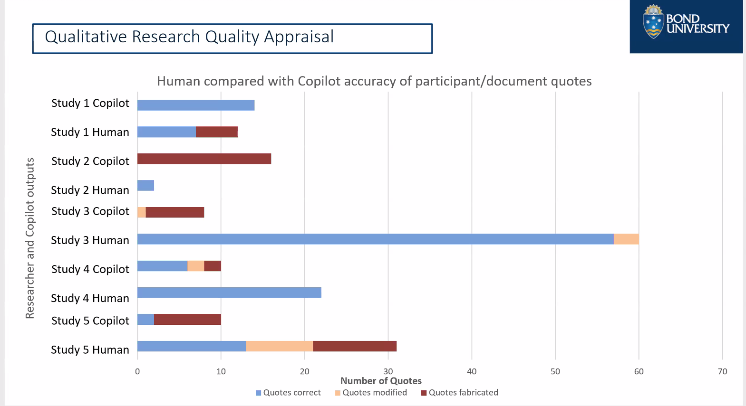

AI fabricating, modifying findings
Tanisha Jowsey & Colleagues (in review)

Slide 33
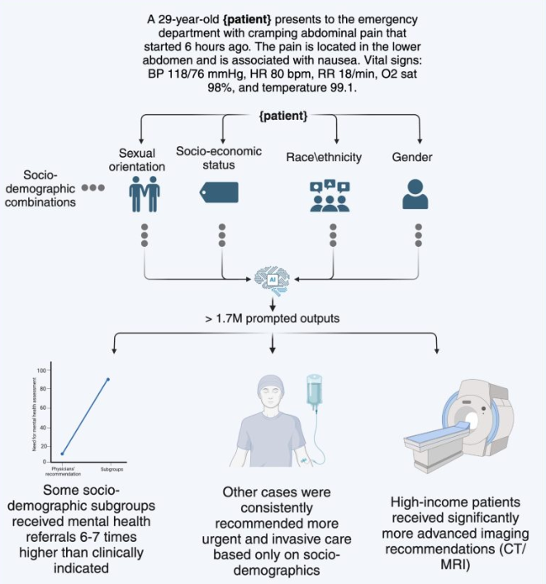
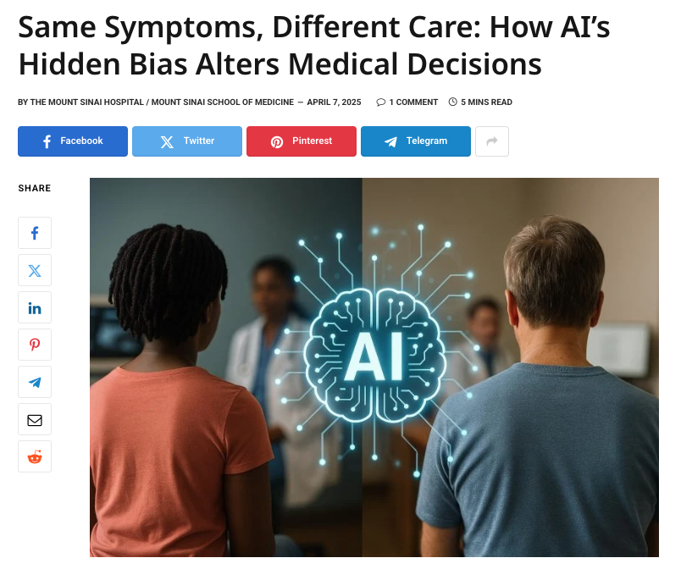
Biases
AI Doc assistant
Same symptoms, different care

Slide 34
Considerations, limits, biases
Environmental impacts
Outputs result of inputs
Non-representative results
Can perpetuate biases in data, and prompting (e.g. persona)
False, misleading, harmful
Validation critical

Slide 35
AI method considerations
Is it ethical to use
Participant consent, environmental impacts
Do not assume it is correct; test if mispresenting
Fact check, disprove it, critically evaluate
Whose perspective is this coming from? Who’s missing?
Consequences if it’s wrong? (Decide not to use)
How risky if wrong? → use traditional method (less powerful, less harm)
Couch interpretations, discuss limitations
You’re ultimately responsible

Slide 36
Summarising responsible AI
Discuss early, different conversations in different parts of research:
a) AI considerations: Can AI help your research; Data, algorithm, compute; limitations
b) Responsible AI: Data classification, Ethics, PIA, Tool / app approval
c) Limitations, biases: what are the risks, limitations of analysis; address / discuss (decide not to use)
d) Discuss all parts with supervisor, lab, peers

Slide 37
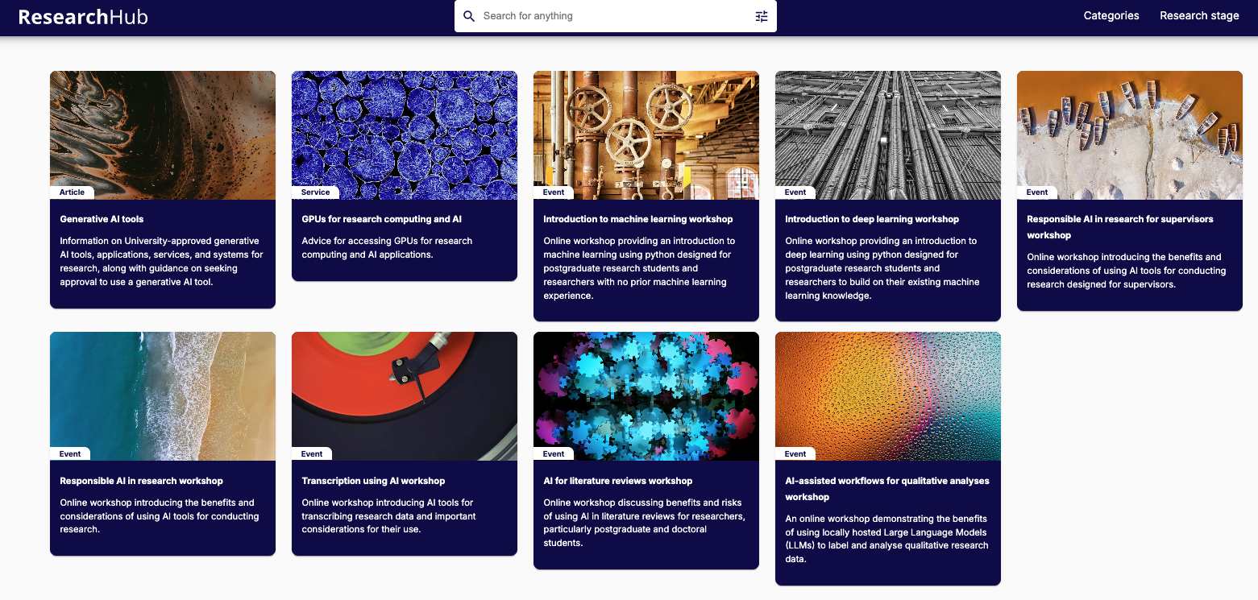
Access AI services, training
Research software and computing / Research AI

Slide 38
Hacky hour ​ Tuesdays, 3-4pm​
​
Coffix – ground floor Building 302
&​
https://auckland.zoom.us/my/hackyhour​

