Slide 1
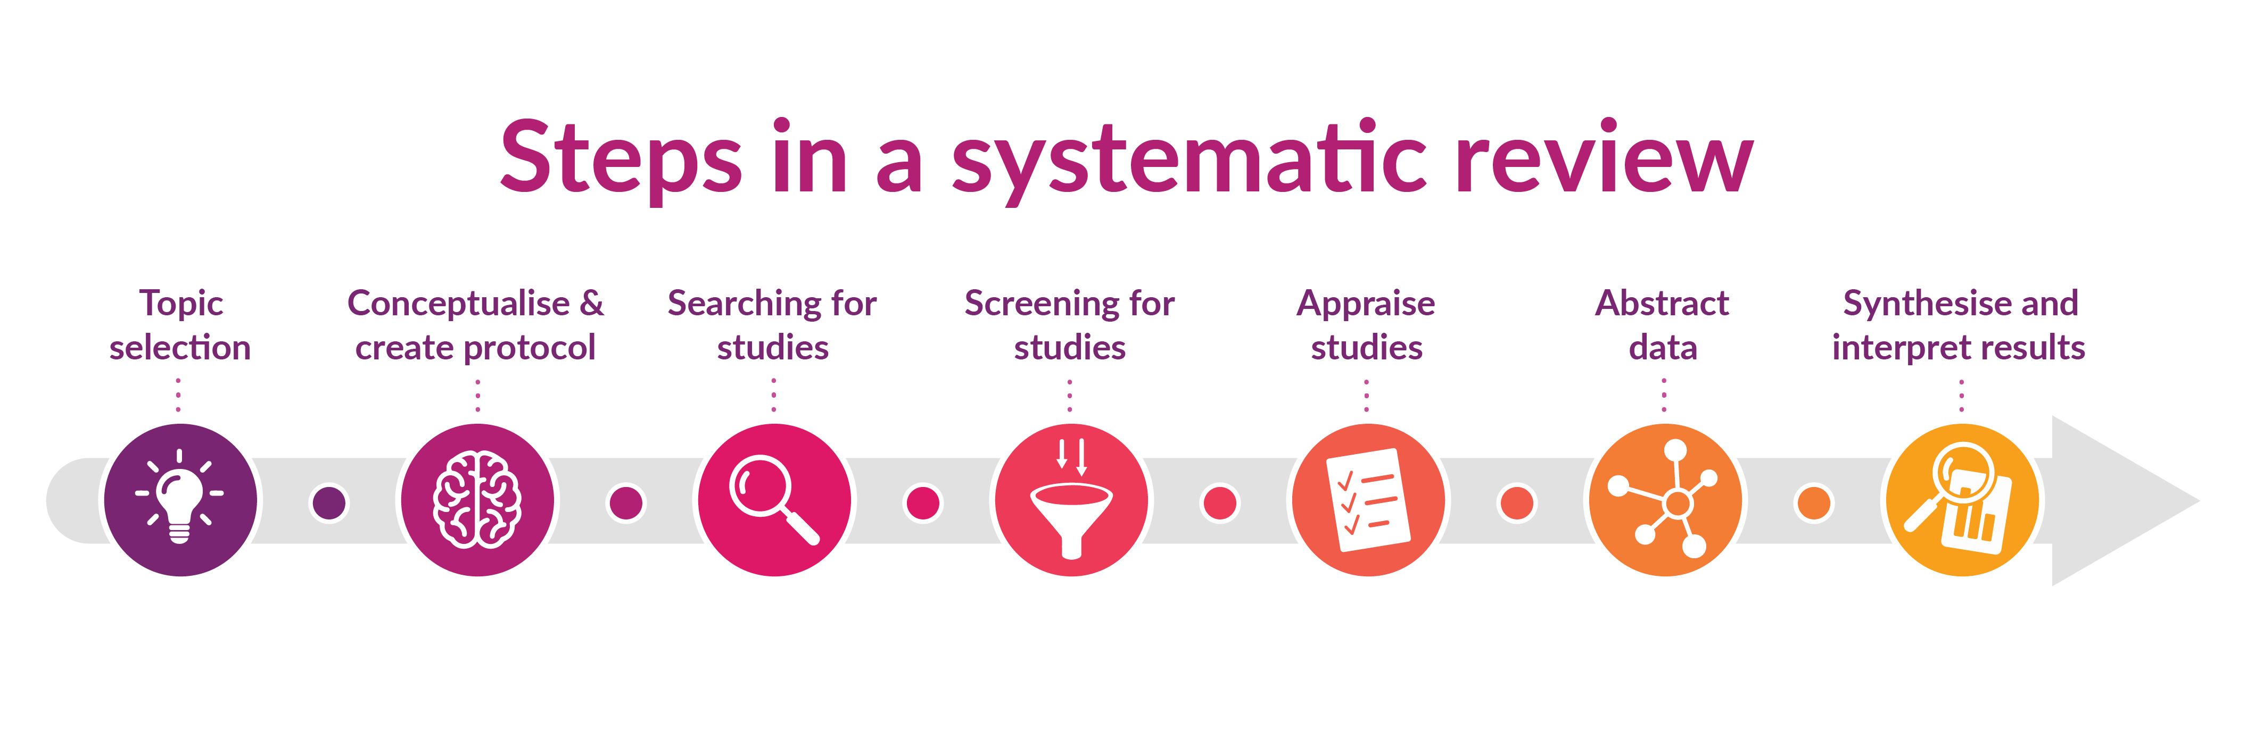

Understanding Systematic Reviews Workshop
Creative Commons BY SA
Illustration created by Karolinska Institutet University Library.
Notes:
Kia ora and welcome – introduce presenters and give some background of our expertise, knowledge.

Slide 2

Which Faculty are you from?
Notes:
Quick whanaungatanga activity – raise hands / share in the chat. SR support is supposed to be across all disciplines so see who is in the room.

Slide 3







Workshop Objectives
Which review type is right?
Systematic review process
Research question & framework
Develop your protocol
Build your search strategy
Run your search strategy
The next steps
Notes:
How to decide which review suits your research.
How to convert your research question into a search framework (e.g., PICO).
What to include and where to submit your protocol.
How to convert your search framework into a systematic search strategy.
How to apply your search strategy to databases.
The next steps.

Slide 4
Review types
Notes:
When conducting research, it's crucial to align your methodology with the specific type of review you're undertaking. Various types of reviews exist, each with its own distinct methodology. Ensuring that your research methodology matches the requirements of the chosen review type is essential for maintaining rigor and validity in your study.

Slide 5

Literature/Narrative Review
Select a topic
Identify appropriate places to search
Search for sources
Read, analyse, critique
Write the review
Useful for:
Providing an overview of main theories and hypotheses, appropriate methods and methodologies, and key findings.
Showcasing the key authors/researchers on a topic.
Identifying knowledge gaps.
Limitations:
Bias Risk: Susceptibility to the reviewer's biases or perspectives.
Lack of Rigor: Absence of a structured methodology can lead to a less systematic approach.
Limited Scope: May not encompass the entire breadth of available literature due to selective inclusion.
Timeframe:
1 to 6 weeks
Further Reading:
Ferrari, R. (2015). Writing narrative style literature reviews. Medical writing, 24(4), 230-235
Jones, B. (2007). Ask the Professor about... good literature reviews
Notes:
Literature narrative reviews provide a qualitative synthesis of existing research, offering a descriptive overview of a topic without employing a systematic methodology. They focus on summarizing and discussing the key findings, themes, and debates within a field of study, often providing valuable insights and interpretations. However, they are prone to subjectivity and bias due to the lack of a systematic search and selection process.

Slide 6
Integrative Review
Problem identification
Literature search
Data evaluation
Data analysis
Presentation
Useful for:
Informing policy and processes​.
Defining concepts​.
Reviewing theories​.
Analysing methodological issues​.
Limitations:
Resource Intensity: Conducting comprehensive reviews is time and resource-demanding.
Publication Bias: Reliance on published literature might overlook unpublished studies.
Synthesis Challenges: Diverse methodologies can make synthesizing findings difficult.
Timeframe:
2 months to 2 years
Further Reading:
Dhollande, S., Taylor, A., Meyer, S., & Scott, M. (2021). Conducting integrative reviews: A guide for novice nursing researchers. Journal of Research in Nursing, 26(5), 427 438
Whittemore, R., & Knafl, K. (2005). The integrative review: updated methodology. Journal of advanced nursing, 52(5), 546-553.
Notes:
Integrative reviews go beyond summarizing existing literature by synthesizing diverse sources to generate new insights or frameworks. They aim to integrate findings from various disciplines or methodologies to provide a comprehensive understanding of a topic. By examining connections between different studies, integrative reviews offer valuable perspectives and contribute to the development of new theories or models.

Slide 7
Rapid Review
Problem identification
Research question definition
Searching & filtering
Assessment
Screening of studies
Synthesis
Overview:
Is a variation of a systematic review but balances time constraints with considerations in bias.
Can exclude hand searching and grey literature.
May apply limits such as years and language.
Can be done Individually or a group.​
Limitations:
Reduced Depth: Limited time may compromise the depth of analysis.
Potential Bias: Quick turnaround might increase the risk of bias or oversight.
Quality Compromise: Rapid reviews might sacrifice thoroughness, affecting overall quality.
Timeframe:
2 months to 6 months
Further Reading:
Dobbins, M. (2017). Rapid review guidebook. Natl Collab Cent Method Tools, 13, 25.
Garritty, C., et al (2021). Cochrane Rapid Reviews Methods Group offers evidence-informed guidance to conduct rapid reviews. Journal of clinical epidemiology, 130, 13-22.
Notes:
Presenter One - Rapid reviews streamline the systematic review process to produce evidence in a shorter timeframe. They prioritize efficiency by employing abbreviated methods such as limiting the scope of the review, using accelerated search strategies, and reducing data extraction and synthesis time. While sacrificing some depth, rapid reviews offer timely evidence synthesis to inform urgent decision-making or address time-sensitive research questions.

Slide 8
Scoping Review
Define topic, objective and sub-questions
Develop a protocol
Apply PCC framework
Conduct systematic searches
Screen studies for eligibility criteria
Extract data
Write up
Useful for:
Examining a body of literature that has not been comprehensively reviewed.
Identifying or clarifying key concepts or definitions.
Seeing how research is conducted on a topic​.
Limitations:
Lack of Detailed Analysis: Focuses on breadth rather than depth, potentially limiting in-depth analysis.
Inclusion of Varied Evidence: Due to inclusivity, the quality and heterogeneity of studies might vary widely.
Potential for Bias: Inherent subjectivity in selection and analysis may introduce bias
Timeframe:
6 months to 18 months
Further Reading:
Peters MDJ, Godfrey C, McInerney P, Munn Z, Tricco AC, Khalil, H. Scoping Reviews (2020). Aromataris E, Lockwood C, Porritt K, Pilla B, Jordan Z, editors. JBI Manual for Evidence Synthesis. JBI; 2024.
Notes:
Presenter One - Scoping reviews aim to map the existing literature on a broad topic, identifying key concepts, sources, and knowledge gaps. They provide a preliminary overview of a research area without necessarily synthesizing or assessing the quality of included studies. Scoping reviews are valuable for clarifying the scope of a field, identifying relevant research questions, and informing the design of future systematic reviews or primary research studies.

Slide 9
Quantitative Systematic Review
Overview:
Seek to answer a specific question with narrow parameters. Often look at interventions or treatments.
Useful for:
Confirming current practices
Guiding decision-making
Informing future research
Limitations:
Time and Resource Intensity: Conducting thorough systematic reviews can be time-consuming and resource-intensive.
Heterogeneity of Studies: Variability in methodologies across included studies can complicate synthesis.
Inherent Bias: Despite systematic approaches, biases in study selection and analysis can still exist.
Timeframe:
8 months to 2 years
Further Reading:
Borah, R., et al (2017). Analysis of the time and workers needed to conduct systematic reviews of medical interventions using data from the PROSPERO registry. BMJ open, 7(2)
Higgins JPT, et al. Cochrane Handbook for Systematic Reviews of Interventions version 6.4 (updated August 2023). Cochrane, 2023.
Notes:
Presenter One - Systematic reviews meticulously gather, appraise, and synthesize all relevant evidence on a specific research question. They follow a rigorous methodology to minimize bias and provide robust conclusions. Systematic reviews are considered the gold standard of evidence synthesis, offering comprehensive insights that inform decision-making in various fields, including healthcare, social sciences, and policy-making.

Slide 10
Qualitative Systematic Review
Overview:
A qualitative systematic review combines and analyses qualitative research on a specific topic. This helps to understand the experiences, perceptions, beliefs, behaviors, and social processes of individuals or groups.
Useful for:
Aims to understand the meaning and context behind human experiences and phenomena.
Limitations:
Variability in study designs, contexts, and methods included makes comparison and synthesis challenging.
Thematic synthesis and interpretation take a lot of time and effort.
Synthesising diverse perspectives requires careful interpretation.
Timeframe:
8 months to 2 years
Further Reading:
Melián, E., Reyes, J. I., & Meneses, J. (2023). The Online PhD Experience: A Qualitative Systematic Review. International Review of Research in Open and Distance Learning, Bulter, A.,et al. (2016). A guide to writing a qualitative systematic review protocol to enhance evidence-based practice in nursing and health care. World views on Evidence-based Nursing, 13(3), 241-249.
Notes:
Presenter One - Systematic reviews meticulously gather, appraise, and synthesize all relevant evidence on a specific research question. They follow a rigorous methodology to minimize bias and provide robust conclusions. Systematic reviews are considered the gold standard of evidence synthesis, offering comprehensive insights that inform decision-making in various fields, including healthcare, social sciences, and policy-making.

Slide 11
Systematic review process
Notes:
Helena - The next section we will be discussing will be the process in general.

Slide 12

Purpose of a Systematic Review
Systematic reviews aim to identify, evaluate, and summarize the findings of all relevant individual studies over a health-related issue, thereby making the available evidence more accessible to decision makers.
Gopalakrishnan, S., & Ganeshkumar, P. (2013). Systematic Reviews and Meta-analysis: Understanding the Best Evidence in Primary Healthcare. Journal of family medicine and primary care, 2(1), 9–14.
Notes:
The purpose of a systematic review is to provide a comprehensive and unbiased summary of the existing evidence on a particular research question or topic. It involves systematically identifying, appraising, and synthesizing all relevant studies to answer a specific research question. By following a rigorous and transparent methodology, systematic reviews aim to minimize bias and provide reliable evidence to inform decision-making in various fields, including healthcare, social sciences, and policy-making. They are often considered the highest level of evidence in evidence-based practice because they offer a synthesis of multiple studies, providing a more robust foundation for drawing conclusions and making informed decisions.

Slide 13
Systematic Review Steps
Library Support
Creative Commons BY SA Illustration created by Karolinska Institutet University Library.
Notes:
This graphic outlines the basic steps of a systematic review – there are a few more steps than your traditional literature review (talk through the steps).
The Systematic Review Timeline
The Protocol – What is it?
Publishing a protocol – We look over the protocol for them. Just an extra set of eyes
What library support!!!!
As for where you can receive library support -you can see we have highlighted the spaces where the library can offer support and advice on your review. While we can help guide you on the selection of a review type, your final topic selection or the development of a research question is something your supervisor or team should support you with. The same with screening for studies, we can recommend some tools to help you with the process, but the library does not complete the screening on your behalf.
What we can help with, is getting your protocol ready for submission – a big part of this is actually developing the search strategy and search plan. A protocol is a declaration of what you intend to do in your review. If you include a search strategy or plan, it's best practice follow that as closely as possible in your actual review. If you are planning to submit a protocol, it can actually be really helpful to nail down the search strategy early on so you don't have to re-do the work in your review or justify why changes were made after the protocol was submitted.
And of course, searching for studies. This is really where our expertise is so please make use of the resources we offer.

Slide 14

Systematic Review Timeline
Develop and register a protocol
Data analysis and interpretation
Peer Review
Perform searches
Data extraction
Define a research question
Database selection and plan search
Screen results
Data appraisal
Write and publish
Notes:
So another quick graphic for you here, if we think about the steps of a systematic review, this is a nice estimate of how long each of those steps should take you – roughly adding up to 12 months.

Slide 15

What questions to ask yourself
Do you have a team?
Is your topic new?
Do you have statistical support?
Do you have time?
Image made by Freepik from www.storyset.com
Notes:
some additional considerations if you decide that a systematic review is the right choice for you, it pays to think about these questions. If you are unsure, or don't have enough time or people to help you complete the review, you may need to think about reconsidering your review choice.

Slide 16

Handbooks and guides
The Cochrane Handbook
Joanna Briggs Institute (JBI)
UoA Systematic Review Guide
Monash University Systematic Review LibGuide (Australia)
Image made by Freepik from www.storyset.com

Slide 17
Research question & frameworks
Notes:
Dawn –
You will need to develop your research question and framework
PICO/PICO /PEO/SPICE/SPIDER

Slide 18
Developing a research question
Research topic Research question
Broad area of research
Answerable
Focused
Specific
New
Notes:
Once you have decided that a systematic review fits your research topic, you need to formulate a research question. The aim of a systematic review is to answer a very specific and focused research question. Your question will guide your methodology, including your search strategy and data analysis, so it's important to think about this carefully.
How do I check that my topic is new? Search for existing protocols in Prospero etc or do a database/google scholar search and limit by publication type (Systematic review) or include the keyword "systematic" in the title.
Your research question is different from your research topic. Your research topic is the broad area of research you are interested in, while your research question must be
Answerable -
Focused -
Specific -
New - has not already been answered

Slide 19

How to check if your topic/question is new?
Q
Q
Q
Q
Q
Check for protocols on PROSPERO
Check databases for reviews on your topic:
Medline
Cochrane Library
Scopus
Search within a discipline specific database using Subject Guides.
Use "systematic review" AND your topic as keywords.
Image made by Freepik from www.storyset.com
Notes:
If there is an existing review:
Refine your focus - If similar reviews exist, adjust your question to explore new angles or address gaps in the research.
Consult experts - Seek advice from supervisors, colleagues, or subject experts to confirm your topic's novelty.

Slide 20
Mnemonic Frameworks
Research questions are often structured using frameworks. There are many types of research frameworks, and the ones we present here are mnemonics – patterns of letters that aid memory. These frameworks help researchers to:
Formulate a clear research question: Each letter guides the definition of a key aspect of the question.
Develop a search strategy: The defined elements create focused search terms to find relevant literature.
Ensure the review is reproducible: Clearly defining the research question makes the process transparent and potentially repeatable.
Quantitative Framework:
P | Population, Patient, Problem
I | Intervention or Exposure
C | Comparison
O | Outcome Measures
Qualitative Framework:
P | Population
E | Exposure
O | Outcomes
Notes:
By using a mnemonic framework like PICO, we can start to develop our research question. PICO is excellent for quantitative-type questions. The PICO framework grid as a helpful tool for structuring and refining your research question. PICO research question's structure inquiries by defining the Population (P), Intervention (I), Comparison (C), and Outcome (O). They provide a clear framework for formulating focused research queries, aiding in systematic literature searches and evidence appraisal. PICO questions help researchers clarify study objectives, identify relevant studies, and facilitate evidence-based decision-making across diverse fields.

Slide 21

Using a framework to develop a question
Research topic: What specific aspects of nursing education were impacted by distance learning during the Covid-19 pandemic, such as satisfaction with learning, academic achievement, instructor-student interaction, self-efficacy, problem-solving ability, and critical thinking? How does this compare to nursing success in traditional face-to-face learning?
Population
Intervention
Comparison
Outcomes
Image made by Freepik from www.storyset.com
Notes:
Once you have decided that a systematic review fits your research topic, you need to formulate a research question. The aim of a systematic review is to answer a very specific and focused research question. Your question will guide your methodology, including your search strategy and data analysis, so it's important to think about this carefully.
Your research question is different from your research topic. Your research topic is the broad area of research you are interested in, while your research question must be
Answerable -
Focused -
Specific -
New - has not already been answered

Slide 22
Using a framework to develop a question
P
Population
Nursing students attending programs during the Covid-19 pandemic.
I
Intervention
Remote instruction/distance learning such as online classes.
C
Comparison
Traditional face-to-face learning in nursing education.
O
Outcome
Nursing success, critical thinking, problem solving skills, quality of education, etc
Notes:
https://www.sciencedirect.com/science/article/pii/S1557308724000830 - article link.

Slide 23
Using a framework to develop a question
P
Population
Nursing students attending programs during the Covid-19 pandemic.
I
Intervention
Remote instruction/distance learning such as online classes.
C
Comparison
Traditional face-to-face learning in nursing education.
O
Outcome
Nursing success, critical thinking, problem solving skills, quality of education, etc
Research question: What are the impacts of remote instruction methods on the learning outcomes of undergraduate nursing students during the COVID-19 pandemic compared to traditional face-to-face instruction?

Slide 24
Popular Frameworks
P I C O | Population or Patient, Intervention, Comparison, Outcome | Quantitative research questions. | Example question: Does the use of aspirin reduce the risk of heart attacks in adults with a history of cardiovascular disease?
P E O | Population or Problem or Patient, Exposure, Outcome | Qualitative research questions. | Example question: How does access to green spaces affect the mental health and well-being of adults living in urban areas?
P C C | Population, Concept, Context | Both qualitative and quantitative (mixed methods) topics, commonly used in scoping reviews | Example question: How do high school teachers perceive online teaching methods in middle income countries?
S P I D E R | Sample, Phenomenon of Interest, Design, Evaluation, Research Type | Useful for qualitative and mixed method type research questions. | Example question: What are the experiences of visitors at historical reenactment events, and how do these experiences influence their understanding of history?
S P I C E | Setting, Population or perspective, Intervention, Comparison, Evaluation | Useful for qualitative and mixed method type research questions. | Example question: What are the effects of predictive maintenance systems on the operational reliability of industrial machinery?
E C L I P S E | Expectation, Cilent group, Location, Impact, Professionals, SErvice | Useful for qualitative and mixed method type research questions. | Example question: What impact do immersive language programmes have on the fluency and cultural understanding of students learning a second language?
Notes:
There are many other framework types – the PCC framework is popular with scoping reviews and others lend themselves well to more qualitative questions.
You might find that your topic does not always fall into one of the models listed on this page. You can always modify a model to make it work for your topic, and either remove or incorporate additional elements.
The important thing is to ensure that you have a high quality question that can be separated into its component parts.

Slide 25

Activity #1
Write down your research topic or question.
If you have time: Start thinking about which mnemonic framework (if any) might be appropriate for your research topic.
2023
25
Notes:
Here is our first activity. 3mins.

Slide 26

Protocol
Notes:
Helena - The next topic we will be discussing is the protocol.

Slide 27




What is a Protocol
The protocol describes the rationale and proposed methods of the review - it is the plan your systematic review will follow.
Why do systematic reviews need a protocol?
Transparency
Reduce biases
Consistency
Duplication
Check out the protocol of our example Clarke 2021.The protocol was created in 2003.
Notes:
A systematic review protocol outlines the planned methodology and procedures for conducting a systematic review. It typically includes details such as the research question, inclusion and exclusion criteria, search strategy, data extraction methods, and analysis plan.
By documenting these procedures in advance, systematic review protocols
enhance transparency
reduce bias – readers can assess your systematic review for bias, i.e. does the protocol (what you planned to do) match your systematic review (what you achieved)?
ensure consistency in the review process
And, prevents duplication with the same systematic review being performed concurrently by two different research groups.
Basically – it's a way of ensuring you have done what you set out to do.

Slide 28

What is included in a Protocol?
Your protocol should contain:
Administrative information – title, reviewers, registration number, sponsors, etc.
Rationale & objectives.
Methods – eligibility criteria, search strategy, data management, etc.
Templates:
PROSPERO systematic review template
OSF systematic review template
Cochrane guide for protocol development
PRISMA protocols checklist
Image made by Freepik from www.storyset.com
Notes:
Because your protocol is setting our your scope, methodology, and processes it is important to have all the required elements before submitting it for registration.

Slide 29

Questions to ask yourself
Will you limit to studies from a particular country/region?
What is the scope of your enquiry?
What will be included & excluded in your study?
Does your population group have a specific age/gender?
What date range will you be working within?
Will you use gray literature?
Image made by Freepik from www.storyset.com
Notes:
knowing the answers to these questions during the protocol phase of your review can help you later on. It outlines up the parameters of your research really clearly and informs your inclusion/exclusion criteria which is used when screening your results. For example, you might only be interested in immigrant families, or a Pacifica population.
Templates are available – Prospero, Covidence, etc. Just have a quick Google.

Slide 30

Where can you register your protocol?
PROSPERO
Is an international database for prospectively registered systematic reviews.
Cochrane Library of Systematic Reviews Offer registration for affiliated papers.
Joanna Briggs Institute (JBI) Offer registration for affiliated papers.
The Open Science Framework
Is a free open platform that supports research through the entire project life cycle. Among other functions, it offers preregistration
Research Registry includes all types of research studies including systematic reviews. Allows prospective and retrospective registrations.
INPLASY accepts a wider variety of protocols including scoping reviews.
Image made by Freepik from www.storyset.com
Notes:
Registering your systematic review protocol involves documenting key details of your planned methodology and procedures in a publicly accessible database such as PROSPERO. This enhances transparency, reduces bias, and prevents duplication of effort by allowing others to view your review's scope and objectives. Why? Registration also helps establish credibility and accountability, as it demonstrates adherence to pre-defined methods and reduces the risk of selective reporting.
Do I need to register in more than one place? No. The idea is that before you start a systematic review, you should check these places for registered protocols to ensure you don't start research that is already being done. The same applies for your protocol, other researchers should be checking these sites so they will see your protocol and know the topic has been "claimed"
If you have already begun a review: Research Registry & INPLASY will accept your protocol. This is not recommended – but possible.

Slide 31

Activity #2
Write down some of the criteria you need for your protocol.
2023
31
Notes:
Activity is to write down some of the criteria for your protocol. There is a place for this on your handout. 3mins

Slide 32

Search strategy
Notes:
Dawn - A search strategy details the way you will search specific databases. The search includes all relevant key terms arranged in a specific structure. The aim of a systematic review is to evaluate and summarise all information available about a topic. Therefore, the success of a systematic review depends entirely on the search strategy. Your systematic review search strategy needs to be: Rigorous, Comprehensive, Structured, Methodical & Replicable.
Your search will ideally be finalized at the protocol stage, before you begin the review proper.

Slide 33
What is a search strategy?
A search strategy details the way you plan to search databases.
A search strategy is comprised of keywords, subject headings and database filters.
The aim of a systematic review is to evaluate and summarise all information available about a topic. Therefore, the success of a systematic review depends on the search strategy.

Slide 34
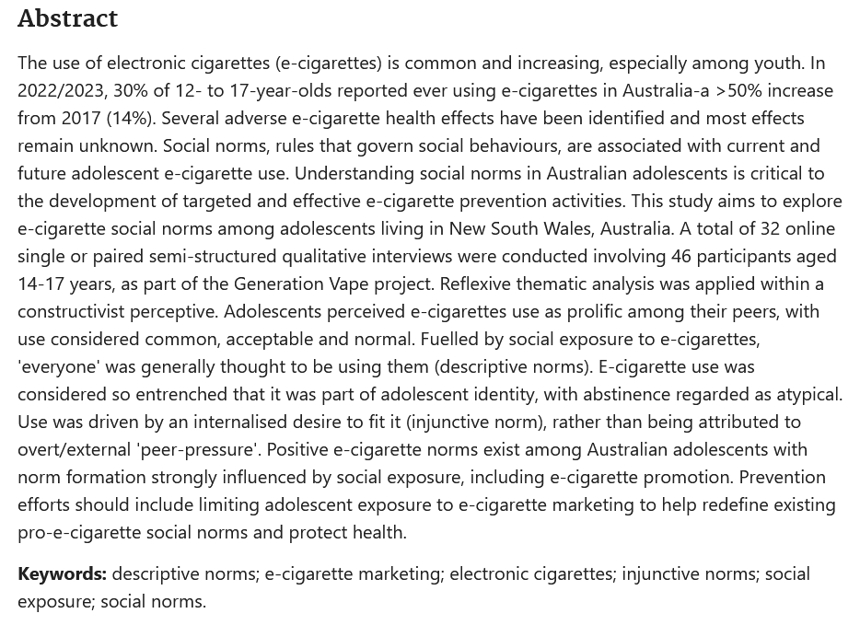
Where to start?
Online Thesaurus
MeSH Database
Author keywords from articles on your topic.
Yazidjoglou, A., Watts, C., Joshy, G., Banks, E., & Freeman, B. (2024). Electronic cigarette social norms among adolescents in New South Wales, Australia. Health promotion international, 39(2), daae018. https://doi.org/10.1093/heapro/daae018
Notes:
So where can you find keywords or subject headings for your search? In some databases you can search for subject headings as part of the searching process but these are some other great places to check out to help get you started.

Slide 35
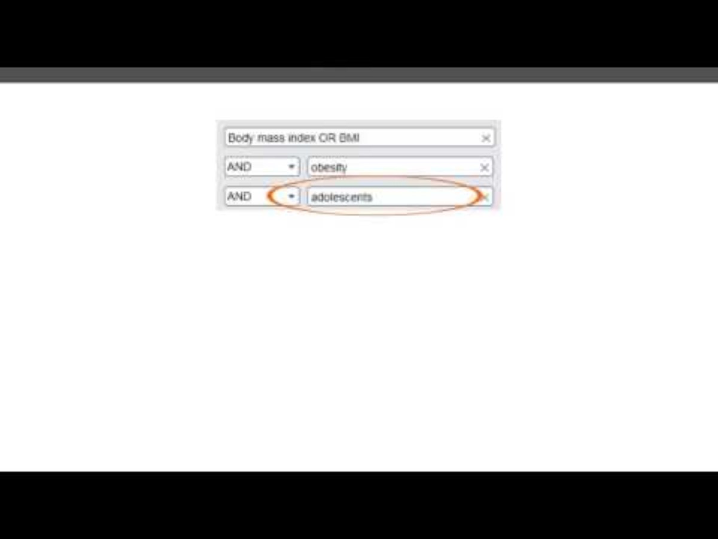
Keywords vs subject headings?
Curtin University. (2017, April 10). Keywords vs. Subject Headings [Video]. YouTube. https://www.youtube.com/watch?v=bNIG4qLuhJA
Notes:
Keywords are terms you create or write and enter into a database manually. Subject Headings are controlled vocabulary that may be unique to a database.
Using both keywords and subject headings in your research search enhances the comprehensiveness and precision of your results. Keywords capture specific terms related to your topic, while subject headings (such as MeSH terms in PubMed) categorize articles based on standardized terminology. By combining both approaches, you ensure that your search retrieves relevant articles regardless of variations in terminology used by authors. This strategy optimizes the effectiveness of your literature search and increases the likelihood of identifying all relevant studies for your review.

Slide 36
Finding keywords using your PICO
Research question: What are the impacts of remote instruction methods on the learning outcomes of undergraduate nursing students during the COVID-19 pandemic compared to traditional face-to-face instruction?
Nursing students
P
Population
Nursing students attending programs during the Covid-19 pandemic.
Nursing education
Student nurses
Covid-19
I
Intervention
Distance learning
Online learning
Distance education
Remote instruction/distance learning such as online classes.
Online education
E-learning
C
Comparison
Traditional face-to-face learning in nursing education.
Face-to face learning
In-person education
O
Outcome
Nursing success, critical thinking, problem solving skills, quality of education, etc
Learning outcomes
Student success
Notes:
So how might we find some keywords using our PICO? Here is our example that we will be working on today but feel free to use your own PICO question or a different framework question. If you haven't got a Research Topic yet you can use this one.
Here is what we came with earlier.

Slide 37
Turning your keywords into a concept map
​ | Concept 1: Nursing students | Concept 2: Covid-19 | Concept 3: Online learning | Concept 4: Learning outcomes
Keywords​ | Nursing students | Covid-19 | Online Learning | Learning Outcomes
Synonyms​ | Student nurse Nurse education Undergraduate nurse | Coronavirus Covid pandemic | Distance learning Online education Distance education E-learning | Student success Success
Subject Headings (e.g. MESH)​ | Students, Nursing Education, Nursing | COVID-19 SARS-CoV-2 | Education, Distance | n/a
Notes:
Turning keywords into a concept map involves visually organizing them to illustrate relationships and connections between different concepts. It helps researchers clarify their understanding of the topic, identify key themes, and refine their search strategy. Concept maps facilitate brainstorming, hypothesis generation, and the development of research questions by providing a visual representation of the conceptual framework underlying a study.

Slide 38
Boolean Operators
Heart Attack
AND
Risk Factors
AND
Includes both search terms
Many databases use AND by default
Narrows your search
OR
Includes either search term
Broadens your search
E.g. heart attack AND risk factors returns documents containing both terms.
Fasting
Low-calorie diet
OR
E.g. fasting OR low-calorie diet returns documents containing either term.
Notes:
So once you have your keywords, what now? You will need to think about how you plan to search them in a database: Boolean operators (AND, OR, NOT) are used to connect keywords and refine search queries in databases.
"AND" narrows down search results by finding articles containing all specified terms. As seen here ….
"OR" broadens search results by finding articles containing at least one of the specified terms. As seen here ….
By strategically combining these operators, researchers can tailor their searches to retrieve articles that precisely match their information needs.

Slide 39
Combine your concept map with AND/OR
​ | Concept 1: | Concept 2: | Concept 3: | Concept 4:
Synonyms​ | Nursing students OR Student nurse OR Nurse education OR Undergraduate nurse | Covid-19 OR Coronavirus OR Covid pandemic | Online learning OR Distance learning OR Online education OR Distance education OR E-learning | Learning outcomes OR Student success OR Success
Subject Headings (e.g. MESH)​ | Students, Nursing Education, Nursing | COVID-19 | Education, Distance | n/a
AND
AND
AND
OR
Notes:
Here we can see our concept with including Boolean operators. So, the Keywords or Symmons are joined with OR and then your concepts are joined with AND.

Slide 40



Phrase Searching
"forest soil“
41
"quotation marks" around a keyword phrase keeps words together in the order specified
forest soil
386
forest AND soil
386
Notes:
Phrase searching involves enclosing specific terms or phrases within quotation marks ("") to retrieve search results that contain the exact phrase. This helps narrow down search results and ensures that the retrieved articles match the intended concept more closely. Phrase searching is particularly useful when searching for specific terms or expressions that may appear together in the text, enhancing the relevance and precision of search results.

Slide 41
*
Truncation
analysis 12 176
analysis* 11 267
analys* 13 320
analyz* 486
analy* 16 162
analysis, analyse, analyze, analyses, analyzes, analyst, analysed, analyzed, analyser, analyzer, analysers, analyzers
ana* 19 097
Using a truncation symbol like * expands a keyword to include all possible variations of a word.
Child* = child, children, childhood
Notes:
Truncation involves using a symbol (usually an asterisk *) to represent multiple characters in a search term, allowing for variations in word endings or spellings. This expands search results to include all possible variations of the truncated term, increasing the comprehensiveness of the search. Truncation is useful for capturing plural forms, different tenses, and alternative spellings of keywords, thereby maximizing the retrieval of relevant articles in database searches.
Here are some more examples:
America* will become America and American
Butter* can become butterfly or butterflies
This graph is a cleaver way of showing what happens if you move the truncation around.

Slide 42
Wildcards
?
#
$
Replace one character to allow for variations within a word.
Behavio?r behavior, behaviour
Wom?n
women, woman
Combine with a truncation (*) to get more variations.
Organi?ation*
organisation,
organization,
organisational,
organizational
Notes:
Wildcards are symbols used in search queries to represent one or more characters within a word. They allow for flexible searching by capturing variations in spelling or word endings. Unlike truncation, which substitutes multiple characters, wildcards replace a single character. Common wildcard symbols include the question mark (?) and the asterisk (*). By incorporating wildcards into search queries, researchers can retrieve a wider range of relevant results, particularly when dealing with uncertain or variable terms.
Usin the ? Here are some examples.
Wom?n becomes women, woman
Organi?ation becomes Organisation, organisations’ organizational’ organization’ organizations’ organizational
And
Psych?ic becomes psychic, psychotic, psychopathic, psychopathologic

Slide 43
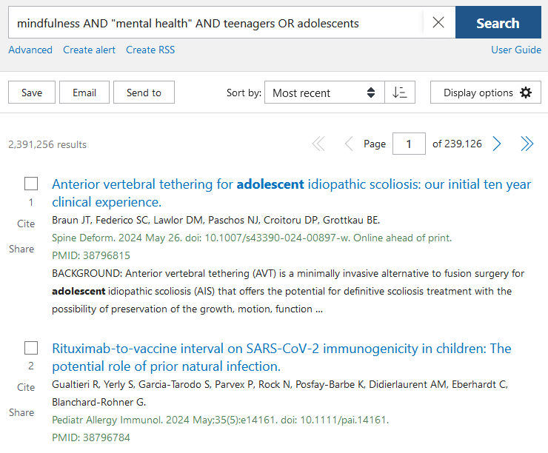
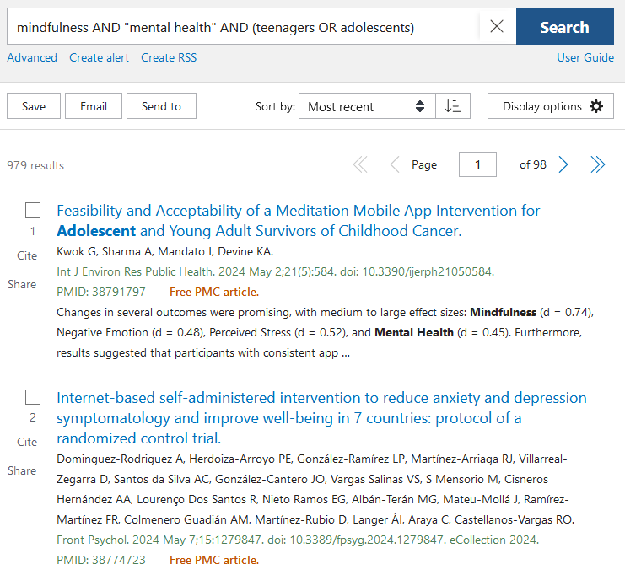
Nesting
( )
Nesting (using brackets) groups keywords together
(paracetamol OR acetaminophen)
Notes:
Nesting involves using parentheses to group search terms and specify the order of operations in complex search queries. It allows researchers to combine multiple Boolean operators effectively, ensuring that the search engine interprets the query as intended. By clarifying the relationships between different search terms, nesting helps researchers construct precise and targeted searches, leading to more relevant results.
Here are some examples seen in different ways. The first one is an example from Medline. This shows Lung and Cancer nested in brackets. The final example is from Cinahl database. Both a little different but doing the same thing.

Slide 44
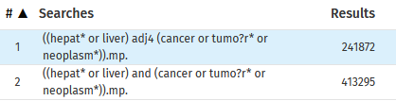
Proximity Searching
ADJ/n NEAR/n W/n
Operators specify how close together (n) two words appear in texts.
liver adj3 cancer
((hepat* OR liver) adj4 (cancer OR tumo?r* OR neoplasm*))
returns results where liver and cancer are no more than 3 words apart
(liver cancer, cancer of the liver)
Combine with nesting to include synonyms
Notes:
Proximity searching involves specifying the distance or relationship between terms within a search query. This allows researchers to find articles where the specified terms appear close to each other in the text. Proximity searching can be particularly useful for identifying articles that discuss the relationship between concepts or for retrieving information within a specific context. It helps researchers locate relevant articles more efficiently by focusing on the spatial arrangement of terms within the text.
It is used by narrowing down results

Slide 45
Update your concept map
​ | Concept 1: | Concept 2: | Concept 3: | Concept 4:
Synonyms​ | ("nursing student*" OR "student nurs*" OR "nurs* educat*" OR "undergrad* nurs*") | (covid-19 OR coronavirus OR "covid pandemic") | ("online learn*" OR "distance learn*" OR "online educat*" OR "distance educat*" OR e-learning) | ("learning outcome*" OR "student success*" OR success*)
Subject Headings (e.g. MESH)​ | Students, Nursing Education, Nursing | COVID-19 | Education, Distance | n/a
AND
AND
AND
OR
Notes:
Here we can see our concept with including Boolean operators. So, the Keywords or Symmons are joined with OR and then your concepts are joined with AND.

Slide 46
Turn your concept map into a search string
("nursing student*" OR "student nurs*" OR "nurs* educat*" OR "undergrad* nurs*")
AND
(covid-19 OR coronavirus OR "covid pandemic")
AND
("online learn*" OR "distance learn*" OR "online educat*" OR "distance educat*" OR e-learning)
AND
("learning outcome*" OR "student success*" OR success*)
There are also pre-made search strings that you can include in your search that can act as filters. For example, see page 62 of the Cochrane Handbook- Technical Supplement
Notes:
Really valuable to have a plain-text version of your search saved on your onenote, word doc, etc so you can easily copy and paste your search strings across the different databses.

Slide 47
Activity #3
Start listing some keywords for your concept map.
2023
47
Notes:
Our third activity is to start listing some keywords into your concept map. This can be found on your concept map.

Slide 48
Database Searching
Notes:
Helena - Database searching involves querying electronic databases to retrieve relevant scholarly articles, books, or other resources related to a specific topic. Researchers use various search strategies, including keyword selection, Boolean operators, truncation, wildcards, and proximity searching, to construct effective search queries. Database searching is a fundamental step in literature review and research, enabling researchers to access a vast array of academic literature and gather evidence to support their work.

Slide 49
Types of searching
Preliminary exploratory searching
Find some seed references and check to see that no other systematic review has been completed.
Initial search:
Choose one database to do an initial search. Test your keywords and subject headings in the title and abstract filters.
Additional search:
Apply identified keywords and subject headings from your first search across all published and unpublished databases/sources.
Pearl-growing search:
Review all reference lists or "cited by" lists of relevant studies.
Notes:
As you start out you may wish to try a few different search methods to see what is out there on your topic, but also to see what LANGUAGE is being used for your topic. This ensures you can update your search strategy with all the relevant tersm that other researchers are using so you don't miss anything.
There will be no perfect search right away – it takes time and tiral and error to find the most effective combination of keywords for your topic. You may also employ methods like pearl-growing to help find keywords on your topic. You might even find that some of your selected databases have minimal results on your topic and you have to pivot to a different one – this is why doing this searching BEFORE you submit your protocol can be incredibly beneficial.
[Student with the 10 thousand Scopus search]

Slide 50

Selecting Databases
Subject Guides are an excellent starting point to find databases in your discipline.
Notes:
If you need some guidance on where to start finding relevant databases – subject guides offer a curated selection of discipline specific databases for you to try.
Should ALWAYS access databases from the library website – we pay subscriptions so you get access to more.

Slide 51
Selecting databases
1 | Bibliographic databases
2 | Full-text databases
3 | Primary source databases
4 | Subject-specific databases
5 | Multidisciplinary database
Education Research Complete Scholarly research relating to all areas of education, curriculum instruction, administration, policy, funding, related social issues and New Zealand research.
CINAHL Complete Nursing and Allied Health journal articles and dissertations.
ERIC Scholarly research on all areas of education in journals, non-journal literature and audiovisual resources.
Scopus The largest abstract and citation database of peer-reviewed literature; covers Sciences, Engineering, Medicine, Social Sciences and some Arts.
Notes:
When selecting databases, you might want a mix of options for your search. This is a very medical heavy example, but all three databases are popular for different reasons – list off attributes. Including varied databases can help ensure you find all the relevant material on your topic.
Presenter One - Determining the number of databases to use for a systematic review depends on several factors, including the research question, the scope of the review, and the availability of resources. As a general guideline, it's recommended to search multiple databases to ensure comprehensive coverage of the literature and minimize the risk of missing relevant studies.
Typically, researchers aim to search at least two or three major databases relevant to their field of study, such as PubMed/MEDLINE, Embase, Scopus, Web of Science, PsycINFO, or CINAHL. However, the specific databases chosen may vary depending on the research topic and discipline.
Additionally, researchers should consider searching grey literature sources, such as conference proceedings, dissertations, and unpublished studies, to minimize publication bias and ensure a thorough examination of the available evidence.
Ultimately, the decision on the number of databases to include should be based on a balance between feasibility, resource constraints, and the need for comprehensive coverage of the relevant literature to address the research question effectively. Consulting with a librarian or information specialist experienced in systematic reviews can also provide valuable guidance in selecting appropriate databases for the review.

Slide 52
Input your search string into a database
("nursing student*" OR "student nurs*" OR "nurs* educat*" OR "undergrad* nurs*")
AND
(covid-19 OR coronavirus OR "covid pandemic")
AND
("online learn*" OR "distance learn*" OR "online educat*" OR "distance educat*" OR e-learning)
AND
("learning outcome*" OR "student success*" OR success*)
Notes:
Really valuable to have a plain-text version of your search saved on your onenote, word doc, etc so you can easily copy and paste your search strings across the different databses.
Also good to set up accounts on each database (separate to accessing through the library website) - means you can save searches and re-visit especially in the "testing" phase of your searching.

Slide 53
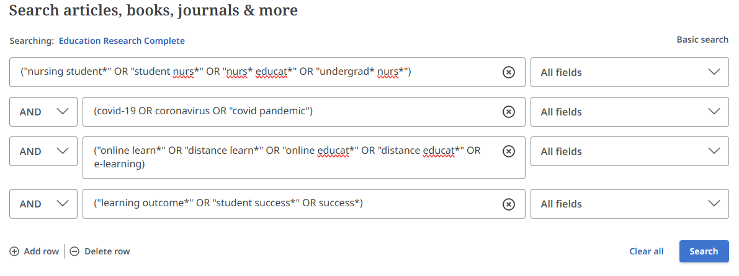

Example Education Research Complete Search
1
2
3
4
Access Education Research Complete through the library website: https://auckland.primo.exlibrisgroup.com/permalink/64UAUCK_INST/1lk16jl/alma99265474080202091

Slide 54
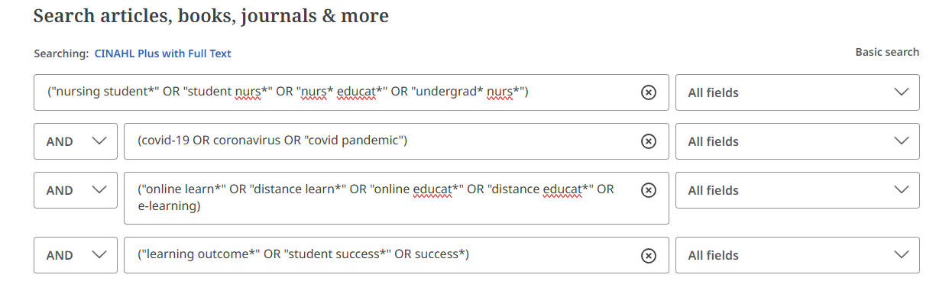

Example CINAHL Plus Search
1
2
3
4
Access CINAHL through the library website:https://auckland.primo.exlibrisgroup.com/permalink/64UAUCK_INST/1lk16jl/alma99265493479702091
Notes:
Worth noting CINAHL does have the option to include subject headings. And there is guidance on how to do this on their help guide.

Slide 55
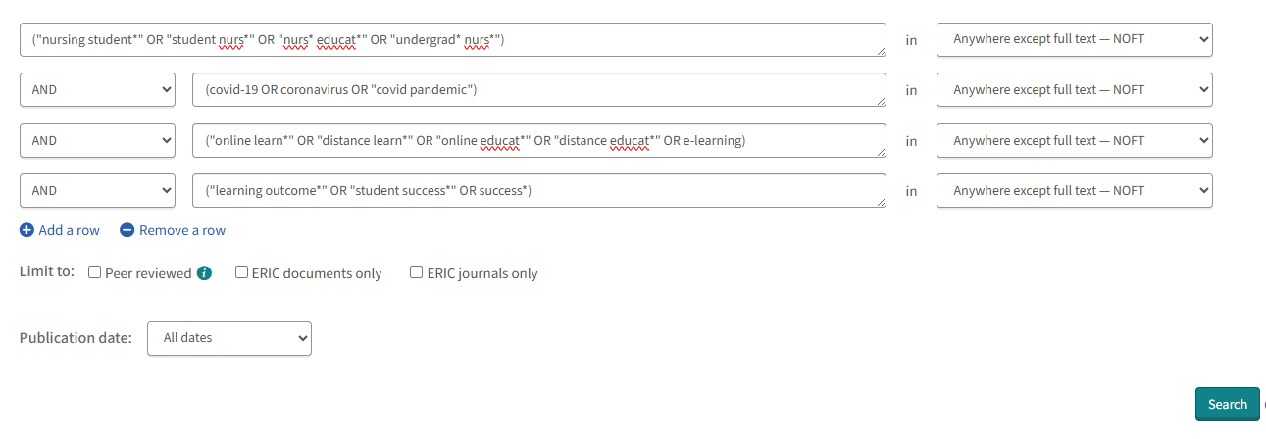

Example ERIC Search
1
2
3
4
Access ERIC through the library website: https://auckland.primo.exlibrisgroup.com/permalink/64UAUCK_INST/1lk16jl/alma9940153314002091
Notes:
A good example of testing your results – some databases won't have results on your topic so you may decide to pivot and choose a different database.

Slide 56
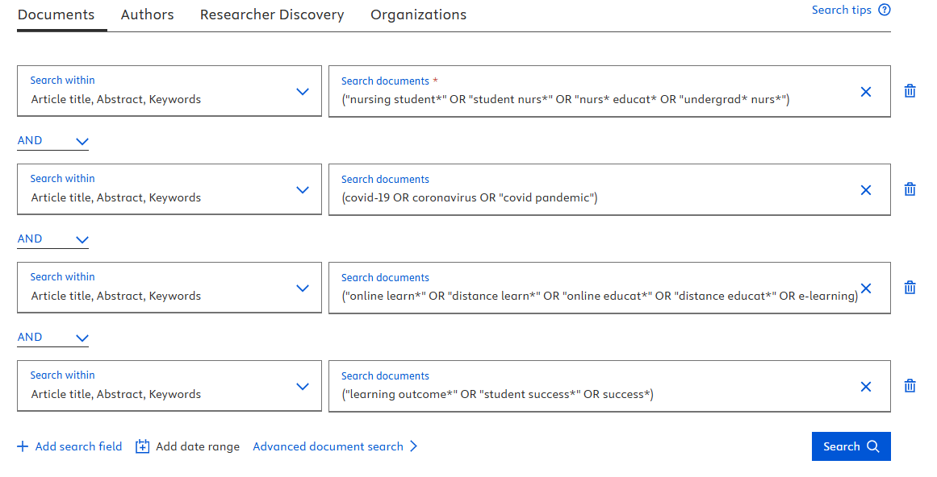

Example Scopus Search
1
2
3
4
Access Scopus through the library website:https://auckland.primo.exlibrisgroup.com/permalink/64UAUCK_INST/1lk16jl/alma99134396714002091

Slide 57
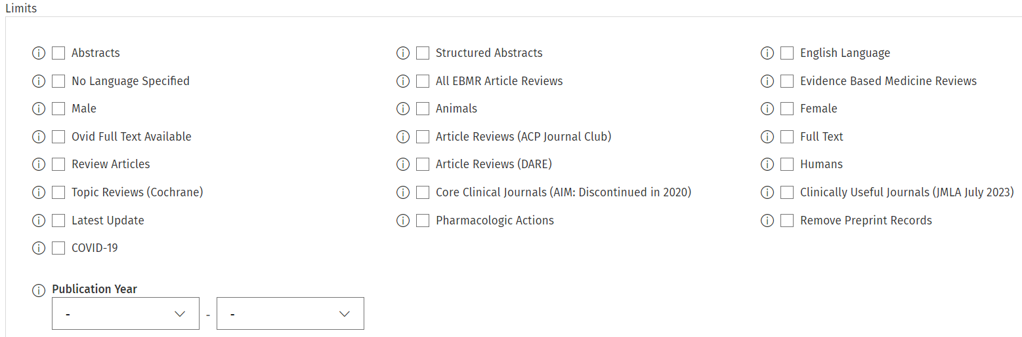
Additional Filters & Limitations
!
Many databases have built-in filters and limits
e.g., publication date, study type, age of participants, human/animal studies, etc.
Some of these filters can be a little unreliable so it is important to test them out before finalising your search.
Notes:
Important to remember also – your search should be consistent and replicable across all your chosen databases as much as possible. If you use additional filters from one database, you need to ensure that those same filters are available across EVERY database you use.

Slide 58

Ensuring your search is robust
To make sure you are finding all relevant data, ask yourself the following questions:
How will you find relevant papers from other regions and in other languages?
Are you searching in enough places or using enough search terms?
How will you access any relevant data that may be unpublished or not found in the usual databases?
Image made by Freepik from www.storyset.com
Notes:
You will need to ask yourself these questions. The main aim is to limit the bias as much as possible.
Are you searching in enough places or using enough search terms? A good rule is 3 databases plus Google Scholar.
How will you find relevant papers from other regions and in other languages?
How will you access any relevant data that may be unpublished or not found in the usual databases?

Slide 59

Managing Search Results
Keep a record of:
Number of results for each database searched.
Date you ran each search.
Search strategies for each database.
Databases used.
Image made by Freepik from www.storyset.com
Notes:
Databases are continuously being updated so numbers will change. Feasibly searching all of your databases should be done as close together as possible to best reflect the results being produced.
Remember to keep a record of
Number of results for each database
Date you ran each search
Search strategies for each database
Databases used

Slide 60
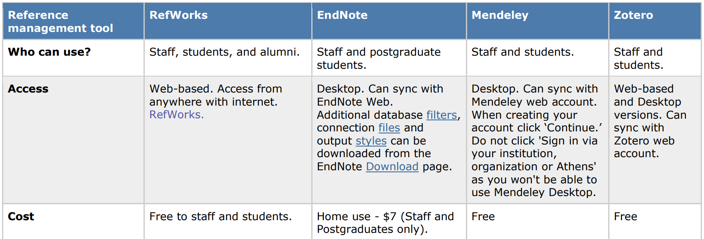
Reference Management Systems
Find out more through our Learning Essentials page: https://learningessentials.auckland.ac.nz/referencing/reference-management-tools/
Notes:
You can choose to use a reference management system to collate your results. The UoA doesn't endorse a particular system so our best advice is to stick to whatever you are already using, or if you are new, ask your supervisor what they recommend.
The main ones are Endnote, Zotero and Mendeley

Slide 61
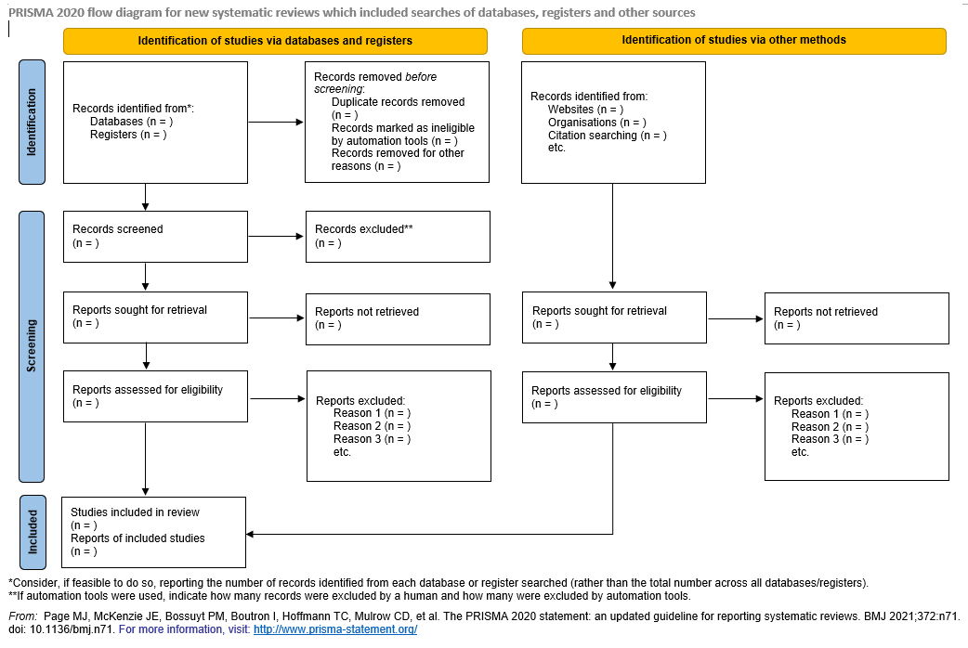
PRISMA Diagram
PRISMA Statement
Enhances systematic review and meta-analysis reporting quality.
27-item checklist and a four-phase flow diagram for improved reporting.
Notes:
One way to keep a record is to use a PRISMA Diagram. PRISMA diagrams are graphical representations that outline the flow of information through the different stages of a systematic review. They visually depict the process of study selection, from initial identification through to inclusion in the final analysis. PRISMA diagrams provide transparency and clarity regarding the review's methodology and help readers understand how studies were screened and included or excluded. They are an essential component of systematic review reporting, facilitating reproducibility and critical appraisal of the review's methodology and results.

Slide 62
Next steps
Notes:
Dawn - Just a reminder that the library does not support these stages of a systematic review.
Screening Results
Critical appraisal
Abstract Data
Synthesize and Interpret Results
And the next set of slides is just a brief overview of each section.

Slide 63

Screening Results
Two or more independent reviewers use the inclusion and exclusion criteria (established in the protocol) to select the relevant studies.
A third reviewer can mediate any disagreements.
There are tools available to help assist you with the screening process:
Notes:
There is a cost associated with Covidence – but there is a free trial if you have less than 500 records. We don't recommend "fixing" your results to get them under 500 just to use this software as that introduces too much bias into your review.
RevMan is now available to non Cochrane-reviews for a cost.
Rayyan has a free subscription, but also has priced options.
Excel is free and you should have access to this as a staff or student of UoA with the microsoft software package.

Slide 64
Steps for Screening Results
Pre-screening: Record the numbers of results from each database (or other source) before screening commences. PRISMA Statement is useful here.
Remove duplicates: Most reference managers have a tool to facilitate this, or you can do it by hand in Excel, etc.
Title/abstract screening: Reviewers scan titles and abstracts to see if they match the inclusion/exclusion criteria or have some value to the systematic review.
Full-text screening: Reviewers look through the full-text of included articles to fine-tune the final collection of articles that will contribute to the review. You will need to provide reasons for exclusion at this step.
Notes:
Reminder that the library can usually source full-text for you if you can't access through the databases. Our interloans team can find it.

Slide 65
Appraise Studies
Critical appraisal involves evaluating the quality and reliability of the studies you include. This ensures that the evidence you use is strong and trustworthy.
The process for appraising studies is available on our Systematic Review Guide.
We also have a list of recommended appraisal tools and checklists for a variety of study types.
Notes:
Critical appraisal in a systematic review involves assessing the quality and validity of included studies to determine their reliability and relevance to the research question. It typically includes evaluating study design, methodology, risk of bias, and other relevant factors. Critical appraisal helps researchers identify strengths and weaknesses in the evidence base, which informs the interpretation and synthesis of study findings. It ensures that only high-quality studies are used to draw conclusions in the systematic review, enhancing the credibility and reliability of the review's results.
Things to consider
Has the research been conducted in a way that minimizes bias? Is it trustworthy, has it been funded by an interested party, etc.
What is the impact and importance of the findings? What real-world value does the research hold.
Are the results applicable to your patient/population/problem? Is it relevant to your research question?
Does it have Validity, Trustworthiness or results and value and relevancce

Slide 66
Extract Data
Data extraction involves summarising studies in a consistent format for later synthesis and identifying any numerical data needed.
Elements of each study, such as methods, participants, setting, interventions, outcome, results, and publications, etc. will be noted down into a data extraction form.
The section on extracting data in the Systematic Review Guide has an overview of steps and templates to guide you.
Notes:
Abstracting data in a systematic review involves extracting relevant information from included studies to address the review's research question. This typically includes details such as study characteristics, participant demographics, intervention/exposure details, outcomes measured, and key findings. Abstracted data are organized and synthesized to facilitate analysis and interpretation, enabling researchers to identify patterns, trends, and associations across studies. Effective abstraction ensures that the systematic review accurately reflects the evidence base and supports robust conclusions.
At this stage it pays to be orgaised with your data.
Making a form is a good way to organize your thoughts on each article you have reviewed. Here is an example
Customize for Your Review
Adjust the form based on what you're studying
Finding the Right Balance
Don't get too much data; keep it essential
And here is an example of a Rise of bias form

Slide 67
Synthesise and Interpret Results
Pick a synthesis method that fits your research question and data type to combine the results, for example meta-analysis or another statistical method if meta-analysis is not possible.
Some examples are:
Narrative synthesis
Meta-analysis
Thematic synthesis
Qualitative comparative analysis
Synthesis
Qualitative
Potentially quantitative
Outcomes and effects
Methodological / quality issues
Level of evidence
Degree of consistency
Treatment outcomes and basis
Notes:
Your collected data must be combined into a coherent whole and accompanied by an analysis that conveys a deeper understanding of the body of evidence. All reviews should include a qualitative synthesis and may or may not include a quantitative synthesis (also known as a meta-analysis).
Whatever tool/s you use, the general purpose of extracting and synthesising data is to show the outcomes and effects of various studies and identify issues with methodology and quality. This means that your synthesis might reveal a number of elements, including:
overall level of evidence
the degree of consistency in the findings
what the positive effects of a drug or treatment are, and what these effects are based on
how many studies found a relationship or association between two things
The methods of synthesis in a systematic review involve the techniques used to integrate and analyze data from included studies. These methods can vary depending on the nature of the research question, the type of data collected, and the heterogeneity of the included studies. Common methods of synthesis include narrative synthesis, meta-analysis, thematic synthesis, and qualitative comparative analysis. Each method offers unique advantages and challenges and may be selected based on the characteristics of the included studies and the objectives of the systematic review. Effective synthesis methods ensure that the review produces meaningful and robust conclusions that address the research question comprehensively.
They can come under the usual headings of
Quantitative data synthesis and Qualitative data synthesis
Requirements for quantitative synthesis:
Clinical and methodological similarity between compared studies
Consistent study quality among compared studies
Statistical expertise from a review team member or consultant

Slide 68
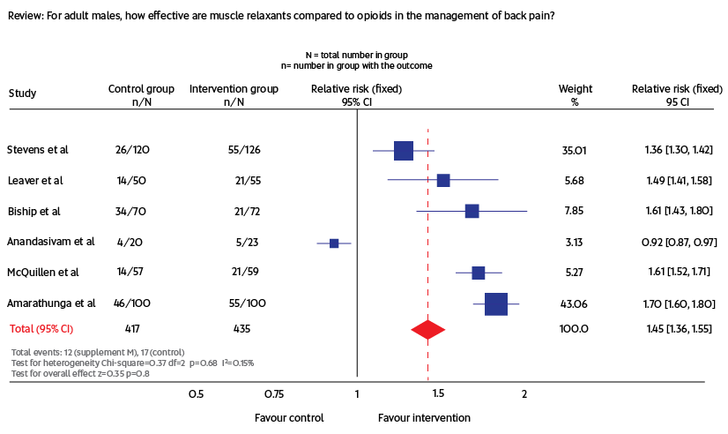
Quantitative Data Synthesis
This might include a Meta-analysis which is a statistical method for analysing the differences of the selected studies and their effects. You may also include a tree plot.
Feasibility and sensibility depends on
data available & team skillset
Clinical and methodological similarity
Consistent study quality
Team has statistical expertise
Further Reading:
Lee, C.H., et al. (2016). Comparison of two meta-analysis methods: Inverse-variance-weighted average and weighted sum of z-score. Genomics & Informatics, 14(4), 173–180. Neyeloff, J. L., et al. (2012). Meta-analyses and Forest plots using a microsoft excel spreadsheet: Step-by-step guide focusing on descriptive data analysis. BMC Research Notes.
Notes:
A meta-analysis in a systematic review is a statistical technique used to synthesize quantitative data from multiple studies on a similar topic. It involves pooling effect sizes or other relevant statistics across studies to estimate an overall effect size or summary measure. Meta-analyses provide a quantitative summary of the evidence, increasing statistical power and precision compared to individual studies. They can help identify patterns, trends, and associations that may not be apparent in single studies alone. However, conducting a meta-analysis requires careful consideration of study heterogeneity, potential biases, and statistical assumptions. Effective meta-analyses enhance the validity and reliability of systematic review findings by providing robust quantitative estimates of the treatment effect or association under investigation.
If you have quantitative information, some of the more common tools used to summarise data include:
grouping of similar data, i.e. presenting the results in tables
charts, e.g. pie-charts
graphical displays such as forest plots
One way of accurately representing all of your data is in the form of a forest plot. A forest plot is a way of combining results of multiple clinical trials in order to show point estimates arising from different studies of the same condition or treatment. As seen here
Requirements for quantitative synthesis:
Clinical and methodological similarity between compared studies
Consistent study quality among compared studies
Statistical expertise from a review team member or consultant

Slide 69
Qualitative Data Synthesis
There are various methods that can be used for synthesising qualitative research. This might include narrative descriptions, a thematic analysis, or content analysis.
Thematic analysis | Content analysis
Thematic analysis is a method of qualitative data analysis that can be used with varying research designs | Content analysis is a data analysis method that can be used to analyze both quantitative and qualitative data
Analyses qualitative data | Analyses both qualitative and quantitative data
Helps the researcher create a logical structure for the research | Content data analyzed through content analysis can help to identify frequencies of data
Researcher focuses more on the frequency of the occurrence of various categories | Researcher's focus is on identifying themes and developing the analysis in the most cohesive manner possible
Adapted from www.pediaa.com
Further Reading:
Korhonen, A., et al. (2013). Meta-synthesis and evidence-based health care - a method for systematic review. Scandinavian Journal of Caring Sciences, 27(4), 1027–1034.
Barnett-Page, E., & Thomas, J. (2009) Methods for the synthesis of qualitative research: a critical review. BMC medical research methodology, 9, Article 59.
Notes:
A thematic or content analysis in a systematic review involves synthesizing qualitative data from included studies to identify common themes, patterns, or concepts related to the research question. This method is particularly useful when studies provide rich qualitative data or when the research question involves exploring complex phenomena. Thematic analysis involves coding and categorizing data into themes or categories, which are then synthesized to generate overarching findings. Content analysis focuses on identifying and analyzing specific content elements, such as textual descriptions or quotes, to explore patterns or relationships within the data. Thematic or content analyses in systematic reviews provide valuable insights into the experiences, perspectives, and contexts represented in the included studies, enriching the understanding of the research topic beyond quantitative measures alone.

Slide 70

Writing and Publishing
Writing a systematic review involves presenting a clear, structured, and comprehensive summary of evidence:
Outline of systematic review structure
JBI guidelines for systematic review report writing
Publishing involves preparing your work for dissemination in a peer-reviewed journal or other academic platform. For more information see our UoA Publishing Guide.
Image made by Freepik from www.storyset.com

Slide 71

Need more help?

Slide 72
Additional Support
One-on-one support service for systematic reviews on ResearchHub
Library’s AskUs form
Upcoming workshops
Searching Medline effectively
Post graduate workshops

Slide 73

What did you think of this workshop?
Scan the QR code or click this link and have your say.
Your feedback will help us develop this workshop.
Thank you from the Research Services team!

Slide 74

Reflection in chat
What one thing did you learn from this workshop?
Did we answer all your questions from the start?

Slide 75

Thankyou

Slide 76
Review Type | Description | Timeframe | No. of Reviewers | Searching Guidelines | Frameworks
Literature/ Narrative Review | Generic term: published materials that provide examination of recent or current literature. Can cover wide range of subjects at various levels of completeness and comprehensiveness. May include research findings | 1 – 6 weeks | One or more | For a literature review, define your topic, choose relevant databases, and use keywords to refine your search. Evaluate sources critically, document your process, and iterate as needed for comprehensive coverage. | Luft, J. A., Jeong, S., Idsardi, R., & Gardner, G. (2022).
Integrative Review | Midway between a simple literature review and a complex systematic review, an integrative review uses a detailed search strategy to find relevant evidence to answer a clinical question. To summarize and critique the state of the science about a specific research topic by analyzing previously conducted research studies. | 2 months - 2 years | Two or more | For an integrative review, broadly define your research topic, use diverse sources and databases, synthesize findings thematically, and present a comprehensive overview of key insights and themes. | Christmals, C.D., & Gross, J.J. (2017).
Rapid Review | Rapid reviews target high quality and authoritative resources for time-critical decision-making or clinically urgent questions. Yet like a systematic review they aim to identify the key concepts, theories and resources in a field, and to survey the major research studies. Less time may be spent on critical appraisal as systematic reviews, evidence briefs, and clinical guidelines are sought in preference to exhaustive coverage of primary studies. | 2 – 6 months | One or more | For a rapid review, streamline your research question, focus on key databases and sources, use broad search terms, prioritize recent and high-impact studies, summarize findings succinctly, and consider limitations due to the expedited process. | Smela, B., Toumi, M., Świerk, K., Francois, C., Biernikiewicz, M., Clay, E., & Boyer, L. (2023).
Scoping Review | Preliminary assessment of potential size and scope of available research literature. Aims to identify nature and extent of research evidence (usually including ongoing research) | 12 months – 3 years | Two or more | For a scoping review, define your research topic and questions, use a structured search on diverse sources, and summarize your findings to answer your research questions. | Arksey & O'Malley (2005); Levaq & Colquhoun (2014)
Systematic Review | Combines strengths of critical review with a comprehensive search process. Typically addresses broad questions to produce ‘best evidence synthesis’ | 8 months – 2 years | Three or more | For a systematic review, the aim is to evaluate and summarise all available information. The search should be rigorous, comprehensive, structured, and methodical using a diverse number of databases. Results should be analysed with minimal bias and presented. | Munn, Z., et al. (2018); Ganeshkumar & Gopalakrishnan, (2013

Slide 77
 | P | I | C | O
 | Population, Patient, Problem | Intervention or Exposure | Comparison | Outcome Measures
Element of the clinical question | Describe as accurately as possible the patient or group of patients of interest. | What is the main intervention or therapy you wish to consider? Including an exposure to disease, a diagnostic test, a prognostic factor, a treatment, a patient perception, a risk factor, etc. | Is there an alternative treatment to compare? Including no disease, placebo, a different prognostic factor, absence of risk factor, etc. | What is the clinical outcome, including a time horizon if relevant?
Example | In patients with acute bronchitis | Do antibiotics | None | Reduce sputum production, cough or days off?
Example | In children with cancer | What are the current treatments | None | In the management of fever and infection?
Example | Among family-members of patients undergoing diagnostic procedures | Does standard care | Listening to tranquil music, or audio taped comedy routines | Make a difference in the reduction of reported anxiety.
Notes:
Here are some examples of what a PICO question might look like.
Reiterate that the PICO framework grid is a valuable tool for organizing and refining your research question.

Slide 78
 | P | I | C | O
Question Type: | Population, Patient, Problem | Intervention or Exposure | Comparison | Outcome Measures
Treatment (Therapy) | The patient’s disease or condition. | A therapeutic measure a medical, surgical intervention, or lifestyle change. | Standard of care, another intervention, or a placebo. | Ex: mortality rate, days lost from work, pain, disability.
Prevention | The Patient’s risk factors and general health condition. | A preventive measure, e.g. a medication or a lifestyle change. | May not be applicable. | Ex. Disease incidence, mortality rate, days lost from work.
Diagnosis | The target disease or condition. | A diagnostic test or procedure. | The current “reference standard” or “gold standard” test for the problem. | Measures of the test utility, ex sensitivity, specificity, odds ratio.
Prognosis (Nature History) | The main prognostic factor or clinical problem in terms of its severity and duration. | The exposure of interest is usually time, sometimes expressed as “watchful waiting”. | Usually not applicable. Identify the standard treatment if your question is about “watchful waiting”. | Ex: survival rates, mortality rates, rates disease progression.
Etiology or Harm (Causation) | Your patient’s risk factors, current health disorders or general health condition. | The intervention or exposure of interest, including some indications of the strength (dose) of the risk factor and the duration of the exposure. | May not be applicable. | Ex: disease incidence, rates of disease progression, mortality rates.
Notes:
Presenter Two - The PICO framework grid as a helpful tool for structuring and refining your research question. PICO research question's structure inquiries by defining the Population (P), Intervention (I), Comparison (C), and Outcome (O). They provide a clear framework for formulating focused research queries, aiding in systematic literature searches and evidence appraisal. PICO questions help researchers clarify study objectives, identify relevant studies, and facilitate evidence-based decision-making across diverse fields.
Reiterate that the PICO framework grid is a valuable tool for organizing and refining your research question.

Slide 79
PICO Framework
Research question: Do dietary interventions such as intermittent fasting reduce the risk of heart attack in adults?
P
Patient Population
Adults
I
Intervention or Exposure
Intermittent Fasting
C
Comparison
Conventional Treatment Options
O
Outcome measures
Reduced risk of heart attack
Notes:
Here is our example that we will be working on today but feel free to use your own PICO question or a different framework question. If you haven't got a Research Topic yet you can use this one.
https://www.cochranelibrary.com/cdsr/doi/10.1002/14651858.CD013496.pub2/full?highlightAbstract=nutrition%7Cdiabet%7Cnutrit%7Cdiabetes

Slide 80
Activity #1
Create a PICO framework for your research topic.
P | I | C | O
Population, Patient, Problem | Intervention or Exposure | Comparison | Outcome Measures
2023
80
Notes:
Here is our first activity. On your handout you will find a PICO framework. Fill it out with our question or one in your area of research. 3mins

Slide 81
Keywords
Some databases don't use subject headings.
Subject headings for a topic can vary across databases.
Subject headings applied to articles by manual indexing can have errors.
Keywords become crucial for newer topics since subject headings may take a while to catch up ensuring a search stays current and yields more results.
To expand a search for more results, especially for a topic that hasn't been extensively researched.
Notes:
So subject headings sounds great! Why do we bother using keywords as well? Keywords are specific terms or phrases used to represent the main concepts of a research topic. They play a crucial role in literature searches, helping researchers locate relevant articles within databases. By selecting appropriate keywords, researchers can effectively narrow down search results to find articles that closely match their topic of interest. Keywords should be chosen carefully to accurately reflect the key aspects of the research question or topic, maximizing the relevance of retrieved articles.
Also, Some databases don't use subject headings.
Subject headings for a topic can vary across databases.
Subject headings applied to articles by manual indexing can have errors.
Keywords become crucial for newer topics since subject headings may take a while to catch up ensuring a search stays current and yields more results.
To expand a search for more results, especially for a topic that hasn't been extensively researched.

Slide 82
Turn your concept map into a search string
(adult* OR aged OR "middle?aged")
AND
("intermittent fast*" OR "time restricted eat*" OR "calori* restrict*" OR fasting OR "meal skip*" OR diet* OR nutrition* OR "low?calorie diet*")
AND
("heart attack*" OR "myocardial infarction*" OR "cardiovascular stroke*")
AND
(risk* OR reduc* OR prevent* OR "risk factor*")
There are also pre-made search strings that you can include in your search that can act as filters. For example, see page 62 of the Cochrane Handbook- Technical Supplement
Notes:
From here we can turn our concept map into a search string. Search strings are combinations of keywords, operators, and modifiers used to conduct searches in databases or search engines. They allow researchers to construct precise queries to retrieve relevant information. A well-constructed search string incorporates Boolean operators, truncation, wildcards, phrase searching, and other search techniques to optimize search results. By refining search strings, researchers can effectively navigate large volumes of information and locate the most pertinent articles for their research.
Here is our example.
The Cochrane handbook has some premade search strings that may be helpful as well.

Slide 83
Finding keywords using your PICO
Research question: Do dietary interventions such as intermittent fasting reduce the risk of heart attack in adults?
P
Patient Population
Adults
Middle aged
Calorie restriction
I
Intervention or Exposure
Intermittent Fasting
Time restricted feeding
Fasting
Diet
Nutrition
C
Comparison
Conventional Treatment Options
Usual care
O
Heart attack
Outcome measures
Reduced risk of heart attack
Myocardial infarction
Cardiovascular stroke
Reduction
Prevention
Risk
Notes:
So how might we find some keywords using our PICO? Here is our example that we will be working on today but feel free to use your own PICO question or a different framework question. If you haven't got a Research Topic yet you can use this one.
Here is what we came with earlier.

Slide 84
Turning your keywords into a concept map
​ | Concept 1: Adult | Concept 2: Intermittent Fasting | Concept 3: Heart Attack | Concept 4: Risk​
Keywords​ | Adult | Intermittent Fasting | Heart Attack | Risk
Synonyms​ | Aged Middle-aged | Time restricted eating Calorie restriction Fasting Meal Skipping Diet Nutrition Low-calorie diet | Myocardial infarction Cardiovascular stroke | Reduction Reduce Prevention Risk factors
Subject Headings (e.g. MESH)​ | Adult | Intermittent Fasting Caloric Restriction | ​Myocardial Infarction | n/a
Notes:
Turning keywords into a concept map involves visually organizing them to illustrate relationships and connections between different concepts. It helps researchers clarify their understanding of the topic, identify key themes, and refine their search strategy. Concept maps facilitate brainstorming, hypothesis generation, and the development of research questions by providing a visual representation of the conceptual framework underlying a study.

Slide 85
Turning your keywords into a concept map
​ | Concept 1: Adult | Concept 2: Intermittent Fasting | Concept 3: Heart Attack | Concept 4: Risk​
Keywords​ | Adult | Intermittent Fasting | Heart Attack | Risk
Synonyms​ | Aged Middle-aged | Time restricted eating Calorie restriction Fasting Meal Skipping Diet Nutrition Low-calorie diet | Myocardial infarction Cardiovascular stroke | Reduction Reduce Prevention Risk factors
Subject Headings (e.g. MESH)​ | Adult | Intermittent Fasting Caloric Restriction | ​Myocardial Infarction | n/a
Notes:
Turning keywords into a concept map involves visually organizing them to illustrate relationships and connections between different concepts. It helps researchers clarify their understanding of the topic, identify key themes, and refine their search strategy. Concept maps facilitate brainstorming, hypothesis generation, and the development of research questions by providing a visual representation of the conceptual framework underlying a study.

Slide 86
Update your concept map
​ | Concept 1: | Concept 2: | Concept 3: | Concept 4:
Synonyms​ | Adult* OR Aged OR "Middle?aged" | "Intermittent Fast*" OR "Time restricted eat*" OR "Calori* restrict*" OR Fasting OR "Meal Skip*" OR Diet* OR Nutrition* OR "Low?calorie diet*" | "Heart Attack*" OR "Myocardial infarction*" OR "Cardiovascular stroke*" | Risk* OR Reduc* OR Prevent* OR "Risk factor*"
Subject Headings (e.g. MESH)​ | Adult | Intermittent Fasting OR Caloric Restriction | ​Myocardial Infarction | -
AND
AND
AND
OR
Notes:
Now adding all these searching features into out concept map with the Boolean operators as well.

Slide 87
Selecting databases
MedLine Journal articles in all fields of medicine, biomedicine, health sciences and allied health, from 1946 to current; now includes all records which were previously in the OldMedline database.
CINAHL Complete Nursing and Allied Health journal articles and dissertations.
1 | Bibliographic databases
2 | Full-text databases
3 | Primary source databases
4 | Subject-specific databases
5 | Multidisciplinary database
Scopus The largest abstract and citation database of peer-reviewed literature; covers Sciences, Engineering, Medicine, Social Sciences and some Arts.
Notes:
When selecting databases, you might want a mix of options for your search. This is a very medical heavy example, but all three databases are popular for different reasons – list off attributes. Including varied databases can help ensure you find all the relevant material on your topic.
Presenter One - Determining the number of databases to use for a systematic review depends on several factors, including the research question, the scope of the review, and the availability of resources. As a general guideline, it's recommended to search multiple databases to ensure comprehensive coverage of the literature and minimize the risk of missing relevant studies.
Typically, researchers aim to search at least two or three major databases relevant to their field of study, such as PubMed/MEDLINE, Embase, Scopus, Web of Science, PsycINFO, or CINAHL. However, the specific databases chosen may vary depending on the research topic and discipline.
Additionally, researchers should consider searching grey literature sources, such as conference proceedings, dissertations, and unpublished studies, to minimize publication bias and ensure a thorough examination of the available evidence.
Ultimately, the decision on the number of databases to include should be based on a balance between feasibility, resource constraints, and the need for comprehensive coverage of the relevant literature to address the research question effectively. Consulting with a librarian or information specialist experienced in systematic reviews can also provide valuable guidance in selecting appropriate databases for the review.

Slide 88
Input your search string into a database
(adult* OR aged OR "middle?aged")
AND
("intermittent fast*" OR "time restricted eat*" OR "calori* restrict*" OR fasting OR "meal skip*" OR diet* OR nutrition* OR "low?calorie diet*")
AND
("heart attack*" OR "myocardial infarction*" OR "cardiovascular stroke*")
AND
(risk* OR reduc* OR prevent* OR "risk factor*")
Notes:
Really valuable to have a plain-text version of your search saved on your onenote, word doc, etc so you can easily copy and paste your search strings across the different databses.

Slide 89
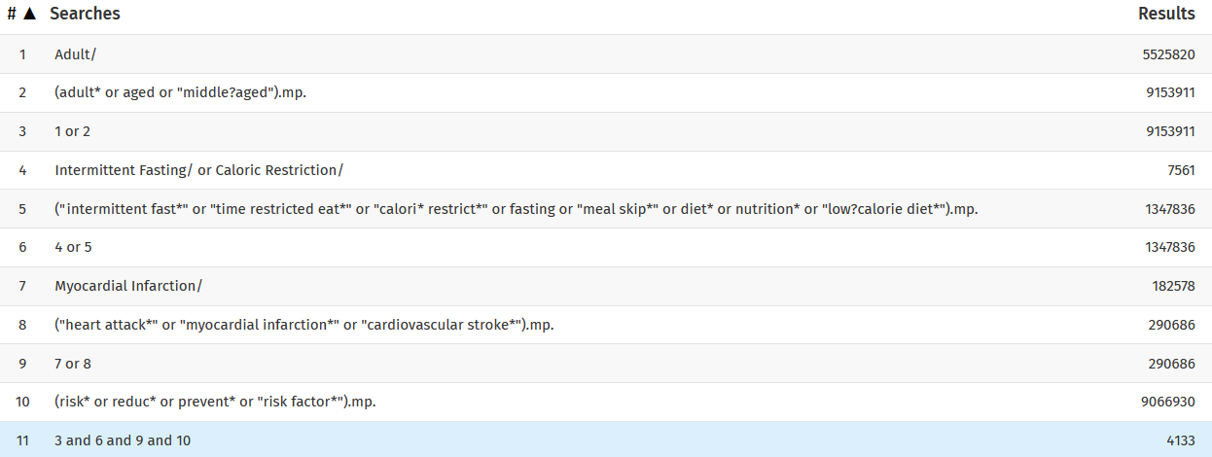
Example Medline Search
1
2
3
4
Access Medline through the library website:https://auckland.primo.exlibrisgroup.com/permalink/64UAUCK_INST/1lk16jl/alma9955080314002091

Slide 90
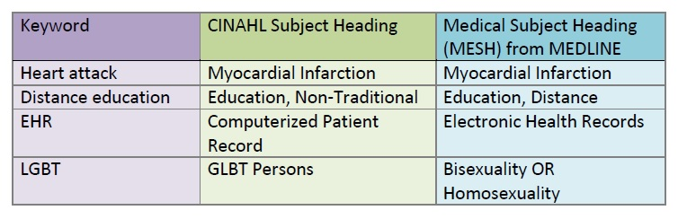
Subject headings
They are consistent in their definition in a specific database.
They capture all the results that have been indexed with that subject heading.
Notes:
Subject headings are standardized terms used to categorize and index articles in databases according to their content. They provide a consistent way to organize and retrieve information across diverse literature. Subject headings, such as Medical Subject Headings (MeSH) in PubMed, offer a controlled vocabulary that helps researchers locate relevant articles more effectively by ensuring consistent terminology regardless of variations in authors' wording. By using subject headings, researchers can improve the precision and comprehensiveness of their literature searches.
They are consistent in their definition in a specific database, and they capture all the results that have been indexed with that subject heading. So as seen here we have a keyword or natural language and the subject heading for the Cinahl database and then MESH such headings used in Medline.

Slide 91
Database variations for Proximity Searching
Database | Proximity operators
Embase (Ovid) | ADJn
Medline (Ovid) | ADJn
Cochrane Library | NEAR/n | NEXT/n
Web of Science | NEAR/n
Scopus | W/n | PRE/n
Notes:
Be aware that proximity operators will vary between databases.
Here is a table of the different proximity operators in the different databases.
And here are some examples using the N (Near) and the adj3

Slide 92







What are library databases?
1 | Bibliographic databases
2 | Full-text databases
3 | Primary source databases
4 | Subject-specific databases
5 | Multidisciplinary database
Image made by Freepik from www.storyset.com
Notes:
Library databases are curated collections of scholarly resources, including academic journals, books, conference proceedings, and other materials relevant to various fields of study. They provide researchers with access to a wide range of high-quality, peer-reviewed literature for their research needs. Library databases often offer advanced search functionalities, allowing users to conduct precise searches using keywords, subject headings, and other search strategies. Addit
Library databases encompass various types, each serving different purposes and containing distinct types of content. Here are some common types:
Bibliographic Databases: These databases contain citations and abstracts of scholarly articles, books, conference proceedings, and other publications. Examples include PubMed, Web of Science, and Scopus.
Full-text Databases: Full-text databases provide access to the complete text of articles, books, and other documents. Examples include JSTOR, ProQuest, and EBSCOhost.
Primary Source Databases: These databases contain original, firsthand sources of information created at the time of an event or phenomenon. They provide valuable historical, cultural, and contextual insights into various topics. Examples include digitized newspapers, manuscripts, letters, diaries, photographs, and archival materials. Primary source databases are essential for researchers in history, sociology, anthropology, and other fields interested in studying the past or understanding specific events or periods in detail. Examples include the Library of Congress Digital Collections, British Library Digital Collections, and Archives Unbound.
Subject-specific Databases: These databases focus on specific subject areas or disciplines, providing targeted access to relevant literature. Examples include PsycINFO for psychology, PubMed for biomedical sciences, and IEEE Xplore for engineering.
Multidisciplinary Databases: These databases cover a wide range of disciplines, offering access to diverse scholarly content. Examples include Google Scholar, Scopus, and Web of Science.

Slide 93
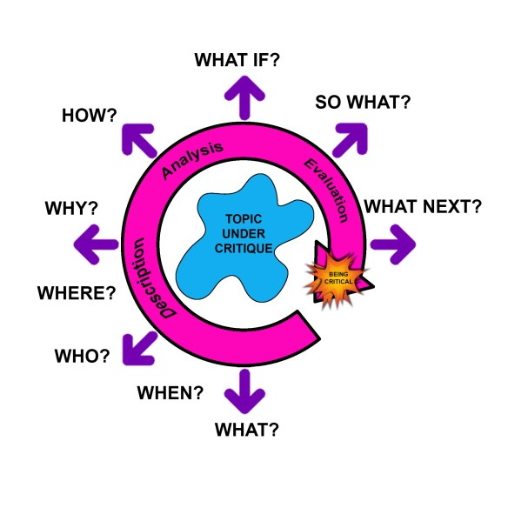
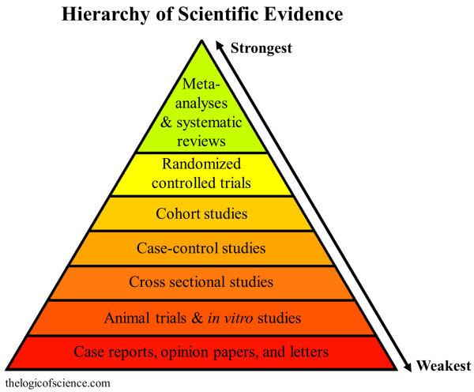
What is critical appraisal?
The process of assessing and interpreting evidence by systematically considering its validity, results and relevance to an individual’s own clinical work.
Notes:
Presenter Two - this is a good quote describing what a critical appraisal is

Slide 94
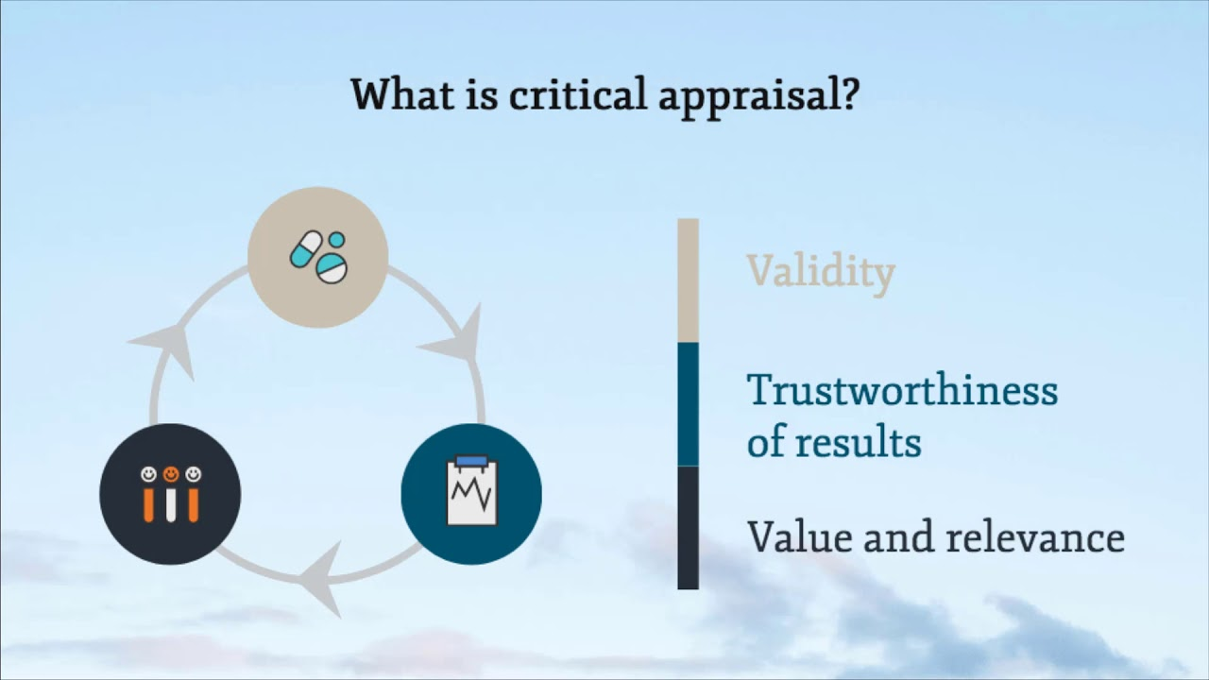
Things to consider:
1. Has the research been conducted in a way that minimizes bias? Is it trustworthy, has it been funded by an interested party, etc.
Validity
2. What is the impact and importance of the findings? What real-world value does the research hold.
3. Are the results applicable to your patient/population/problem? Is it relevant to your research question?
Value and relevance
Trustworthiness of results
Notes:
Critical appraisal in a systematic review involves assessing the quality and validity of included studies to determine their reliability and relevance to the research question. It typically includes evaluating study design, methodology, risk of bias, and other relevant factors. Critical appraisal helps researchers identify strengths and weaknesses in the evidence base, which informs the interpretation and synthesis of study findings. It ensures that only high-quality studies are used to draw conclusions in the systematic review, enhancing the credibility and reliability of the review's results.
Things to consider
Has the research been conducted in a way that minimizes bias? Is it trustworthy, has it been funded by an interested party, etc.
What is the impact and importance of the findings? What real-world value does the research hold.
Are the results applicable to your patient/population/problem? Is it relevant to your research question?
Does it have Validity, Trustworthiness or results and value and relevancce

Slide 95



What is critical appraisal?
Things to consider:
1. Has the research been conducted in a way that minimizes bias? Is it trustworthy, has it been funded by an interested party, etc.
Validity
2. What is the impact and importance of the findings? What real-world value does the research hold.
3. Are the results applicable to your patient/population/problem? Is it relevant to your research question?
Value and relevance
Trustworthiness of results
Notes:
Critical appraisal in a systematic review involves assessing the quality and validity of included studies to determine their reliability and relevance to the research question. It typically includes evaluating study design, methodology, risk of bias, and other relevant factors. Critical appraisal helps researchers identify strengths and weaknesses in the evidence base, which informs the interpretation and synthesis of study findings. It ensures that only high-quality studies are used to draw conclusions in the systematic review, enhancing the credibility and reliability of the review's results.
Things to consider
Has the research been conducted in a way that minimizes bias? Is it trustworthy, has it been funded by an interested party, etc.
What is the impact and importance of the findings? What real-world value does the research hold.
Are the results applicable to your patient/population/problem? Is it relevant to your research question?
Does it have Validity, Trustworthiness or results and value and relevancce

Slide 96
What is critical appraisal?
The process of assessing and interpreting evidence by systematically considering its validity, results and relevance to an individual’s own clinical work.
Has the research been conducted in a way that minimizes bias?
Is it trustworthy, has it been funded by an interested party, etc?
Are the results applicable to your patient, population, problem? Is it relevant to your research question?
What is the impact and importance of the findings? What real-world value does the research hold.
Validity
Do you have questions for validity? Can you change these bubbles to address the most pertinent questions?
Trustworthiness of results
Value and relevance
Notes:
Critical appraisal in a systematic review involves assessing the quality and validity of included studies to determine their reliability and relevance to the research question. It typically includes evaluating study design, methodology, risk of bias, and other relevant factors. Critical appraisal helps researchers identify strengths and weaknesses in the evidence base, which informs the interpretation and synthesis of study findings. It ensures that only high-quality studies are used to draw conclusions in the systematic review, enhancing the credibility and reliability of the review's results.
Things to consider
Has the research been conducted in a way that minimizes bias? Is it trustworthy, has it been funded by an interested party, etc.
What is the impact and importance of the findings? What real-world value does the research hold.
Are the results applicable to your patient/population/problem? Is it relevant to your research question?
Does it have Validity, Trustworthiness or results and value and relevancce

Slide 97

Synthesize and Interpret Results
The interpretation/discussion section
collating, analyzing, and summarizing
Strengths/weaknesses
Potential biases
Implications for healthcare
Analyzes review results
Discussing evidence validity
The discussion aids practical decision understanding without making recommendations based on assumptions.
Notes:
Synthesizing and interpreting results in a systematic review involves collating, analyzing, and summarizing the findings from included studies to address the review's research question. This process may include statistical meta-analysis to quantify the overall effect size, as well as qualitative synthesis to explore themes, patterns, and discrepancies across studies. By integrating findings from multiple sources, researchers can draw conclusions, identify implications for practice or policy, and generate new insights or hypotheses. Effective synthesis and interpretation ensure that the systematic review provides a comprehensive and meaningful understanding of the topic under investigation.
The interpretation/discussion section shows
Strengths/weaknesses
Potential biases
Implications for healthcare
Analyzes review results
Discussing evidence validity

Slide 98
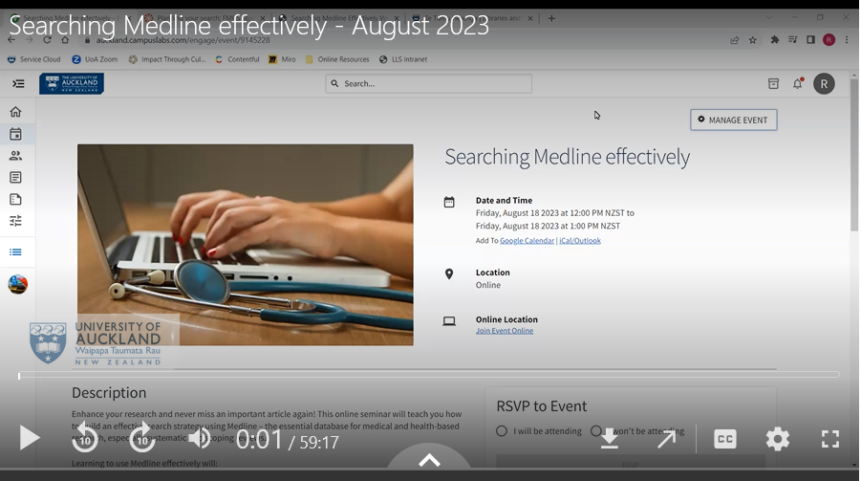
Databases Searching Support
FMHS Research & Study Skills Hub video tutorials: https://canvas.auckland.ac.nz/courses/70858/pages/video-tutorials
Includes:
planning your search
searching Medline effectively
troubleshooting

Slide 99
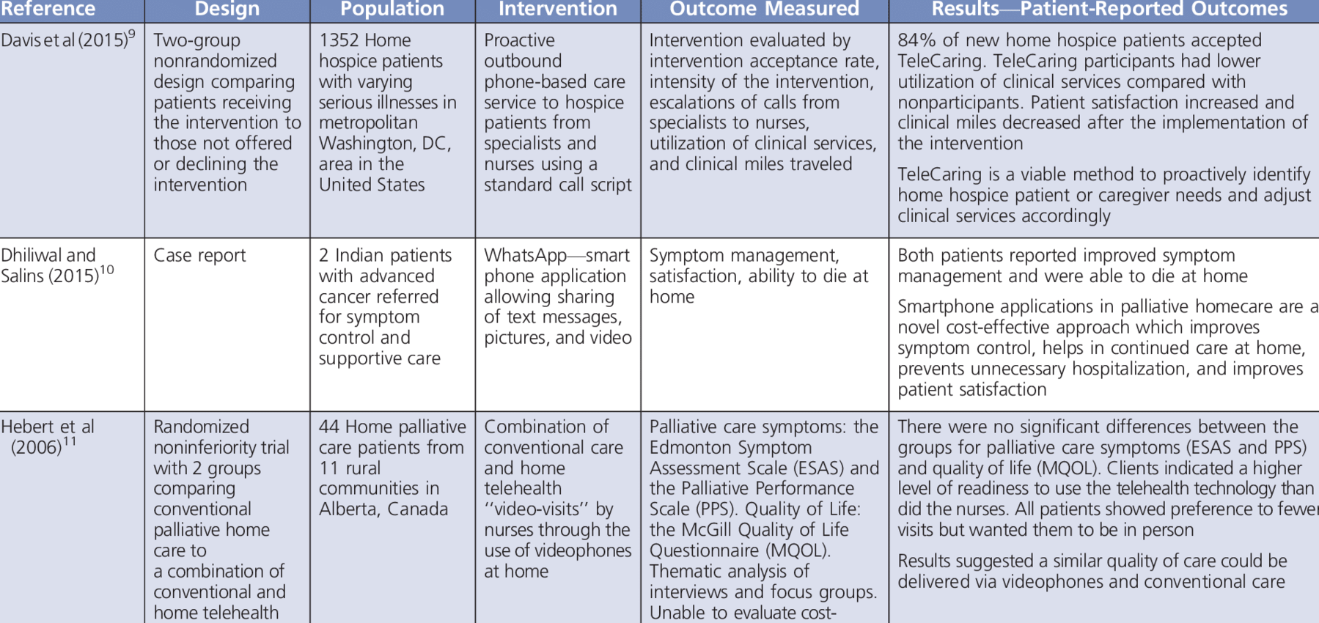
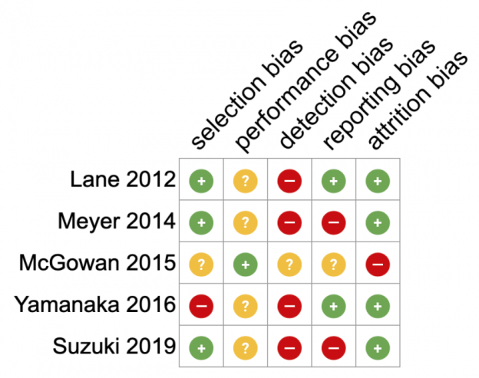
Absract Data
Getting Data for Systematic Review Use a structured form to note study details.
Making the Form
Design it for your research question
Test it out for improvements
Finding the Right Balance
Don’t collect too much data; keep it essential
Customize for Your Review
Adjust the form based on what you're studying
Risk of bias form.
Notes:
Abstracting data in a systematic review involves extracting relevant information from included studies to address the review's research question. This typically includes details such as study characteristics, participant demographics, intervention/exposure details, outcomes measured, and key findings. Abstracted data are organized and synthesized to facilitate analysis and interpretation, enabling researchers to identify patterns, trends, and associations across studies. Effective abstraction ensures that the systematic review accurately reflects the evidence base and supports robust conclusions.
At this stage it pays to be orgaised with your data.
Making a form is a good way to organize your thoughts on each article you have reviewed. Here is an example
Customize for Your Review
Adjust the form based on what you're studying
Finding the Right Balance
Don't get too much data; keep it essential
And here is an example of a Rise of bias form

Slide 100
Thematic synthesis
1 | Coding of text line-by-line
2 | Development of descriptive themes
3 | Generation of analytical themes
Content analysis
1 | Preparation
2 | Coding
3 | Analysis and interpretation
 | Coded data examined for patterns and themes and related to the research question and context
Coding and categorizing textual or visual data from included studies to identify specific content elements related to the research question.
Notes:
In a systematic review, thematic analysis involves identifying recurring themes or patterns within qualitative data extracted from included studies. Researchers categorize and organize data into themes that capture key concepts, ideas, or experiences related to the research question. Thematic analysis helps to uncover underlying meanings and relationships within the data, providing insights into the breadth and depth of the topic under investigation. It offers a structured approach to synthesizing qualitative evidence, enhancing the comprehensiveness and interpretability of the systematic review findings.
Thematic synthesis has three stages:
the coding of text 'line-by-line’
the development of 'descriptive themes
and the generation of 'analytical themes
In a systematic review, content analysis involves systematically coding and categorizing textual or visual data from included studies to identify specific content elements related to the research question. Researchers analyze the frequency, distribution, and characteristics of these content elements to draw conclusions or identify patterns across the data set. Content analysis allows for the exploration of textual descriptions, quotes, images, or other forms of data, providing insights into the nature and scope of the topic under investigation. It offers a structured and rigorous method for synthesizing qualitative data in systematic reviews, contributing to a deeper understanding of the research area.
Preparation
Organizing
Analysis and Interpretation

