Slide 1
Young Scholars Programme
Application Guide

Slide 2
Required documentation
To apply for this programme, you will need to provide the following documentation:
Discretionary Entrance form (signed by your Principal)
Letter of support/reference from your school.
Once your application has been processed, you will be informed by email confirming the outcome of your application.
Please note that delays in processing your application may occur during peak admission periods (December through to March). Hence, we encourage you to apply as early as possible.
After your application has been approved, you will need to provide:
Certified proof of your identity*
* In order to verify your legal name, date of birth and citizenship status, please send in certified photocopies of your identification documents such as your birth certificate or relevant pages of your passport. You can send a certified photocopy of these via post. Alternatively, if you are on our campus and able to, you can drop in to AskAuckland Central with the original documents and they can photocopy and certify these for you. For more information, please see Certifying copies of documents for Admission. Please note, providing proof of identity will not affect or delay the processing of your application, so we advise that you provide this once your application has been approved and you have been accepted into the programme. You do need to have provided your ID before you can enrol.

Slide 3
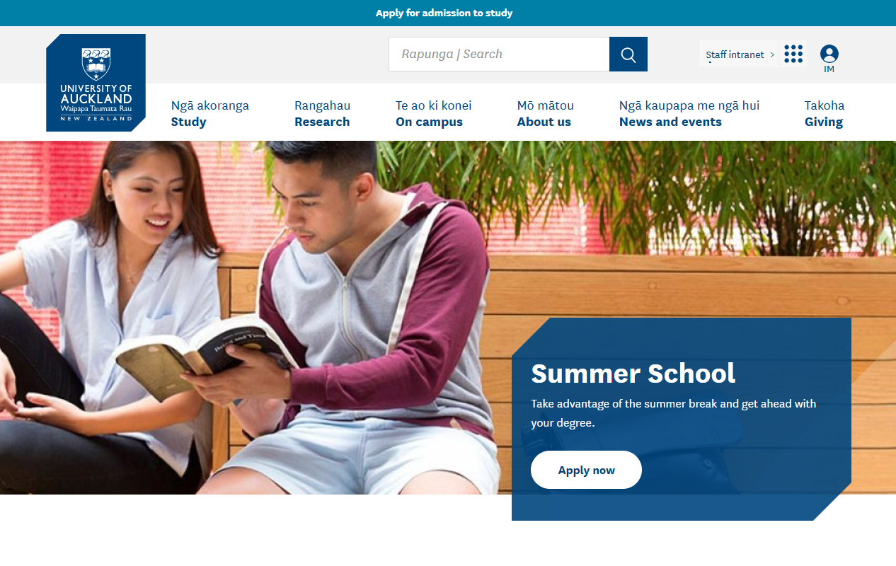

To start your
application,
click ‘Apply
for Admission
to study’ at
the top of the
University of
Auckland
homepage.

Slide 4
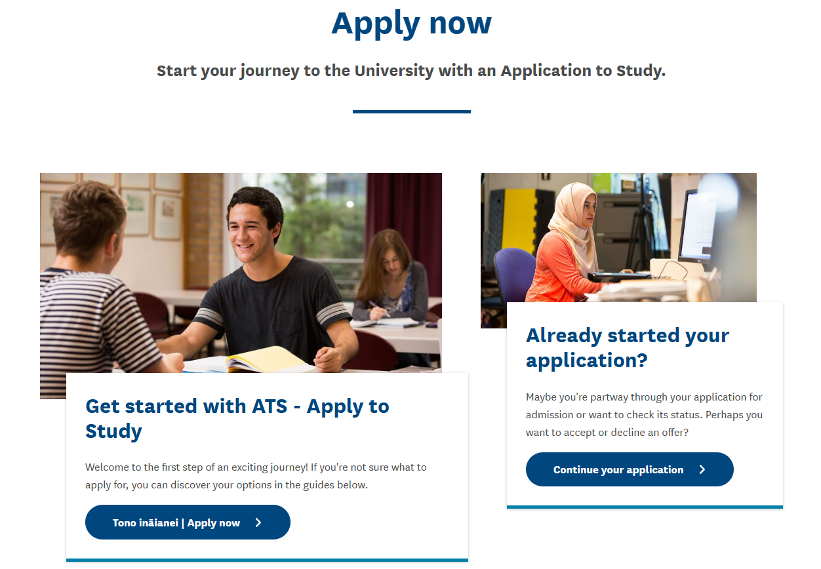
Click ‘Apply now’
to start a new application, or ‘Continue your application’ to resume an existing application.

Slide 5
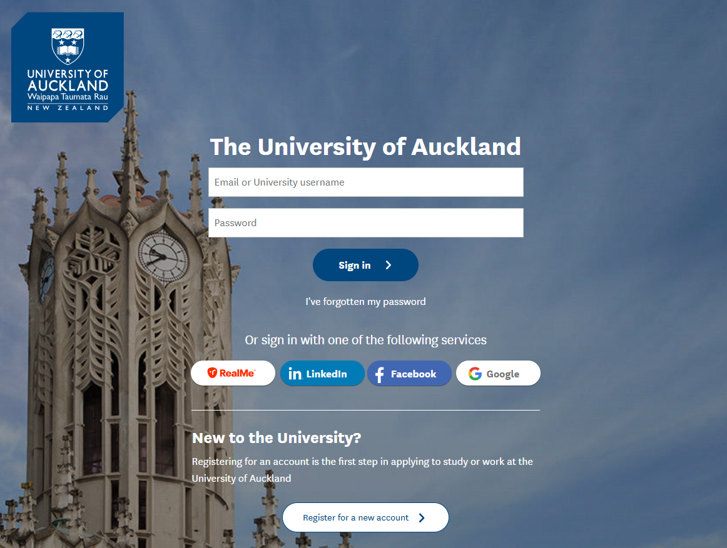
If you already have
a University of Auckland ID, log in
here. If you have
Forgotten your ID or password, call our support team
on 0800 61 62 63 to
reset this over the
phone.
If you have never been a student or
applied to the University of Auckland before, you will need to register for an account.

Slide 6
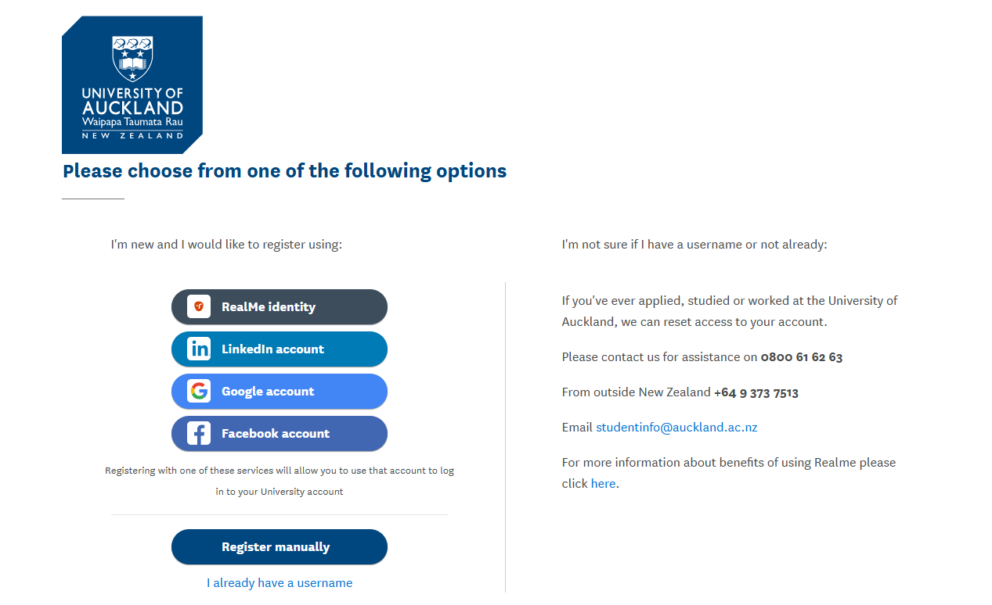
To register for a new account with the University of
Auckland, please follow the prompts. You can log in
with your RealMe, LinkedIn, etc. or manually enter
your details for an account.

Slide 7
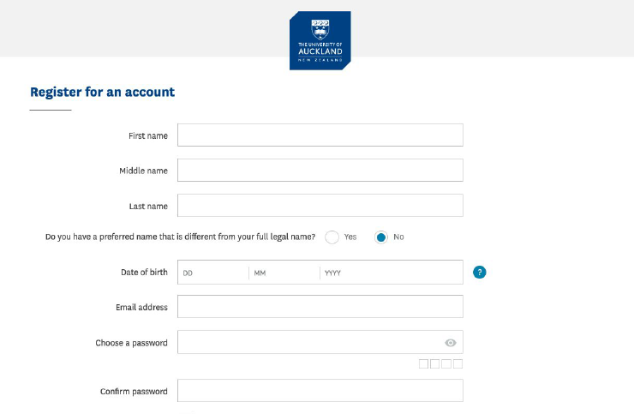
If you choose to register manually, follow the
prompts to enter your personal details. Make sure
to enter the correct citizenship and residency, as
this will be used to calculate your fee type
(domestic vs. international).

Slide 8
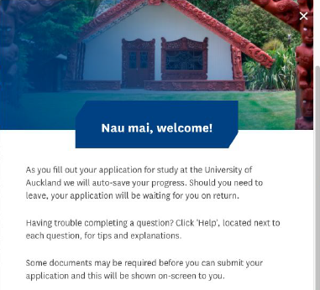
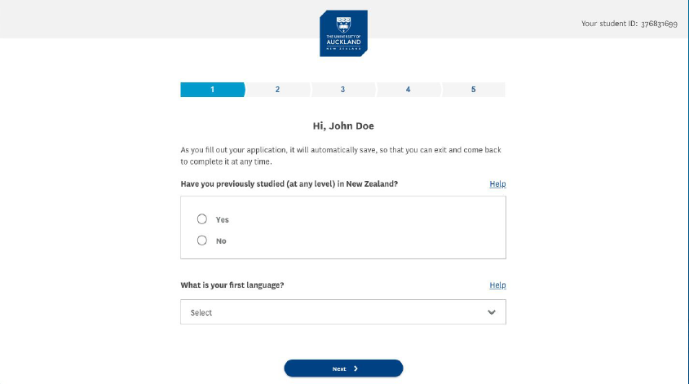
Click ‘Get started’. You will be prompted to enter all
your previous academic history.

Slide 9
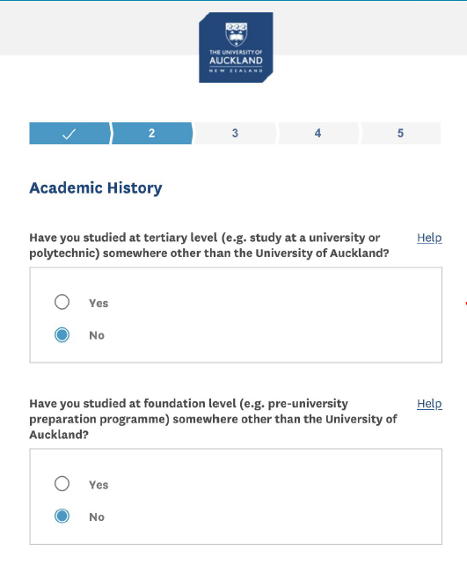
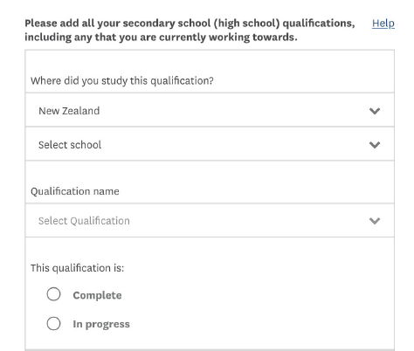
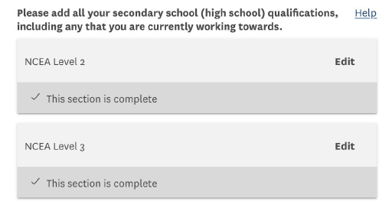
Add your high school study. You will need to have your NSN number ready.
You can add qualifications you have completed and those you are still working towards.

Slide 10
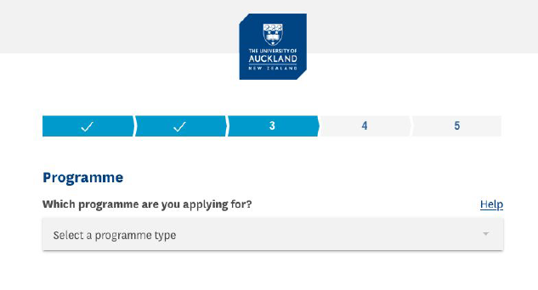
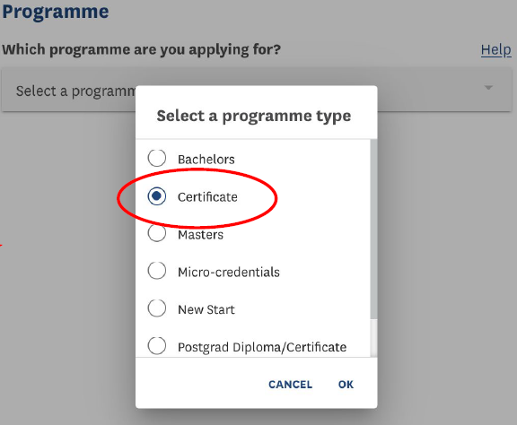
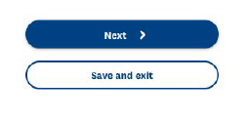
Make sure to select ‘Certificate’ as
‘Programme Type’.

Slide 11
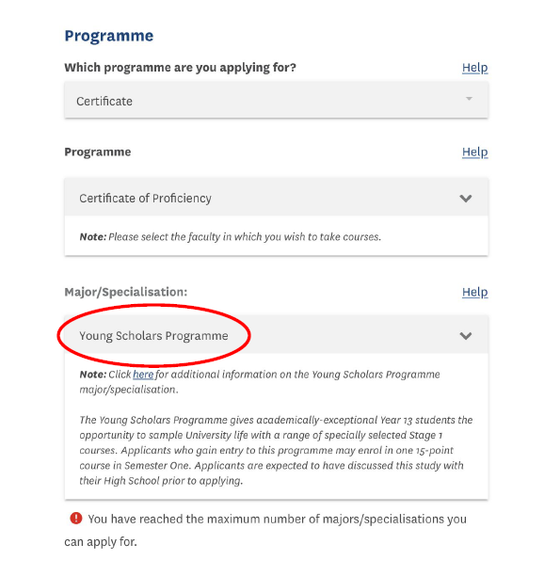
Search ‘Young Scholars’ and
select the ‘Young Scholars
Programme’ from the drop
down list.

Slide 12
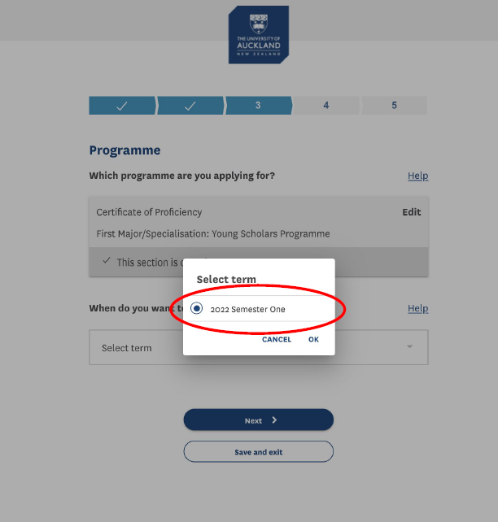
You will be prompted to select a start term. Please select Semester One of the relevant year.

Slide 13
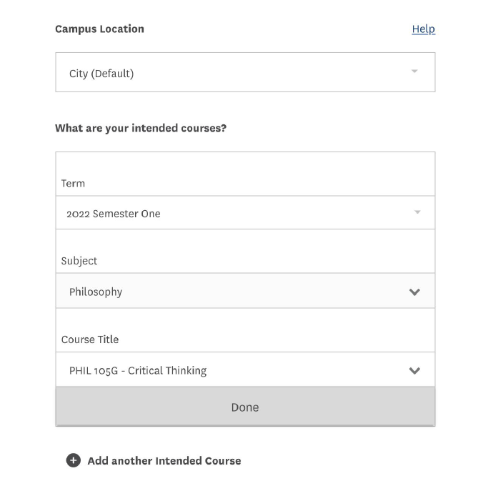
You will be prompted to select
your intended course. If you
are unsure what course you
wish to study, please reach out to our Faculty Academic Coordinators.

Slide 14
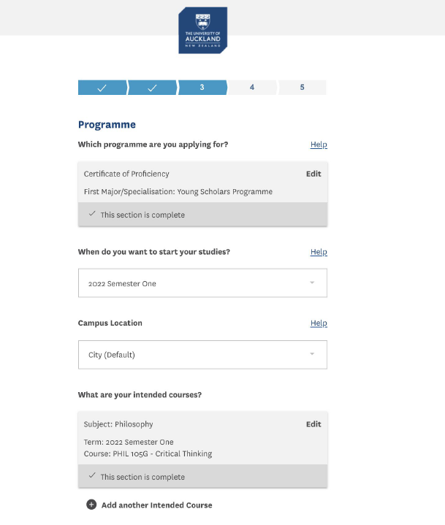
Double check all your programme selections.
For a March start-date, you should have the following options selected:
Select a programme type: Certificate
Programme: Certificate of Proficiency
Select major/specialisation: Young Scholars Programme
When do you want to start your studies: Semester One
Campus Location: City (Default)

Slide 15
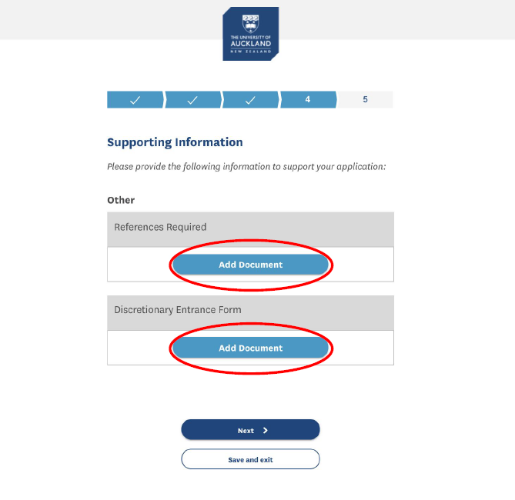
You will need to provide a letter of support from your school and a discretionary entrance form, also signed by your school Principal. If you do not have these ready, then you can submit your application without them and upload them later.

Slide 16
Read the student agreement and terms and conditions, then click ‘Submit Application’.

Slide 17
Quote your ID in any
communication with
us so we can easily
locate your application.

Slide 18
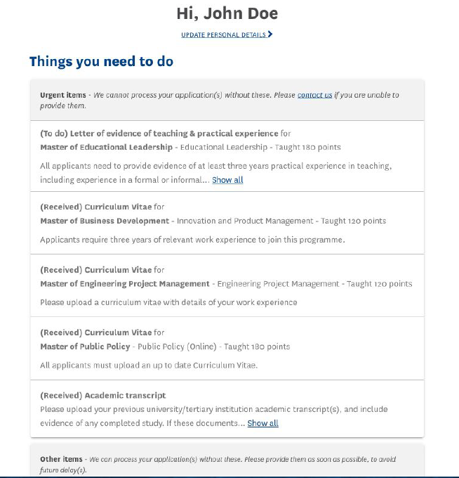
You can come back and check
on your application at any time
here:
applytostudy.auckland.ac.nz/
Any outstanding tasks will
appear in the ‘Things you need
to do’ list.
If you have not provided your
letter of support or discretionary entrance form, you can upload them here.

