Slide 1

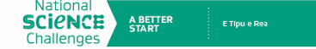

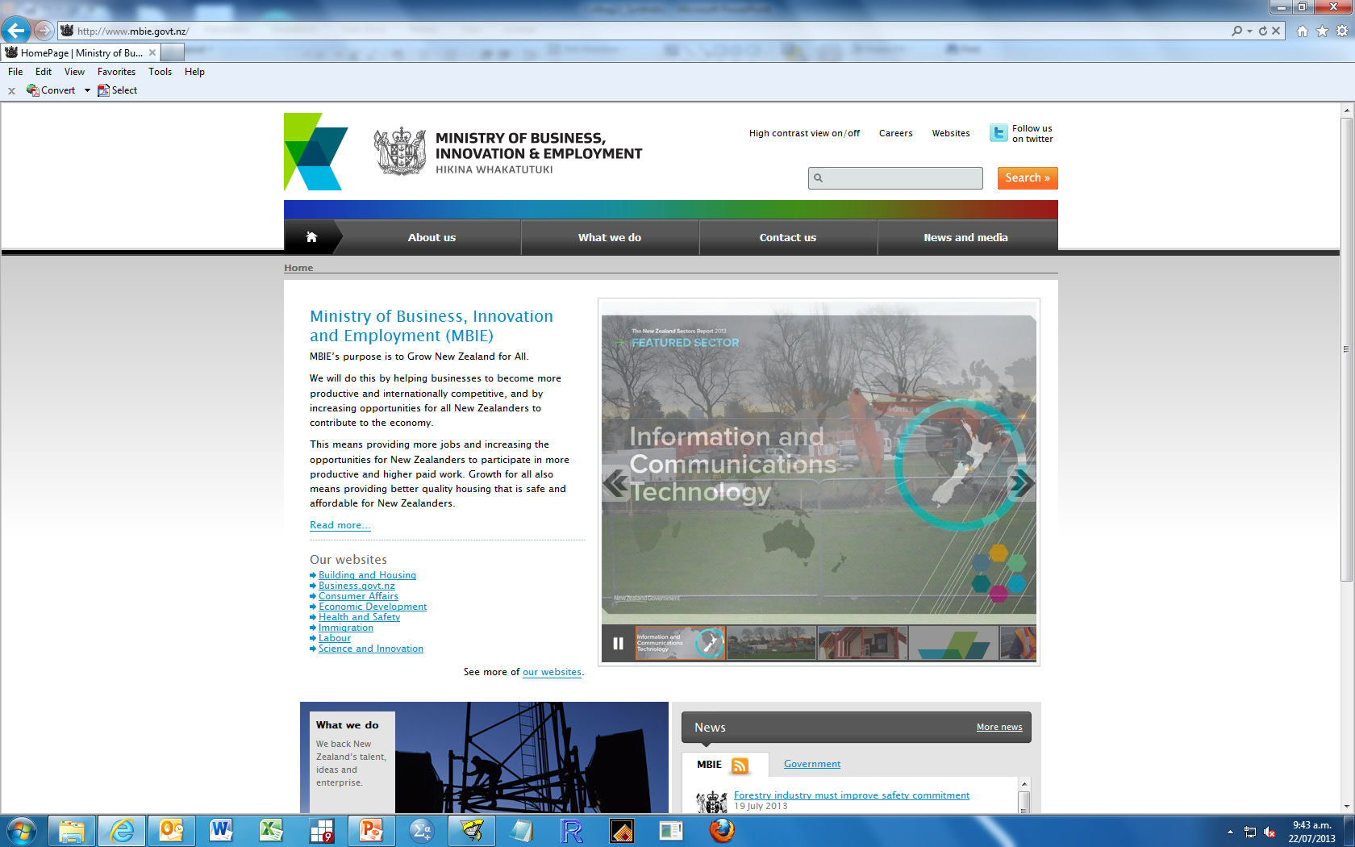

COMPASS Research Colloquium
COMPASS team
11th Research Colloquium
Statistics NZ
10 August 2017

Slide 2
Colloquium Outline
10.15 Introduction to COMPASS – Barry Milne
10.30 E Tipu E Rea: The Better Start National Science Challenge – Rick Audas
11.00 Who misses out on the B4 School Check? – Sheree Gibb
11.30 Improving rates of obesity in New Zealand 4 year old children – Nichola Shackleton
12.00 Seasonal effects on obesity in New Zealand 4 year old children – Barry Milne
12.30 LUNCH BREAK
13.15 Index of multiple deprivation and dental health – Nichola Shackleton
13.45 Loneliness across the life course – Roy Lay-Yee
14.15 A Shiny new app for policy – Barry Milne
14.45 CONCLUSION
Notes:
I start by making the point that the social sciences are very much more than sociology and provide an all-important link to the non-physical environment. I mention Professor Jack Vowles of Political Science and Associate Professor Robin Kearns of Geography, who both expressed interest in being involved in the study at an early stage. If this study is to be more than an updated re-run of Dunedin and Christchurch then we need to take this potential for collaboration very seriously, otherwise this will be just another longitudinal study driven largely by an individualistic and therapeutic disciplinary perspective.
I will say more about sociology – suffice it to say that it addresses the relationships between individuals, groups and institutions in society.
When I come to discuss policy I will distinguish its role as a contextual factor and potential determinant in our scientific model from the research/policy interfrace (i.e. science influencing policy).

Slide 3
What is COMPASS?
2000 – Social Science Research Group
2008 – COMPASS formed
  Centre of Methods and Policy Application in the Social Sciences
The team
  Director: Barry Milne
  Founding Director: Peter Davis
  Senior Research Fellow: Roy Lay-Yee
  Research Fellow: Nichola Shackleton, Jinfeng Zhao
  Research Officer/Admin: Lara Greaves
  Data Analysts: Jessica McLay, Martin von Randow, Kevin Chang, Chris Liu
  Students: Liza Bolton
  Research management: Gerry Cotterell

Slide 4

What does Compass do?
The point(s) of COMPASS

Slide 5
What does Compass do?
The point(s) of COMPASS
Micro-simulation

Slide 6
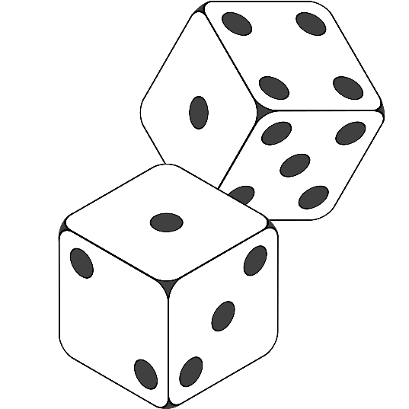
Microsimulation
2005-2008 PCASO (HRC)
2009-2012 BCASO (HRC)
2009-2013 MELC (FRST)
2013-2016 Knowledge Lab (MBIE)
2015-2017 Social Laboratory (RSNZ, Te Pūnaha Matatini)

Slide 7
What does Compass do?
The point(s) of COMPASS
Micro-simulation
Whole population data analysis

Slide 8

Whole Population Data Analysis
2014-2017 Life-course mortality (HRC)
2016-2024 E Tipu E Rea, A Better Start NSC (MBIE)
2016-2018 Vulnerable Children Investment Approach (MSD)
2017-2020 Child Poverty Project (HRC)
Contracts
  2016-2017 Multilingualism (UOA-FDRF – Louise Buckingham)
  2017 Te kaha o nga rangatahi ki Tamakimakaurau (IMSB)
  2017 NZ Index of Multiple Deprivation (HRC – Dan Exeter)

Slide 9
What does Compass do?
The point(s) of COMPASS
Micro-simulation
Quantitative training
Whole population data analysis

Slide 10
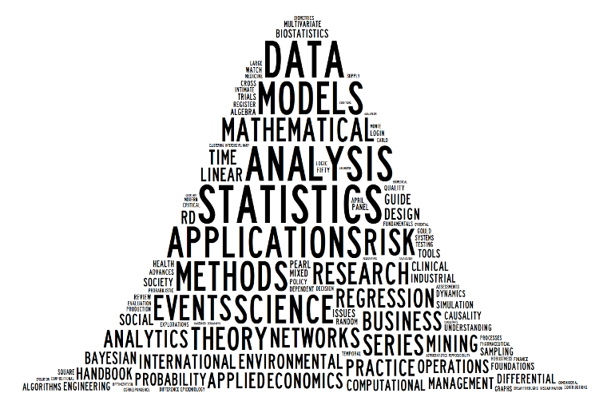
Quantitative training
Training Courses
  NZSSN (http://www.nzssn.org.nz/), since 2005
  Wgtn Nov 2017; Auck Feb 2018)
Taught courses
  Postgrad courses (Stats, PolSci, Education)
Students
  PhD student
  1-3 Postgraduate students
  2-3 Summer Students

Slide 11
What does Compass do?
The point(s) of COMPASS
Micro-simulation
Quantitative training
Surveys
Whole population data analysis

Slide 12

Surveys
International Social Survey Programme (ISSP)
    2013 – National Identity 2016 – Role of Government
    2014 – Citizenship 2017 – Social Networks
    2015 – Work 2018 – Religion
    2019 – Social Inequalities
New Zealand Election Survey
    2011, 2014, 2017
Others
  Ngāti Whātua Ōrākei Survey 2013
  Pacific Suicide Postvention Survey 2015
  Probabilistic Online Panel for New Zealand (POPNZ)

Slide 13
What does Compass do?
The point(s) of COMPASS
Micro-simulation
Promoting Social Science
Quantitative training
Surveys
Whole population data analysis

Slide 14
What does Compass do?
The point(s) of COMPASS
Micro-simulation
Promoting Social Science
Seminar Series
Quantitative training
Surveys
Whole population data analysis

Slide 15
What does Compass do?
The point(s) of COMPASS
Micro-simulation
Promoting Social Science
Quantitative training
Surveys
Collaborations
Whole population data analysis

Slide 16
What does Compass do?
The point(s) of COMPASS
Micro-simulation
Promoting Social Science
Quantitative training
Surveys
Collaborations
Multilingualism
Pacific Aid
VHIN
SUDI
Reoffending
Whole population data analysis

Slide 17
What does Compass do?
The point(s) of COMPASS
Micro-simulation
Longitudinal data
Promoting Social Science
Quantitative training
Surveys
Collaborations
Whole population data analysis

Slide 18
What does Compass do?
The point(s) of COMPASS
Micro-simulation
Longitudinal data
NZLC
LiLACS
Dunedin, NCLR
BCS/MCS
Promoting Social Science
Quantitative training
Surveys
Collaborations
Whole population data analysis

Slide 19
What does Compass do?
The point(s) of COMPASS
Micro-simulation
Longitudinal data
Promoting Social Science
Quantitative training
Surveys
Collaborations
Whole population data analysis
Policy engagement

Slide 20
What does Compass do?
The point(s) of COMPASS
Micro-simulation
Longitudinal data
Promoting Social Science
Quantitative training
Surveys
Collaborations
Whole population data analysis
Policy engagement
MOH, MSD, MOE, MOJ, OCC, TPK, SuPERU, ACC

Slide 21
What does Compass do?
The point(s) of COMPASS
Micro-simulation
Longitudinal data
Promoting Social Science
Quantitative training
Surveys
Collaborations
Whole population data analysis
Policy engagement

Slide 22
Colloquium Outline
10.15 Introduction to COMPASS – Barry Milne
10.30 E Tipu E Rea: The Better Start National Science Challenge – Rick Audas
11.00 Who misses out on the B4 School Check? – Sheree Gibb
11.30 Improving rates of obesity in New Zealand 4 year old children – Nichola Shackleton
12.00 Seasonal effects on obesity in New Zealand 4 year old children – Barry Milne
12.30 LUNCH BREAK
13.15 Index of multiple deprivation and dental health – Nichola Shackleton
13.45 Loneliness across the life course – Roy Lay-Yee
14.15 A Shiny new app for policy – Barry Milne
14.45 CONCLUSION
Notes:
I start by making the point that the social sciences are very much more than sociology and provide an all-important link to the non-physical environment. I mention Professor Jack Vowles of Political Science and Associate Professor Robin Kearns of Geography, who both expressed interest in being involved in the study at an early stage. If this study is to be more than an updated re-run of Dunedin and Christchurch then we need to take this potential for collaboration very seriously, otherwise this will be just another longitudinal study driven largely by an individualistic and therapeutic disciplinary perspective.
I will say more about sociology – suffice it to say that it addresses the relationships between individuals, groups and institutions in society.
When I come to discuss policy I will distinguish its role as a contextual factor and potential determinant in our scientific model from the research/policy interfrace (i.e. science influencing policy).

