Slide 1



Improving rates of obesity in
New Zealand 4 year old children.
Nichola Shackleton
N.shackleton@Auckland.ac.nz

Slide 2
Acknowledgements & Disclaimer Statement
Access to the data presented was managed by Statistics New Zealand under strict micro-data access protocols and in accordance with the security and confidentiality provisions of the Statistic Act 1975. Our findings are not Official Statistics. The opinions, findings, recommendations, and conclusions expressed are those of the researchers, not Statistics NZ
This study was funded by A Better Start – National Science Challenge, New Zealand Ministry for Business, Innovation and Employment.
We would like to thank Ash Dovey from the Ministry of Health for providing information on the eligible population of the B4 School Check, and El-Shadan (Dan) Tautolo (Auckland University of Technology), Rose Richards (University of Otago), Jesse Kokaua (University of Otago) and Justine Camp (University of Otago) for their constructive comments. We also thank Statistics New Zealand for access to these data, and specifically Caleb Moses and Stephen Challands for facilitating timely release of data outputs.

Slide 3

National Science Challenges
Big Data Theme:
Nichola Shackleton, Barry Milne, Rick Audas, Tong Zhu, Barry Taylor
Obesity Theme:
José Derraik, Rachael Taylor, Susan Morton, Marewa Glover, Wayne Cutfield
BIG DATA
OBESITY
MENTAL HEALTH
LITERACY

Slide 4
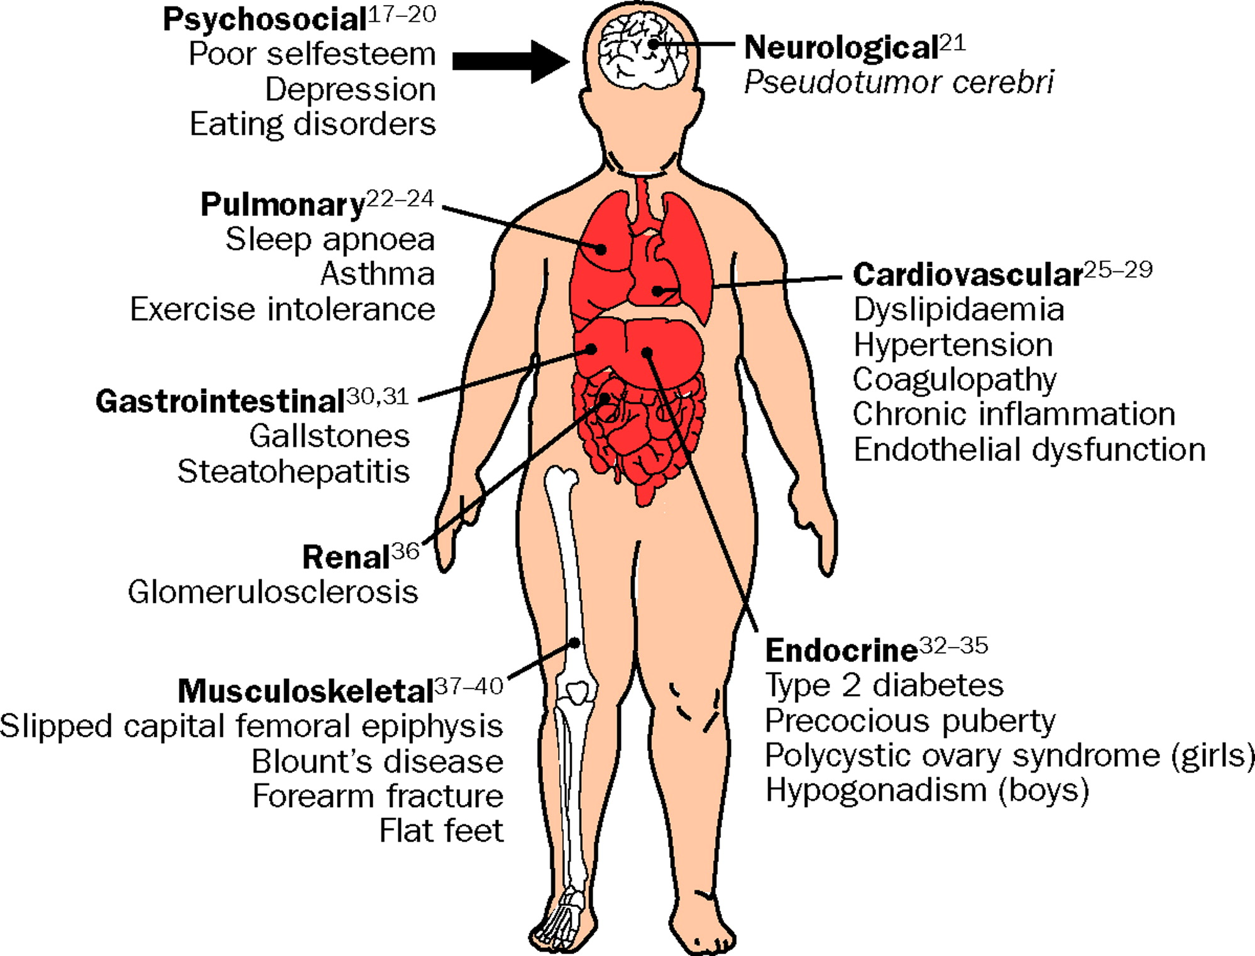

Background
What we know from international literature
Childhood obesity: public-health crisis, common sense cure
Cara B Ebbeling, PhD, Dorota B Pawlak, PhD, Dr David S Ludwig, MD
The Lancet Volume 360, Issue 9331, Pages 473-482 (August 2002)
DOI: 10.1016/S0140-6736(02)09678-2
Evidence from Europe, the USA and Australia suggest stabilising/decreasing prevalence in younger children.
Obesity rates continue to increase for children of lower socioeconomic groups, whereas they are stable or decreasing among children of higher socioeconomic status (NCMP: White et al (2016) HSE: Stamatakis et al (2010) NHANES & NSCH: Frederick et al (2014))
There has been an increasing focus on preventing obesity in early life (during preschool years)
Parents of young children frequently underestimate their children’s overweight or obese status
The Lancet 2002 360, 473-482DOI: (10.1016/S0140-6736(02)09678-2)
Copyright © 2002 Elsevier Ltd Terms and Conditions

Slide 5
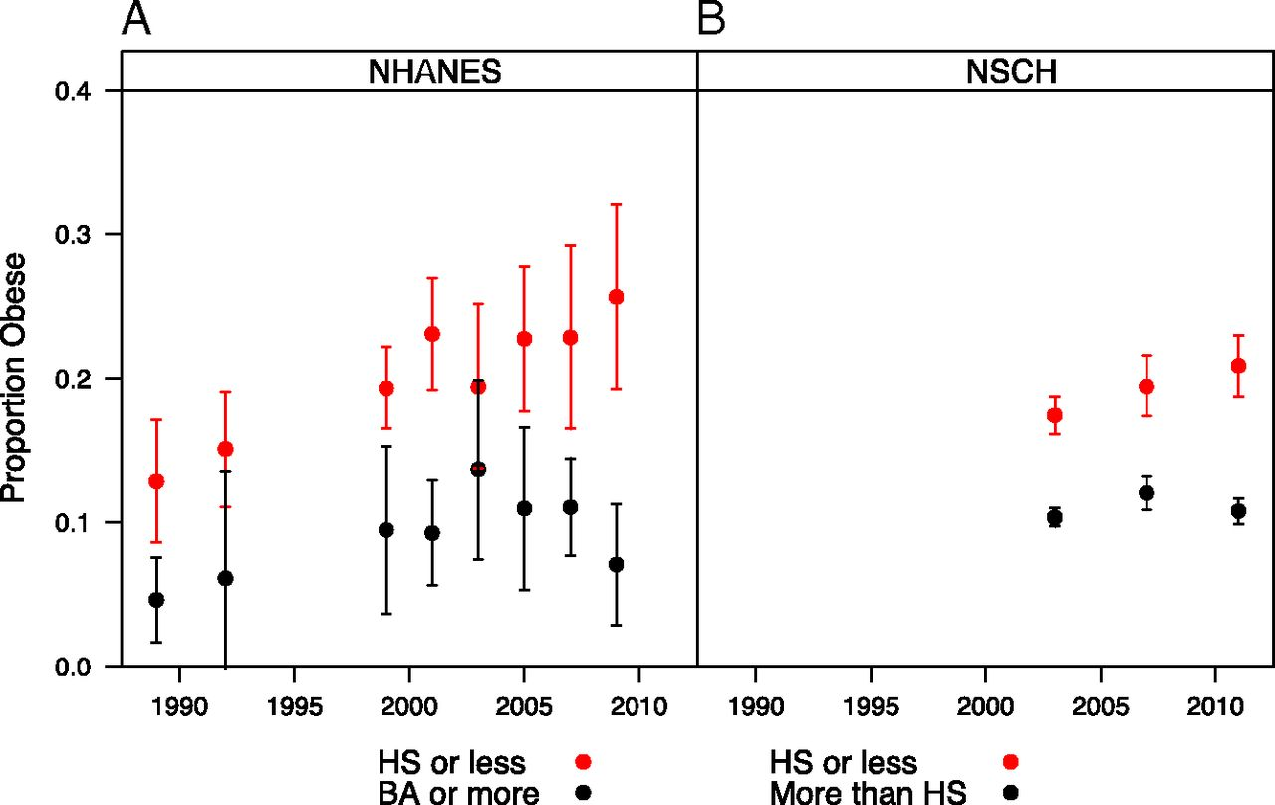
Background
What we know from international literature
Trends in obesity among adolescents aged 12–17 y by parental education in the NHANES III (1999–2010) (A) and the NSCH (2003, 2007, and 2011).
Carl B. Frederick et al. PNAS 2014;111:1338-1342
©2014 by National Academy of Sciences
Notes:
using data from two nationally representative health surveys, the 1988–2010 National Health and Nutrition Examination Surveys and the 2003–2011 National Survey of Children’s Health 91,000-100,000
NHANES 5000 per year

Slide 6
Background
What we know from international literature
Evidence from Europe, the USA and Australia suggest stabilising/decreasing prevalence in younger children.
Obesity rates continue to increase for children of lower socioeconomic groups, whereas they are stable or decreasing among children of higher socioeconomic status (NCMP: White et al (2016) HSE: Stamatakis et al (2010) NHANES & NSCH: Frederick et al (2014))
There has been an increasing focus on preventing obesity in early life (during preschool years)
Parents of young children frequently underestimate their children’s overweight or obese status
The Lancet 2002 360, 473-482DOI: (10.1016/S0140-6736(02)09678-2)
Copyright © 2002 Elsevier Ltd Terms and Conditions

Slide 7
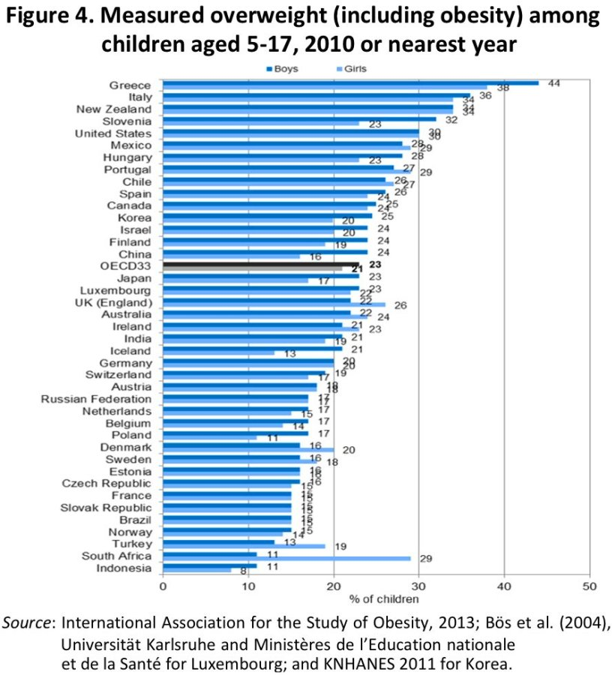
Background
What we know about NZ
Number 3
The prevalence rates of childhood overweight and obesity in New Zealand are amongst the highest in the world.
National Health Survey data estimate that 22% of children aged 2-14 years are classified as overweight, and a further 11% are classified as obese
Rates of obesity in New Zealand are particularly high amongst those living in the most deprived areas, Pacific children, and Māori children.
However, these data were obtained on relatively small cohorts of children and adolescents, and we know little about trends in obesity amongst younger children in New Zealand.

Slide 8

Background
What we can add
The B4 School Check data is integrated into the IDI
Established September 2008 (we use 2010/2011 to 2015/2016)
Eligible children are those who are enrolled with a PHO on their 4th birthday- target is 90% of eligible children
coverage between 72-92%
We can link to better quality ethnicity information (census/DIA)
We have the numbers to look at ethnic subgroups
http://www.health.govt.nz/our-work/life-stages/child-health/b4-school-check

Slide 9
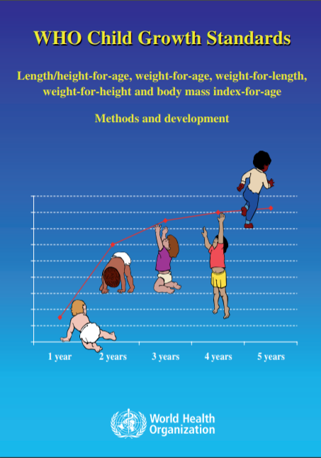
Data Preparation & measures
Restricted data to:
  those ages 48-60 months
  Fiscal years 2010/2011 – 2015/2016
Sample:
  Height and weight for 319,101 children
    measured in light clothing, shoes removed, equipment on stable levelled hard surface to the nearest 0.1 cm and 0.1 kg
  84% of the 379 080 Estimated Resident Population of 4-year-olds
  1 803 individuals (0.6% of the sample) were excluded due to extreme BMI (<-5 SDS,>5 SDS)
  analytic sample of 317 298 children
Linked to other data
  Census, source_ranked_ethnicity table, Address notification
WHO Anthro package used to calculate ZBMI
  Overweight: ≥ 85th percentile
  Obesity: ≥ 95th percentile
  Extreme Obesity ≥ 99.7th percentile

Slide 10
Describing the sample
 | 2010/2011 | 2011/2012 | 2012/2013 | 2013/2014 | 2014/2015 | 2015/2016
nª | 45285 | 50469 | 50331 | 58029 | 56643 | 56541
MoH coverage rate (%) | 72 | 79 | 80 | 91 | 92 | 92
Gender (%)
Male | 50.8 | 51.3 | 51.6 | 51.4 | 51.1 | 51.2
Female | 49.2 | 48.7 | 48.4 | 48.6 | 48.9 | 48.8
Ethnicity (%)
European | 74.0 | 72.2 | 72.5 | 71.2 | 69.8 | 69.1
Māori | 27.0 | 25.9 | 26.0 | 25.9 | 26.1 | 25.8
Pacific overall | 12.5 | 13.4 | 13.2 | 13.9 | 14.3 | 14.1
-Samoan | 6.0 | 6.7 | 6.4 | 6.7 | 6.7 | 6.4
-Tongan | 2.7 | 3.0 | 3.1 | 3.4 | 3.3 | 3.4
-Cook Island Māori | 3.0 | 3.0 | 3.1 | 3.1 | 3.3 | 3.2
Asian overall | 9.8 | 11.8 | 12.2 | 13.1 | 14.7 | 15.9
-Indian | 3.6 | 4.2 | 4.3 | 4.4 | 4.6 | 4.5
-Chinese | 2.7 | 3.6 | 3.8 | 4.0 | 4.7 | 5.1
ª randomly rounded to a base of 3, as per the confidentiality rules of Statistics New Zealand.
^{b} Ethnic groups are not mutually exclusive, a child can be classified as belonging to multiple ethnicities.

Slide 11
Describing the sample
 | 2010/2011 | 2011/2012 | 2012/2013 | 2013/2014 | 2014/2015 | 2015/2016
Deprivation (NZDep) (%)
quintile 1 (least deprived) | 18.3 | 18.9 | 19.0 | 19.3 | 18.8 | 19.6
quintile 2 | 17.4 | 18.0 | 18.3 | 18.0 | 18.7 | 18.5
quintile 3 | 18.2 | 17.9 | 18.2 | 18.6 | 18.2 | 18.3
quintile 4 | 19.0 | 18.7 | 19.4 | 19.3 | 19.5 | 19.0
quintile 5 (most deprived) | 25.0 | 24.7 | 24.1 | 24.5 | 24.6 | 24.2
Area (%)
Urban | 85.2 | 86.2 | 86.2 | 87.2 | 87.1 | 87.4
Rural | 14.8 | 13.8 | 13.8 | 12.8 | 12.9 | 12.6

Slide 12
Results: Overall Prevalence rates
prevalence rates for overweight decreased by 2.2 percentage points [1.8-2.5], from 35 to 32.8%
Prevalence rates for obesity decreased by 2.0 percentage points [1.8-2.2], from 16.9 to 14.9%
extreme obesity decreased by 0.6 [0.4-0.6] percentage points, from 3.5 to 2.9%
evidence for a decreasing linear trend for overweight (slope=-0.38), obesity (slope=-0.35) and extreme obesity (slope=-0.12)
 | 2010/ 2011 | 2011/ 2012 | 2012/ 2013 | 2013/ 2014 | 2014/ 2015 | 2015/ 2016 | Trend (RR)
Overweight | 35.0 | 34.3 | 33.5 | 33.3 | 33.6 | 32.8 | 0.989
 | (34.8, 35.2) | (34.1, 34.5) | (33.3, 33.7) | (33.2, 33.4) | (33.5, 33.7) | (32.7, 33.0) | (0.988, 0.990)
Obesity | 16.9 | 16.1 | 15.6 | 15.3 | 15.5 | 14.9 | 0.979
 | (16.7, 17.0) | (15.9, 16.2) | (15.4, 15.7) | (15.2, 15.4) | (15.4, 15.6) | (14.8, 14.9) | (0.977, 0.980)
Extreme obesity | 3.5 | 3.4 | 3.2 | 3.2 | 3.0 | 2.9 | 0.966
 | (3.4, 3.5) | (3.4, 3.5) | (3.2, 3.3) | (3.2, 3.3) | (3.0, 3.1) | (2.9, 3.0) | (0.962, 0.970)

Slide 13
Results: Gender
 |  | 2010/ | 2011/ | 2012/ | 2013/ | 2014/ | 2015/ | Trend
 |  | 2011 | 2012 | 2013 | 2014 | 2015 | 2016 | (RR)
Overweight | Male | 39.1 | 38.1 | 37.2 | 36.7 | 36.9 | 36.2 | 0.986
 |  | (38.8, 39.4) | (37.8, 38.4) | (36.9, 37.4) | (36.5, 36.8) | (36.7, 37.0) | (36.1, 36.4) | (0.985, 0.988)
 | Female | 30.8 | 30.3 | 29.5 | 29.7 | 30.3 | 29.3 | 0.993
 |  | (30.5, 31.1) | (30.1, 30.6) | (29.3, 29.8) | (29.5, 29.8) | (30.1, 30.4) | (29.2, 29.5) | (0.991, 0.995)
Obesity | Male | 19.6 | 18.5 | 17.9 | 17.4 | 17.6 | 17.1 | 0.976
 |  | (19.3, 19.8) | (18.2, 18.7) | (17.7, 18.1) | (17.3, 17.5) | (17.5, 17.8) | (16.9, 17.2) | (0.974, 0.978)
 | Female | 14.1 | 13.5 | 13.1 | 13.0 | 13.2 | 12.5 | 0.982
 |  | (13.9, 14.3) | (13.3, 13.7) | (12.9, 13.3) | (12.9, 13.1) | (13.1, 13.3) | (12.4, 12.7) | (0.979, 0.985)
Extreme Obesity | Male | 4.0 | 4.0 | 3.7 | 3.7 | 3.4 | 3.2 | 0.957
 |  | (3.9, 4.1) | (3.9, 4.1) | (3.6, 3.8) | (3.7, 3.8) | (3.4, 3.5) | (3.2, 3.3) | (0.952, 0.962)
 | Female | 2.9 | 2.8 | 2.7 | 2.7 | 2.6 | 2.6 | 0.978
 |  | (2.8, 3.0) | (2.7, 2.9) | (2.6, 2.8) | (2.6, 2.7) | (2.6, 2.7) | (2.5, 2.6) | (0.972, 0.984)

Slide 14
Results: Major Ethnic Groups - Overweight
 | 2010/ | 2011/ | 2012/ | 2013/ | 2014/ | 2015/ | Trend
 | 2011 | 2012 | 2013 | 2014 | 2015 | 2016 | (RR)
European | 32.2 | 31.7 | 30.8 | 30.4 | 31.3 | 30.8 | 0.993
 | (32.0, 32.5) | (31.5, 31.9) | (30.5, 31.0) | (30.3, 30.6) | (31.2, 31.5) | (30.7, 31.0) | (0.991,0.994)
Māori | 42.2 | 42.0 | 41.6 | 41.4 | 41.9 | 41.1 | 0.996
 | (41.8, 42.6) | (41.6, 42.4) | (41.2, 42.0) | (41.1, 41.6) | (41.6, 42.1) | (40.9, 41.3) | (0.994,0.998)
Pacific | 55.4 | 54.0 | 54.6 | 54.8 | 53.4 | 52.4 | 0.991
 | (54.7, 56.0) | (53.5, 54.5) | (54.1, 55.1) | (54.5, 55.2) | (53.1, 53.7) | (52.1, 52.7) | (0.989,0.993)
Asian | 22.8 | 23.0 | 21.0 | 21.4 | 20.8 | 20.4 | 0.977
 | (22.2, 23.4) | (22.5, 23.5) | (20.5, 21.4) | (21.1, 21.7) | (20.6, 21.1) | (20.2, 20.6) | (0.973,0.981)
overall | 35.0 | 34.3 | 33.5 | 33.3 | 33.6 | 32.8 | 0.989
 | (34.8, 35.2) | (34.1, 34.5) | (33.3, 33.7) | (33.2, 33.4) | (33.5, 33.7) | (32.7, 33.0) | (0.988,0.990)
Decreasing trends in overweight for all ethnic groups. Relative to the initial prevalence, Asian children experienced the largest decrease in prevalence
COMPARE TO TOTAL POPULATION

Slide 15
Results: Major Ethnic Groups - Obese
Largest relative decrease for Asian children. Changes in obesity prevalence largest for Pacific (3.3 [2.4-4.2] percentage points) and Asian (2.8 [2.1-3.5] percentage points) children, compared to the overall population.
 | 2010/ | 2011/ | 2012/ | 2013/ | 2014/ | 2015/ | Trend
 | 2011 | 2012 | 2013 | 2014 | 2015 | 2016 | (RR)
European | 14.2 | 13.5 | 12.8 | 12.5 | 13.2 | 12.7 | 0.983
 | (14.0, 14.3) | (13.3, 13.6) | (12.6, 13.0) | (12.4, 12.6) | (13.1, 13.3) | (12.6, 12.8) | (0.981,0.985)
Māori | 22.2 | 20.9 | 21.0 | 20.4 | 20.9 | 20.0 | 0.985
 | (21.8, 22.6) | (20.6, 21.2) | (20.6, 21.3) | (20.3, 20.6) | (20.7, 21.1) | (19.8, 20.2) | (0.982,0.988)
Pacific | 33.5 | 31.8 | 32.9 | 31.8 | 30.1 | 30.2 | 0.980
 | (32.8, 34.1) | (31.3, 32.3) | (32.4, 33.4) | (31.5, 32.1) | (29.9, 30.4) | (29.9, 30.5) | (0.977,0.983)
Asian | 10.9 | 10.8 | 10.3 | 9.3 | 8.8 | 8.1 | 0.938
 | (10.4, 11.3) | (10.5, 11.2) | (9.9, 10.6) | (9.1, 9.5) | (8.7, 9.0) | (7.9, 8.3) | (0.932,0.944)
overall | 16.9 | 16.1 | 15.6 | 15.3 | 15.5 | 14.9 | 0.979
 | (16.7, 17.0) | (15.9, 16.2) | (15.4, 15.7) | (15.2, 15.4) | (15.4, 15.6) | (14.8, 14.9) | (0.977,0.980)

Slide 16
Results: Major Ethnic Groups – Extreme obesity
 | 2010/ | 2011/ | 2012/ | 2013/ | 2014/ | 2015/ | Trend
 | 2011 | 2012 | 2013 | 2014 | 2015 | 2016 | (RR)
European | 2.3 | 2.2 | 2.1 | 2.1 | 2.0 | 2.0 | 0.976
 | (2.2, 2.3) | (2.1, 2.3) | (2.0, 2.2) | (2.1, 2.2) | (2.0, 2.0) | (2.0, 2.1) | (0.97,0.982)
Māori | 5.0 | 4.7 | 4.6 | 4.3 | 4.5 | 4.2 | 0.970
 | (4.8, 5.1) | (4.5, 4.9) | (4.5, 4.8) | (4.2, 4.4) | (4.4, 4.6) | (4.1, 4.3) | (0.963,0.976)
Pacific | 10.0 | 9.7 | 9.7 | 8.8 | 8.2 | 7.9 | 0.949
 | (9.6, 10.4) | (9.4, 10.1) | (9.4, 10.0) | (8.6, 9.0) | (8.0, 8.3) | (7.7, 8.0) | (0.943,0.956)
Asian | 2.7 | 2.5 | 2.5 | 2.4 | 2.0 | 1.8 | 0.920
 | (2.5, 2.9) | (2.3, 2.7) | (2.3, 2.7) | (2.3, 2.5) | (1.9, 2.1) | (1.7, 1.8) | (0.908,0.932)
overall | 3.5 | 3.4 | 3.2 | 3.2 | 3.0 | 2.9 | 0.966
 | (3.4, 3.5) | (3.4, 3.5) | (3.2, 3.3) | (3.2, 3.3) | (3.0, 3.1) | (2.9, 3.0) | (0.962,0.970)

Slide 17
Results: Ethnic sub groups
Trends Over time | Overweight | Obese | Extreme Obesity
- Samoan | 0.996 | 0.990 | 0.969
 | (0.993,0.999) | (0.986,0.994) | (0.96,0.978)
- Tongan | 0.985 | 0.966 | 0.927
 | (0.982,0.989) | (0.96,0.971) | (0.917, 0.938)
- Cook Island Māori | 0.985 | 0.982 | 0.963
 | (0.981,0.990) | (0.975,0.988) | (0.948,0.978)
- Indian | 0.991 | 0.961 | 0.948
 | (0.983,0.999) | (0.951,0.972) | (0.928,0.968)
- Chinese | 0.984 | 0.912 | 0.919
 | (0.976,0.991) | (0.901,0.923) | (0.892,0.948)
In the pacific subgroups: Tongan children experienced the largest relative and absolute decrease in the prevalence of obesity and extreme obesity, despite having the highest prevalence rates: Decrease in obesity and extreme obesity of 7.6 and 5.3 percentage points respectively

Slide 18
Results: Ethnic sub groups - Obesity
 | 2010/ | 2011/ | 2012/ | 2013/ | 2014/ | 2015/ | Trend
 | 2011 | 2012 | 2013 | 2014 | 2015 | 2016 | (RR)
Pacific overall | 33.5 | 31.8 | 32.9 | 31.8 | 30.1 | 30.2 | 0.980
 | (32.8, 34.1) | (31.3, 32.3) | (32.4, 33.4) | (31.5, 32.1) | (29.9, 30.4) | (29.9, 30.5) | (0.977,0.983)
- Samoan | 34.5 | 33.3 | 33.8 | 32.8 | 31.7 | 33.2 | 0.990
 | (33.6, 35.4) | (32.6, 34.1) | (33.0, 34.5) | (32.4, 33.3) | (31.2, 32.1) | (32.8, 33.7) | (0.986,0.994)
- Tongan | 42.6 | 37.2 | 40.0 | 38.6 | 34.7 | 35.0 | 0.966
 | (41.2, 44.0) | (36.1, 38.3) | (38.9, 41.1) | (38.0, 39.3) | (34.1, 35.3) | (34.4, 35.6) | (0.96,0.971)
- Cook Island Māori | 29.8 | 28.3 | 27.4 | 27.4 | 26.7 | 26.9 | 0.982
 | (28.6, 31.1) | (27.2, 29.3) | (26.4, 28.4) | (26.8, 28.0) | (26.1, 27.3) | (26.4, 27.5) | (0.975,0.988)
Asian overall | 10.9 | 10.8 | 10.3 | 9.3 | 8.8 | 8.1 | 0.938
 | (10.4, 11.3) | (10.5, 11.2) | (9.9, 10.6) | (9.1, 9.5) | (8.7, 9.0) | (7.9, 8.3) | (0.932,0.944)
- Indian | 10.7 | 10.9 | 10.7 | 9.7 | 8.9 | 9.2 | 0.961
 | (9.9, 11.4) | (10.2, 11.5) | (10.1, 11.3) | (9.4, 10.1) | (8.6, 9.2) | (8.9, 9.5) | (0.951,0.972)
- Chinese | 11.5 | 10.1 | 8.4 | 7.6 | 8.6 | 6.6 | 0.912
 | (10.7, 12.4) | (9.5, 10.7) | (7.8, 8.9) | (7.2, 7.9) | (8.3, 8.9) | (6.4, 6.9) | (0.901,0.923)

Slide 19
Results: Deprivation
Children residing in the least deprived areas (quintile 1) experienced greater relative decreases in overweight and obesity than those residing in the most deprived areas
Trends Over time | Overweight | Obese | Extreme Obesity
Quintile 1 (least deprived) | 0.988 | 0.976 | 0.956
 | (0.985,0.991) | (0.97,0.981) | (0.942,0.970)
Quintile 2 | 0.986 | 0.969 | 0.968
 | (0.983,0.988) | (0.964,0.974) | (0.956,0.981)
Quintile 3 | 0.986 | 0.976 | 0.975
 | (0.983,0.988) | (0.971,0.980) | (0.965,0.986)
Quintile 4 | 0.991 | 0.985 | 0.960
 | (0.989,0.994) | (0.981,0.989) | (0.951,0.968)
Quintile 5 (most deprived) | 0.995 | 0.984 | 0.973
 | (0.993,0.996) | (0.982,0.987) | (0.967,0.979)

Slide 20
Results: Deprivation - obesity
 | 2010/ | 2011/ | 2012/ | 2013/ | 2014/ | 2015/ | Trend
 | 2011 | 2012 | 2013 | 2014 | 2015 | 2016 | (RR)
Quintile 1 (least deprived) | 10.8 | 10.6 | 9.8 | 9.6 | 9.6 | 9.7 | 0.976
 | (10.5, 11.2) | (10.3, 10.9) | (9.6, 10.1) | (9.4, 9.8) | (9.5, 9.8) | (9.5, 9.9) | (0.97,0.981)
Quintile 2 | 13.1 | 12.5 | 11.7 | 11.2 | 11.8 | 10.9 | 0.969
 | (12.8, 13.5) | (12.1, 12.8) | (11.4, 12.0) | (11.0, 11.3) | (11.7, 12.0) | (10.7, 11.1) | (0.964,0.974)
Quintile 3 | 15.5 | 13.4 | 13.8 | 13.0 | 13.7 | 12.9 | 0.976
 | (15.1, 15.8) | (13.1, 13.8) | (13.5, 14.1) | (12.8, 13.2) | (13.5, 13.9) | (12.7, 13.1) | (0.971,0.980)
Quintile 4 | 17.9 | 17.0 | 16.4 | 16.8 | 16.6 | 16.2 | 0.985
 | (17.5, 18.3) | (16.6, 17.3) | (16.1, 16.7) | (16.6, 17.0) | (16.4, 16.8) | (16.0, 16.4) | (0.981,0.989)
Quintile 5 (most deprived) | 24.3 | 24.1 | 23.8 | 23.3 | 23.3 | 22.4 | 0.984
 | (23.9, 24.7) | (23.8, 24.5) | (23.4, 24.1) | (23.0, 23.5) | (23.1, 23.5) | (22.2, 22.6) | (0.982,0.987)

Slide 21
Results
Are downward trends fully explained by changing composition of sample/population?
  Linear time trends were adjusted for sex, ethnicity, deprivation and area. Overweight RR=0.992[0.990-0.994]; Obesity RR=0.980[0.977-0.983]; extreme obesity RR=0.963[0.956-0.969])
Was using WHO protocols of (≥-5SD to ≤ 5SD) too restrictive for a NZ population?
  We found no systematic differences by ethnicity, deprivation, gender or fiscal year for those between +5SDS and +7SDS. including those up to +7SD did not change the overall prevalence to the nearest 1 decimal place, and estimated prevalence by ethnicity and deprivation were within the estimated confidence intervals presented.
Attendance is not 100%. What if those who do not attend had higher obesity rates?
  We conducted a sensitivity check considering what would happen to the overall trends if those who did not attend had a 50% higher obesity rate than those who did attend. As attendance rates were lower in the earlier years, this exaggerates the observed downward trend with obesity decreasing from 19.3% in 2010/2011 to 15.5% in 2015/2016.
  We also considered what would happen with a 50% lower obesity rate among non-attendees. This resulted in stable prevalence estimates across time from 14.5% in 2010/2011 to 14.3% in 2015/2016.

Slide 22
Limitations
we are unsure of the extent to which protocols for measuring children’s height and weight were adhered to for all children
Māori and Pacific children may have different body compositions for a given BMI compared to other ethnic groups in New Zealand. Our figures may over-estimate obesity in these populations. BUT any misclassification of BMI for Māori or Pacific should affect data from all years similarly, so should not affect the overall downward trend.
In the 2010/2011 fiscal year, the MoH reports very low (35%) uptake of the B4 School Check in Auckland. The rate increased to 65% in 2011/2012 and climbed to 95% in 2015/2016. Based on the characteristics we measured (ethnicity, deprivation, gender), the composition of the 2010/2011 sample appears to be very similar to later years.
We only captured six years’ worth of data, and longer follow-up will provide more confidence in the estimates of change over time

Slide 23
Conclusions
Our findings support international reports of decreasing child obesity prevalence from developed countries such as the USA, Singapore, some parts of Europe and UK.
Overweight and obesity rates appear to be on a downward trend among 4-year-old children in New Zealand, and this trend is consistent across socioeconomic and demographic groups.
This research was only descriptive. Future research will concentrate on unpacking and explaining differentials in prevalence rates across demographic groups and communities, as this is a key issue requiring thorough investigation to better inform future strategies to reduce inequity.

Slide 25
Defining overweight and obesity in pre-school children: IOTF reference or WHO standard?
L. Monasta, T. Lobstein, T. J. Cole, J. Vignerová and A. Cattaneo
The IOTF reference is based on children from cross-sectional surveys designed to be representative of the whole population.
The WHO standard is based on samples of children selected to represent optimal growth (no environmental or economic constraints, exclusive or predominant breastfeeding for at least 4 months, single birth, non-smoking mother and absence of significant morbidity in the newborn).
The IOTF approach is based on the idea that the BMI-based definitions of overweight and obesity at 18 years of age, which are considered to be associated to health consequences in adults, can be tracked back to younger ages.
The WHO approach is based on the concept that, under ideal circumstances, average child growth, in terms of height and weight, is the same everywhere in the world.

Slide 26
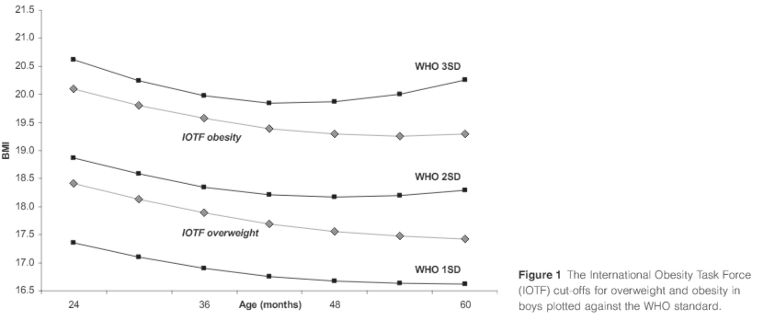
Defining overweight and obesity in pre-school
children: IOTF reference or WHO standard?
L. Monasta, T. Lobstein, T. J. Cole, J. Vignerová and A. Cattaneo

Slide 27
Subgroup n’s
N
 | NZDep | 2010/2011 | 2011/2012 | 2012/2013 | 2013/2014 | 2014/2015 | 2015/2016
Cook Island Maori | 1 | 60 | 54 | 66 | 69 | 75 | 81
 | 2 | 63 | 96 | 93 | 99 | 108 | 111
 | 3 | 141 | 147 | 162 | 168 | 192 | 204
 | 4 | 255 | 267 | 303 | 342 | 399 | 339
 | 5 | 816 | 948 | 921 | 1122 | 1083 | 1074
 | total | 1335 | 1512 | 1545 | 1800 | 1857 | 1809
Samoan | 1 | 123 | 147 | 138 | 183 | 171 | 165
 | 2 | 189 | 237 | 228 | 267 | 288 | 297
 | 3 | 282 | 354 | 324 | 411 | 405 | 411
 | 4 | 549 | 630 | 657 | 828 | 789 | 711
 | 5 | 1569 | 1983 | 1833 | 2202 | 2112 | 2019
 | total | 2712 | 3351 | 3180 | 3891 | 3765 | 3603
Tongan | 1 | 39 | 51 | 48 | 63 | 51 | 63
 | 2 | 69 | 87 | 72 | 93 | 126 | 96
 | 3 | 96 | 150 | 168 | 189 | 177 | 189
 | 4 | 234 | 294 | 300 | 375 | 372 | 351
 | 5 | 774 | 942 | 966 | 1260 | 1149 | 1200
 | total | 1212 | 1524 | 1554 | 1980 | 1875 | 1899

Slide 28
Subgroup n’s
 | NZDep | 2010/2011 | 2011/2012 | 2012/2013 | 2013/2014 | 2014/2015 | 2015/2016
Indian | 1 | 165 | 246 | 249 | 288 | 300 | 309
 | 2 | 240 | 327 | 354 | 426 | 441 | 432
 | 3 | 312 | 441 | 402 | 534 | 510 | 507
 | 4 | 453 | 546 | 615 | 666 | 684 | 642
 | 5 | 432 | 507 | 525 | 642 | 666 | 672
 | total | 1602 | 2067 | 2145 | 2556 | 2601 | 2562
Chinese | 1 | 285 | 453 | 459 | 591 | 726 | 834
 | 2 | 276 | 432 | 447 | 588 | 672 | 804
 | 3 | 231 | 366 | 396 | 486 | 534 | 552
 | 4 | 201 | 306 | 327 | 405 | 411 | 402
 | 5 | 201 | 255 | 249 | 261 | 273 | 240
 | total | 1194 | 1812 | 1878 | 2331 | 2616 | 2832

