Slide 1
Seasonal effects on 4-yr old obesity in New Zealand
Barry Milne, Tong Zhu, Nichola Shackleton, Better Start team
COMPASS Colloquium, SNZ Wellington, 10 August 2017
A Better Start is funded by the Ministry of Business, Innovation and Employment

Slide 2
Disclaimer
Access to the data presented was managed by Statistics New Zealand under strict micro-data access protocols and in accordance with the security and confidentiality provisions of the Statistic Act 1975. Our findings are not Official Statistics. The opinions, findings, recommendations, and conclusions expressed are those of the researchers, not Statistics NZ

Slide 3
Overweight and obese time trends

Slide 4
Overweight and obese time trends

Slide 5
Overweight and obese by season
Season of measurement | BMI (z-score) | Overweight (%) | Obese (%) | Extremely Obese (%)
Spring | 0.682 | 34.1 | 15.6 | 3.1
Summer | 0.587 | 30.5 | 14.1 | 3.0
Autumn | 0.665 | 33.4 | 15.6 | 3.3
Winter | 0.735 | 36.2 | 16.9 | 3.4
Winter-Summer | +0.148 SD | +5.7 (+19%) | +2.8 (+20%) | +0.4 +13%

Slide 6
Is it different for boys and girls?
NO

Slide 7
Does it differ by ethnic group?
A LITTLE

Slide 8
Does it differ by ethnic group?
A LITTLE, smaller effect for Asian and perhaps Pacific

Slide 9
Does it differ by deprivation group?
POSSIBLY

Slide 10
Does it differ by deprivation group?
POSSIBLY smaller effect for highest deprivation group

Slide 11
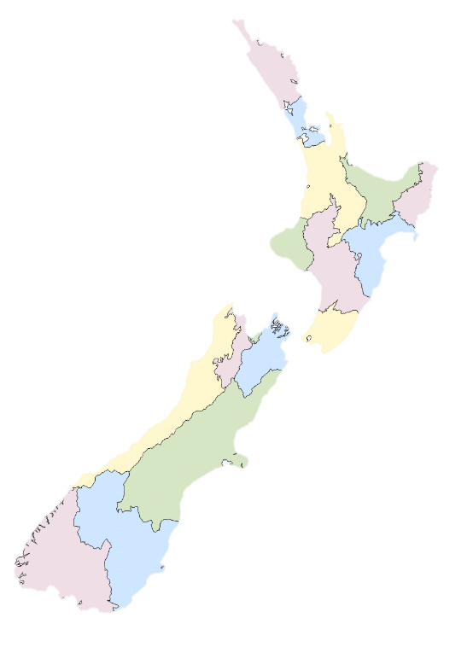
Does it vary by region?
NO
Northern

Slide 12
Does it vary by region?
NO
Central

Slide 13
Does it vary by region?
NO
Southern

Slide 14
Is it a season of birth effect in disguise?
Children more likely to be seen close to their birthday

Slide 15
Is it a season of birth effect in disguise?
NO, in models adjusted for each other, gender, ethnicity, deprivation, rurality and time trends…
 | OVERWEIGHT OR (95% CI) | OBESE OR (95% CI)
Season of measurement
Spring (v summer) | 1.18 (1.15-1.20) | 1.13 (1.10-1.16)
Autumn (v summer) | 1.13 (1.10-1.15) | 1.11 (1.08-1.15)
Winter (v summer) | 1.28 (1.25-1.31) | 1.23 (1.19-1.26)
Season of birth
Spring (v summer) | 0.99 (0.97-1.01) | 1.00 (0.97-1.03)
Autumn (v summer) | 1.04 (1.02-1.07) | 1.04 (1.01-1.07)
Winter (v summer) | 1.00 (0.98-1.02) | 1.01 (0.98-1.04)

Slide 16
What does the literature say?
Few(er) investigations at preschool age
Chilean study (Stanojevic et al., 2008) showed obesity higher in winter/spring
Suggestion due to increased energy intake and less energy expenditure
Vietnamese study (Huong et al., 2014) showed greatest underweight and lowest energy intake in summer
…But FLAME study (Dunedin; Taylor et al., 2008) showed no seasonal differences in physical activity in 4 and 5 year olds (effects at age 3, though: summer/ winter BOTH higher than spring)
However, may be more sedentary and less time outside, less walking around, etc.

Slide 17
What does the literature say?
More studies at school age
Most show obesity higher in summer than winter
Suggestion that school is protective (organised physical activity during school year but not in summer)
…But two Japanese studies showed most children increased weight in winter and lost in summer, except obese children (Tobe at al., 1994; Kobayashi & Kobayashi, 2006).
Evidence from UK that physical activity in children declines with increasing rainfall
No evidence for a regional effect using current data, but investigating rainfall and other climatic factors

Slide 18
Other suggestions
Marewa Glover:
I put this to my focus group of Māori parents (urban N=7) last week. They were all like duh of course! Reasons given were – spending more time indoors, changing what’s eaten in winter e.g. stews, less time at the park – it’s too cold / rain. BUT one contributor we didn’t have was that they avoid taking their kids to places that had “too many germs” – hence they avoid taking their kids to swimming (if they can even afford that). I asked about indoor recreational facilities like Chipmunks – No! Too many germs. This also makes them wary of taking kids to things that will bring their children into contact with lots of other children. One reason they need to do this is because if one of their children contracts cold/flu it’ll go through the whole household (they had 2-4 kids).

Slide 19
What are the implications?
Lack of awareness of seasonal effects could lead to an increase in referrals/treatment during winter compared to summer.
Practitioners need to be aware
…The B4School Check IS USED as a screen for referrals for obesity (and other issues)

Slide 20
B4School Check Obesity referrals

Slide 21
Obesity referrals by season
Are there seasonal differences in referrals?
Not in the same way as seasonal differences in obesity

Slide 22
What are the implications?
Factors found to be responsible for the seasonality effect (e.g., activity/diet) might be policy targets
The NZ Health Survey measures anthropometry in children aged 2-14.
Are there seasonal trends in NZ Health Survey?
Do they differ by age? [Some effects shown in adults]
Should these be accounted for when reporting obesity?
If comparing across years, may need to take account of measurement period.

Slide 23
Limitations
Unequal distribution of children across season
Summer 20-21%, Autumn 27-28%, Spring/Winter 25-26%
Possible that those with low zBMI more likely to have B4SchoolCheck over summer? Can’t rule it out, but…
Peak in winter nearly as strong as trough in summer
No spike in autumn (which seems to take most of summer excess)
No characteristic (e.g., eth/dep) varies by season of measure
Misclassification of Māori and Pacific zBMI; Incomplete coverage of 4-year olds
Should affect each season equally
Height/weight measurement protocols not followed
E.g., heavier clothes/shoes worn in winter. Can’t rule it out, but…
Effect too large; no regional differences

Slide 24
Conclusions
There are strong effects of season on 4-year old obesity in NZ
These are consistent across gender, ethnicity, deprivation and region
Practitioners need to be aware
Referral activity in B4SchoolCheck not affected
Interpretation of NZ Health survey child obesity trends may need caution
Causes of seasonal effect need thorough investigation, and policy implications assessed

Slide 25
QUESTIONS?

