Slide 1
Trends and disparities in Early Childhood Caries
Nichola Shackleton, Jonathan Broadbent, Simon thornley, Barry Milne, Sue Crengle & Daniel J Exeter

Slide 2
Acknowledgements & Disclaimer Statement
Access to the data presented was managed by Statistics New Zealand under strict micro-data access protocols and in accordance with the security and confidentiality provisions of the Statistic Act 1975. Our findings are not Official Statistics. The opinions, findings, recommendations, and conclusions expressed are those of the researchers, not Statistics NZ, or the University of Auckland.
This research was funded by the Health Research Council of New Zealand. Thanks to the developers of zone design software for allowing us to use their data, and to the IDI and geospatial teams at Statistics New Zealand for their input and use of data.

Slide 3
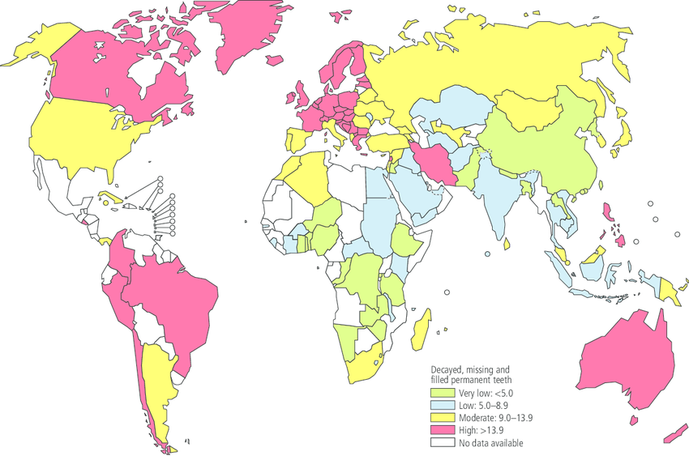
Background
The Global Burden of Disease (GBD) 2010 Study produced comparable estimates of the burden of 291 diseases and injuries in 1990, 2005, and 2010.
Untreated caries in permanent teeth was the most prevalent condition evaluated for the entire GBD 2010 Study. Global prevalence estimated at 35%
Socioeconomic and ethnic inequalities in dental caries have been widely observed (even in countries with state-funded dental services)
Dental caries levels (Decayed, Missing and Filled Teeth (DMFT) index) among 35–44-year-olds worldwide, December 2004
Petersen, P. E., Bourgeois, D., Ogawa, H., Estupinan-Day, S., & Ndiaye, C. (2005). The global burden of oral diseases and risks to oral health. Bulletin of the World Health Organization, 83(9), 661-669.

Slide 4
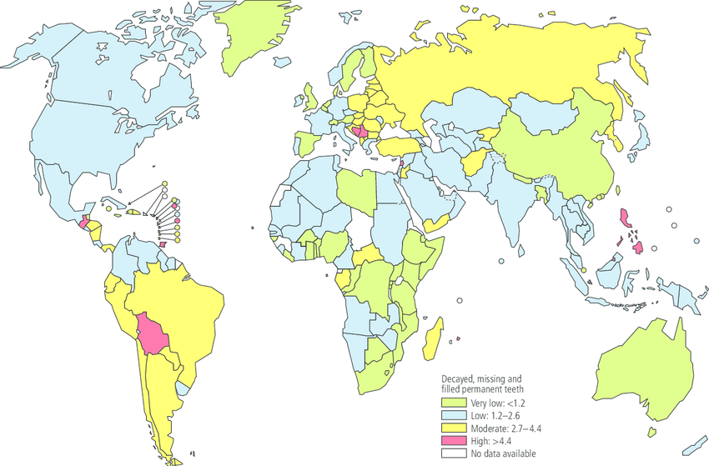
Background
Dental caries levels (Decayed, Missing and Filled Teeth (DMFT) index) among 12-year-olds worldwide, December 2004
Among New Zealand children aged 5, mean DMFT decreased from 2.2 in 2003 to 1.9 in 2013
Recent report by HAT showed substantial inequalities in dental caries among 5-year-old children
Documenting these disparities is important but understanding the interplay between ethnicity and deprivation is important
We hope to better understand the relationship between deprivation and child oral health, and how this varies by ethnicity
Petersen, P. E., Bourgeois, D., Ogawa, H., Estupinan-Day, S., & Ndiaye, C. (2005). The global burden of oral diseases and risks to oral health. Bulletin of the World Health Organization, 83(9), 661-669.

Slide 5
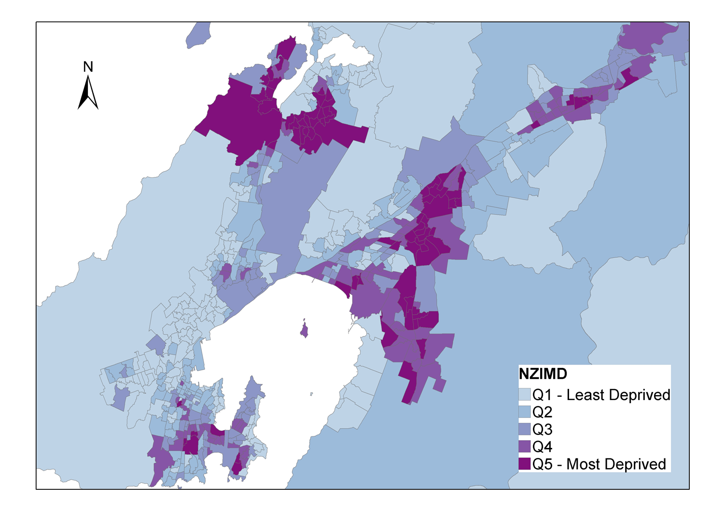
The IMD
The New Zealand Index of Multiple Deprivation (IMD)
Measures deprivation at the neighbourhood-level in custom designed data zones that have an average population of 712 (range 500-1000)
Data zones are aggregations of census Meshblocks (approximately 8 Meshblocks per data zone)

Slide 6
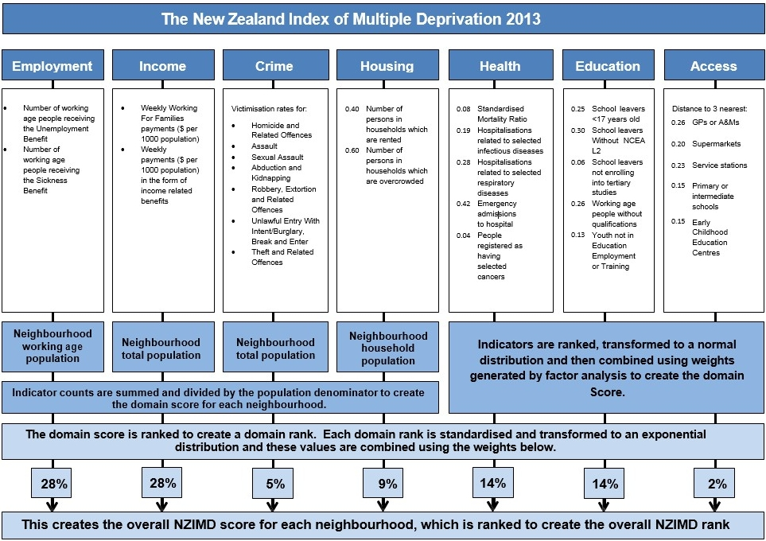

Slide 7
EMPLOYMENT
Measures the degree to which working age people are excluded from employment
INCOME
Captures the extent of income deprivation in a data zone by measuring financial assistance provided by the state to those with insufficient income
CRIME
Counts victims for 7 major offences per 1000. Counts were collected after 30 days of investigation: Homicide/Assault/Sexual Assault/Abduction/Robbery/Extortion/Unlawful Entry with intent/ Theft
HOUSING
Proportion of people living in overcrowded housing and the proportion living in rented accommodation.
HEALTH
Identifies areas with a high level of ill health or mortality.
EDUCATION
Captures youth disengagement, and the proportion of the working age population without a formal qualification
ACCESS
Measures the cost and inconvenience of travelling to access basic services. Supermarkets, primary health care providers, service stations, ECE, primary and intermediate schools.

Slide 8
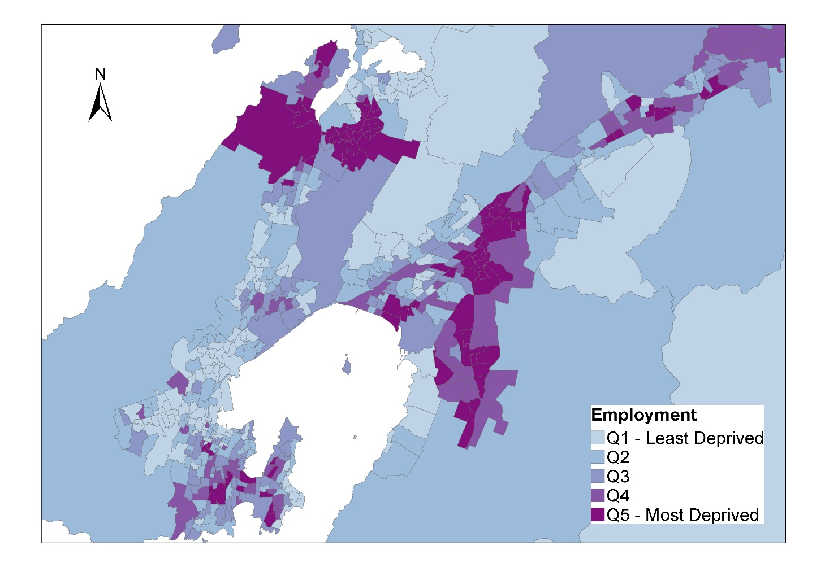
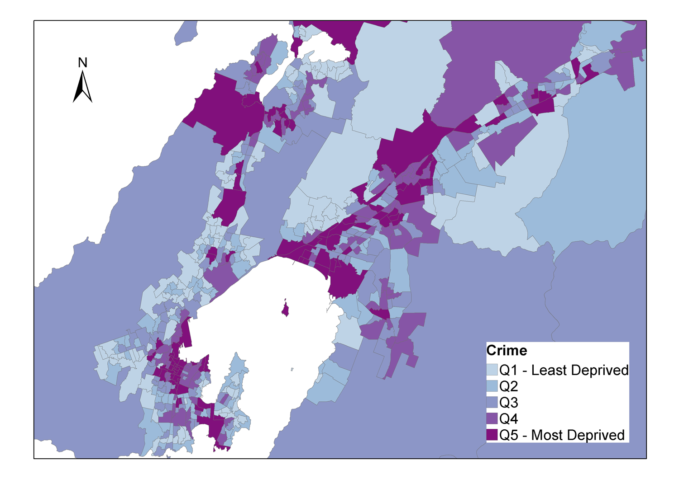
The IMD

Slide 9
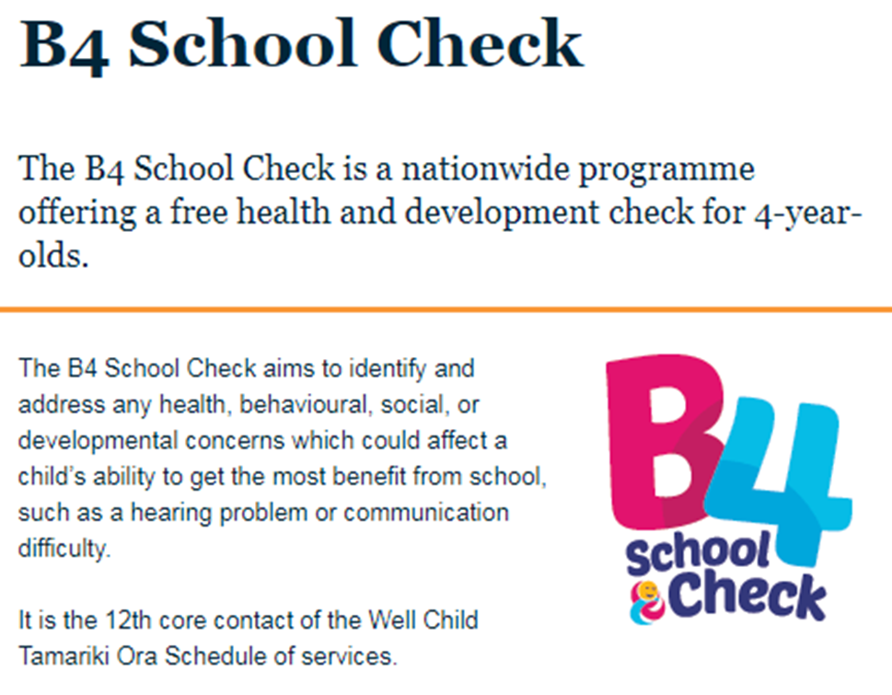
B4 School Check
The B4 School Check data is integrated into the IDI
Established September 2008 (we use 2010/2011 to 2015/2016)
Eligible children are those who are enrolled with a PHO on their 4th birthday- target is 90% of eligible children
coverage between 72-92%
We can link to better quality ethnicity information (census/DIA)
http://www.health.govt.nz/our-work/life-stages/child-health/b4-school-check

Slide 10

Lift the lip
http://www.healthysmiles.org.nz/your-oral-health/educational-videos/lift-the-lip/

Slide 11
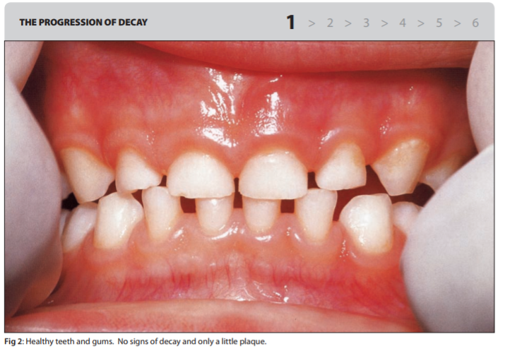
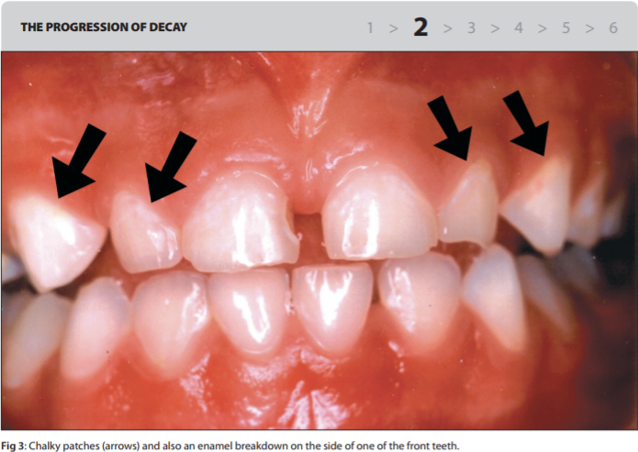
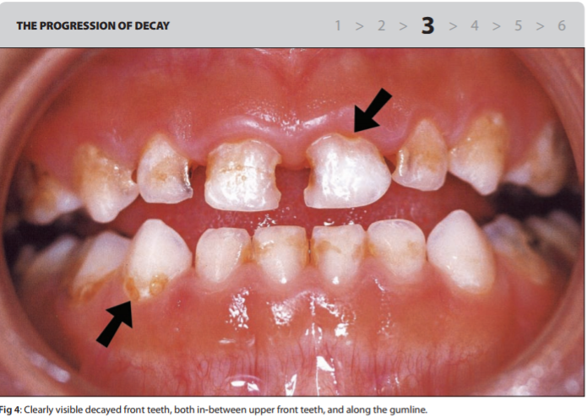
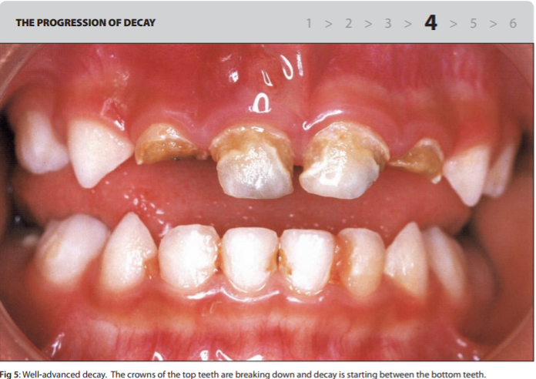
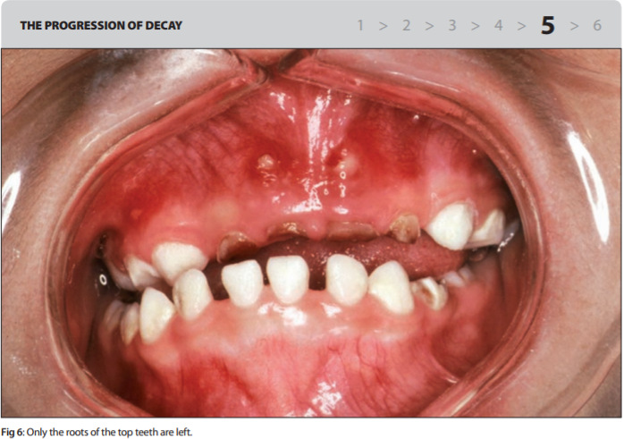
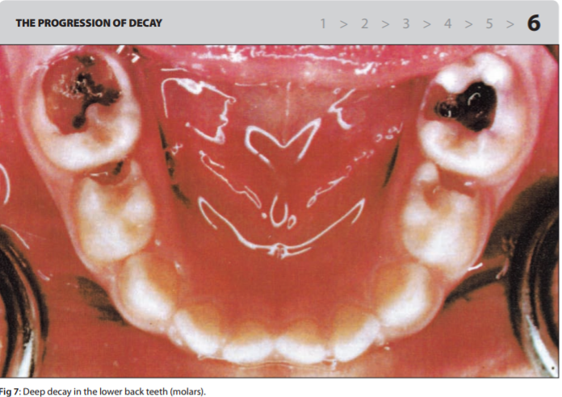
1 = No visible caries
2 = Chalky patches (enamel demineralisation) and possible initial enamel breakdown on anterior teeth
3 = Obvious caries between anterior teeth and/or along gum line
4 = Partial coronal breakdown of anterior teeth (as in, teeth collapsing due to caries)
5 = Carious retained roots, whole crowns of anterior teeth are gone
6 = Severe caries including back teeth.

Slide 12
Data Preparation & Measures
Restricted data to:
  Those ages 48-60 months
  Fiscal years 2010/2011 – 2015/206
Sample:
  318321 children attended dental check
  84% of the 379 080 Estimated Resident Population of 4-year-olds
Linked to other data
  Source_ranked_ethnicity table, Address notification, IMD
Caries
  Severe caries → categories 4-6. Aligns to AAPD definition of severe early childhood caries, indicates that one or more teeth is cavitated or restored
  Any caries → categories 2-6.

Slide 13
Characteristics of the sample: Deprivation & Ethnicity
Deprivation deciles
IMD | %
1 | 8.9
2 | 8.7
3 | 8.4
4 | 8.9
5 | 9.1
6 | 9.4
7 | 9.8
8 | 10.4
9 | 11.7
10 | 14.7
Missing Meshblock | 0.2
Ethnicity | %
European and other | 50.8
Māori | 26.2
Pacific | 9.7
Asian | 11.7
MELAA | 1.65

Slide 14
Characteristics of the sample: Caries
 |  | %
Life the lip score | Description
1 | No visible decay | 85.4
2 | Chalky patches and possible initial enamel breakdown on anterior teeth | 8.3
3 | Obvious decay between anterior teeth and/or along gum line | 2.8
4 | Partial coronal breakdown of anterior teeth | 1.0
5 | Decayed retained roots, whole crowns of anterior teeth are gone | 0.5
6 | Severe decay including back teeth | 2.1

Slide 15
Results
The presence of visible caries was higher in males (15.1%) than females (14.1%).
Prevalence of visible caries was lowest among European and other children (6.8%), followed by MELAA (15.0%), Asian (17.9%), Māori (22.3%) and Pacific (30.7%).
The prevalence of visible dental caries decreased from 15.8% in 2010/2011 to 14.7% in 2015/2016.
The prevalence of severe dental caries increased from 3.0% in 2010/2011 to 4.4% in 2015/2016.

Slide 16
Trends in the prevalence of any caries and severe caries stratified by ethnicity.
Any caries -1.8
Severe caries +0.2
Any caries -2.7
Severe caries +1.1
Any caries +0.4 (NS)
Severe caries +7.0
Any caries -2.1
Severe caries +0.8
Any caries -0.2 (NS)
Severe caries +1.3
Notes:
The prevalence of any caries decreased for European (-1.8% (95% CI, -1.6; -2.1%), Māori (-2.7% (95% CI, -2.1; -3.2%)) and Asian (-2.1% (95% CI, -1.3; -2.9%)) children, but not for Pacific children (+0.4% (95% CI, -1.5; 0.6%)) or MELAA (-0.2% (95% CI, -1.8; 2.1%)).
There were increases in the prevalence of severe caries for all ethnic groups (European (0.2% (95% CI, 0.1; 0.3%)), Māori (1.1% (95% CI, 0.8; 1.4%)), Asian (0.8% (95% CI, 0.4; 1.2%)), and MELAA (1.3%( 95% CI, 0.4; 2.3%)) with the largest increases in children identifying as Pacific (7.0% (95% CI, 6.3; 7.7%))

Slide 17
The association between the IMD and any caries by ethnicity

Slide 18
The association between the seven domains of deprivation and any caries by ethnicity
European and other
Māori
Pacific
Asian
MELAA
Overall

Slide 19
Adjusted relationship between the IMD and its seven domains of deprivation with any caries
All models were adjusted for age in months, gender, ethnicity and year.

Slide 20
Summary
Socioeconomic gradients in dental caries experience are evident already at age 4 years.
There is variation in deprivation gradients in dental caries among 4-year-old children in New Zealand by ethnicity and domain of deprivation.
We found evidence for a decreases in the reports of any evidence of decay, but an increase in severe decay, which was largest for Pacific children
Māori and Pacific children had the highest levels of caries, and the steepest socioeconomic gradients
Household income showed the strongest association with caries, of all the domains examined, with Access showing the weakest association.

Slide 21
Appendix
1: NZDep vs IMD
2: Sequentially adjusted models
3: unadjusted relationships by dental category

Slide 22
Comparing IMD to NZDep:
Odds ratios from adjusted and unadjusted models

Slide 23
 | M1 | M2 | M3 | M4
Age in months | 1.06 (1.06-1.06) | 1.05 (1.05-1.06) | 1.05 (1.05-1.06) | 1.05 (1.05-1.06)
Fiscal Year | 1.00(1.00-1.00) | 0.99 (0.98-0.99) | 1.00 (1.00-1.00) | 0.99 (098-0.99)
Gender
Male | 1 | 1 | 1 | 1
Female | 0.91 (0.91-0.92) | 0.91 (0.90-0.92) | 0.91 (0.91-0.92) | 0.91 (0.90-0.92)
Ethnicity
European and other |  | 1 |  | 1
Maori |  | 3.11 (3.08-3.15) |  | 2.73 (2.70-2.76)
Pacific |  | 4.42 (4.35-4.48) |  | 3.73 (3.67-3.78)
Asian |  | 2.90 (2.86-2.94) |  | 2.77 (2.73-2.81)
MELAA |  | 2.30 (2.23-2.38) |  | 2.16 (2.09-2.23)
IMD Deciles
1 |  |  | 1 | 1
2 |  |  | 1.19 (1.15-1.23) | 1.14 (1.11-1.18)
3 |  |  | 1.29 (1.25-1.33) | 1.18 (1.14-1.22)
4 |  |  | 1.51 (1.47-1.55) | 1.34 (1.29-1.38)
5 |  |  | 1.56 (1.51-1.61) | 1.33 (1.29-1.37)
6 |  |  | 1.86 (1.81-1.92) | 1.50 (1.45-1.54)
7 |  |  | 2.16 (2.09-2.22) | 1.64 (1.59-1.69)
8 |  |  | 2.83 (2.75-2.92) | 1.94 (1.88-1.99)
9 |  |  | 3.87 (3.76-3.99) | 2.39 (2.32-2.46)
10 |  |  | 6.30 (6.12-6.49) | 3.30 (3.20-3.40)
constant | 0.00 (0.00-0.00) | 0.00 (0.00-0.00) | 0.00 (0.00-0.00) | 0.00 (0.00-0.00)
Variance | 0.56 (0.55-0.57) | 0.28 (0.27-0.29) | 0.21 (0.20-0.22) | 0.15 (0.15-0.16)
ICC | 0.15 (0.14-0.15) | 0.08 (0.08-0.08) | 0.06 (0.06-0.06) | 0.04 (0.04-0.05)

Slide 24
 | No visible decay (1) | Chalky patches, possible initial enamel breakdown on anterior teeth (2) | Obvious decay between anterior decay and/or along gum line (3) | Partial coronal breakdown of anterior teeth (4) | Decayed retained roots, whole crowns of anterior teeth are gone (5) | Severe decay including back teeth (6)
Gender | % | % | % | % | % | %
Male | 84.9 | 8.6 | 2.9 | 1.0 | 0.6 | 2.1
Female | 85.9 | 7.9 | 2.7 | 1.0 | 0.5 | 2.0
Fiscal Year
2010/2011 | 84.2 | 9.8 | 3.0 | 1.0 | 0.6 | 1.5
2011/2012 | 85.3 | 8.6 | 2.7 | 1.0 | 0.5 | 1.9
2012/2013 | 85.7 | 8.2 | 2.7 | 1.0 | 0.5 | 1.9
2013/2014 | 86.2 | 7.7 | 2.7 | 0.9 | 0.5 | 2.0
2014/2015 | 85.3 | 7.8 | 3.2 | 1.0 | 0.5 | 2.2
2015/2016 | 85.3 | 7.7 | 2.6 | 1.1 | 0.7 | 2.7
Ethnicity
European | 93.2 | 4.9 | 1.1 | 0.3 | 0.1 | 0.5
Māori | 77.7 | 12.0 | 4.3 | 1.5 | 0.9 | 3.7
Pacific | 69.4 | 14.0 | 6.4 | 2.8 | 1.4 | 6.0
Asian | 82.1 | 9.8 | 4.0 | 1.5 | 0.7 | 2.0
MELAA | 85.0 | 8.1 | 3.4 | 1.3 | 0.7 | 1.6
Deprivation
IMD Decile
1 | 93.5 | 4.6 | 1.1 | 0.2 | 0.1 | 0.4
2 | 92.2 | 5.3 | 1.4 | 0.5 | 0.1 | 0.5
3 | 91.7 | 5.5 | 1.5 | 0.4 | 0.2 | 0.6
4 | 90.5 | 6.0 | 1.7 | 0.6 | 0.3 | 0.9
5 | 90.0 | 6.2 | 2.0 | 0.6 | 0.3 | 0.9
6 | 88.5 | 6.9 | 2.3 | 0.7 | 0.3 | 1.3
7 | 87.1 | 7.8 | 2.4 | 0.9 | 0.5 | 1.4
8 | 83.8 | 9.2 | 3.1 | 1.1 | 0.6 | 2.1
9 | 79.1 | 11.0 | 4.1 | 1.6 | 0.9 | 3.4
10 | 69.9 | 14.6 | 5.8 | 2.4 | 1.3 | 6.0

