Slide 1
Child Poverty and Wellbeing in Australia
Melissa Wong
Social Policy Research Centre
University of New South Wales, Australia
Presented to the COMPASS Seminar Series
University of Auckland
20 May 2016

Slide 2
Outline
Child poverty in Australia
The income approach vs. the deprivation approach
The Australian Child Wellbeing Project (ACWP)
Deprivation rates and levels
Wellbeing measures
Marginalised groups and households arrangements
Conclusions and policy implications

Slide 3
Child Poverty Rates by Household Type, 2011-12

Slide 4
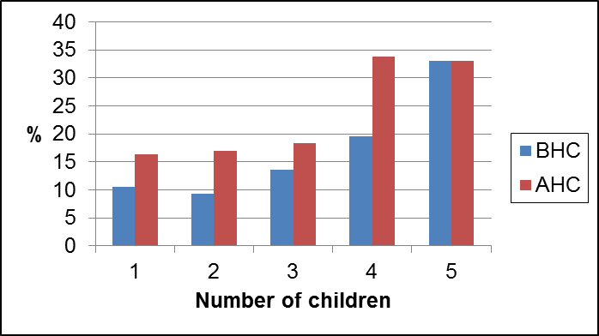
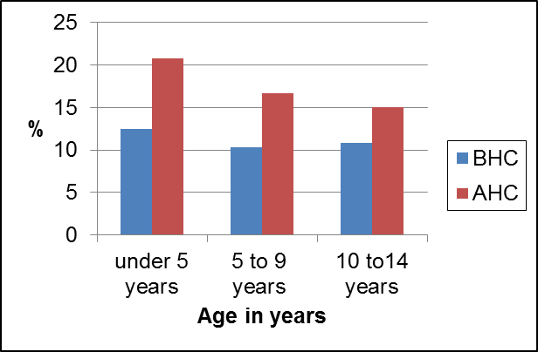
Child Poverty Rates by Number of Children and Age of Youngest Child, 2011-12

Slide 5
Child Poverty in Australia, 2003-04 to 2011-12

Slide 6
The Conventional (Income) Approach
  Uni-dimensional
  ‘Needs’ of children simply assumed using an equivalence scale or reflected through parental expenditure patterns
  Children are invisible and child poverty is the same as parental poverty
  Does not allow for the complexities and changing nature of children’s actual lives

Slide 7
The Deprivation Approach
Adopts a living standards perspective
Is explicitly multi-dimensional, with no equivalence assumptions
Emphasises the affordability of essential items
Can be applied at different levels - the household and/or individuals (including children)
Capable of incorporating children’s views (Main and Bradshaw, 2012)
United Nation’s Convention on the Rights of the Child (UN CRC) where children’s views should be given due weight on matters that affect them
Produce measures that better explain variations in children’s well-being
  a focus of the Australian Child Wellbeing Project

Slide 8
The Australian Child Wellbeing Project (ACWP)
Australian Research Council Linkage Project (2012-2015)
  Flinders University
  University of New South Wales
  Australian Council for Educational Research (ACER)
  Department of Education
  Department of Social Services
  Australian Institute of Health and Welfare
  Australian Bureau of Statistics

Slide 9
The ACWP: Rationale
  Wellbeing is important for young people now, and for their healthy development.
  Young people themselves are the foremost experts on their own wellbeing.
  The middle years (age 8-14) receive less policy attention then early childhood and adolescent.

Slide 10
The ACWP: Project Framework
An integrated mixed-method child-centred study
Focus group discussions/interviews with young people (ages 8-14)
Survey design
National survey (Year 4, 6 and 8)
Going back to young people

Slide 11
The ACWP: National Survey
  Questions covering wide areas of wellbeing
    -Family -Living arrangements
    -School -Health
    -Friends -Material wellbeing
    -Bullying -Subjective wellbeing
  Conducted between July to October 2014
  Computer-based and online instrument; easy to read with audio assist
  Sample size: n=5,440 from 180 schools answered the survey
  Weights developed to according to sex and geolocation of schools.

Slide 12
Using ACWP Data to Measure Deprivation (1)
  Applied for the first time to measure poverty among young people in Australia
    Using data provided by young people themselves
  Deprivation indicators developed from international studies
    Family Affluence Scale (FAS) (Currie et al., 2008; Currie et al., 2012; Currie et al., 1997)
    Child Deprivation Scale (CDS) based on the work by Main (2014); Main and Bradshaw (2012)
      Child’s own views
      Democratic/consensual approach
    International comparisons

Slide 13
Using ACWP Data to Measure Deprivation (2)
ACWP has collected information on
  Affluence level of the family as a whole; and
  Child deprivation items:
    An iPod or other music player
    Some money to save each month, in a bank or at home
    The right kinds of clothes to fit in with people of their age
    Enough money to go on a school camp
    Your own mobile phone
  Whether they have the item,
  Whether they don’t have it but would like it, or
  Whether they don’t have it but don’t want or need it

Slide 14
Child Deprivation Rates by Item (%)
Item | Year 4 | Year 6 | Year 8 | Full sample
iPod | 16.5 | 16.0 | 5.8 | 12.8
Money | 21.5 | 19.3 | 19.4 | 20.1
Clothes | 7.6 | 5.6 | 5.9 | 6.4
School camp | 13.6 | 8.3 | 5.0 | 8.9
Mobile phone | 53.3 | 44.0 | 12.9 | 36.6

Slide 15
Mean Deprivation Score for Children Deprived of Each Item (0-5 scale)
Item | Mean
iPod | 2.28
Money | 2.03
Clothes | 2.32
School camp | 2.35
Mobile phone | 1.65
All | 0.83

Slide 16
Severity of Deprivation by Age
(%, weighted)
Level of statistical significance: *p<0.05, **p<0.01

Slide 17
Cantril Score by Level of Deprivation
(mean score)

Slide 18
Life Satisfaction and Health by Level of
Deprivation (%)

Slide 19
Family Cohesion and Friendship by Level of
Deprivation (%)

Slide 20
School Satisfaction and Teacher Connectedness by Level of Deprivation (%)

Slide 21
Marginalised Groups (1)
Young people with disability
  Have you had a disability for a long time (more than 6 months)?
  Yes or Don’t know: Does your disability make it hard for you, or stop you from...
    Doing everyday activities that other children your age can usually do
    Talking to people, understanding what other people say or hanging out with friends
    Doing any other activity that children your age can usually do?
    (NZ Youth ’12 Survey)
Young carers
  If answered “Yes” to a family member who is seriously affected by disability or long term illness, depression or mental illness or using alcohol or other drugs and
  “Yes” if they ‘do extra work around your home because someone is disabled or sick or can't do things?’ (NZ Youth ’12 Survey)

Slide 22
Marginalised Groups (2)
Culturally and Linguistically Diverse (CALD)
  ‘Sometimes’ or ‘Never’ speak English at home (TIMSS)
Indigenous young people
  Aboriginal, Torres Strait, Islander or both Aboriginal and Torres Strait Islander

Slide 23
Deprived of 2 or more items by Marginalised Groups (%)

Slide 24
Deprived of 2 or more items by Living Arrangement and Joblessness (%)

Slide 25
Aggregated Measures of Wellbeing (1)
Cantril Ladder (Cantril, 1965)
  Here is a picture of a ladder. The top of the ladder “10” is the best possible life for you and the bottom “0” is the worst possible life for you. In general, where on the ladder do you feel you stand at the moment?
    0 – 10 scale; higher → more satisfied
Student Life Satisfaction Scale (Huebner, 1991; Rees, Goswami, et al. (2010)
  5 items: My life is going well, My life is just right, I wish I had a different kind of life, I have a good life and I have what I want in life.
  0 – 20 scale; higher → more satisfied

Slide 26
Aggregated Measures of Wellbeing (2)
  Health symptom load (Elgar et al., 2013; Ravens-Sieberer, Erhart, Torsheim et al., 2008)
    Questions from the HBSC
    Psychological and somatic symptom load was measured by asking about eight psychological and somatic symptoms
    0 – 32 scale ; higher → more complaints
  School satisfaction scale (Longitudinal Surveys of Australian Youth)
    6 items: I feel happy, I really like to go to each day, I find that learning is a lot of fun, I feel safe and secure, I like learning, I get enjoyment from being there
    0-18 scale; higher → more satisfied

Slide 27
Cantril Score by Deprived Marginalised Groups (mean score)

Slide 28
Life and School Satisfaction by Deprived Marginalised Groups (mean score)

Slide 29
Health Symptoms Load by Deprived Marginalised Groups (mean score)

Slide 30
Cantril Score by Deprived Households (mean score)

Slide 31
Life and School Satisfaction by Deprived Households (mean score)

Slide 32
Health Symptoms Load by Deprived Households (mean score)

Slide 33
Conclusions
Relationship between deprivation items based on children’s own views and their level of wellbeing.
Overall one-fifth (20.9%) of all children of at least 2 (out of 5) items.
The severity of deprivation is negatively associated with indicators of subjective wellbeing and some measures of school engagement/satisfaction.
Young people from marginalised groups are more likely than young people who are not marginalised to experience low wellbeing.
  Young people with a disability and young carers generally worse off.
Levels of wellbeing differ significantly according to living arrangements.
Results are preliminary and needs further investigation.
  Membership of a marginalised group and living in a jobless household

Slide 34
Policies to promote young people’s wellbeing
Joined up approaches
  Coordination across different policy silos
Better consultation with young people
  Build consultations into policy reform
  Identify priority areas for policy action across interconnected domains
  Monitor progress towards reducing disadvantage and marginalisation
Ongoing monitoring
  Young people’s own perspectives on their lives, their wellbeing, and the services that are provided for them
  International comparisons

Slide 35

The ACWP Documents and Links
  http://australianchildwellbeing.com.au
Data
Questionnaires
Final report

