Slide 1



Kaupapa Māori Research and Q Methodology
Emerald Muriwai (Te Whakatōhea)
Researcher, Te Rōpū Whāriki, Massey University

Slide 2
Today’s talk
Kaupapa Māori Research
Q Methodology
  Setting up the study
  Creating a Q-set
  Forced Choice Distribution
  Analysis
What does Q-method offer Māori Research?
A ‘sensible fit’ for Māori research
Q-methodology and ‘uncomfortable’ research topics

Slide 3
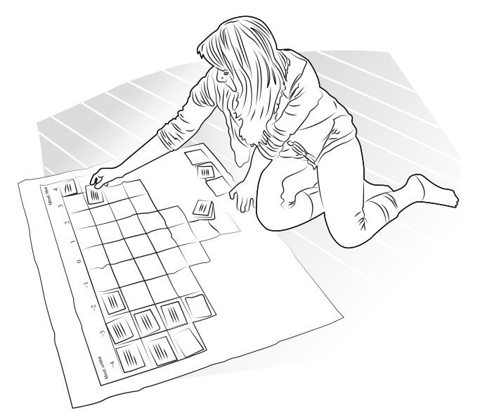
Acknowledgements
The research featured in this talk is drawn from the project Māori Health Identities (2014-2017). This research was funded by the Health Research Council, Reference ID: 13/490
We also wish to acknowledge the 12 interviewers and 116 participants who took part in the study across Aotearoa
Image source: http://karthur.org/2016/teaching-the-q-method-urban-sustainability.html

Slide 4
Kaupapa Māori Research
Māori have a well-documented history of being subjects of non-Māori research (e.g. Bishop, 1996; Cram, 2001; Smith, 1991; Borell, 2014)
Quantitative research in particular has been weaponised against Māori for colonising research agendas
Much of the available literature on Māori is imperialist, racist and inaccurate (Mikaere, 2011)
Over the past four decades Māori researchers have reclaimed mana over our research through using a Kaupapa Māori approach and working alongside our people
Notes:
Non-Māori representations of Māori are far too often appropriative and damaging. Further, these representations are presented without consequence for the non-Māori author but with real impacts in the lives and experiences of Māori people

Slide 5

Kaupapa Māori Research
A Kaupapa Māori approach is critical to understanding Māori subjectivities and conducting research with and alongside Māori communities
Kaupapa Māori research is decolonising; it acknowledges the ongoing effects of colonisation

Slide 6

Kaupapa Māori Research
Kaupapa Māori captures both the ordinariness (i.e. Māori are ordinary not ‘other’) and diversity (Māori are not a homogenous people) of tangata whenua (indigenous people of the land; Moewaka Barnes, 2000; 2009)
Kaupapa Māori embodies Māori epistemology and approaches to research within our own contexts in ways that are culturally appropriate and safe
Māori Women in Solidarity with Idle No More – Robyn Kahukiwa (2013)

Slide 7
Kaupapa Māori Research
Kaupapa Māori Theory is guided by eight principles, as outlined by Linda Tuhiwai Smith and Fiona Cram:
  Tino rangatiratanga – Self Determination
  Taonga Tuku Iho – Cultural Aspirations
  Ako Māori – Culturally Preferred Pedagogy
  Kia piki ake I nga – Socioeconomic Mediation
  rauraru o te kainga
  Whānau – Extended Whānau
  Kaupapa – Collective Philosphy
  Te Tiriti o Waitangi – Treaty of Waitangi
  Ata – Respectful Relationships

Slide 8


Q-Methodology
Founded by William Stephenson (1902-1989) as an interpretive turn away from positivist methods
Representative of ‘between objectivity and subjectivity’
Q-method has its origins in assessing the thinking patterns of individuals experiencing psychological issues
Q-method is less interested in generalising from a representative sample, instead examining different clusters of perspectives

Slide 9
Q-Methodology
Q-methodology has been described as ‘qualiquantological’ (Ramlo & Newman, 2011) due to its hybrid blending of qualitative and quantitative methods
Q-methodology is not about testing difference, instead looking at similarities (clustering) between individual viewpoints
Image source: http://karthur.org/2016/teaching-the-q-method-urban-sustainability.html
Notes:
As opposed to the traditions of R-method and objectivist analyses, Q-method is characteristically ‘unsettling’ as it goes against the grain of a solutions-based empirical research approach (Capedevila & Lazard, 2009)

Slide 10
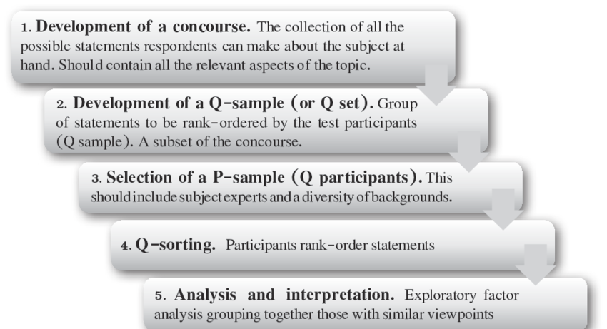
Q-Methodology: Setting up the study
From Stone & Turale (2015) Q Methodology: An Introduction

Slide 11

Q-Methodology: Setting up the study
Multiple-participant design – whose perspectives are we interested in?
What are the general research questions? How do they matter and who would they matter to?
Is the research drawing on issues of representation?
(i.e. something commonly represented and understood in different ways)
How many possible statements can be drawn from the research topic – creating a concourse
Will your Q-set be structured (statements asked in a specific order) or unstructured?

Slide 12
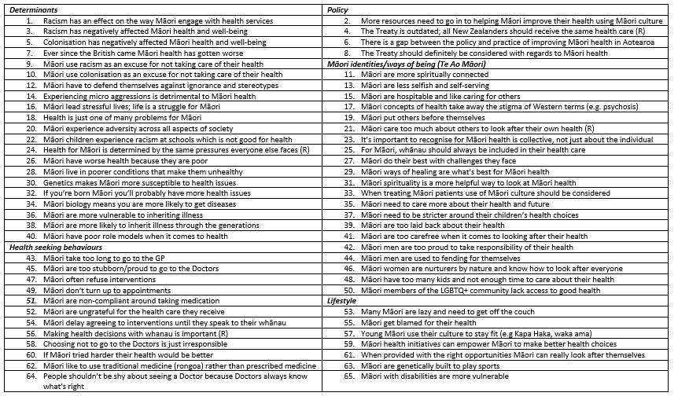
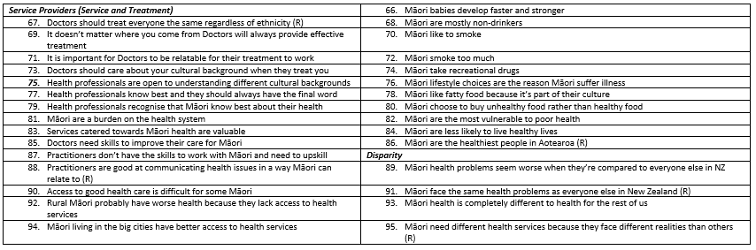
Q-Methodology: Creating a Q-set
Q-sets often range between 40-80 statements
Size of Q-set is usually dependent on the topic
Should aim for a large concourse initially
Refined through pilot testing
Māori Health Identities
Round One interviews
95 statements (concourse)
40 statements (Q-set)

Slide 13
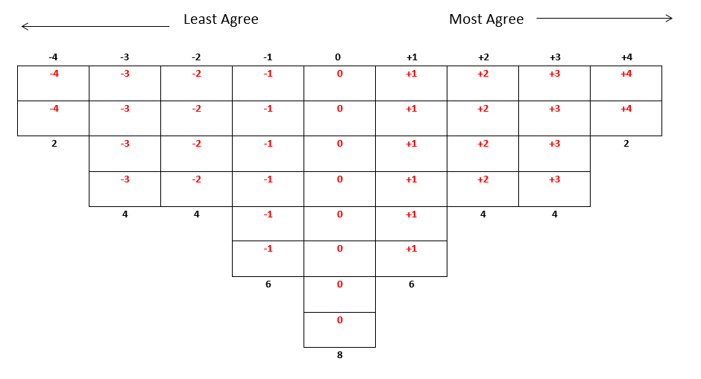
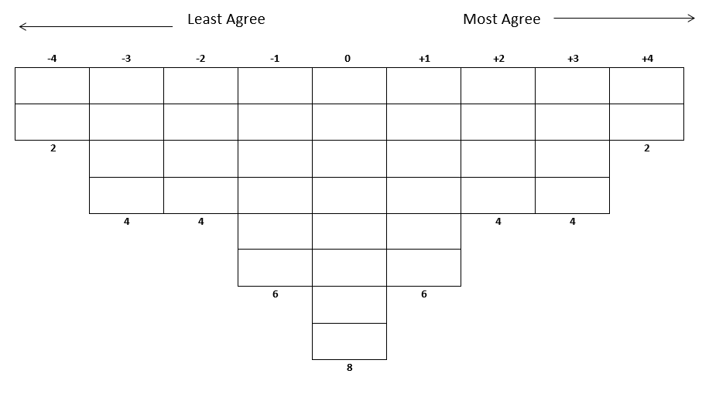
Forced Choice Distribution
Easier to read data for data entry purposes
Less ambiguous to analyse alongside other Q-sorts

Slide 14
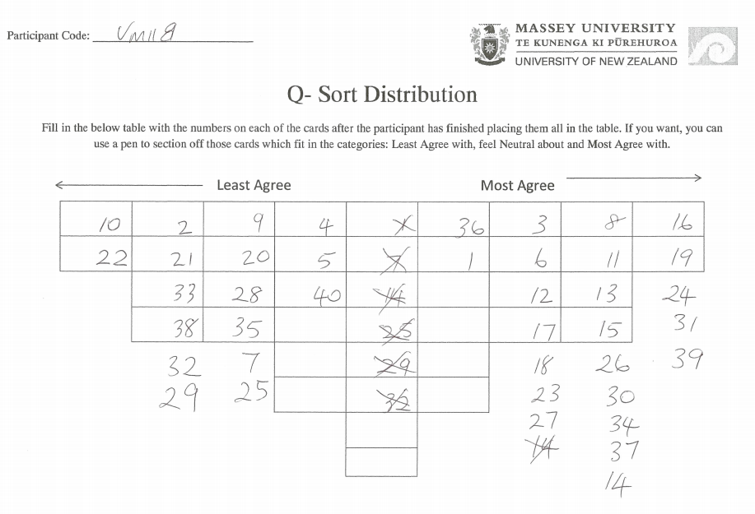
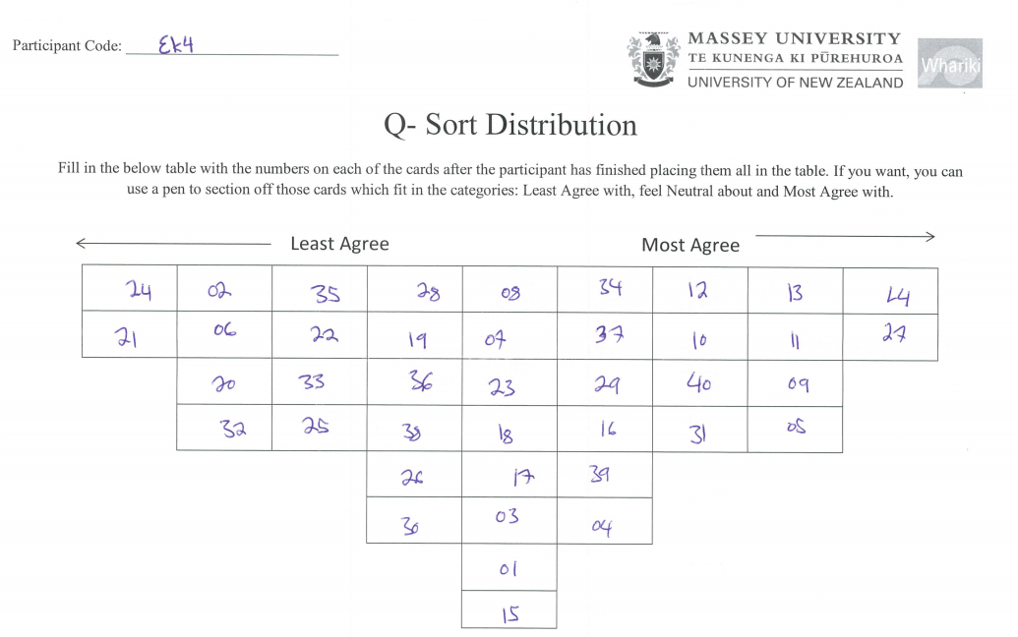
Forced Choice Distribution: Issues
Some participants will still refuse the forced choice distribution
Researchers have to make decisions on which way to ‘read’ the data
Semi-structured interview and recording of audio responses to the sorting task are essential to understanding the choices made by participants

Slide 15
Q-methodology: Analysis
Free software purpose-built (PQMethod)
Two types of data collected:
  Quantitative –Q-sort placement of cards transferred to a rank value
  Qualitative – semi-structured interview accompanying Q-sort task
Factor analysis:
  quantitative – significant factor loadings, factors chosen based on criteria
  qualitative - interpretive process based on research expertise

Slide 16

Q-methodology: Māori Health Identities
N = 116
Research questions:
  How do Māori and health service providers construct and perceive Māori health identities?
  How do these identities emerge in relation to health settings and responses to health initiatives and messages?
  How can this provide an evidence base for better aligning services with Māori needs and expectations?
Findings:
  Factor 1: resisting the deficit
  Factor 2: ambivalence and defeat
  Factor 3: critical insights
  Factor 4: reinforcing the stereotypes.
Notes:
How do these translate into health efficacy and affective practices such as fatalism, fear, shame, pride, motivation, determination, increased understanding and respect?
What are the implications for better engagement with and targeting of health messages?

Slide 17
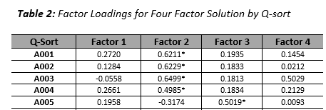
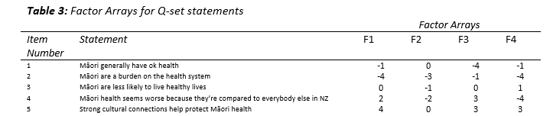
Q-methodology: Māori Health Identities
Significant Factor Loadings
Determining the level of significance required for an individual Q-sort to match onto a factor.
Formula=
2.58 x (1 ÷ √ n.o items in Q-set)
Factor Arrays
Factor arrays indicate the most commonly placed position of statements according to each factor
Notes:
For example ‘Māori have generally ok health’ was placed at -1 slightly disagree for Factor 1, 0 or neutral for Factor 2, -4 or stongly disagree for Factor 3 and again -1 slightly disagree for Factor 4.

Slide 18
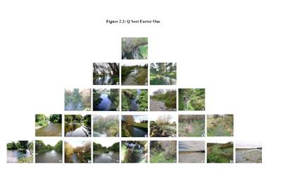
Q-Methodology in New Zealand
Q-method has mostly been used in tourism, agricultural and environmental studies research in NZ
Swaffield and Fairweather have led this research
Q-method has been used with visual prompts
Only one other instance of Q-method
being used with Māori in Sheed (2014)
Māori political agency : a q-­method
study of Māori political attitudes
in New Zealand.

Slide 19
What does Q-methodology offer for Māori research?
Q-methodology does not seek hypotheses to be answered - instead looking at clusters of possible perspectives
Q-methodology relies on participant perspectives to centre the analysis rather than following an imposed agenda
Q is exploratory, seeking to understand complexities
Q is now used across a variety of disciplines and is characteristically adaptable to and interested in different epistemologies
Q-method the ‘Marginalised method for studying the Marginalised’. Brown’s (2006) acknowledges power differentials between researcher and participant
Q has been recognised as a feminist methodology for its potential to address intersectionality and multiplicity (Capedevila & Lazard, 2008; Roper, Capedevila, Lazard & Roberts, 2015)

Slide 20
The ‘sensible fit’ for Māori research
Sheed (2014) describes Q-methodology as a ‘sensible fit’ for Māori research because it is not hypothesis driven, it looks for understanding complexity over solutions and includes participant voice in the research agenda
Māori science has existed for centuries and its critical advancement requires the use of innovative ways to explore research topics relevant to modern Māori lives
Q-methodology is about giving voice to a range of perspectives on a topic, which is in line with Māori autonomy and aspirations for self-determination

Slide 21
“I don’t think I could ever do this comfortably” Q Methodology and ‘uncomfortable’ research topics
Q-methodology is a good tool for assessing people’s perspectives on topics which could otherwise be considered emotionally, politically, culturally difficult to respond to
Q-method gives participants a unique opportunity to simultaneously absolve and reclaim responsibility for their perspectives on a given topic
Through the sorting task participants often respond with one of the following affective responses:
  I’ve never thought about this topic before so it’s interesting to see what my perspective on this is
  Some of the statements were difficult to respond to but I just put the cards there because I had to for the task

Slide 22
Where to from here?
Q-method can expand our understanding of complex topics through looking at clusters of perspectives
Through turning away from wanting generalisations and representative samples we may be able to see nuances in perspectives which are often overlooked
Q-method also enhances our ability to articulate perspectives on ‘uncomfortable’ topics, though we must always consider and abide by ethical principles
Māori knowledge continues to surface in many different forms through research and this adds to a list of innovations in Māori science

Slide 23

Ngā mihi nui – Thank you for listening
Emerald Mary Muriwai McPhee (MSc, CPT)
Te Rōpū Whāriki, Te Kura Hauora Tangata, Te Kunenga ki Pūrehuroa
SHORE & Whāriki Research Centre, College of Health, Massey University
E: e.mcphee@massey.ac.nz
P: 09 366 6136 ext 41321
A: PO Box 6137, Wellesley Street, Auckland 1141

Slide 24
References
Bishop, R. (1996). Addressing issues of self-determination and legitimation in Kaupapa Maori research. Research perspectives in Maori education, 143-60.
Borrel, B (2014). When the marginalised research the privileged: One Māori group’s experience. International Journal of Critical Indigenous Studies. 7 (2), 1-11.
Brown, S. R. (2006). A match made in heaven: A marginalized methodology for studying the marginalized. Quality & Quantity, 40(3), 361-382.
Capdevila, R., & Lazard, L. (2008). 'Is it just me...?': Q methodology and representing the marginal. Operant Subjectivity, 32, 70-84.
Cram, F. 2001. “Rangahau Mäori: Tona Tika Tona Pono”. In Research ethics in Aotearoa: concepts, practice, critique, Edited by: Tolich, M. 35–52. Auckland: Longman.
Mikaere, A. (2011). Colonising myths-Maori realities: He rukuruku whakaaro. Huia Publishers.
Moewaka Barnes, H. M. (2000). Kaupapa maori: explaining the ordinary. Pacific Health Dialog, 7(1), 13-16.
Moewaka Barnes, H. M. (2009). Arguing for the spirit in the language of the mind: a Maori practitioner's view of research and science: a thesis submitted for the degree of Doctor of Philosphy at Massey University.
Ramlo, S. E., & Newman, I. (2011). Q methodology and its position in the mixed methods continuum. Operant Subjectivity, 34(3), 172-191.
Roper, S., Capdevila, R., Lazard, L., & Roberts, A. (2015). How is this feminist again? Q as a feminist methodology. Psychology of Women Section Review, 17, 3-12.
Sheed, T. M. (2014). Māori political agency: a q-method study of Māori political attitudes in New Zealand.
Smith, G. H. (1991). Reform and Maori educational crisis: A grand illusion. Auckland: Research Unit for Maori Education, University of Auckland.
Stone, T., & Turale, S. (2015). Q methodology: An introduction. Pacific Rim International Journal of Nursing Research, 19(3), 183-186.
Watts, S., & Stenner, P. (2012). Doing Q methodological research: Theory, method & interpretation. Sage.

