Slide 1
Countries are not invariant on PISA: A doubtful basis for policy making
Gavin T. L. Brown
The University of Auckland
Presentation to COMPASS Seminar Series, University of Auckland, May 2017

Slide 2
Aims of PISA
A basic profile of knowledge and skills among 15-year-old students.
Contextual indicators relating results to student and school characteristics.
Trend indicators showing how results change over time.
A valuable knowledge base for policy analysis and research.

Slide 3
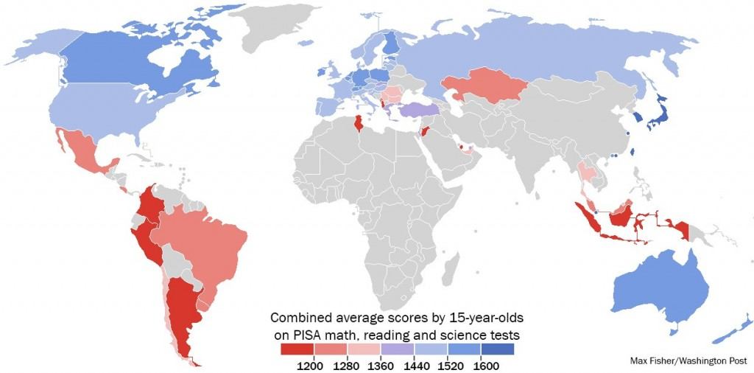
OECD PISA Testing: Global Impact

Slide 4
PISA http://www.pisa.oecd.org/
55 economies since 2000
3 year cycle
3 subjects: school curriculum + important knowledge and skills needed in adult life.
  Reading literacy, 2000, 2009
  Mathematical literacy, 2003, 2012
  Scientific literacy, 2006, 2015
Each subject takes priority in that order
typically involve 4,500 and 10,000 students in each country.

Slide 5
PISA Methods
Administered internationally by ACER
  Substantial inter-country, inter-language comparability judgements and statistical analyses before finalising test forms
A total of about seven hours of test items created
  students take different combinations of test items to a maximum of 2 hours.
Pencil-and-paper tests
  Test items are multiple-choice and constructed response
  The items are organised in groups based on a passage setting out a real-life situation.
background questionnaire
  20-30 minutes
  information about themselves and their homes
School principals
  20-minute questionnaire about their schools.

Slide 6
Impact of PISA
Perception that education is
  Internationally & globally comparable & equivalent
  Marketised—esp. development of human capital
  Borrowable—lendable across national, cultural borders
Example effects: Reforms in various countries
  Afonso and Costa (2009) for Portugal,
  Takayama (2008) for Japan,
  Rautalin and Alasuutari (2009) for Finland,
  Gür et al. (2012) for Turkey.
  Simola et al. (2013) Finland
  Dobbins and Martens (2012) for France
  Egelund (2008) Denmark
  Bieber & Martens (2011) for Switzerland
Teltemann, J., & Klieme, E. (2016). The impact of international testing projects on policy and practice. In G. T. L. Brown & L. R. Harris (Eds.), Handbook of Human and Social Conditions in Assessment (pp. 369-386). New York: Routledge.

Slide 7
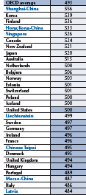
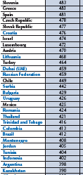

2009 PISA Reading results

Slide 8
Adapted for context
Language checking
  Translate-back translate
  Functional equivalence
  Curriculum alignment
Terminology adjusted
BUT
  Policies, cultures, histories, and societies differ
  So does a test automatically work in a similar way?
  Multiple group confirmatory factor analysis can check

Slide 9
Potential sources of variance
Differences in languages
  Indo-European vs. other
  Multi-country languages (e.g., French, Spanish, German)
  Family groups within Indo-European (e.g., Germanic, Latinate)
Differences in writing systems
  Alphabetic (Roman, Arabic, Cyrillic)
  Logographic (Chinese characters)
  Syllabary (Japanese)
Approaches to teaching and learning
  Exam based vs relational based
  Transmission vs discovery
  Customised vs uniform
Socioeconomic development
  High investment in education vs low

Slide 10
PISA 2009 Booklet 11
Reading literacy OECD
  “understanding, using, reflecting on and engaging with written texts, in order to achieve one’s goals, to develop one’s knowledge and potential, and to participate in society”
65 countries or economies implemented
translated or adapted into 50 different languages.
131 test questions in 13 booklets;
  6 administered in ALL jurisdictions
Booklet 11, 28 items covering
  Access and Retrieve (11 items),
  Integrate and Interpret (11 items), and
  Reflect and Evaluate (6 items).
N = 32,704 from 55 countries
Pairwise comparison: Australia vs. 54 countries

Slide 11
Modelling Self-report:
Latent trait theory
Invisible traits explain responses & behaviours
  Example: Intelligence (latent) explains how many answers (manifest) you get right on a test
  This represents linear regressions
    Increases in Latent (x) cause
    increases in Observed (y)
    Slope is strength of association
    Intercept is biased starting point
Observed behaviour
Residual, everything else in the universe
Latent
Y variable
m: slope
b intercept
X variable

Slide 12
Confirmatory factor analysis
Latent trait explains responses
  Responses are a sample of all possible responses
  Everything else in the world influences responses also
CFA are simplifications of reality of data
  If fit well, then acceptable to work with aggregate values

Slide 13
Estimation
Robust maximum likelihood estimation method (MLR), which provides robust standard errors and adjusted χ2 when data do not follow normal distribution
  (Sass, Schmitt, & Marsh, 2014).
Missing responses are not removed from the data but kept in the analyses using a model-based approach since MLR provides unbiased parameter estimates with missing data when they are missing at random (MAR).
PISA uses a two-stage stratified sampling design
  schools are sampled within countries, then students within schools.
So complex sampling taken into account to compute correct standard errors and chi-square tests of model fit or MI using
  Mplus “type is complex” with “weight,” “stratification,” and “cluster” options.

Slide 14
Evaluating Model Fit
 | Goodness of Fit |  | Badness of fit
Decision | p of χ2/df | CFI gamma hat | RMSEA | SRMR*
Good | >.05 | >.95 | <.05 | <.06
Acceptable | >.05 | >.90 | <.08 | <.08
Marginal but should reject | >.01 | .85-.89 | <.10
Reject | <.01 | <.85 | >.10 | >.08
Note.
Report multiple indices but beware…..
CFI punishes falsely complex models (i.e., >3 factors)
RMSEA rewards falsely complex models with mis-specification
See Fan & Sivo, 2007
*AMOS only generates SRMR if NO missing data;
thus, important to clean up missing values prior to any analysis. Recommend expectation maximization (EM) procedure

Slide 15
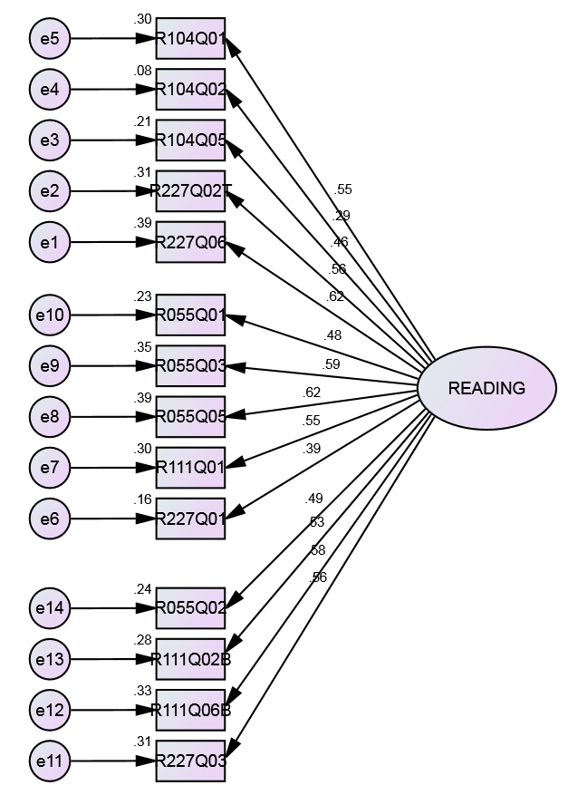
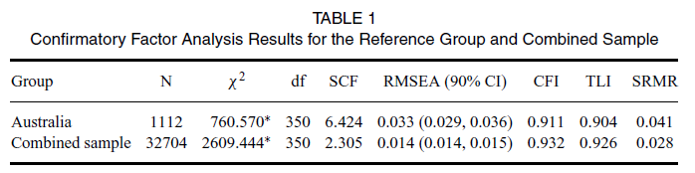
Booklet 11: A single factor

Slide 16
MGCFA invariance testing
CFA tests how well a simplified model fits data
MG tests how well the same model fits 2 or more different groups
If responses differ only by chance then the inventory works in the same way for both groups; they are drawn from one population
If responses differ by more than chance than one set of factor scores cannot be used to compare groups
  Different models and scores are needed

Slide 17
Testing for Invariance
Equivalence is needed for
  Configural (all paths identical)
  Metric (all regression weights similar)
  Scalar (all intercepts similar)
  Each tested sequentially
Australia vs. each country pairwise

Slide 18
Invariance
If setting the parameter to equivalent disturbs the fit of the model by a small amount, then the observed differences are highly likely to be due to chance
  Difference in CFI of <.01 supports invariance

Slide 19
d_{MACS} effect size determination
Simultaneous examination of factor loadings and intercepts after establishing configural invariance
  (a) item probability curves are influenced by both parameters simultaneously,
  (b) subsequent examination increases number of comparisons which may result in higher Type I error rates, and
  (c) item non-invariance or non-equivalence of loadings and/or intercepts (or thresholds) is unimportant from a practical point of view.
magnitude of measurement non-invariance effect size index (d_{MACS})
  dMACS computer program (Nye & Drasgow, 2011).

Slide 20
dMACS: unidimensional
effect size indices must be calculated separately for each latent factor.
  Because group-level differences are integrated over the assumed normal distribution of the latent trait in the focal group (i.e., with a mean of F and a variance of F), the distributions will not necessarily be the same for different dimensions.
Thus, the parameters used to estimate the effect size will not be the same for each latent factor, and effect sizes must be estimated separately for items loading on different factors.

Slide 21
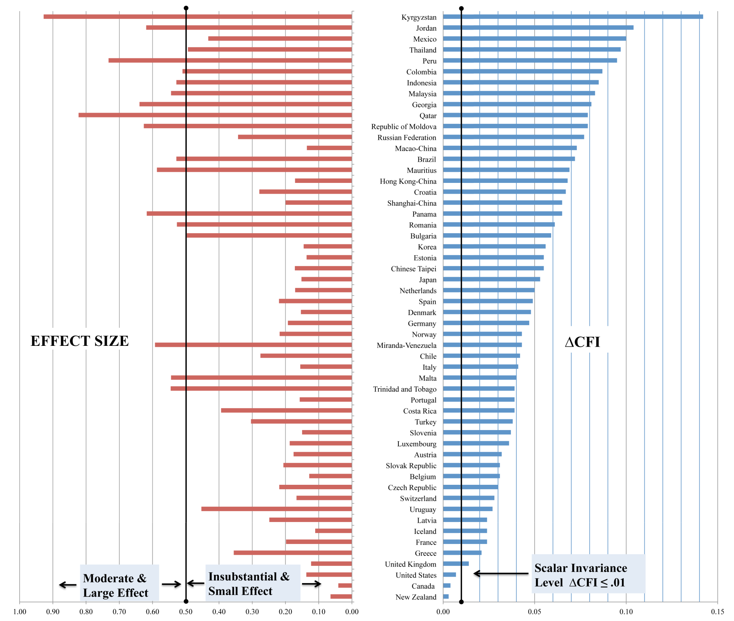
Accept all these countries because differences are trivial or small
31% LARGE
Reject all these countries as not being equivalent

Slide 22
Who is different?
mean dMACS (<0.20) to Australia included
  4 wealthy English-speaking countries,
  12 countries of Western Europe (plus Estonia), and
  6 high-performing East Asian jurisdictions (i.e., Japan, Taipei, Korea, Shanghai, Hong Kong, and Macau).
These countries are the predominantly wealthy nations participating in the survey which invest considerable resources in education or have high cultural emphasis on educational performance.
No patterns here of impact to do with language family, writing script, or culture.

Slide 23
Wealth seems to matter
moderate to large range (i.e., mean dMACS > 0.50)
  16 countries with a variety of scripts (albeit all syllabic), locations, and cultures;
  this group of South American, Eastern European, Asian, and Middle Eastern countries seem to have relatively lower levels of investment in education
PISA index of economic, social, and cultural status (ESCS)
  “captures a range of aspects of a student’s family and home background that combines information on parents’ education and occupations and home possessions”
  There was a moderate but negative relationship
    δCFI (r = –0.61, p < 0.05)
    dMACS (r = –0.54, p < 0.05)
  lower levels of ESCS associated with less equivalence to Australia and greater differences

Slide 24
SES within language groups
differences in socioeconomic resources seem important both within and across language groups.
  For example, Trinidad-Tobago uses English, but is not a high-wealth society, and had a moderately large effect size relative to Australia (dMACS = 0.55).
  Similarly, Portugal ($8000 USD per pupil expenditure), the richer country, using the same language as Brazil ($3000 USD per pupil), was considerably closer to Australian parameters (dMACS = 0.16 vs. dMACS = 0.53, respectively).

Slide 25
Language effects
language similarity seems to play a small role in these results.
  Indo-European languages were relatively located in the bottom half of the graph;
  whereas, non-Indo-European languages tended to be in the upper half,
This is consistent with our hypothesis about the similarity of languages influencing reading achievement but a much weaker contributor to observed differences than the impact of socioeconomic resources

Slide 26
Script effects
type of writing script used in different languages might be a small contributor to non-invariance.
  Most of the languages in the bottom half of Figure 1 use a Roman or Latin alphabet;
  whereas, we see Cyrillic, Arabic, and Chinese scripts mostly in the upper half of scalar invariance.
This provides some support for the hypothesis that changes in the nature of reading comprehension arise in response to differences in reading nonsyllabic or phonemic scripts.
Hence, these results suggest that once reading for comprehension is mastered, impact on models of reading comprehension are minimal, unless exacerbated by significant differences in socioeconomic and cultural resources

Slide 27
Pedagogical practices
British Commonwealth countries that emphasize a child-centered pedagogical approach and that were relatively wealthy were invariant to Australia.
In contrast, more traditional societies, seemed to group at the top of the graph, relatively variant to Australia, but only in terms of scalar invariance, rather than effect size.
  probably emphasizing more didactic teaching,
This suggests that insofar as reading literacy in an achievement test context is concerned, approaches to teaching are less consequential than commonly thought.
Efforts to change pedagogical practices in such contexts to more child-centered approaches may not make any substantial difference to performance on PISA.

Slide 28
Alternative reporting
Ranking within ESCS groups
  High vs. low ESCS economies
Ranking within ‘countries-like-me’ groups
  Nordic countries (Sweden, Norway, Finland, Denmark, Iceland)
  North Asia (China, Macau, HK, Taiwan, Singapore)
  Anglo (USA, UK, Canada, Australia, NZ)
  Continental Europe…..
  Allow switch and compare?

Slide 29
Future Research
Use an alternative reference country
Conduct invariance within economies that are multilingual (Canada, Switzerland, Belgium)
Different reading test booklet
Different PISA round

Slide 30
Major result
The more an education system and economy is similar to Australia, the more likely its students will respond to the PISA reading literacy tests in a similar and comparable fashion
But lack of global invariance means PISA might better report results more cautiously.

