Slide 1
Food, family and the wellbeing of young people
Jennifer Utter, PhD, MPH
School of Population Health
j.utter@auckland.ac.nz

Slide 2
Overview
Update on nutrition and wellbeing in young people in New Zealand
Improving youth wellbeing through family cooking intervention

Slide 3
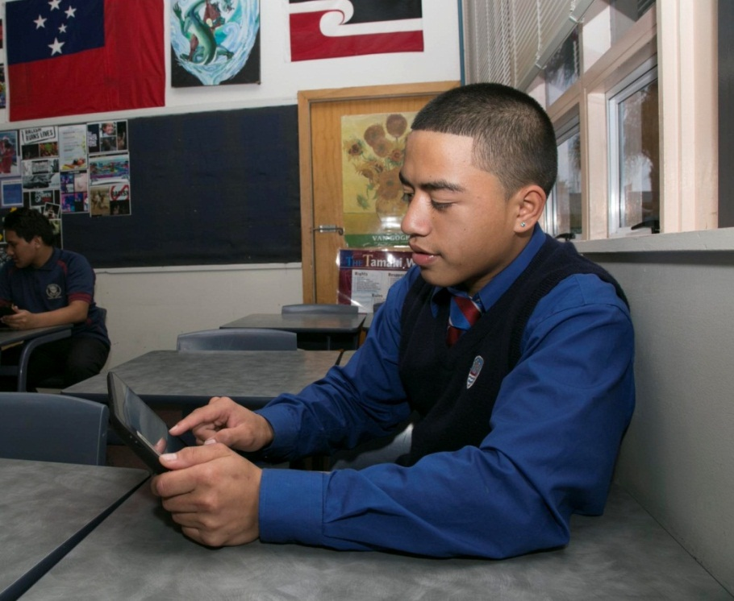
Youth2000 surveys

Slide 5
Obesity and severe obesity among New Zealand young people
Child Obes 2015 11:585-589
Notes:
In fact nutrition and obesity in one of the areas where we have seen things worsen for specific groups of young people. In this case Pacific young people have seen rates of obesity and severe obesity worsen significantly. Severe obesity has increased from 9% to 14% - this is a huge increase.

Slide 7
Healthy eating and emotional wellbeing
Puloka, J Paed Child Hlth; 2017: 657-662

Slide 8
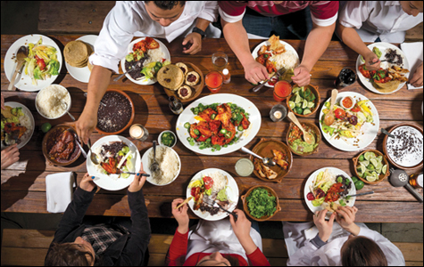

Slide 9
Frequency of Family Meals

Slide 10
Family meals and eating behaviors of adolescents
J Nutr Educ Behav 2013 45:3-11

Slide 11
Family meals and emotional wellbeing of adolescents
J Nutr Educ Behav 2017: 67-72

Slide 12
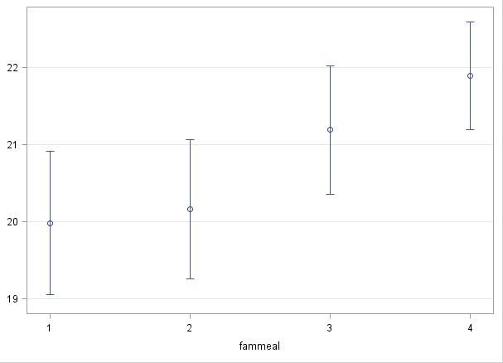
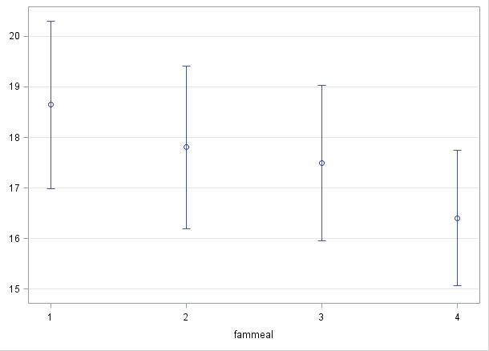
Family meals and emotional wellbeing of parents (Project EAT)
Family functioning
Depressive mood
Data from Project EAT, in prep

Slide 14
Can you cook a meal from basic ingredients?
J Nutr Educ Behav 2016 48:35-41

Slide 15
Where did you learn to cook?
Int J Adolesc Med & Hlth, in press

Slide 16
Cooking and nutrition & wellbeing
J Nutr Educ Behav 2016: 35-41

Slide 17
Adequacy of cooking skills at 18-23y associated with better diets at 30-35y (Project EAT)
Data from Project EAT, in prep

Slide 19
Food insecurity continues to worsen in NZ
Do your parents, or the people who act as your parents, ever worry about not having enough money to buy food?
Kotuitiu, under review

Slide 20
Food insecurity and health and wellbeing
Kotuitiu, under review

Slide 21
Media environment
Healthy eating
Economic factors
Food security
Nutritional wellbeing
Emotional wellbeing
Communities
Culture
Family
Social engagement
Physical environment
School

Slide 22
Healthy eating
Food security
Nutritional wellbeing
Emotional wellbeing
Family
Social engagement

Slide 23
Youth development
Healthy eating
Build social connections
Strengths-based
Skill-based, participatory
Acknowledge the wider context
Food security
Nutritional wellbeing
Emotional wellbeing
Family
Social engagement

Slide 24
How can we intervene with families to cook at home and eat together?

Slide 25
Feasibility of a family meal intervention
Study 1:
Recruited 10 families (one adolescent, one parent/ caregiver) from general population
Provided meal plans, recipes and ingredients for 5 family meals each week for 8 weeks
Study 2:
Recruited 9 families from specialist youth health clinic in South Auckland
Provided meal plans, recipes and ingredients for 5 family meals each week for 4 weeks
J Nutr Educ Behav, 2016;48:716-722

Slide 26
85% of meals provided were prepared
Of the meals prepared, 96% were eaten together by families
We were able to change how families cook and eat!

Slide 27
Was the intervention acceptable to families?
Families enjoyed the opportunity to try new foods
Eating together was a positive experience for the families
“We would talk about how we enjoyed the food and what we like about the meal and talk about school as well sometimes.”
J Nutr Educ Behav, 2016;48:716-722

Slide 28
Perceived benefits of the intervention
Eating healthier
“You know the plates were full, not of just meat like we normally did. The portion sizes had changed, but to benefit us so that portion of vege we now had on our plate was a lot bigger than what it used to be, and I was just amazed that the kids really loved it.” (parent/ caregiver)
Improved wellbeing
“I have been feeling more energetic and could do much more in the day. Like more awake and working better at school and everything.” (adolescent)
Better relationships
“I think we’ve gotten closer [adolescent and mum] like during the day when we’re not cooking we’ll have a conversation about you know what we cooked and stuff. Say how mean [the food] was.” (adolescent)
J Nutr Educ Behav, 2016;48:716-722

Slide 29
Next steps
New approaches needed to engage adolescents and families in nutrition interventions
Interventions need to be positive and skill-based
Measure wider range of health outcomes

Slide 30
Thank you!

