Slide 1
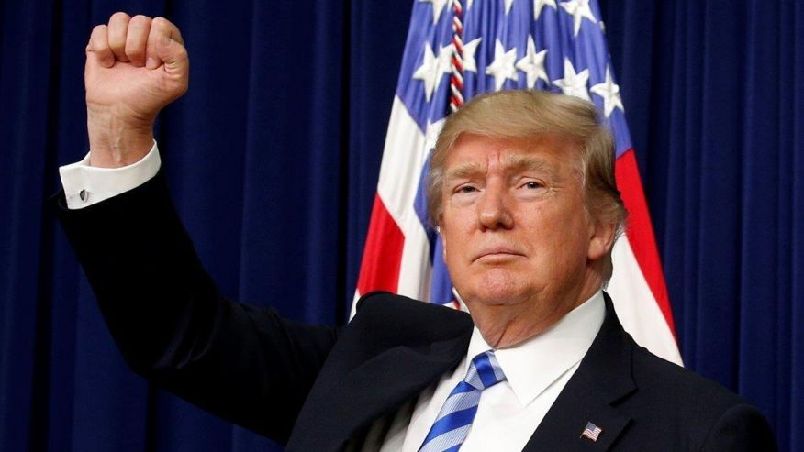
Trump’s ethnonationalism:
America’s problem or a real possibility for New Zealand?
Image sourced from http://www.foxnews.com/politics/2017/04/21/trump-says-media-wont-give-him-credit-for-his-accomplishments.html
Associate Professor Louise Humpage
Sociology, University of Auckland
5 May 2017
Paper presented in the COMPASS seminar series

Slide 2
Thanks
Barry Milne and Clark Tipene have been a great help in preparing this and related papers based on the ISSP 2015 data☺
Thanks also to funders of the ISSP survey (including UoA Faculty of Arts PBRF fund)

Slide 3
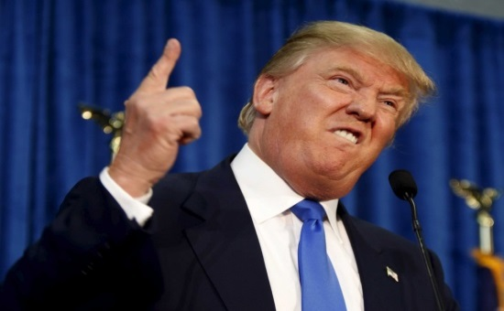
Trump’s ethnonationalist views on national identity
Image sourced from https://jaxpsychogeo.com/west-riverside-avondale/trump-campaign-office/
Trump regards American identity as reflecting Anglo-Protestant culture and thus ‘only certain groups, principally Anglo-Saxons, possess the moral qualities and cultural values that are inherently American’ (Citron et al., 2001: 254-55)
He accuses naturalised immigrants as retaining stronger loyalties elsewhere and, more controversially, that birth within US borders does not guarantee loyalty to the American nation-state
  Questioned President Obama’s American citizenship and eligibility of his rival for the Republican Party’s 2016 nomination, Ted Cruz, who was born in Canada to an American mother and a Cuban father
  Said a federal judge was biased against him in a fraud case because the judge was born in Indiana to Mexican immigrants
  Said Florida Senator Marco Rubio favoured amnesty for undocumented immigrants because he is the son of Cuban immigrants
Notes:
My starting point was Trump – you are probably familiar with these claims …

Slide 4
Trump’s ethnonationalist views on national identity
Trump also blames immigration policy for:
  allowing the ‘wrong’ types of people into the country (e.g. Mexican immigrants are all ‘criminals, drug dealers, rapists’) and threatening US jobs and social security
  for increasing numbers of Muslims gaining permanent residency - noting that the man behind the 2016 Pulse Nightclub attack in Florida was the son of Afghani immigrants, Trump said ‘[w]e cannot continue to allow thousands upon thousands of people to pour into our country, many of whom have the same thought process as this savage killer’
a wall between Mexico and the US
deporting undocumented Mexican immigrants
abolishing automatic US citizenship for children born to such immigrants
immigration bans targeting Muslim-majority countries

Slide 5
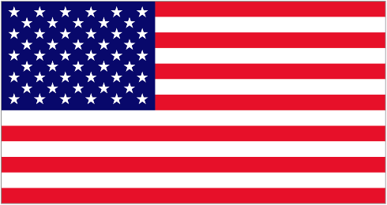
American national identity
National identity relies on citizens viewing themselves as a group, sharing something in common with others they do not know personally: an ‘imagined political community’ (Anderson 1991).
  In the US, naturalised citizens officially need only to endorse the national creed to become ‘American’ = ‘civic nationalism’ = membership based on shared rights/obligations, political institutions and values
  But in practice these civic ideals often accompanied by strong public views about nationalism based on descent and ethno-cultural traits …
Image sourced from http://www.flags.net/UNST.htm

Slide 6
American national identity
Since 1990, American scholars have been studying what the public believes constitutes a ‘real’ American - this tells us about ‘the boundaries [Americans] set to determine who is fully in the group and who is not’ (Theiss-Morse 2012:4)
In surveys, they distinguish between:
    Ascriptive items that are difficult (e.g. English language, belief in God) or impossible (e.g. being born in US) for immigrants to meet
    Civic items that in theory all members in the political community can achieve (e.g. having US citizenship or respect for political institutions)
exclusive, ethnocultural view of national identity because citizens are
believed to share certain characteristics, such as race, ethnicity, and language
more inclusive cultural pluralist or incorporationist model where citizenship
rights are separated from ethnicity/culture

Slide 7
American national identity
Schildkraut (2014) reports that most US studies find civic notions of American identity more widely endorsed than ascriptive ones. However:
  Speaking English is considered important by most Americans
  Ascriptive ideas strengthened after the terrorist attacks on 11 September 2011
  Citron et al (1990) predicted a backlash if strong emphasis was placed on preserving group differences because many white Americans associate multiculturalism with special and unjustly favourable treatment for other ethnic groups
Age, education and political orientation are most important in explaining ethnonationalist views, challenging perceptions that ‘increasing racial or ethnic diversity is eroding consensus on what being American means’ (Schildkraut 2014: 448)
  Racial minorities were more likely than white Americans to view ethnocultural items as important to making someone a true American (high degree of religiosity amongst black and Latino Americans? Greater need amongst minority group members to assert their belonging through rigid rules for membership than majority group members whose belonging is never questioned?)
Notes:
So not completely about self-interest
This is interesting since NZ also rapidly diverse population …

Slide 8
The rapidly changing demographic context
    United States
In 2014, ‘ethnic minorities’ represented 38% of the entire US population, up from 33% in 2004 (already the majority in four states and Washington DC).
Overseas-born proportion of population almost trebled to 14% between 1965 and 2015, with fundamental changes in the source regions of immigrants over the same period from Europe to South/Central America, Asia, and Africa.
The US remains home to more Christians than any other country and only 0.9% of the US population identifies as Muslim but the Christian proportion declined from 78% in 2007 to 71% in 2014.
  New Zealand
  By 2013, 25 per cent of the NZ population was born overseas.
  The ‘Asian’ population rapidly increased by 33 percentage points to 12% of the population over the same period.
  The Muslim population increased by 28 percentage points from 2006, but still represents only 1.2% of the NZ population.
Notes:
Of course, these views, as well as Trump’s claims reflect – at least in part – concerns about a rapidly changing demographic context –
Similarly, the NZ population has gone from being culturally homogenous to super diverse in less than 50 years, as policy preferences for British immigrants shifted towards attracting high-skilled or business immigrants from any country in the 1980s.

Slide 9
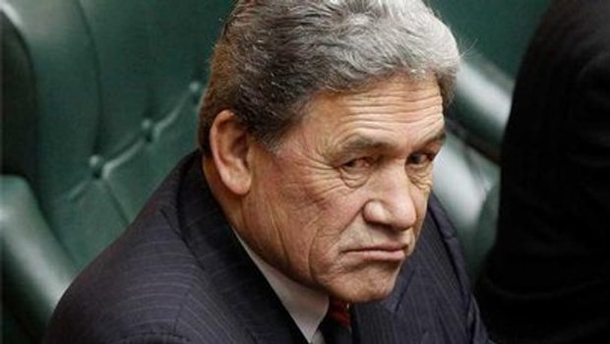
Peters’ ethnonationalist views on national identity
Image sourced from https://www.whaleoil.co.nz/2014/05/winston-peters-deals-media-enquiries/
NZ First Party leader, Winston Peters, has articulated ethnonationlist concerns about (Asian) immigration since 1996:
We ‘need to keep a tight lid on immigration if we are to avoid NZ’s identity, values and heritage being swamped’ (2002, cited in Skilling 2012: 370)
Proposes that all applicants be interviewed to ensure they embody ‘New Zealand’ attitudes because: ‘We want them to salute our flag, respect our laws, honour our institutions and, above all, don’t bring absolutely anti-women attitudes with them, treating women like cattle, like fourth-class citizens’ (2016, cited Kirk 2016)
We need to ‘put a wall around this country to ensure that we do not have a flood of immigrants competing with us with respect to social services, education and health’ (2002, cited in Skilling 2012: 370)

Slide 10
NZ views on immigration
Other parties have also proposed reductions to immigration:
BUT McMillan (2010) argues that immigration has not been a ‘political wedge’ as in the US or Europe since both Centre-Left and Centre-Right governments in NZ agree that skilled migrants are economically necessary to counter population ageing and significant emigration
AND
NZ First itself is a Centrist party that has supported both Left and Right governments, while anti-immigration sentiment was only one factor behind its electoral success in 1996
National government will restrict the ability of lower-skilled migrants to apply to and stay in NZ (arguably shifting towards a guest-worker type programme)
Labour Party leader Andrew Little vows to slash immigration by ‘tens of thousands’ in order to give the country a ‘breather’. He promised ‘immigration that meets the genuine shortage of skills that we've got, not just the open slather policy we've got right now’ (cited in NZ Herald 2017)
Green Party promises to cap overall net migration at 1 per cent of the population, including returning New Zealanders
Notes:
A poll conducted during the Republican and Democratic Conventions found that only 9% of New Zealanders would vote for Trump if they had a chance, suggesting his ideas have little credence in NZ.

Slide 11
NZ views on immigration
New Zealanders generally believe immigration has a positive impact YET support reduced immigration
  Big improvements in attitudes towards Asian immigrants after 1996, though a hardening between 2012-2015 (Butcher et al 2015)
  NZES data since 1990 suggests consistently high support for restricting immigration (Skilling 2012)
  Older people more likely to believe immigration had increased a lot in the last five years and support for immigration restrictions (Ipsos 2016)
  NZ First and National voters more likely to want to restrict immigration ( Ipsos, 2016; Gower, 2016).
  NZ born (especially Māori) and immigrants who arrived before 1999 (more likely from UK/Europe) tend to be less positive towards immigration/immigrants (Spoonley et al 2007; Ipsos 2016; MBIE 2017)
  Unemployment trends unrelated to attitudes towards immigrants but more general perceptions of relative disadvantage may e.g housing affordability (Ward et al. 2011).

Slide 12
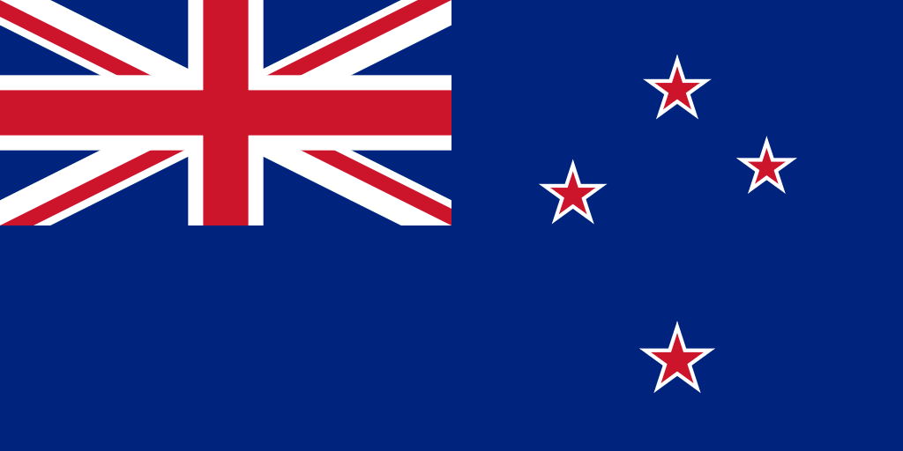
NZ national identity
Image sourced from https://en.wikipedia.org/wiki/Flag_of_New_Zealand
Studies generally show New Zealanders articulate an internationally strong multicultural/bicultural ideology
    Several older studies (e.g. Gendall et al 2007; Ward et al 2011) find a majority believe immigrants should be able to maintain their traditional culture while also adopting NZ culture and only a minority think immigrants should give up their original culture
  At least two-thirds of Ipsos (2016) respondents agreed that: it’s a good thing for society to be made up of people from different races; migrants make an important contribution to New Zealand’s culture and society; migrants make New Zealand more productive and innovative; and migrants have qualities they admire
  Sibley and Liu (2007) found Māori and Pākehā respondents unified in terms of their associations with national symbols with Pākehā respondents strongly associating both Pākehā and Māori New Zealanders with NZ
  YET immigrants often feel left out of bicultural relationship (MSD 2008) and Pākehā often feel ‘disadvantaged’ by it (Terruhn, 2014)
Notes:
So would NZers support ethnonationalist views articulated by Trump?

Slide 13
Methods
The International Social Survey Programme module on citizenship, run as part of the ‘Social Attitudes Survey New Zealand’ in 2015, included 6 ascriptive and 4 civic items that allow us to ask:
  Is ‘truly being a New Zealander’ more closely associated with exclusive, ascriptive signifiers or more inclusive, civic items?
  Have these associations changed since 2003?
  Are there any differences in the above responses across varied social groups?
Notes:
Not exactly the same questions as in US

Slide 14
Methods
The 2015 survey was sent to 2500 individuals (aged 18 years and older) randomly selected from the electoral roll, with 901 returning surveys (36% response rate).
  Reflecting the electoral roll, the sample was older and contained fewer individuals of Māori descent than found in the general population, while also under-representing those from Auckland and those living in deprived areas and over-representing those in rural areas
  Weightings were computed to deal with these issues but caution is still needed when cross-tabulating data by: place of birth, ethnicity, political affiliation, party vote in 2014, age and current financial situation.
  Statistical significance was tested using Chi-square – only significant findings discussed

Slide 15
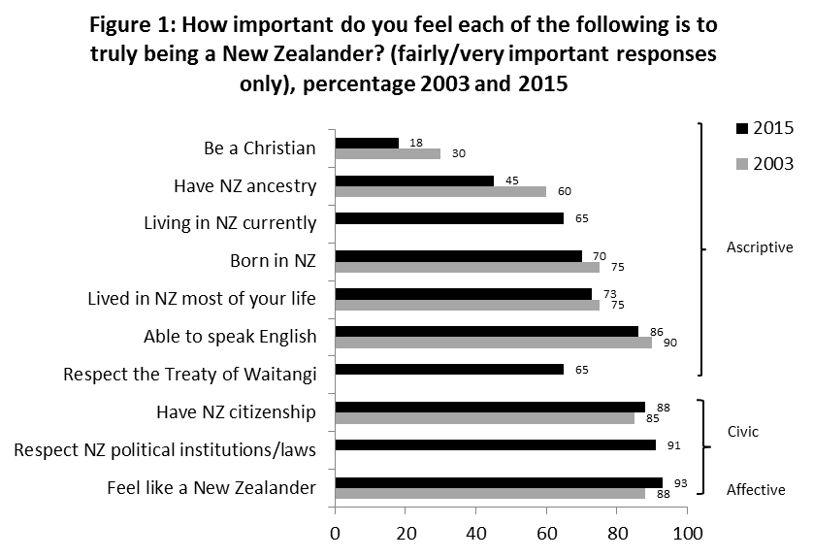
Notes:
Overall, the data suggest that New Zealanders support an inclusive understanding of national identity and, indeed, the boundaries of the national imaginary may have broadened since 2003. Shows that 93% of all respondents in 2015 believed that feeling like a New Zealander was important to truly being a New Zealander, up from 88% in 2003. Respondents were not asked to specify further but this finding suggests they interpret NZ identity as subjectively decided by each individual, boding well for the incorporation of diverse immigrants living in NZ.
Also high levels of support for ‘Respect NZ political institutions/laws’ and NZ citizenship, suggesting respondents believe naturalised immigrants can become true New Zealanders. Given strong support for these civic items, it is notable however that only around 65% of respondents agreed that truly being a NZ involved respect for the 1840 Treaty of Waitangi. This supports previous research indicating ambivalence about the role of the Treaty, a key aspect of biculturalism, in national life. Nonetheless, a clearly majority of respondents believed that truly being a New Zealander requires respect for the Treaty.
Civic items garnered the greatest support overall but some ascriptive ideas were favoured strongly, although less so than in the past: being NZ-born and having lived most of your life in NZ. Less so for NZ ancestry which dropped significantly. Historically, such ancestry would have almost exclusively denoted British/European or Māori descent, so this shift may reflect the growing ethnic diversity of the NZ population. Moreover, only 65% of respondents agreed with a new question asking if living in NZ currently was important, meaning a significant minority thought national identity could travel with you beyond the nation-state. This is not surprising given NZ’s high rates of emigration and given that 17% of the 2015 survey respondents thought it likely they would move overseas to live within the next five years.
Earlier research suggested that New Zealanders are relatively open to multicultural ideas of integration yet 86% of the 2015 respondents believed that being able to speak English is important to being truly a New Zealander;, only a small proportion (18%) of 2015 respondents thought that being a Christian was important to truly being a New Zealander, a significant decline since 2003

Slide 16
✓
✓
✓
✓
✓
Notes:
Far fewer overseas-born respondents than NZ-born respondents thought that being born in NZ, NZ ancestry, having lived in NZ most of your life and NZ citizenship were important to being a true New Zealander. This is not surprising, since they are unlikely to meet the first three criteria themselves and will be acutely aware that only permanent residency (not NZ citizenship) is required to gain most rights and entitlements in NZ.
Other responses were not always as expected. Notably, a higher proportion of overseas-born than NZ-born respondents agreed that respecting the Treaty of Waitangi was important. Although not statistically significant, overseas-borns were also more likely to feel that respecting NZ political institutions/laws and speaking English were important to truly being a New Zealander. Together support for the Treaty, other political institutions and English may reflect a desire to ‘fit in’, as noted by Fozdar and Low earlier, although greater support for the Treaty amongst overseas-borns than NZ-borns does sit in tension with reports that immigrants often feel excluded within the bicultural project.

Slide 17
✓
✓
✓
✓
✓
Notes:
Immigrant experiences are likely shaped by the ethnicity of such migrants- Small sample sizes for minority ethnic groups make reliable disaggregation by ethnicity difficult but Table 2 does differentiate between those who identified as ‘NZ European’ and ‘Māori’ across the whole sample. NZ Europeans do not have notably stronger views on ascriptive items except for speaking English but Māori respondents do for born in NZ, NZ ancestry, lived in NZ most of your life. Māori may adopt more rigid rules of belonging in asserting their political claims as indigenous peoples, given the political concerns about immigration articulated by Māori noted earlier, but it is also important to acknowledge that ancestry and a relationship with land and place are central to Māori society. The focus on these amongst Māori ISSP participants is thus hardly surprising. Nor is it unexpected that the Māori sample overall were more likely than NZ Europeans to agree that ‘respect the Treaty of Waitangi’ was important.
Although these 2 slides suggest ethnonationalist views of belonging are common amongst NZ-borns (particularly Māori), it is important to reiterate that feeling like a New Zealander remained the most frequently named characteristic of truly being a New Zealander by all groups.

Slide 18
✓
✓
✓
✓
✓
✓
✓
✓
✓
✓
½ of the 2015 survey respondents who placed themselves on the political scale identified as Centrist (compared to 19% identifying as Left and 30% on the Right).
¼ of the total sample could or would not locate themselves on the political scale.
Notes:
The MMP representation environment makes political affiliation difficult to measure, since smaller political parties (such as NZ First) attract a significant minority of voters and do not always sit clearly on the Left or Right. It is thus useful to consider both a respondent’s self-identification on a political scale, as well as the party they voted for in 2014. Read red: given their potential significance as ‘swing-voters’ who may change the political party they support across elections, this group – as well as those who did not vote in the 2014 election – are included in the following analysis.
Pol affiliation important for understanding some factors associated with national identity. In rank order, the political Right placed a stronger focus than the Left on: feel like a New Zealander, respect NZ political institutions/laws, speaking English, living in NZ most of your life, born in NZ and living in NZ currently. The only item more likely to be named by the Left was respect the Treaty of Waitangi. Overall, those on the Right offered strong support for items suggesting that both birth and naturalisation are appropriate means for gaining a sense of belonging and identity in NZ, with higher levels of support for civic than ascriptive items suggesting the former dominates
However, respondents that could not identify themselves on the political scale offered the highest level of agreement that NZ ancestry, having lived most of your life in NZ and being NZ-born were important to truly being a New Zealander. This indicates exclusionary views about national identity are linked with a strong and enduring commitment to NZ. Those at the political Centre literally took a middle view, reporting a level of agreement sitting between Left and Right with the exception of born in NZ, lived in NZ most of your life and NZ ancestry where support was closer to the Right. It therefore seems likely that those without a political affiliation, Centre and Right voters could together swing an election if it were focused on ‘protecting’ an exclusive notion of national identity.

Slide 19
✓
✓
✓
✓
✓
✓
✓
✓
✓
15% of survey respondents who indicated voting preferences said they did not/were not eligible to vote
Notes:
Table 4 confirms NZ First’s potential to speak to the political Centre, as noted earlier. Small sample sizes require caution: read red This is important because Table 4 shows that NZ First voters across the whole sample offered the highest level of support (in rank order) for ascriptive views regarding being a Christian, born in NZ, living in NZ currently and NZ ancestry, as well as the civic item of NZ citizenship. Read red note: National Party voters offered very similar levels of support to NZ First for NZ citizenship and the highest support for respect NZ political institutions, speaking English and feeling like a New Zealander, suggesting views more mixed than those of NZ First supporters. Labour voters offered the greater level of support only for respect the Treaty of Waitangi.
Although these findings suggest differences in NZ First and National voter views, a Right-Centre coalition focused on ethnonationalist ideas about loyalty and commitment is possible, particularly if it focused on ‘Māori privilege’ since National voters were least likely to support respect for Treaty of Waitangi. The likelihood of a coalition would be enhanced if the 39% and 33% respectively of those who identified as Centrist or could not name a political affiliation and who did not vote in 2014 became electorally active in the future

Slide 20
!
✓
✓
✓
!
✓
✓
✓
!
✓
!
✓
Notes:
The proportion agreeing that being a Christian is an important was considerably higher (35%) amongst those aged over 61 than other groups, particularly those aged under 45 (8%). This suggests the importance of Christianity to the New Zealand national identity may diminish over time.
Almost all (96%) of the over 61 age group thought respecting New Zealand political institutions and laws was important to being a true New Zealander (compared to only 83% of those aged 18-30). This may be explained by a general disaffection with political institutions amongst young adults and/or the older group’s greater understanding and experience of engaging with such institutions.
Asides from Christianity, it is unlikely support for other ascriptive views will diminish in the long-term. Although the oldest age group were most likely to think NZ ancestry and being born in NZ is important to truly being a New Zealander (53% and 77% respectively), in both cases the 31-45 age group offered the lowest support (35% and 58%) not the 18-30s (43% and 71%). A similar but less distinctive trend is also apparent for being able to speak English and NZ citizenship. This raises some concern that both younger and older people may be endorsing more exclusive views of national identity than those in the middle age groups.
Although findings were not statistically significant, there is also no indication that growing up in the bicultural era has made young New Zealanders more open to the idea of respecting the Treaty, since they offered the lowest level of support for this item

Slide 21
✓
✓
✓
✓
✓
Notes:
Table 6 analyses responses regarding what is important to truly being a New Zealander by the best available proxy for perceived disadvantage: the respondent’s self-reported description of their current financial situation.
Notably, only respect the Treaty of Waitangi gained higher support from those describing their financial situation as ‘very bad’ than those perceiving their financial situation more favourably and support is considerably lower amongst other groups (ranging 55-67%). Although not statistically significant, the ‘very bad’ group also reported the highest level of support for NZ ancestry and living currently in NZ; the ‘very bad’ sample is too small to disaggregate but Table 2 showed that Māori overall were more likely than NZ European to agree with these items, likely because Māori place significant focus on genealogical connections with each other and land as a basis for entitlement and cultural affiliation and as a group are disproportionately socioeconomically disadvantaged. As such, ethnicity may intersect with socioeconomic status here, supporting previous findings that Māori are concerned about immigration.
Respondents reporting a ‘very good’ financial situation offered statistically significant higher levels of support only for respecting NZ political institutions and laws and speaking English. Overall, current financial situation is less important than other factors for determining perceptions of what it means to truly be a New Zealander.

Slide 22
Conclusions
ISSP data from 2015 shows that the boundaries of NZ identity are relatively permeable and have overall become a little more inclusive than in 2003
  Feeling like a New Zealander and other civic items were rated most highly by respondents as identifiers of truly being a New Zealander
  There are nonetheless strongly exclusive views that true New Zealanders should be born in NZ and, to a lesser degree, have NZ ancestry, particularly amongst:
    those aged over 61 and (in some cases) under 35
    politically Right, Centre or ambivalent (especially those voting for NZ First)
    those born in NZ
    Māori
  Combined these groups could provide sufficient electoral support to see NZ First become part of government again and put ethno-nationalist ideas into policy

Slide 23
Conclusions
The findings further indicate that NZ’s current ‘laissez-faire’ approach to multiculturalism within the context of the bicultural project may be insufficient in the long-term to avoid the growth of ethno-nationalist feelings that further exclude migrants (and Māori) from the national imaginary
While NZ attitudes were relatively inclusive overall, radical institutional change is needed to avoid the divisive ethnonationalism evident in the US and Europe. This requires:
  A form of bi-nationalism providing Māori more certainty about the ongoing role of the Treaty of Waitangi and power-sharing
  AND
  A more dynamic multicultural policy that actively supports and welcomes immigrants to NZ
  AND
  A process of collective reflection on colonialism, ongoing institutional racism and historical representations of national identity that encourages Pākehā to acknowledge their privilege within NZ society without recourse to blame

