Slide 1
Life In A New Zealand Rest Home
Focusing on care within an institution

Slide 2
Contents
History of rest homes
Rest homes today
Rest Home Critiques
Research Question
Methodology
Institutional Ethnography
Ethics
Process
Results
Daily lives of residents
Residents and staff
Influencing the rest home environment.
Conclusion
Implications
Future Focus: Eden Alternative
Notes:
Go through what we will discuss and describe how this was a good rest home which met all the criteria set out by the Health and Disability Service Standards. In everything size, gender proportion, income stream, it represented the common rest home in New Zealand.

Slide 3
HISTORY OF REST HOMES
Developed from older institutions known as workhouses, almshouses or benevolent institutions (Hardie, 2014).
Contained a wide variety of individual’s who could no longer live independently or with family.
Widely considered a negative experience for those living in them (Achenbaum, 1978, p. 80), Swarbrick, 2012). One of the reason’s for this was the rules which governed all aspects of their daily life.
Example: New Zealand benevolent institutions where all residents were to abstrain from alcohol and leave all personal possessions outside of the institution (Swarbrick, 2012).
Notes:
Rest homes developed from an older institution known as workhouses, almshouses or benevolent institutions (Hardie, 2014). They contained a wide variety of individual’s who could no longer live independently or with family.
Widely considered as a negative experience for those living in them (Achenbaum, 1978, p. 80), Swarbrick, 2012). One of the reason’s for this was the rules which governed all aspects of their daily life such as in the New Zealand benevolent institutions where all residents were to abstrain from alcohol and leave all personal possessions outside of the institution (Swarbrick, 2012). The 1900’s brought improvements to institutional care for older adult’s and the introduction of some of the first rest homes. One of the reason’s for this was that, while earlier benevolent institutions has been associated with moral failure of not being able to work in society, these were seen more as a reward, such as for serving the New Zealand Army (Ranfurly Veteran’s Home 1903, The Ranfurly Trust, 2015).
Also the Disabled Servicemen Rehabilitation League was set up in 1930 by the government to provide care for soldier’s returning from the war (Tennant et al., 2006, p. 9).

Slide 4
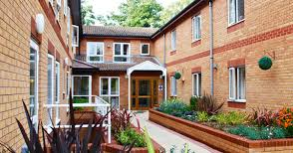
REST HOMES TODAY
Today rest homes are a thriving industry in New Zealand and receive government subsidies for residents who have limited means.
To receive a subsidy residents must be older than 65 years, have income and assets assessed, and need that care for a substantial period of time.
if an older adult can receive the subsidy the money is then paid from Work and Income directly to the rest home, rather than to the individual resident (Work and Income, 2015).
Notes:
Today rest homes are a thriving industry in New Zealand and receive government subsidies for residents who have limited means (Work and Income, 2015).
To receive a subsidy residents must be older than 65 years, have income and assets assessed, and need that care for a substantial period of time.
If an individual is eligible to receive the subsidy then
Once these assessments are done, if an older adult can receive the subsidy the money is then paid from Work and Income directly to the rest home, rather than to the individual resident (Work and Income, 2015).
Rest homes that receive subsidies are then placed in a supervised contract with the government. This contract means includes regular audits by organisations selected by Ministry of Health. In the 2014 Aged Care Service Agreement (DHB Shared Services, 2014) it is specifically stated that auditors require access to those people who receive subsidies to check audit regulations are being followed. The Ministry of Health does not request the same for those older adults who are in the rest home but do not receive a subsidy (DHB Shared Services, 2014; Grant Thornton, 2010).

Slide 5
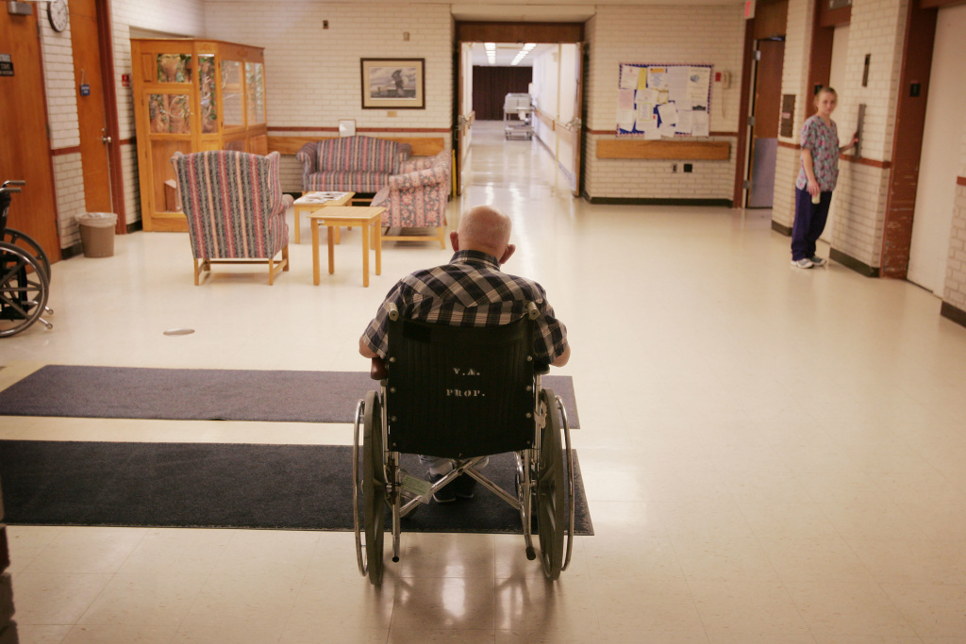
REST HOME CRITIQUE’S
Dominant discussions of rest homes in society acknowledge that there are serious problems with the way some rest homes are run.
Through a series of observations and interviews with staff members Bland (2005) found evidence of misconduct, such as neglect, within a New Zealand institution.
Notes:
Dominant discussions of rest homes in society also acknowledge that there are serious problems with the way some rest homes are run. Research and discussions in the media have identified maltreatment including physical and verbal abuse, neglect, and unnecessary restraint (Bland, 2005; Buzgova & Ivanova, 2009; Families Commission, 2008; Gay, 2008).
Bland (2005) also discussed the negative experiences of institutionalised older adults, this time in New Zealand. Through a series of observations and interviews with staff members Bland (2005) found evidence of misconduct, such as neglect, within the institution. George, one of the residents, recounted that when he initially entered the rest home from hospital he was placed on lockdown in a dementia care unit, despite not having dementia (Bland, 2005 p. 6). George spent six weeks in this locked unit, without access to his money, personal possessions or any way to leave (Bland, 2005 p. 6). Eventually his cognitive functioning was reassessed and he was transferred to rest
home care but no reason was given for his initial position.
Another mistreatment that can occur in rest homes is overmedication. This is particularly because the focus of care in the dominant view of rest homes is on maintaining physical health, something that according to the biomedical model can be done with medical treatment (Bowker, 1982; Kendall, 2005).
A study of psychotropic medication prescribed to older adults in Gisborne, New Zealand over the course of a year, found older adults who lived in rest homes were more likely to receive psychotropic medication compared to older adults not in these institutions (Norris et al., 2011 p. 210). The researchers concluded there was a need to understand why this high prescription for older adults in a rest home was occurring, particularly as psychotropic drugs are used for mental health issues such as anxiety and depression (Norris et al., 2011). It is possible this increased drug use is a by-product of the fact that those entering a rest home generally have higher levels of health problems than those in the community, but there is some indication that overmedication within the rest home may be a problem (Norris et al., 2011).
While it is accepted that instances of abuse in rest home care exists and must be prevented, this is not considered an insurmountable problem within the dominant literature for aged care (Brownie, 2011; Coleman et al., 2002). Instead, it is believed that the institution can be improved through changes in the attitude and actions of rest home members, as well as increased staff training and tighter policy regulations (Ministry of Health, 2003). Therefore, there is an expectation that rest homes can change for the better while still maintaining their existing structure and most of their processes.

Slide 6
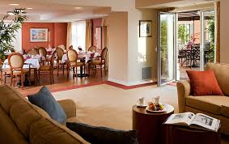
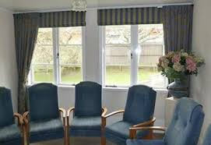
RESEARCH QUESTION
What does the daily life of a resident in a New Zealand rest home look like?
What formal and informal rules and regulations are evident in a New Zealand rest home?
How are expectations conveyed to residents through text and discourse with staff members?
Which elements of institutions are evident in the rest home?
Notes:
Research into rest homes from a dominant perspective of care has been more prolific, however, this scholarship does not have a strong focus on observing the experiences of residents in the rest home and prioritising their voice over the voices of staff or family members.
One of the reasons for this is that it can be difficult to gain access to residents in a rest home, as the consent of the manager must first be gained (Diamond, 1992).
My study aims to close these gaps in the research by conducting an ethnographic observation study to gain a better sociological understanding of rest home life. This will be the first sociological ethnographic study of rest home care in New Zealand, and will add to the limited amount of scholarship examining rest homes as a total institution worldwide.
By spending time with residents rather than conducting an interview with a pre-considered list of topics, I intend to bring the voices and experiences of resident‟s into the literature, where it has often been passed over for discourse with those who work with older adults (Harnett, 2010; Lundh et al., 2000). It is my hope that this ethnographic research method will also help me to reflexively examine my position in the research and to ensure the needs and views of the residents have the highest priority.
Overall, the aim of my research is to examine the everyday experiences of rest home life from the perspective of the residents. This research also proposes to make visible the rules and expectations of rest home care and how these affect residents in the rest home.
1. What does the daily life of a resident in a New Zealand rest home look like?
2. What formal and informal rules and regulations are evident in a New Zealand rest home?
3. How are expectations conveyed to residents through text and discourse with staff members?
4. Which elements of institutions are evident in the rest home?

Slide 7
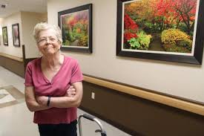
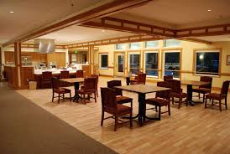
METHODOLOGY: INSTITUTIONAL ETHNOGRAPHY
I chose to conduct observational ethnnographic research in the rest home in order to gain a more in-depth understanding of the lives of residents
The purpose of my study was to empower the voices of the residents, and observing in the rest home would allow me to spend more time working with them compared to interviews or surveys.
Notes:
As I am interested in understanding the daily lives of residents in the rest home as well as the rules and expectations used in this setting, I will be conducting ethnographic research (Angrosino, 2007). In this study, I chose to conduct observational ethnnographic research in the rest home in order to gain a more in-depth undertstanding of the lives of residents. This is particularly important as the purpose of my study is to empower the voices of the residents, and observing in the rest home will allow me to spend more time working with them than interviews or surveys would. I will observe the actions and discussions of both staff members and residents within the public spaces of the rest home, as well as the objects within these spaces, such as the notices on the wall and the Christmas decorations.
Initially my research was to be conducted in an observor-as-participant role (Angrosino, 2007, p. 4). In this role the researcher is known to the participants but interacts very little with them (Angrosino, 2007 p. 5). Instead they take notes, record observations and are largely removed from what is being observed (Angrosino, 2007, p. 5). I planned to sit at the back of the lounge and quietly take notes during my time in the rest home, speaking to the residents and staff as little as possible and interacting mainly as a researcher. However, once I entered the rest home I found that I moved into more of a participant observor role (Angrosino, 2007, p. 5). As part of a participant observor role the researcher interacts more in the daily life of the participants and is seen more as an aquaintance or friend rather than simply a researcher (Angrosino, 2007, p. 5). Other studies of observational research have also noted these shifts in the roles of the researcher (Adler & Adler, 1987, p. 42).
One of the potential limitations of observational research methods is that it is difficult to know if the research is reliable (Angrosino, 2007, p. 10). Qualitative research is not that focused on reliability because there is an understanding that different researchers will observe different aspects of participants lives (Angrosino, 2007, p. 9). However, in order to achieve some form of reliability
these observations will be done systematically using the same format to record the data (Angrosino, 2007 p. 10).
Validity was much more important for this qualitative research, as observations that were conducted needed to accurately relect the reality of the residents in rest home care (Angrosino, 2007). This research was valid as I wrote down the events in the rest home in real time, making it likely that I measured what I aimed to measure, the experiences of residents in the rest home (Angrosino, 2007, p. 11). Therefore this research is expected to have a low reliability but a high validity
One of the limitations of ethnographic observational research is observor bias (Angrosino, 2007, p. 12). This bias means the researcher unintentionally changes the behaviour of the participants (Angrosino, 2007, p. 12). I aimed to reduce observor bias by acting as a participant-observor, and therefore (unlike interviewers or those conducting survey research) did not request specific actions
from the residents (Angrosino, 2007 p. 12). Therefore, over time it was expected that my presence would appear normal and the amount of change will be minimised (Angrosino, 2007 p. 12). Triangulation can also reduce the observor bias (Angrosino, 2007 p. 13; Flick, 1992). This is when observations in the field are checked against information from archives, later texts and interviews (Angrosino, 2007 p. 13; Flick, 1992). I will carry out triangulation in my research by using the Ministry of Health audits (2003) to find the official regulations for all rest homes and compare these to the rules and expectations in the rest home.
Ethnography allows social researchers to understand the experiences of the individuals being researched. However, because I am interested in institutions and how rest home care is experienced 45 by residents in these institution, I will be using institutional ethnography. Previous research into rest homes has also used institutional ethnography (Diamond, 1992; Gubrium, 2012). Gubrium‟s (2012) work was originally done in the 1970s and focused on the experiences of both staff members and residents, and Diamond (1992) conducted his study while working as a caregiver for residents in the rest home. In both of these studies the emphasis was on either the caregiver predominantly or the caregiver and the resident equally. In contrast, my research emphasises the experiences of the residents over the experiences of all other individuals in the institution to develop a better understanding of the daily lives of the residents. Even in those cases where residents are recorded in discussion with other individuals such as caregivers, the purpose of recording the conversation is to better understand the experiences of the residents.
Institutional ethnography differs from other forms of ethnography as it is focused on the wider image of how institutions operate and how groups fit within the procedures of an institution (Marvasti, 2003, p. 36). Institutional ethnography was developed by Dorothy Smith, who wanted to understand how her experiences as a single mother could be examined and incoporated sociologically into research methods that have previously „excluded the local and bodily from its field‟ (Smith, 2005, p. 12).
Smith (2005, p. 225) defines institutional ethnography as a method of research that explores the social relations that are a part of the organising of institutions. She argues that „people are the expert practitioners of their own lives‟ (Smith, 2005, p. 225). The purpose of the ethnographer therefore is to learn from participants, and then to move beyond what these groups know to look at the wider “institutional aspects of the ruling relations‟ (Smith, 2005 p. 225). This trans-local perspective can then connect the daily experiences of residents in institutions with processes that they cannot see.
In the case of my research, the purpose is to focus on the residents as the experts, learn from them, assemble this understanding from intra local and trans-local perspectives and then discover how residents experiences and activities are connected with the institution‟s rules and expectations (Smith, 2005, p. 225). Smith expands on this understanding of ethnography as a bottom up approach that starts from people‟s experiences rather than from theory, by describing it in terms of conducting research from the perspective of the „small hero‟ (Smith, 2006, p. 3). A study‟s focus on the perspective of this „small hero‟ could be a single parent or, in the case of this research, a resident in a rest home. As a researcher my role is also to start my inquiry from the point of view of the „small hero‟, in this case the resident. I can then look up at the ruling relations and organisational processes that are part of the institution, in order to explore how this institution works and how and why the „small hero‟ is engaged in this process (Smith, 2006, p. 3). As Smith notes when conducting institutional ethnography the key is „looking up and into [the trans-local level] as a process of investigation,‟ (Smith, 2006, p. 5) using what you have at the ground level of the institution as „a base from which to move to investigating further and more widely‟ (Smith, 2006, p. 5)

Slide 8
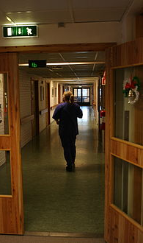
METHODOLOGY: ETHICS
One of the big factors when working with residents in rest homes is that they are part of a vulnerable population.
Separation through seating.
Ensuring informed and voluntary consent.
Preserving Anonymity.
Illegal or Harmful Activity.
Ending the Research Process.
Notes:
One of the big factors when working with residents in rest homes is that they are part of a vulnerable population (Pitts & Smith, 2007, p. 130; Smith, 2005). Jokinen, Lappalainen, Meriläinen, and Pelkonen (2002, p. 165) stated that working with older adults causes ethical issues, as often older adults are considered to have less authority and in some cases less ability to act independently in decision making around research. Therefore it is very important when conducting this research to consider, at every stage the researcher‟s position in the rest home, whether the dignity of the research participants is being upheld and whether they are being empowered to make independent and informed decisions (Smith, 2005; Jokinen et al., 2002 p. 165).
As I was interested in trying to subjectively understand the experiences of the resident, I also wanted to be separate from the caregivers and management. In order to emphasise this separation I sat with the residents during my time in the rest home, and I communicated mainly with residents rather than with staff members.
In the case of residents who were not cognitively impaired, I focused on ensuring that they provided informed and voluntary consent by first having the manager approach all the residents as a group to outline my research. I then entered the rest home a few days later, handed out participation information sheets and consent forms and spent an hour speaking with each resident, discussed the purpose of the research with them, answered questions and asked questions to ensure resident had a full understanding of the research that was being conducted. I also left the handing in of consent forms for this study open throughout my six weeks of observing between the 11th of November and the 18th of December. Some residents agreed to participate on the first day, while others waited for family members to discuss the research with them, or to see the impact my observation would have on their daily lives in the rest home before consenting to the study. As a result I received a total of thirteen consent forms throughout the six weeks I was in the rest home. Ten of these consent forms were from residents and three were from caregivers. These participants were representative of the rest home as a whole in terms of age, ethnicity and gender.
To preserve this anonymity I selected pseudonyms for the participants that I used both when taking notes in the home and when writing up the research. Using pseudonyms, even when taking notes in the rest home, meant that if a participant caught a glimpse of these notes the statements could not be easily identified.
The other anonymity that had to be maintained was the anonymity of those caregivers and residents who had not agreed to take part in the research. This was also an important part of preserving the dignity of residents, as their decision to not take part had to be respected and upheld throughout the research process. In order to ensure that this anonymity was preserved, I learned the names and faces of those caregivers and residents who had agreed to take part. When observing in the rest home I would take notes on those residents and caregivers who participated. If a participant was, for example, in conversation with an individual who had not agreed to take part in ethnography only the reactions of the individual who had agreed to take part would be recorded. Any information coming from those who had not agreed to take part would not be recorded
Jokinen et al., (2002, p. 167), stated that age differences do factor into research, and therefore as a researcher working with a group of individuals at a different stage of life than myself, I needed to be open and reciprocal to ensure that there was no confusion. One of the benefits of being young in the rest home (I was 25 at the time of this study) was that the residents tended to see me as a child rather than a researcher. For example, some residents compared me to their grandchildren, such as Tracey who said that her grandchild was also at University studying. This relationship meant that I was less of an authority figure, which was a big part of establishing and maintaining a participant- researcher relationship (Jokinen et al., 2002, p. 167).
Another ethical issue in the decisions that were made centred on identifying to the manager any activity that was considered illegal or harmful. One of the reasons this was particularly important was because I was working with a vulnerable population, and therefore had a duty to report any unethical behaviour that occurred in the rest home. However, there was also the issue of, again, preserving the anonymity of participants (Jokinen et al., 2002; Pitts & Smith, 2007, p. 14). This relates to a researcher‟s duty of care when it comes to the disclosure of observations and the integrity of avoiding the collection of information that could put participants at risk (Pitts & Smith, 2007, p. 14). In order to both preserve the anonymity of residents and ensure the duty of care, it was decided in conjunction with my supervisor and an academic researcher (who had previously worked with rest homes) that I would have a rest home advisor, who was not part of the rest home staff or management in any way, but had experience with rest home research. Once this advisor accepted, I provided them with a confidentiality agreement and contacted them every two weeks, outlining any illegal or abusive activity that had occurred. If an issue arose I was to discuss this situation activity with my rest home advisor, without revealing the names of the individuals involved. It was important that I did not reveal these names as I wanted to ensure that anonymity was preserved for as long as possible unless it was necessary to break that anonymity in order to enact the duty of care. If both the advisor and I agreed that any incident that had occurred was serious, this information would then be passed on to the nursing manager in order to protect those within the rest home. As the quality of the rest home I worked with was high and they had met the standards of care in their last audit, it was considered unlikely that any harmful activity would be found. In the end, no illegal or abusive activity was found, but the systems were in place if necessary.
Finally, one of the potential issues when working with participants, particularly in a vulnerable population, is that there is a tendency to enter the population, gather data and then leave without acknowledging the relationship that has formed with participants (Jokinen et al., 2002 p. 169). As noted by Jokinen et al. (2002, p. 169), relationships with research participants can come close to friendships. Jokinen et al. (2002, p. 169), argues that older adults in particular could feel lonelier when the research was completed. One of the ways to minimise this issue of loss at the end of research procedures was to ensure I was very open with residents about how long I would be in the rest home. I also spent my last day of research, not observing, but simply talking with residents. I did not bring my notebook on this last day, but instead brought knitting and sat with the residents knitting and talking about their daily lives and the end of the research process. On a more positive note Jokinen et al.‟s (2002, p. 169) research also found older adults were pleased that they had participated in the research and felt that they had received something valuable from the study.

Slide 9
METHODOLOGY: PROCESS
When collecting this research I only wrote my observations by hand and did not bring a recording device.
I visited the rest home for six weeks between the the 11th of November through to the 18th of December, 2014.
Visits lasted for three hours and occurred during all times of the week day, but no earlier than 9.30 am and not later than 9pm.
Notes:
When collecting this research I only wrote my observations by hand and did not bring a recording device. Instead I had A5 notebook which I set up very simply with the date at the top of the page and descriptions of the participants discourse of the on one side and my observations of the overall environment, as well as any notices which were on the wall on the corresponsing page. For example, during dinner I would be writing the discourse of the caregivers and residents on one page and my observations about the time the food that was served, how long residents waited and so on, on the opposite page.
Overall I visited the rest home for six weeks between the the 11th of November through to the 18th of December, 2014. These visits lasted for three hours and occurred during all times of the week day, but no earlier than 9.30 am and not later than 9pm. The members of the rest home knew I was coming during these weeks, but not the precise time of the observations. I generally sat in one of the lounge chairs used by residents and wrote notes, occassionally answering residents questions or conversing with them.

Slide 10
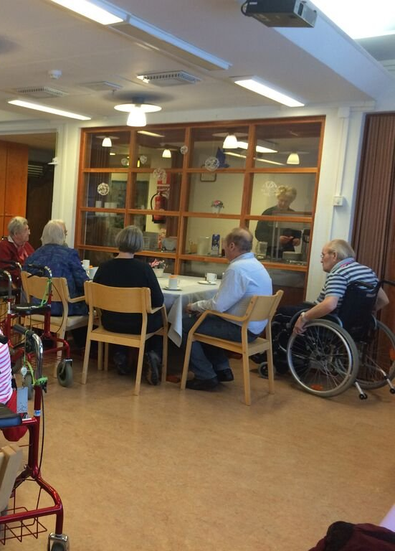
RESULTS: DAILY LIFE OF RESIDENTS
Breakfast at 8am (most residents eat privately).
10.30am morning tea in the lounge.
10.30- 12.30pm occupational therapy games.
12.30pm lunch.
3.30pm afternoon tea.
5.15pm dinner
8.30pm most residents leave the lounge.
Notes:
I spent the majority of my time in the rest home moving from the administrator‟s desk at the front of the rest home to the lounge and dining room at the end of a long hallway.
Walking down a long hallway from the front of the rest home to the lounge and dining room at the back you go past a row of doors. Many of these doors belong to the residents and their first and last names are printed on cards on the doors. There were also a number of posters, and a noticeboard on the walls. These notices present an overall image of bustling cheeriness, as there were a lot of bright colours, photos of smiling residents and text advertising upcoming events both in the rest home and in the local community.
In the lounge there was a piano (which was played only once by a volunteer while I was there), a number of high backed armchairs arranged around the perimeter of the room and a small table where residents played cards. In terms of entertainment there was a stereo system with space for five CDs and a television. During my observation I heard the stereo playing the same CDs on loop until Christmas, when they were replaced with more festive music. Residents spent most of their time outside their rooms sitting in this lounge.
The dining room was adjacent to the living room and contained seven sets of small round tables with about four or five chairs to a table. Each table was decorated with small vases of flowers that were regularly changed, and there were some paintings and prints on the wall. At the end of the dining room there was a door leading to the kitchen. There was also a glass cabinet that contained glasses and mugs as well as a large plastic water dispenser. Overall the atmosphere in the rest home was quiet and calm. The lounge and dining room both provided views of the garden. The setup of these rooms so far from the rest homes entranceway also meant that the noise of any traffic or visitors could not be heard
THE DAILY ROUTINE OF REST HOME RESIDENTS
It became evident during my time observing in the rest home that the daily life of residents follows a very regular routine. The day starts early and residents have their breakfast at approximately 8am. While I was not there during this part of the morning I was informed by a resident, Nellie, that most residents had this meal served privately in their rooms. According to Nellie breakfast was a very quiet part of the day in the rest home‟s public spaces. Life in public spaces therefore really started at 10.30am, when residents came into the lounge for morning tea. This was generally biscuits and tea or coffee, served by the caregivers to the residents. Like breakfast and afternoon tea, this meal could be served privately to the residents, but many residents chose to have morning tea in the lounge. The busiest period in the rest home was between morning tea at 10.30am and lunch at 12.30pm was. The occupational therapist would usually conduct events with residents during this period. While I was observing, these activities included a quiz game, crafts, baking or watching a movie. Lunch was then served at 12.30pm, and residents had to be in the dining hall for lunch to be served as it was less accepted for residents to stay in their rooms. After lunch staff members cleared the tables and residents sat quietly, reading, playing cards or talking. Some residents went back to their rooms while family and friends took others out for the day.
Afternoon tea was served at 3.30pm and was the same tea and biscuits as with the morning tea. Dinner was served at approximately 5.15pm and after dinner a number of residents sat and watched television in the lounge for a few hours and eventually left for bed, with the latest residents staying until approximately 8.30pm

Slide 11
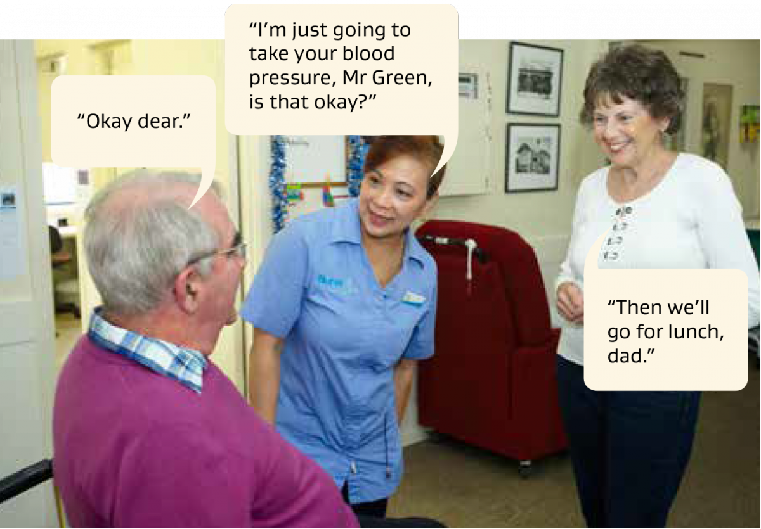
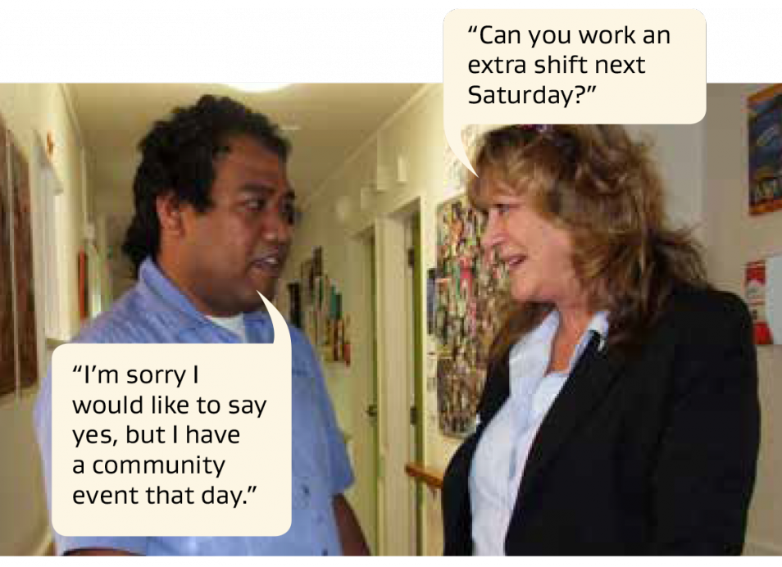
RESULTS: RESIDENTS AND STAFF
Upper management rarely seen in lounge or dining room with residents.
Nurses and caregiver’s spent the majority of the time working with resident’s
Activities included serving meals, assisting with walking or sitting, and both providing and cleaning up morning and afternoon tea
Notes:
Upper management, in comparison to caregivers and nurses, was rarely seen in the lounge and dining room with residents. Instead they spent the majority of their time in offices at the front of the rest home. The occupational therapist was also part of the staff but was not always there. Often she came only in the morning to do activities. Nurses spent more time with residents that upper management; generally this was to help with physical frailty and included sorting out care-plans and doing monthly weight and blood pressure checks. However, the caregivers did the bulk of work directly with residents. They looked after the personal needs of the residents, serving meals, assisting with walking or sitting, and both providing and cleaning up morning and afternoon tea.

Slide 12
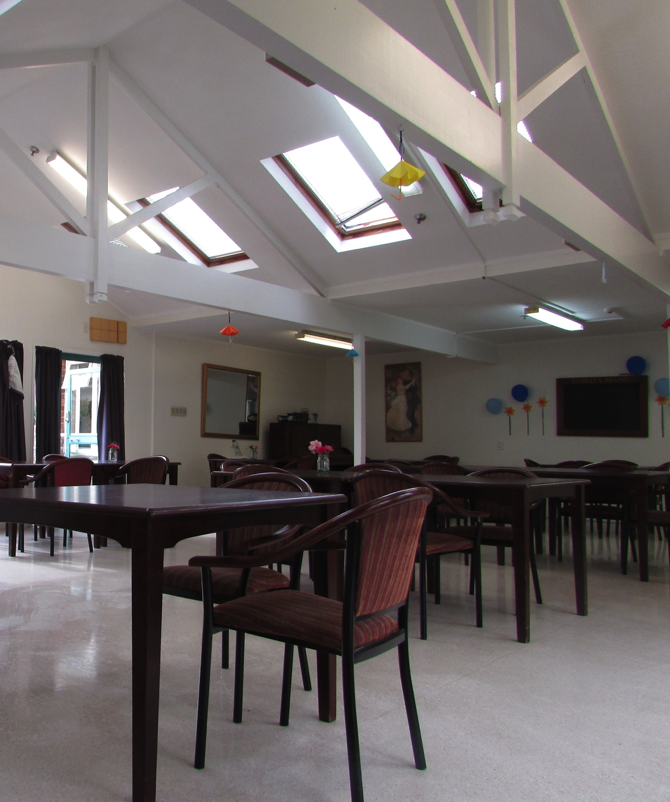
RESULTS: INFLUENCING THE REST HOME ENVIRONMENT
Declared Mission
‘To deliver quality holistic care in a safe and supportive environment’.
‘To uphold the dignity, individuality, privacy and freedom of choice for all these people in our care by ensuring that we meet their physical, emotional, social and spiritual needs’.
Notes:
REST HOME TEXT
Despite the fact that I did not have access to official institutional texts such as the notes written by the nurses and manager, there was a lot of text available for me to read on the walls of the rest home itself. In the hallway there was a large notice board and in the dining room there was both a black board and a white board. In addition, there were a number of posters set up which displayed statements about the rest home.
Official pieces of text outlined the main purpose of the rest home. These were the laminated philosophy and mission statements that were placed on the wall next to the door leading into the lounge and dining room. The mission statement said that this rest home aimed to „deliver quality holistic care in a safe and supportive environment‟, while the philosophy was to „uphold the dignity, individuality, privacy and freedom of choice for all these people in our care by ensuring that we meet their physical, emotional, social and spiritual needs‟. These two statements represent the official values and the officially espoused ruling relations of the rest home as an institution of care, and will serve as overall text that speaks to each section of these results.
However, as my results will show, there is evidence to suggest that these official expectations and obligations are not the only ones that rest home staff members use to make decisions. There are also a number of informal texts in the rest home. These included a sign about the importance of waiting which was created by the residents as part of a craft activity, a black board which outlines the day‟s activities, a whiteboard which describes that day‟s menu, a resident of the month frame, a monthly activities schedule, and a paper outlining the minutes of the last resident‟s meeting

Slide 13
RESULTS: INFLUENCING THE REST HOME ENVIRONMENT
To provide care that is both safe and allows independence and freedom.
"I've had enough of sitting down"
“Be nice to think you can go up the road and back before bed. I’m sick of sitting”.
"Oh I'm getting sore sitting. My back goes into a spasm… went to an osteopath, and back and hips freezing up from sitting".
"I'm being careful. We will not meet with an accident!”
Notes:
PHYSICAL ACTIVITIES IN THE REST HOME
The official philosophy of this rest home was to provide care that is both safe and allows independence and freedom. However in reality this freedom was not seen in the rest home, as there was very little physical activity and an informal rule of safety over independence. This was the case even though residents complained about sitting too long and the health issues that occurred as a result of this lack of exercise. Many residents used a walker to aid mobility, and some, but not all of the residents also had a form of physical disability. For example when I initially spoke with a resident, Shelley, she noted that she had difficulty keeping her hands steady.
The majority of residents‟ time was spent sitting in the high backed lounge chairs or wooden dining room chairs. When they did move, it was often from one of these chairs to the other. All activities also occurred sitting down. For example a quiz game involved a light ball being passed between the residents and the occupational therapist whilst seated. Similarly Jane, a resident, noted that tai chi was sometimes offered but that this also occurred whilst being seated.
I heard a number of residents comment on this lack of movement during my six weeks observing in the rest home. The restrictions were also exacerbated by the steep walk it took to get to the nearest amenities, making it difficult for many of the residents to go for a walk. Residents expressed discontent with this situation as they talked amongst each other during the day. For example Cara said "I've had enough of sitting down". Another resident, Shelley also noted it would “be nice to think you can go up the road and back before bed. I‟m sick of sitting”. This dissatisfaction was not just about boredom but also about the potential health risks from excessive sitting. In particular Shelley, who had a background in health work and had previously been an ardent traveler, commented to other residents that "Oh I'm getting sore sitting. My back goes into a spasm… went to an osteopath, and back and hips freezing up from sitting". Therefore a lack of physical exercise in the rest home could be having a negative effect on resident health.
The discomfort and boredom experienced as a result of staying seated in a single position is one I also experienced while observing in the rest home. Since my observation occurred in the living area of the rest home I sat in same lounge chairs that residents spent most of their time in. Difficulty staying awake, leg spasms and fidgeting quickly became part of my own experience at the rest home. For example, during the first few weeks I noted that „I can feel my breathing slowing‟. Towards the end of the research I was dozing in my chair when management came past, an experience I also observed happening to the rest home residents. I stated that „I close my eyes and then open them when upper management goes by. Interestingly, so do Cybil and Jane… It‟s so hot and slow, not falling asleep is almost impossible‟. Overall, my experiences also highlighted the difficulty of spending too much time seated in the rest home.
Despite these issues, when the ruling relations of the rest home are explicated it appears that encouraging exercise is not a priority. Instead text-based discourse indicated that the ruling relations focused on resident safety rather than exercise. For example, the hallway to the rest home lounge displayed a poster which discussed the importance of avoiding falls when in the rest home. This text emphasized the importance of moving slowly and safely, and with the aid of a walker if necessary. The text warned of the consequences of disobeying these rules, stating that „if you fall while you are here, you could be injured, which limits your enjoyment of life.‟ This view of safety being more important than encouraging independent movement and exercise was also illustrated in the discourse between residents and staff following meals. When meals were finished and residents wished to leave the table, those using walkers were expected to sit and wait for a caregiver to bring their walker. This sometimes resulted in conflict when residents felt able to go and get their walker themselves. For example Molly, a caregiver, saw one of the residents moving towards her walker and exclaimed, "No, no, no, we'll meet with an accident! Be careful, don't walk backward!" The resident however disagreed with this assumption that her actions were unsafe or dangerous, arguing "I'm being careful. We will not meet with an accident!" (Nellie). With another resident, Molly also enforced these ruling relations of prioritizing the safety of residents over their movement, saying to a resident who was leaving the table after a meal “Cybil wait, wait, please wait your [walker] is right inside”. Overall it appears that there is a ruling relation in the rest home that focuses on maximizing the safety of the residents rather than meeting their need for exercise. When examining this safety focus from a trans-local perspective, it becomes clear that the regulations imposed on New Zealand rest homes from the Ministry of Health also prioritize resident safety (Standards New Zealand, 2008). For example, in an audit of another rest home unconnected with this research it was found that the focus of the audit was on providing services in a way that „minimizes harm‟ to the residents (Ativas Limited, 2014). The audit stated that rest home needed to „aid independence‟, (Ativas Limited, 2014) but this statement was preceded by others that the environment both „minimise the risk of harm‟ and „promote safe mobility‟. Therefore it appears evident that the focus not only at a local rest home level but also at a trans-local level is on ensuring residents are safe and all harm is reduced, rather than encouraging independent mobility (Ativas Limited, 2014). This is perhaps understandable, as older adults are at risk of falls and serious injuries such as breaking a hip if they do fall (Cameron et al., 2010). However, the residents appeared to disagree that harm needs to be avoided to this level as it can result in other negative effects such as boredom, a reduction in independence and stiffening of the legs and back. Therefore there appears to be some conflict between the needs of the residents and the ruling relations of the rest home that prioritise risk management.

Slide 14
RESULTS: INFLUENCING THE REST HOME ENVIRONMENT
Residents were relatively constrained when it came to changing the public space around them. Instead they had to depend on the staff members to notice and make these changes.
“The heat‟s getting everyone”.
“No, it was very hot up here before. My gosh it‟s like an oven”.
It‟s too cold here my legs are freezing. So I‟m going home”.
“Well and I [sic] can‟t touch the blinds”.
“Oh I wouldn‟t dare touch that blind. They‟d [staff] kill me!”.
Notes:
RESIDENT‟S ABILITY TO INFLUENCE THE PHYSICAL ENVIRONMENT IN THEIR SHARED SPACES
Residents were relatively constrained when it came to changing the public space around them. Instead they had to depend on the staff members to notice and make these changes. The indoor temperature, the sun in their face, whether the sliding doors were open or closed all of these factors affected the daily life of residents though they had limited control over them. In addition, residents did not seem to be able to change the music on the stereo or the channel of the television. Informal rules stopped residents from making changes despite their expressed frustration.
Residents‟ frustration was expressed in their conversations between themselves and occasionally with a caregiver. For example a resident, Olga, in discussion with the residents and staff one afternoon noted, “The heat‟s getting everyone” and “No, it was very hot up here before. My gosh it‟s like an oven”. The heat was not the only complaint. Often I observed that during the evening, as the temperature changed, the rest home was also considered too cold. For example Cybil stated at approximately 7.30pm one evening “It‟s a bit chilly isn‟t it?” while Nellie noted, “it‟s too cold here my legs are freezing. So I‟m going home”. Both of these statements illustrate dissatisfaction with the temperature of the room, but Nellie‟s is particularly interesting as it also indicates that she believes her best option for changing her physical comfort is to leave the room. Therefore it appears that there is a view that residents cannot change their shared physical environment even if it is uncomfortable for them.
During my time at the rest home residents appeared most frustrated with their physical environment when they were in direct sunlight. One of the main reasons for this frustration was that even when temporarily blinded by the sun residents were not allowed to adjust the window blinds for safety reasons. On my first official day observing I noted that „residents are not allowed to touch the blinds‟. This informal rule and the associated expectations of punishment were also discussed between residents. For example, one resident Olga, while discussing the glaring sun with another resident stated that “Well and I [sic] can‟t touch the blinds”, and again two weeks later she stated, “Oh I wouldn‟t dare touch that blind. They‟d [staff] kill me!”.
For their part, staff did not appear to verbally acknowledge this informal rule that residents could not adjust their physical environment to suit their needs. Instead, staff focused on helping residents who they noticed clearly needed a change in their environment. Once again, glare from the sun was the most common example, perhaps because the residents‟ discomfort and its cause were
easier to spot. During dinner Molly (the caregiver) said to one of the residents “Is it too bright?” and to another “Do you like the sunshine?” before proceeding to draw the blinds. At a trans-local level these informal restrictions on residents appear to once again follow the ruling relation of maximizing safety rather than independence. In this case the rest home audits directive to „minimize harm‟ (Atavis Limited, 2014, n.p.) seems to be extended in this rest home to touching the blinds. Once again the discomfort of the residents is not as important as reducing the risk of falls or other injuries in order to streamline the care process and avoid individual difficulties in the institution 6.7

Slide 15
RESULTS: INFLUENCING THE REST HOME ENVIRONMENT
The dining experiences of residents appeared to be where the need of the staff members to work quickly and efficiently with all the residents was prioritized.
Molly explained that residents were told dinner was at 5pm but in fact it was served 10 to 15 minutes later, with the earlier time being used to ensure all residents were seated.
“[Name] is here at your table, you can go now. Please”
“Hurry up and wait!”
“Ah ah, I can‟t wait, I can‟t wait!
One of the most important parts of patience was ‘how we [residents] behave while waiting’.
Notes:
RESIDENTS‟ DINING EXPERIENCES The dining experiences of residents appeared to be an instance where the need of the staff members to work quickly and efficiently with all the residents was prioritized over the needs of residents. This ruling relation was shown through the strict schedule governing meals, the way residents had to be seated ten to fifteen minutes before food was served and the residents‟ resistance to this process. One of the possible reasons for these routinised meals is because there are few subjective guidelines for dinner at a trans-local level, only a focus on ensuring that each meal must contain the correct nutrients (Atavis Limited, 2014, n.p.). From my perspective as an observer, meals constituted the most significant portion of the residents‟ day. During these times residents who were never usually in the public spaces would arrive. Residents‟ discussion of what the meals would include started in the morning and continued until dinner, as the menu was one of the few texts updated daily. I soon learnt that in the rest home, meals followed a strict agenda. Every stage of the process was timed and organized for maximum efficiency. Residents were aware of these rules around meals, both through the texts on the walls that outlined this section and through staff instructions.
For the caregivers, one of the first steps in the meal was moving residents to their table. While some residents would arrive early, others sat in the lounge right until the last moment despite the urging of various caregivers. Lunch was served at 12.15pm, and at 12.00pm Molly would start asking residents to move to the table or ensure they did not need assistance to the bathroom during the meal. These urgings were never issued as a command but as more of an urgent request. For example Molly would state, “[Name] have you been [to the bathroom]? Please go now. Please!” Or “[Name] is here at your table, you can go now. Please”, to coax a resident to the dinner table. Some residents would bargain with staff to be allowed more time before sitting down for a meal. For example, Jane and another resident playing a card game anticipated being asked to move and requested time to finish their game. In this case they were allowed and were given a reprieve from the coaxing. At first I was unsure why residents were reluctant to sit for dinner. They discussed the meals and seemed excited to have them, yet were reluctant to move. It was only later that I realized the real problem was that residents knew they would be waiting for approximately 15 minutes prior to the meal being served. The first time I was there during dinner Molly explained that residents were told dinner was at 5pm but in fact it was served 10 to 15 minutes later, with the earlier time being used to ensure all residents were seated. This was one of the most formally enforced rules I encountered during my observation, appearing both in text and in the discourse of staff. For example, as you entered the dining hall there was a notice on the wall stating the time of meals as 12.15 for lunch and 5pm for dinner, 10 to 15 minutes before it was actually served. There was also a notice on the dining room wall that stated that one of the most important parts of patience was „how we [residents] behave while waiting‟. Both of these texts emphasised the twin expectations that residents would be seated early for meals, (even though they knew they would not be served for another 10-15 minutes) and that, once seated, they would wait patiently until their food was brought. I observed that a number of residents struggled with and resisted this work in the rest home. For example, the minutes of the residents committee meeting that was posted on the wall stated that staff had reminded the committee that all residents „must be seated at dinner 10 minutes before serving‟. This reinforcing of the formal rule indicates that these expectations were not always met. Similarly, residents who were waiting for their meal showed signs of visible struggle and discomfort as those around them received food. For example Tracey, after waiting in silence for approximately 10 minutes turned to another resident and murmured “hurry up and wait!” while Lily, another resident, expressed her difficulty waiting by stating, “ah ah, I can‟t wait, I can‟t wait!” when she realized that her food was coming. In both these cases Tracey and Lily were directly responding to the directive to wait. Despite this emphasis on being patiently seated in the rest home‟s formal rules, at a trans-local level there is little discussion of this aspect of meals (Standards New Zealand, 2008). Instead the focus is on safe and nutritious delivery of food and other services (Standards New Zealand, 2008). The only note on residents subjective view of meals is that „the dignity of the consumer is maintained during meal times” (Standards New Zealand, 2008, p. 20), and that „consumers have adequate time to eat and meals are enjoyable‟ (Standards New Zealand, 2008, p. 20). While this could arguably be connected to the issue of waiting for meals, the Standards did not go more deeply into this.

Slide 16
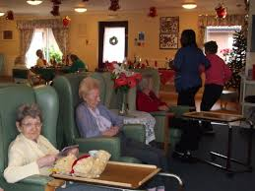
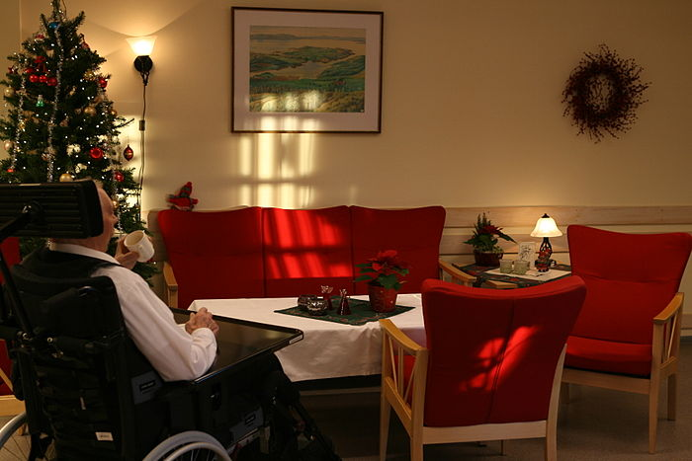
RESULTS: INFLUENCING THE REST HOME ENVIRONMENT
Cara noted, “It looks like Christmas”. Shelley agreed, saying “Isn‟t it pretty? So pretty.”
Cybil - “They‟re not personal though are they”.
“You look at this [name]. Now you know what happens”. Then in an aside to the other residents Olga added, “She hasn‟t been here as long as us”.
Notes:
Ceremonies in the rest home, and the decorations and activities that occurred around during these ceremonies were viewed as being for the residents. Yet that view was complicated by the fact that residents had mixed feelings about the ceremonies and that even when an activity was specifically viewed as meeting the residents‟ need for fun and supportive care, the focus of the ruling relations was still on prioritising the needs of the institution. To illustrate this I will discuss the effective use of staff member‟s time when they put up decorations in a room that had been set up for the residents to watch a movie. During my time in the rest home I witnessed the start of the upcoming Christmas festivities. The rest home put a lot of effort into decorating and organising Christmas activities for residents. For example, on each resident‟s door there was a small Star of David, the ceiling was hung with garlands of green tinsel and pohutakawa decorations, and there was a Christmas tree in the lounge. The music on the stereo itself shifted from the same five CDs that had been playing for as long as I had been there to Christmas-related music. As I wrote in December it appeared that „a festive atmosphere reigns. The caregivers are happy, the manager wanders around and the music and the Christmas decorations are jovial‟. This festive focus was also evident in the committee meetings. In the minutes of the November meeting it was noted that residents were informed of the Christmas dates, and that on December 22nd there would be a Christmas concert, while on December 23rd there would be carol singing followed by Christmas dinner. Nevertheless, the arrival of Christmas festivities was met with a mixed response from residents. While some were excited, others remained disconnected from what was occurring in the rest home. For example on the day the Christmas tree was set up and decorated Cara noted, “It looks like Christmas”. Shelley agreed, saying “Isn‟t it pretty? So pretty.” However, another resident, Cybil, noted that the decorations were not special to the residents themselves. She stated, “They‟re not personal though are they”. Overall there appeared to be differing opinions between residents, as some believed that the Christmas ceremonies were positive, and others felt like the ceremonies were not connected to them. Part of this conflict may be the result of coming to terms with being in an institution during Christmas time. For some residents this was a new experience and they were accordingly educated and socialized by more experienced residents. Olga, who had resided at the rest home for a number of years, said to a resident “You look at this [name]. Now you know what happens”. Then in an aside to the other residents Olga added, “She hasn‟t been here as long as us”. For the staff, the ruling relation that the needs of the institution came before the needs of the resident seemed to be prominent even during this Christmas period. This was evident in the putting up of the decorations for Christmas, a task that, like all other aspects of rest home life needed to be carried out efficiently. Sometimes this efficiency resulted in a situation that was frustrating for the residents. For example, one of the novel activities that occurred during the Christmas period was the viewing of the film My Fair Lady. This activity was very popular and residents that I had not seen in public spaces before crowded into the living room to watch this film. The room was packed with people, some sitting on dining room chairs which had been specifically brought in for the viewing.
However, once the film had started, it appeared that to staff, this activity that was so obviously important to the residents came second to the tasks they needed to carry out, namely putting up the Christmas decorations on the ceiling of the living room. In order to complete this task, staff - with the assistance of some boys I had not seen before - started decorating in front of the television where the residents were watching the film. This intrusion caused some difficulty as the staff and assistants blocked residents‟ views of the film. Staff showed no sign that they were aware they were intruding on the residents‟ activities and instead talked amongst each other while putting up the decorations

Slide 17
CONCLUSION: REST HOME AS AN INSTITUTION
This study showed that the daily life of a resident in a New Zealand rest home was routine, sedentary and governed by bureaucracy.
Residents spent approximately 90 percent of their time in the rest home‟s public spaces sitting, either in the dining room or in the living room. If they did get it up it was either to move to a different chair to their rooms.
Notes:
In terms of answering the first three research questions this study showed that the daily life of a resident in a New Zealand rest home was routine, sedentary and governed by bureaucracy. The biggest events that occurred daily was lunch and dinner, both of which also had a relatively complex structures which included when to sit at the table, when meals would be served (ten to fifteen minutes after being seated) and the appropriate behaviour while waiting. Residents spent approximately 90 percent of their time in the rest home‟s public spaces sitting, either in the dining room or in the living room. If they did get it up it was either to move to a different chair to their rooms. With regards to the second and third research question, a number of formal and informal rules became evident when observing this rest home. There are too many to identify them all but they included rules governing what residents were allowed to touch, whether they could walk without using a walker, and the routines of leaving and entering the rest home, such as signing the in-and-out book and not using the driveway. Many of these rules were conveyed to residents through discourse with staff members in the committee meetings. The minutes of these meeting were then placed in the hallway of the rest home with these rules written down, formalising the previously informal rest home expectations. Overall these results showed that all the routines, activities and rules in the daily life of the residents were focused around meeting the needs of the rest home.

Slide 18
CONCLUSION: REST HOME AS AN INSTITUTION
Rest homes are places designed to care for those residents who cannot care for themselves, either because they are too ill, lack the resources or do not have family and community support (Ryan & Scullion, 2000).
There were a number of residents who did not appear to be in care as a result of physical frailty. For example, Olga was very physically fit and often helped caregivers set up the tables in the dining hall.
This rest home met the standards of care outlined in the last audit, including upholding consumer rights, providing a safe environment, minimising restraints and preventing infection (Ministry of Health, 2003). Therefore the official view of this rest home is that it has met all the criteria to be considered a good model of care.
Notes:
The dominant view of rest homes, as noted in the literature review, is that they are places designed to care for those residents who cannot care for themselves, either because they are too ill, lack the resources or do not have family and community support (Ryan & Scullion, 2000). This view of rest homes as places to care for those who cannot care for themselves was evident but was not a focus in the daily lives of residents, possibly because residents did not discuss why they had originally come to the rest home. However, some residents did have disabilities that would have made life outside the rest home difficult. For example many residents moved through the institution using a walker. Similarly Shelley one of the residents stated that she had difficulty holding a pen steady for a long time when filling out the consent form for this study. There were also a number of residents who did not appear to be in care as a result of physical frailty. For example, Olga was very physically fit and often helped caregivers set up the tables in the dining hall. Therefore it seems unlikely she entered the rest home as a result of physical frailty. Social support is one of the positives of entering a rest home according to the dominant model and may therefore be the reason for entering the rest home in this case (Bradshaw et al., 2012; Sherer, 2001). Overall it did appear that the dominant expectations of rest homes as places to care for those who cannot care for themselves was somewhat noticeable in this rest home, but that there were also residents who did appear to be capable of caring for themselves, meaning that they were in the rest home for other reasons, possibly social support. Another traditional expectation of rest home care is that good rest homes will include activities for residents, and excellent care will include a chance for residents to participate in rest home life. As well as the activities with the occupational therapist that occurred every morning, there was a monthly activities poster in the hallway that outlined all the activities residents could take part in. Participation in rest home care was also evident in this rest home as some of the residents took part in a bi-monthly committee meeting. This meeting between residents and staff members was a chance for residents to outline some of their grievances with the way the rest home was run, for example wanting the potatoes to be cooked or wanting a main meal served at lunch. Therefore there is evidence that the official expectations of a good rest home was met in the home that I observed. In addition, throughout my time as a researcher in this rest home I personally found no evidence of verbal abuse, physical abuse, or neglect. This is different to researchers like Buzgovia and Ivanova (2009) and Bland (2005), who all found instances of neglect, unnecessary restraint and in some cases verbal abuse in the rest homes they researched. This rest home also met the standards of care outlined in the last audit, including upholding consumer rights, providing a safe environment, minimising restraints and preventing infection (Ministry of Health, 2003). Therefore the official view of this rest home is that it has met all the criteria to be considered a good model of care.
The observation that the rest home meets the standards of care set out by New Zealand policy makers as well as dominant literature on acceptable care indicates the rest home has no issues in terms of its relationships with its clients (Ministry of Health, 2003). As a place for care the rest home provides medical care, social services and leisure activities to maintain the physical and mental functions of residents (Mitty, 2006).

Slide 19
CONCLUSION: REST HOME AS AN INSTITUTION
However, There is also pressure and formal and informal rules.
The committee meetings also showed tension between resident and institutional needs.
Like other studies of rest homes as total institution (Bennett, 1963; Mali, 2008) the rules I observed in the rest home were largely undisclosed and not immediately obvious to an outside observer. I had to learn over six weeks what the rules were. For example I did not know that residents could not move the blinds even if they had sun in their eyes until I heard residents discussing this, I also did not realise that there was an informal rule around caregiver‟s fetching the walker after dinner until I saw Nellie getting reprimanded for getting her own walker.
Notes:
However, There is also pressure and formal and informal rules which emphasises the importance of staying in the total institution and separating from the outside world. For example, in the residents meeting on August 21st there was a reminder that when a resident leaves the rest home they must sign the in-and-out book at reception. The minutes also reminded residents they must not walk up and down the driveway. Shelley, one of the residents who complained about the amount of time spent sitting in the rest home stated that it would “be nice to think you can go up the road and back before bed”. This indicates that for Shelley, although there are few formal restrictions around entering and leaving the rest home there are still a number of difficulties to entering the wider world; such as the length of time it takes to walk and the lack of transport. Overall the rest home appears to have formal and informal rules restricting the way residents leave and making it difficult for them to easily access the outside world.
Goffman (1961) notes that there is a staff world within a total institution and the staff in these often experience conflict between the official aim of the rest home as a place of care and the informal but strong institutional focus on efficiency when carrying out people work within these spaces. This conflict was also seen in my research when negotiating meals in the rest home. The caregivers take care of resident‟s physical needs and work with nurses to maintain their health. However, as a result of the institutional framework that they were in, caregivers also had to focus on efficiency and standardization when carrying out these tasks. This involved ensuring that residents were seated earlier than the meals were served, and that they did not act independently, that they were not served at varying times, or that they did not independently decide when to leave the table. This tension between the two needs meant that caregivers often reprimanded residents for breaking informal rules that were created to ensure the uniformity of the institutional process rather than to support their care
The committee meetings also showed this tension between resident and institutional needs in the staff world. As Goffman (1961, p. 85) has noted, when inmates communicate with staff members it is generally to complain. The job of the staff member is then to listen to these complaints, while also to uphold and reinforce the views of the total institution. In my research on the committee meetings this same tension occurred as staff members heard the complaints and requests of the residents and then proceeded to outline the informal and formal rules of the institution and uphold these rules while making only small changes as the result of resident requests. Like other studies of rest homes as total institution (Bennett, 1963; Mali, 2008) the rules I observed in the rest home were largely undisclosed and not immediately obvious to an outside observer. I had to learn over six weeks what the rules were. For example I did not know that residents could not move the blinds even if they had sun in their eyes until I heard residents discussing this, I also did not realise that there was an informal rule around caregiver‟s fetching the walker after dinner until I saw Nellie getting reprimanded for getting her own walker.

Slide 20
CONCLUSION: REST HOME AS AN INSTITUTION
The results of this research showed that there were a number of rules, both formal and informal, that constrained the daily lives of residents in the rest home.
These rules were conveyed through text on the walls and discourse with the staff members and perpetuated in the discussion of residents themselves.
Furthermore the overall purpose of these rules and expectations appeared to be to prioritise the needs of the staff members over the needs of the residents as the focus of many of these rules was on ensuring that routines were carried out in an efficient and bureaucratic manner, even if it resulted in the discomfort or frustration of residents
Notes:
The results of this research showed that there were a number of rules, both formal and informal, that constrained the daily lives of residents in the rest home. These rules were conveyed through text on the walls and discourse with the staff members and perpetuated in the discussion of residents themselves. Furthermore the overall purpose of these rules and expectations appeared to be to prioritise the needs of the staff members over the needs of the residents as the focus of many of these rules was on ensuring that routines were carried out in an efficient and bureaucratic manner, even if it resulted in the discomfort or frustration of residents

Slide 21
IMPLICATIONS
One of the implications of the findings in this study is that even if a rest home is free of obvious abuses and is meeting generally accepted standards of care, the daily experiences of the residents can still be negative.
The prioritising of the requirements of the institution over the needs of the residents can negatively affect the residents as it leaves them in a position of being unable to control many aspects of their existence.
Notes:
One of the implications of the findings in this study is that even if a rest home is free of obvious abuses and is meeting generally accepted standards of care, the daily experiences of the residents can still be negative. The prioritising of the requirements of the institution over the needs of the residents can negatively affect the residents as it leaves them in a position of being unable to control many aspects of their existence. Therefore, whether current rest home care is an acceptable form of care for older adults is called into question by these results.
The rest home that I worked with was in New Zealand and, at the time of writing, had met the standards of care as set out in the last rest home audit. The results of this observation call into question what the Health and Disability Service Standards audit is measuring. It is possible that the audit is measuring only physical aspects of wellbeing, but is neglecting the more subjective aspects such as independence, being able to make choices, influence and finding meaning in daily activities. It is also possible that the audit, by focusing on processes and not going deeper into the needs of individual residents, is tactically accepting that the needs of the institutional structure and efficacy are prioritised. Overall the results of this research indicate that a more in-depth study of rest home care in New Zealand may be necessary when writing up the parameters for the Health and Disability Service Standards audit
It was my time volunteering in the rest home that initially inspired this research. A feeling of personal helplessness in the face of the institutions tight control and unending routine, as well as the obvious unhappiness of the residents I met, propelled me to develop my understanding of rest home care in New Zealand. This research has been my attempt to add to the research on the often-invisible experiences of residents in rest home institutions. It is my hope that these experiences will not go unnoticed but will challenge the dominant perspective of rest homes as an unavoidable institution, and add to the conversation about alternative forms of aged care which put the needs of older adults first, not last.

Slide 22
IMPLICATIONS
The rest home that I worked with had met the standards of care as set out in the last rest home audit.
It is possible that the Health and Disability Service Standards audit is measuring only physical aspects of wellbeing, but is neglecting the more subjective aspects such as independence, being able to make choices, influence and finding meaning in daily activities.
It is also possible that the audit, by focusing on processes and not going deeper into the needs of individual residents, is tactically accepting that the needs of the institutional structure and efficacy are prioritised.
Overall the results of this research indicate that a more in-depth study of rest home care in New Zealand may be necessary when writing up the parameters for the Health and Disability Service Standards audit
Notes:
One of the implications of the findings in this study is that even if a rest home is free of obvious abuses and is meeting generally accepted standards of care, the daily experiences of the residents can still be negative. The prioritising of the requirements of the institution over the needs of the residents can negatively affect the residents as it leaves them in a position of being unable to control many aspects of their existence. Therefore, whether current rest home care is an acceptable form of care for older adults is called into question by these results.
The rest home that I worked with was in New Zealand and, at the time of writing, had met the standards of care as set out in the last rest home audit. The results of this observation call into question what the Health and Disability Service Standards audit is measuring. It is possible that the audit is measuring only physical aspects of wellbeing, but is neglecting the more subjective aspects such as independence, being able to make choices, influence and finding meaning in daily activities. It is also possible that the audit, by focusing on processes and not going deeper into the needs of individual residents, is tactically accepting that the needs of the institutional structure and efficacy are prioritised. Overall the results of this research indicate that a more in-depth study of rest home care in New Zealand may be necessary when writing up the parameters for the Health and Disability Service Standards audit
It was my time volunteering in the rest home that initially inspired this research. A feeling of personal helplessness in the face of the institutions tight control and unending routine, as well as the obvious unhappiness of the residents I met, propelled me to develop my understanding of rest home care in New Zealand. This research has been my attempt to add to the research on the often-invisible experiences of residents in rest home institutions. It is my hope that these experiences will not go unnoticed but will challenge the dominant perspective of rest homes as an unavoidable institution, and add to the conversation about alternative forms of aged care which put the needs of older adults first, not last.

Slide 23
POSSIBLE FOCUS FOR CHANGE: THE EDEN ALTERNATIVE
Developed in 1991 by American geriatrician William Thomas, the Eden Alternative is made up of ten principles.
Loneliness is a serious issue
Residents need continued close contact with children, animals and plants.
There needs to be a culture of living companionship in giving and receiving care.
Rest homes need to provide residents with variety, spontaneity and meaningful activities
(Brownie, 2011 p. 65).
Notes:
One plan to shift the attitudes of the staff members in a rest home and reduce abuse is the Eden Alternative (Brownie, 2011; Coleman et al., 2002). This philosophy has been influential both in New Zealand and internationally with the idea that in order to improve rest home care there needs to be a change in the focus of these institutions from a medical model to a social model of care (Brownie, 2011; Coleman et al., 2002).
Developed in 1991 by American geriatrician William Thomas, the Eden Alternative is made up of ten principles that were developed in order to provide an outline for shifts in the attitudes of staff members and residents that need to occur in order to improve rest home care (Brownie, 2011). These ten principles include: that loneliness is a serious issue; residents need continued close contact with children, animals and plants; there needs to be a culture of living companionship in giving and receiving care, and that rest homes need to provide residents with variety, spontaneity and meaningful activities (Brownie, 2011 p. 65).
In addition the medical model needs to be de-emphasised, with medical treatment as an aspect of rest home care rather than the main focus (Brownie, 2011 p. 65). And finally the last three points in this philosophy were that older residents need to be respected for their wisdom: growing older is not the end of life and resident leadership is important in rest home care (Brownie, 2011 p. 65).
Since the 1990s these principles of the Eden Alternative have been used in a number of rest homes around the world including America, England, Australia and New Zealand (Brownie, 2011 p. 65). As of 2011 there were 36 aged care institutions in Australia and New Zealand that were incorporating the philosophies of the Eden Alternative into their care strategies (Brownie, 2011 p. 35)

Slide 24
References
Achenbaum, W. (1978). Old age in the new land: The American experience since 1790. Baltimore: Johns Hopkins University Press.
Bland, M. (2005). The challenge of feeling 'at home' in residential aged care in New Zealand. Nursing Praxis in New Zealand Inc, 21(3), 4-12.
Brownie, S. (2011). A culture change in aged care: The Eden Alternative. Australian Journal of Advanced Nursing, 29(1), 63
Hardie, J. (2014). Hear to care: The role of caregivers in the spiritual care of residents in New Zealand rest homes. [Masters Thesis] Wellington: Victoria University Press.
Swarbrick, N. (2012). Care and carers - care of elderly people. Te ara - the encyclopedia of new Zealand. Retrieved March 20, 2015 from http://www.teara.govt.nz/en/care-and-carers/page-2

