Slide 1
Energy Transitions
Basil Sharp
Energy Centre & Department of Economics
University of Auckland, New Zealand
November 24th, 2022
Supported by Energy Education Trust of NZ

Slide 2
Introduction
Efficient, reliable, energy vital to social & economic well being
Factors that influence energy transitions?
Resources – animal products, fossil fuels, water, solar radiation, wind, …
Technology – transforming primary energy into providing a service
Demand – services we desire, as influenced by price, incomes, …
Supply – cost of combining resources, technology, labour, …
External impacts – associated with production & use
Market design – central control, competition, concentration, …
Government policy – taxation, regulations, urban design, …
Coordination and time lags!

Slide 3
(1) Lighting
Candles
Lamps

Slide 4
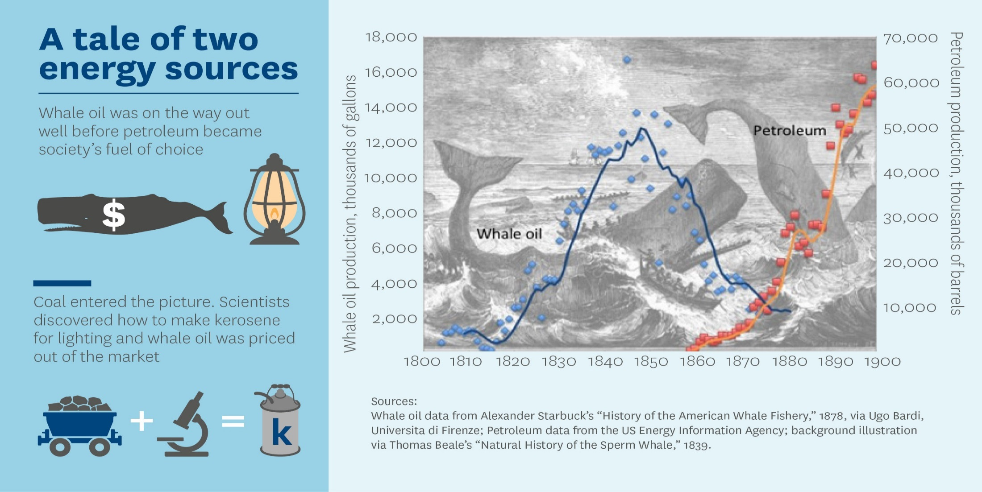
Displacement of whale oil for lighting

Slide 5
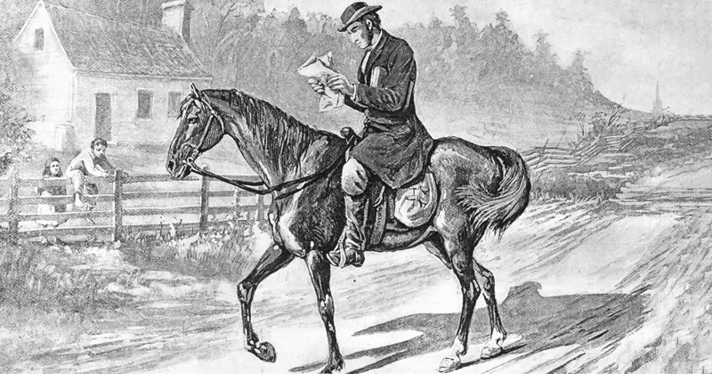
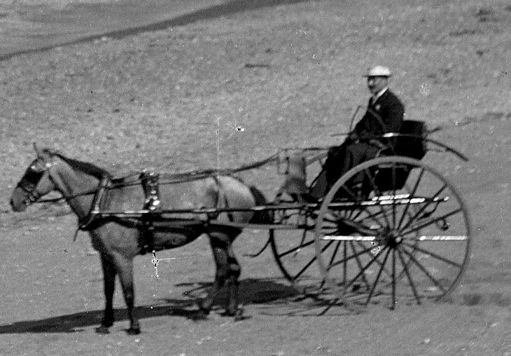
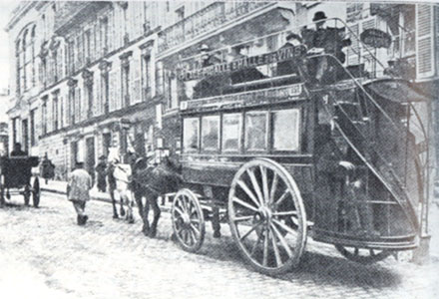
(2) Transport
Single passenger
Multiple passengers
Public transport

Slide 6
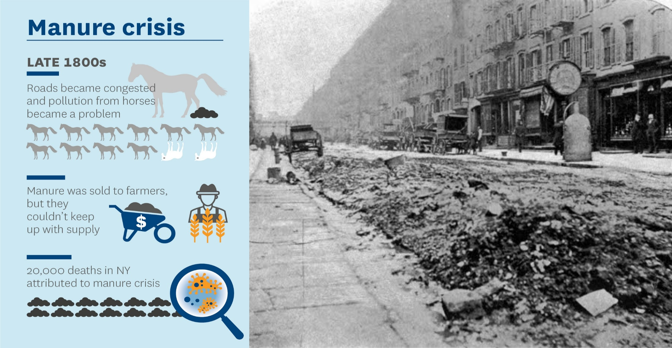
Externality associated with horse powered transport

Slide 7
Coal powered trains & ships

Slide 8
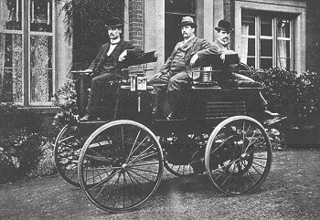
Electric vehicles
Robert Anderson1837, developed the first crude electric vehicle.
Gatson Plante 1857 produced the first vehicle to have a re-chargeable battery.
William Morrison, 1887 crude electric carriage, 12 passengers, 23 km/h.
1897 the first electric cars to be used as taxis in New York

Slide 9
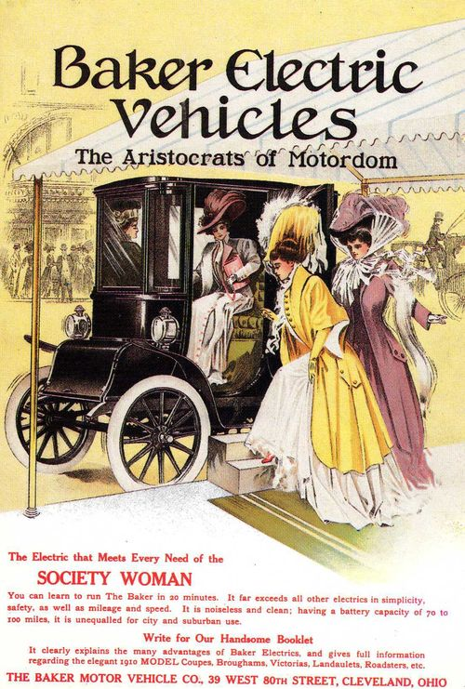
EVs gain in popularity
By late 1800s electric cars gained popularity - considered quiet, easy to drive and didn't emit smelly pollutants
Quickly became popular with urban residents, especially women.
1899 Ferdinand Porsche invented the world’s first hybrid electric car.

Slide 10
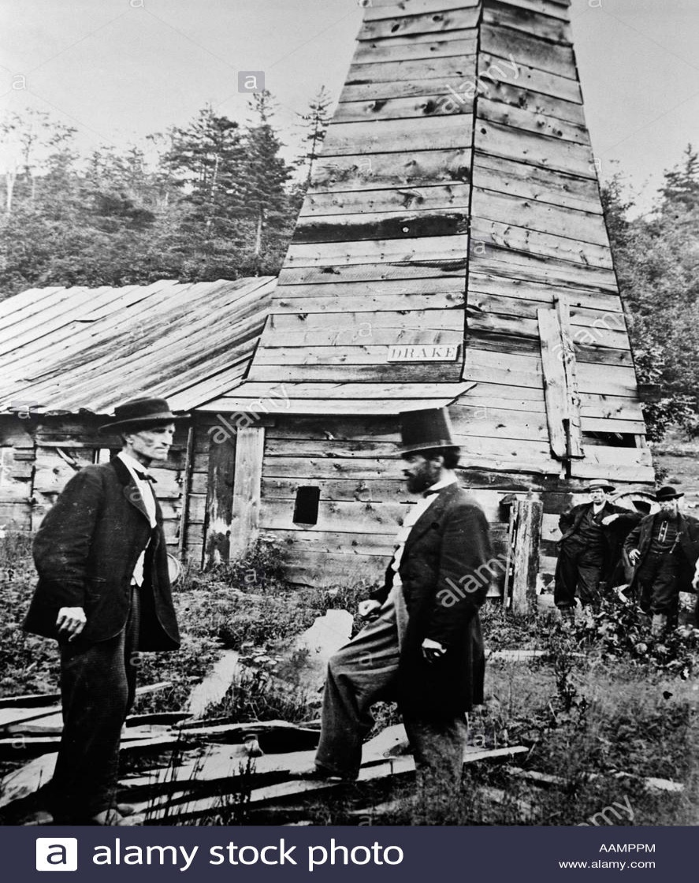
Drake’s well 1859 & ICE

Slide 11
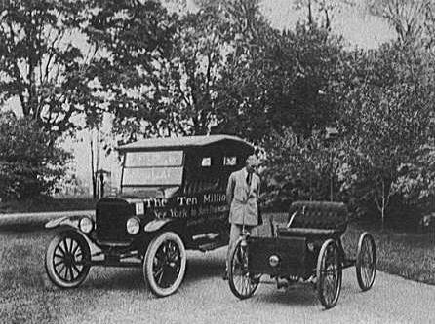
Cheap oil, technology, affordable transport
1908-12, model T dealt a blow to electric vehicles, ICE cars affordable
1912, electric starter!
Better roads , distribution network & cheap crude oil contributed to the decline in electric vehicles. By 1935, they had all but disappeared.
Henry Ford: first Model T
and the 1 millionth

Slide 12
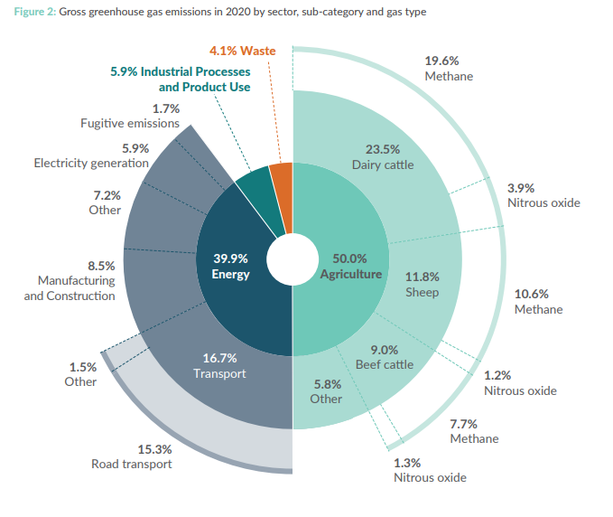
(3) Kiwi transport challenge

Slide 13
CCC final advice
Transport:
Accelerate uptake of electric and zero-emissions cars, buses and trucks
Phase out imports of ICE light vehicles by the early 2030s
Encourage switching to walking, cycling and public transport
Reduce demand for travel, for example through smart urban development and increased working from home
Electrifying ferries, coastal shipping and short-haul flights
Increase use of biofuels

Slide 14
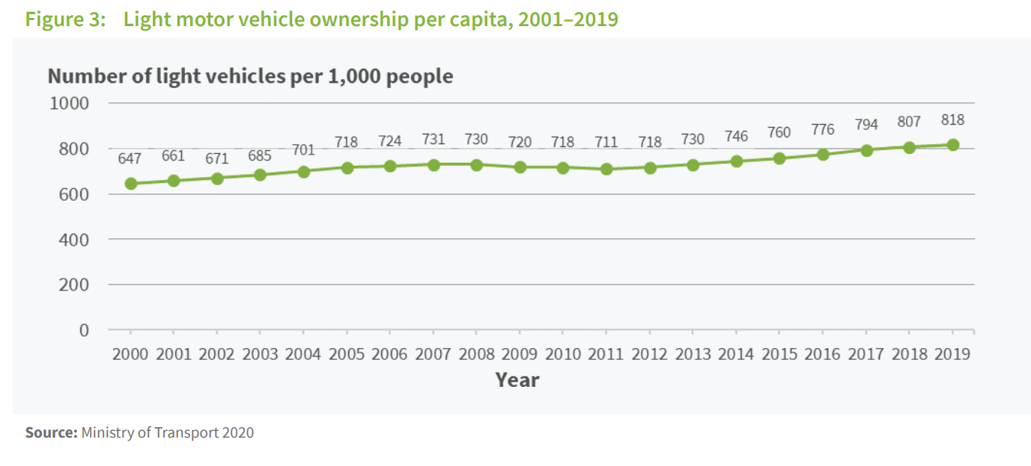
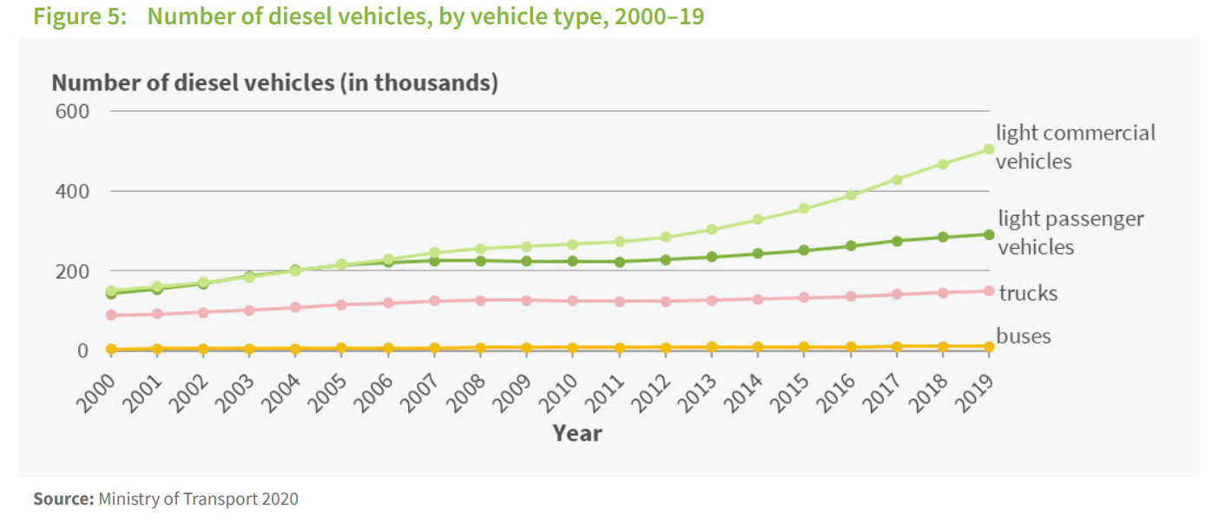
Vehicle fleet

Slide 15
Price elasticities & change in demand
 | Own PED | 10% incr. price | 10% decr. price
Petrol | -1.08 | -10.8%
Diesel | -0.99 | -9.9%
Battery electric | -1.27 |  | +12.7%
Hybrid | -1.72 |  | +17.2%
Lasse Fridstrøm & Vegard Østli, Direct and cross price elasticities of demand for gasoline, diesel, hybrid and battery electric cars: the case of Norway, European Transport Research Review volume 13, Article number: 3 (2021)
https://etrr.springeropen.com/articles/10.1186/s12544-020-00454-2

Slide 16
Income elasticities
UK 3.1
Source: Trends in Income and Price Elasticities of Transport Demand (1850-2010) Roger Fouquet.
https://www.lse.ac.uk/granthaminstitute/wp-content/uploads/2014/06/DemTranspEnPol2012.pdf
China 2.5 (2005-2017)
Source: Joshua Linn & Chang Shen. The Effect of Income on Vehicle Demand: Evidence from China’s New Vehicle Market, June 2021
https://media.rff.org/documents/VehicleDemandWorkingPaper.pdf

Slide 17
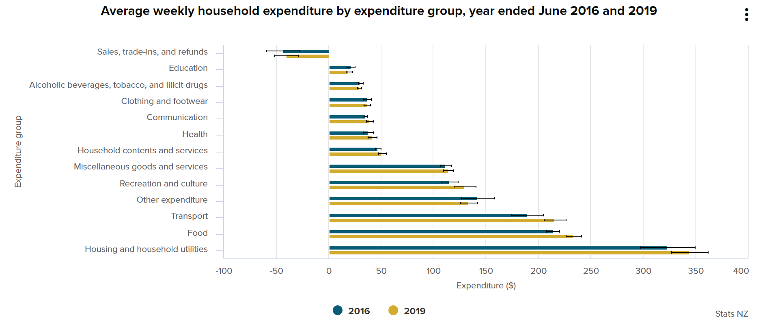
Average weekly household expenditure

Slide 18
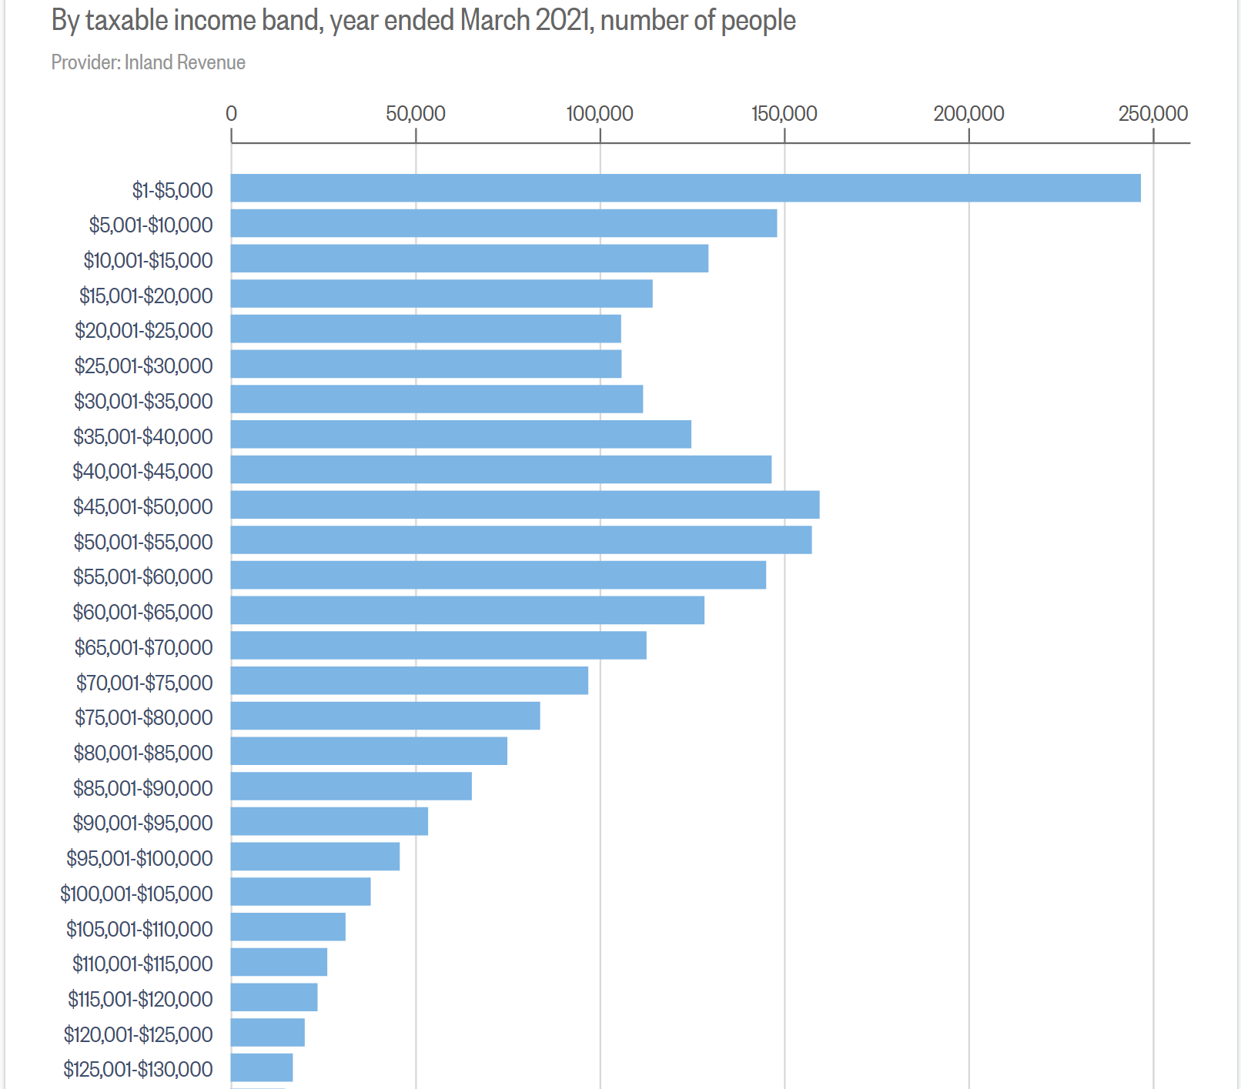
Income distribution

Slide 19
Parting thoughts
Earlier transition:
Alignment of oil, technology, markets to deliver transport services
Coordination
Today:
Substitutes for oil (electricity, H₂ , …), technology, markets, government policy
Coordination
Major challenges for transport:
Dealing with status quo i.e. price of substitutes, ability to pay

