Slide 1
Optimal Allocation of New Zealand Wind Generation
Mathew Brunt, Stephen Poletti, Geordie Reid, Selena Sheng and Le Wen

Slide 2
Overview
Transition to 100% renewable by 2050 in NZ.
Demand doubles
Means huge amount of wind/solar
Here focus on wind.
Investigate optimal location and amount of wind.
Strategy is to look at a number of factors.
Net demand match
Capacity factors
Hour to hour variability

Slide 3
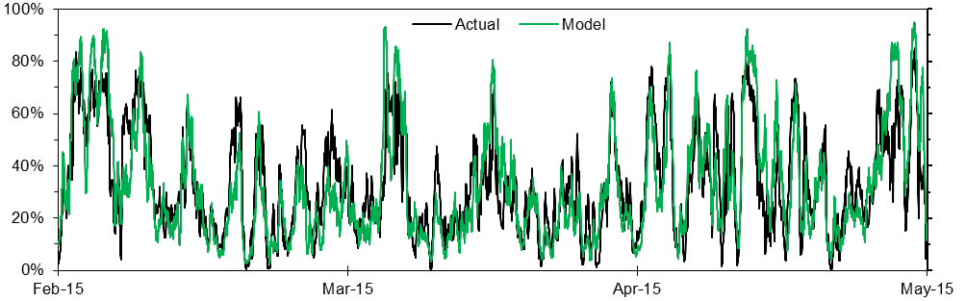
Wind Resources In NZ
Poletti and Steffell (2021) simulated wind output for 31 proposed and possible wind farm sites in New Zealand using NASA data from MERRA.
Calibrated against actual historic data.

Slide 4
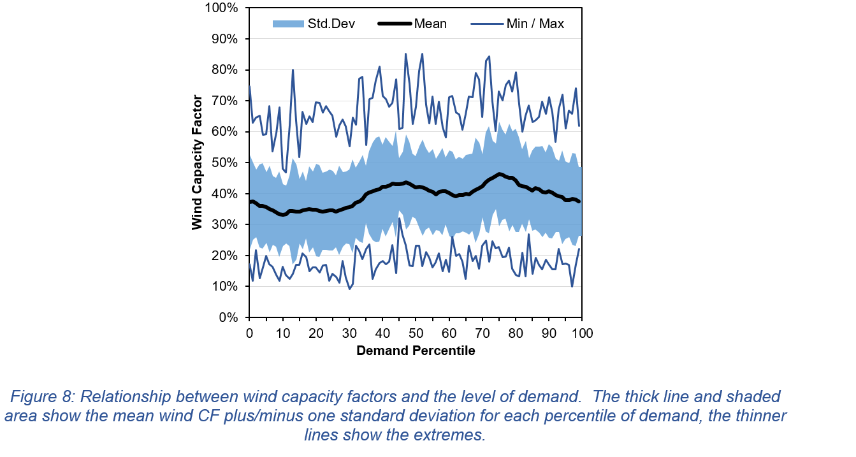
Wind not correlated with Demand

Slide 5
2050 Scenario (following Transpower)
Demand scaled to 70TWh
Hydro. Use historic dispatch
Geothermal – scale up to 1700MW
Solar -5900MW (output from Ninja renewables. Distributed on demand population weighted basis (50%) and utility scale (50%))

Slide 6
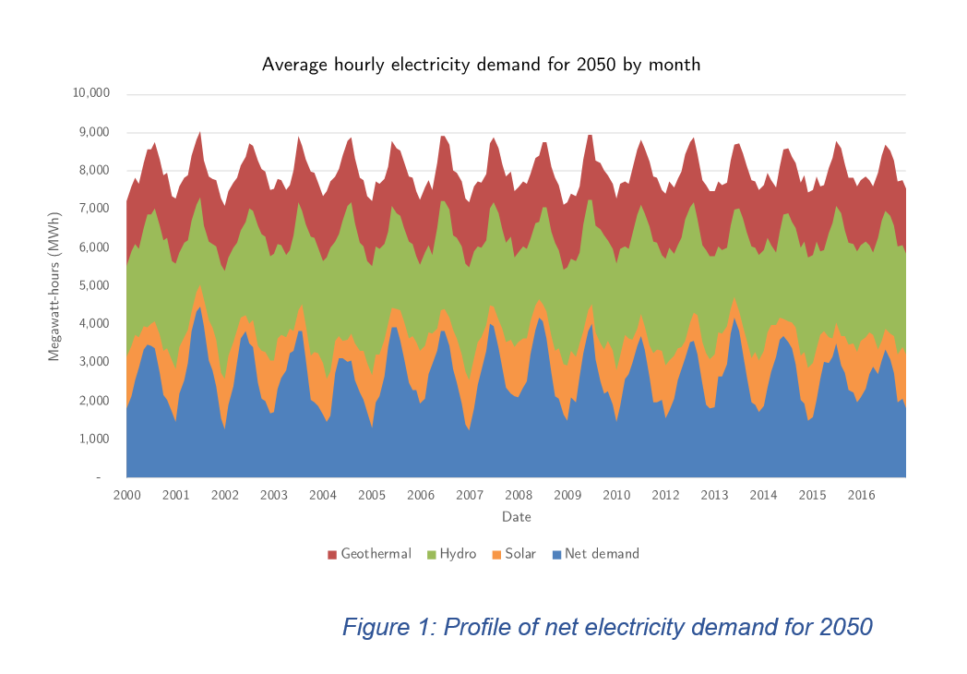
Net Demand

Slide 7
29 possible wind farms. Least squares
Look at half hourly data. No line constraints
Then construct loss function for output less than demand. Least cost.
If wind generation is greater than net demand:
Loss=SUM[Penalty*(wind output_i -net demand_i )]
If wind generation is less than net demand:
Loss_i=SUM[(net demand_i -wind output_i )]
Think of penalty as ratio of LRMC of wind (around $55/MWh) to battery costs (around $200/MWh)
We are less worried about too much wind than not enough. Now vary total capacity and locations to minimise loss function
Use 3 different penalties {0.1, 0.25, 0.5, 0.75}

Slide 8
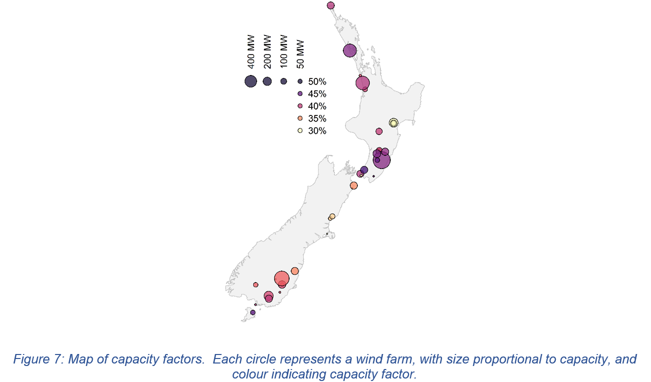

Slide 9
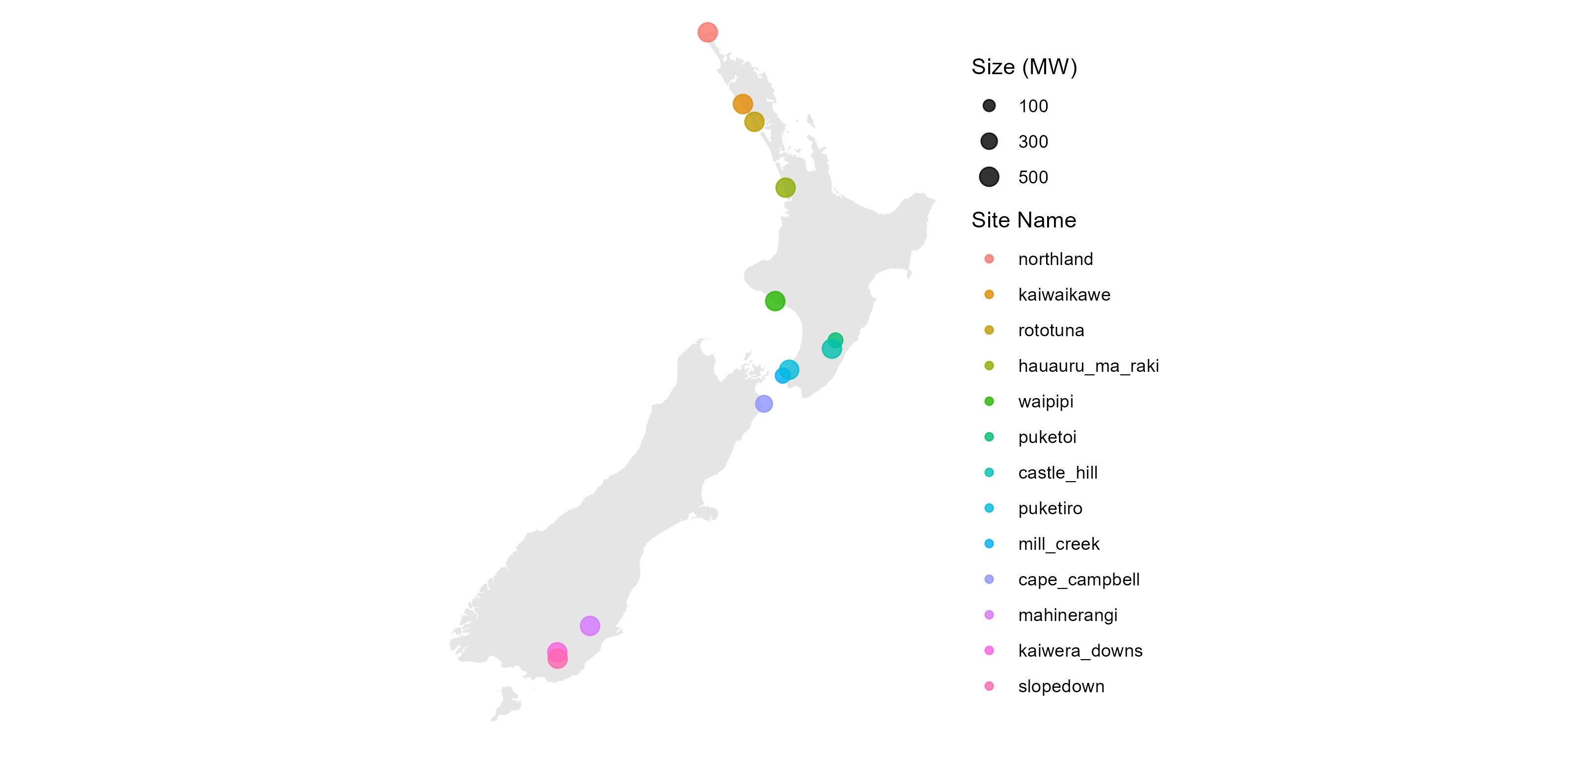


Example. Penalty =0.25, 1000GW max have 5 main sites with 1000MW. Total 6560MW

Slide 10
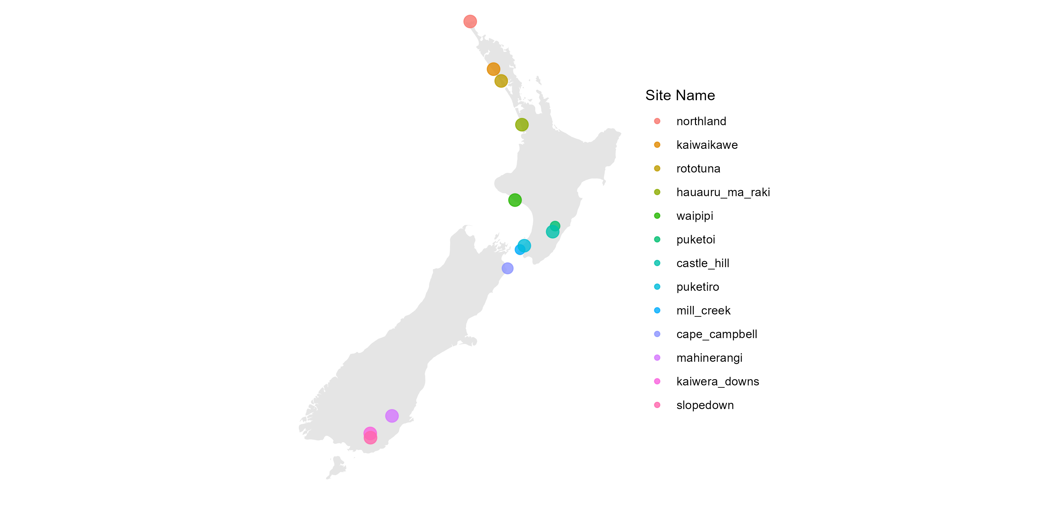
Most frams not included
Name | run_0_25_1000
Mill Creek | 1000
Tararua | 0
Te Apiti | 0
Te Uku | 106.9400839
West Wind | 79.8288401
White Hill | 0
Castle Hill | 0
Kaiwera Downs | 0
Maungaharuru | 0
Central wind | 0
Hauauru ma raki | 326.3344217
Hawkes Bay | 0
Mahinerangi | 0
Hurunui | 0
Puketiro | 1000
Rototuna | 1000
Slopedown | 425.7197208
Turitea | 0
Waitahora | 0
Hayes | 0
Te Waka | 0
Mt Munro | 63.49273345
Cape Campbell | 350.9329653
Mt Stalker | 205.5713378
Northland | 1000
Waipipi | 1000
TOTAL | 6558.820103

Slide 11
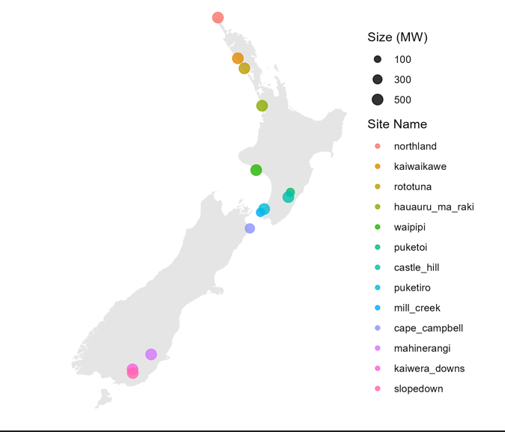
Sensitivity Analysis. Vs penalty=0.75 and 0.1

Slide 12
As penalty changes optimum sites are robust but total capacity changes a lot. Also note 1000MW->500MW results

Slide 13
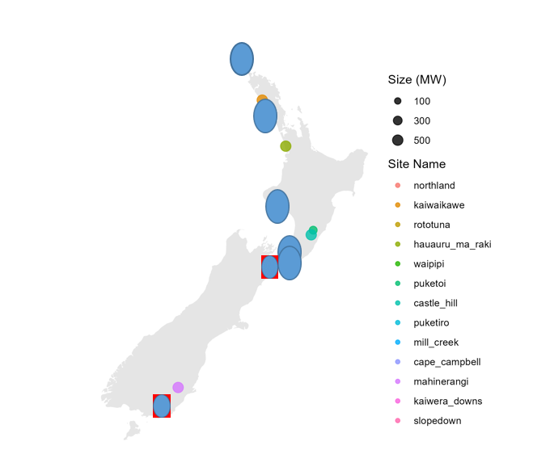
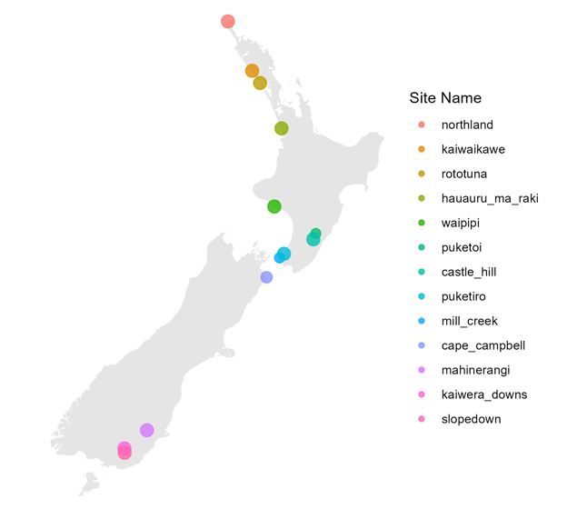
Capacity factors. Favoured sites good cf but not all good cf favoured

Slide 14
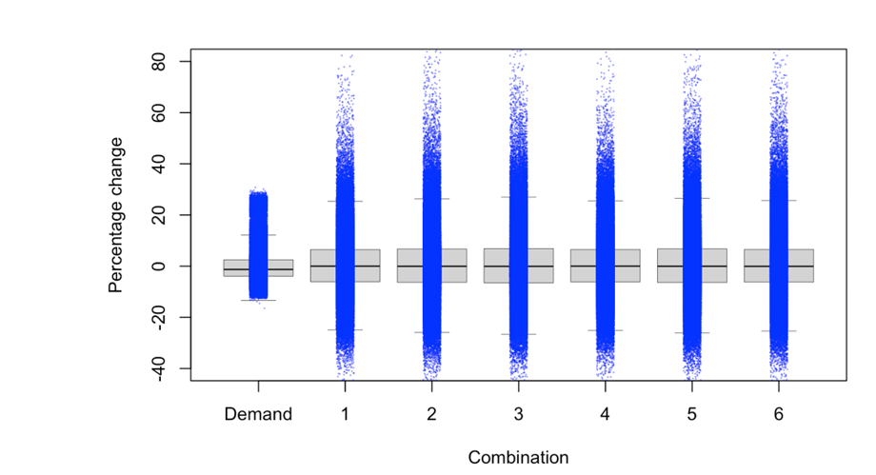
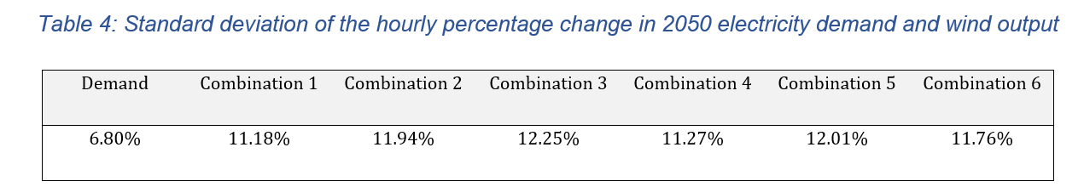
Variability (net?) demand – work in progress

Slide 15
Conclusions
Work in progress but
Clearly wind farm in the top of the North Island is important as is geographic spread.
Favoured sites incredibly robust to different modelling parameters.
Optimal capacity varies a lot. Suggests that battery technology is crucial to least cost

