Slide 1
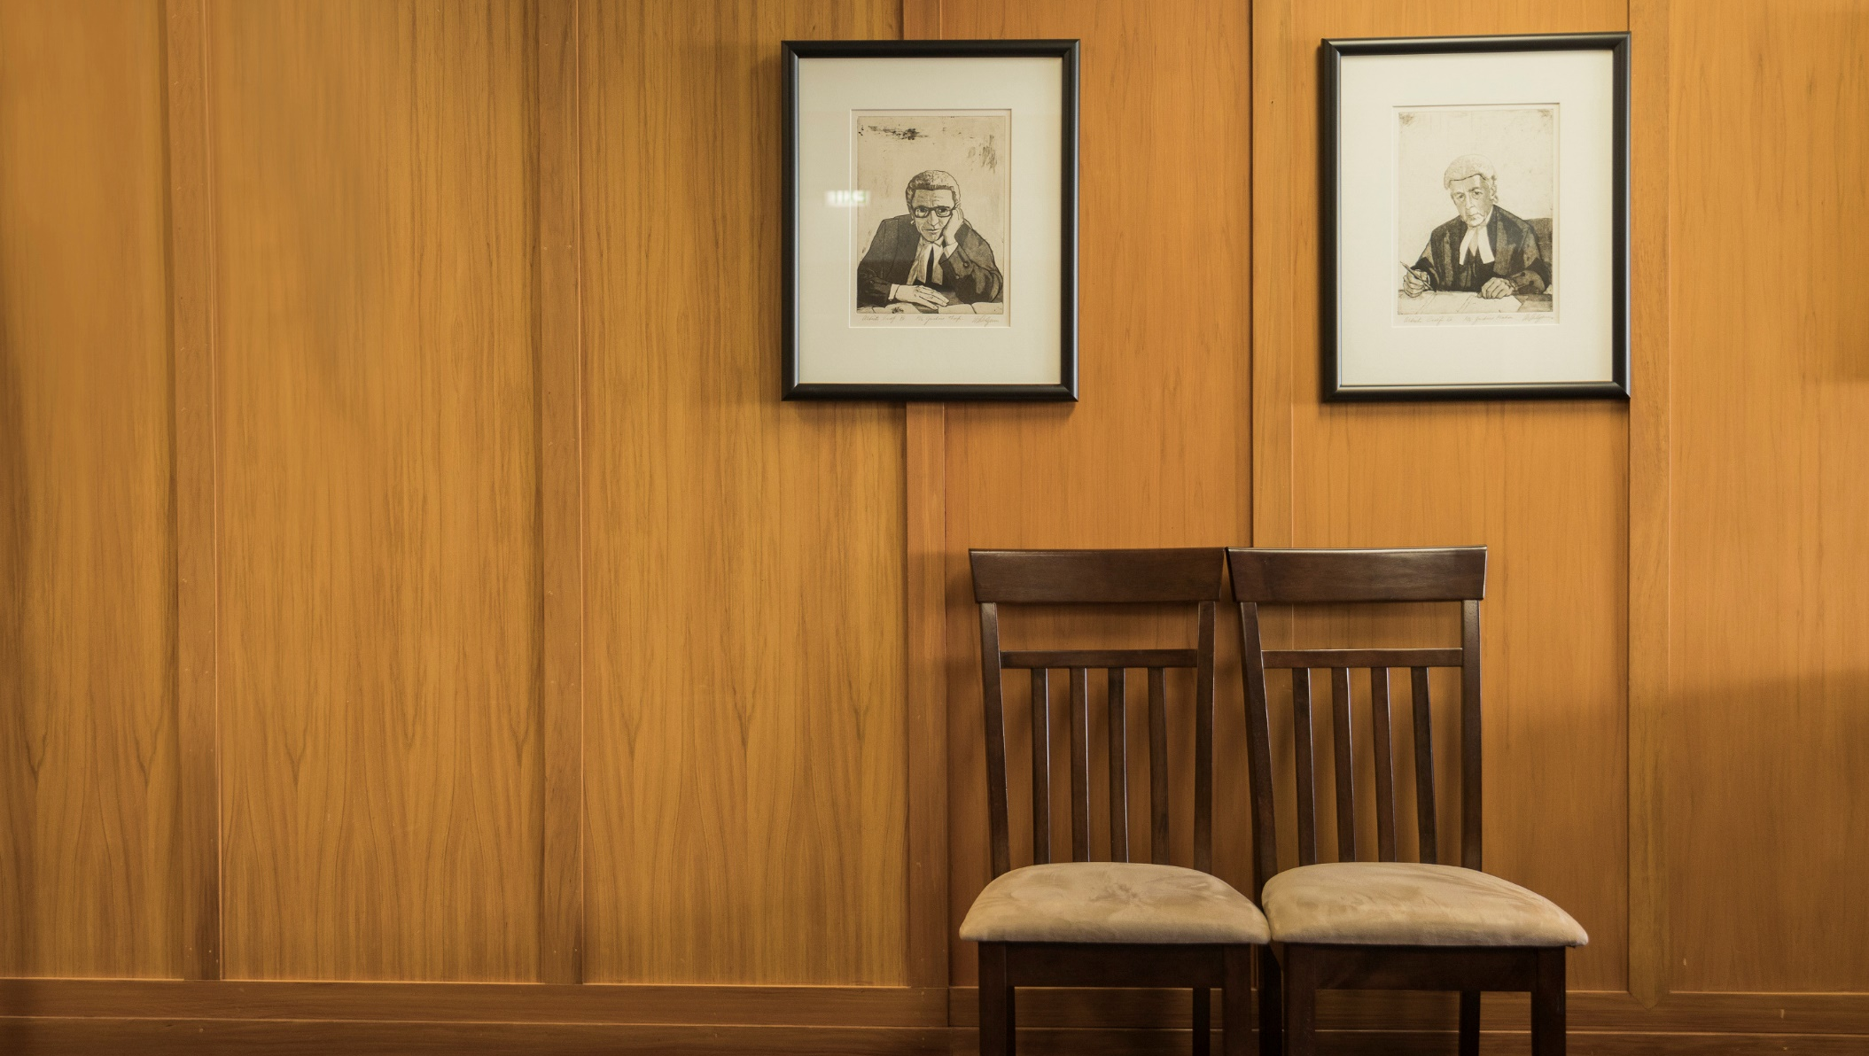
2019 ELECTIVE INFORMATION SESSION

Slide 2
ENROLMENT TIMELINE
Enrolments Open
1 Nov ’18, 6am
Student Advisors Available
From 7am

Slide 3
ENROLMENTS - PART II STUDENTS
Students who still have Part II Law courses to complete
DO NOT HAVE the prerequisites to enrol on Part III core courses
BUT MAY ENROL on some Part IV Law electives PROVIDED you
have met the prerequisites

Slide 4
ENROLMENTS - PART III STUDENTS
If you have completed ALL Part II Law courses you may enrol on
Any/all Part III Law courses
Some Part IV Law electives IF you have the prerequisites

Slide 5
LAW 399 LEGAL RESEARCH 2
If you were enrolled on ANY LLB Part III courses ON OR BEFORE 2018.
Only taught in Semester One, 2019
ENROL 1 Novermber

Slide 6
LAWGENRL 405 Community Law Internship, 20pts
150 hrs unpaid supervised work (approved community agency – Dr Tittawella
10,000-word report:
Meets LAW 498 written requirement
LAWGENRL 447 Community Law Project, 10pts
75hrs unpaid supervised work
5,000-word report
Meets LAW 498 written requirement

Slide 7
SUMMER SCHOOL 2019
LAW 458 Supervised Research, 10pts
LAWCOMM 437 Iwi Corporate Governance, 15pts
LAWCOMM 440 Guarantees and Indemnities, 10pts
LAWGENRL 405 Community Law Internship, 20pts
LAWGENRL 447 Community Law Project, 10pts
LAWPUBL 445 European Union Law, 15pts
LAWPUBL 466 Contemporary Issues in Disarmament Law, 15pts

Slide 8
POSTGRADUATE LAW COURSES
If you have completed Parts II and III with a GPA of >5.00 over the last 120 points of law you may apply for a concession to enrol into a postgraduate law course
You may apply for a concession from 1st November
A list of postgraduate courses that are available to undergraduate students will be available through the Student Centre.

Slide 9
LAW 498 ADVANCED LEGAL
READING, WRITING & COMMUNICATION
You must enrol in your final semester of LLB BUT work from Part III and IV prior to enrolment counts towards the course requirements :
Pass a moot above Part II
Complete single piece of sustained legal writing of at least 4000 words
LAW 456 Supervised Research
PILO of at least 4000 words
LAWGENRL 405 or LAWGENRL 447 course report
Research Essay for a 15 or 30 point masters course taken within the LLB
Honours Seminar Paper (10,000 words)
Honours Dissertation (15,000 words)
Any other single piece of legal writing of at least 4000 words

Slide 10
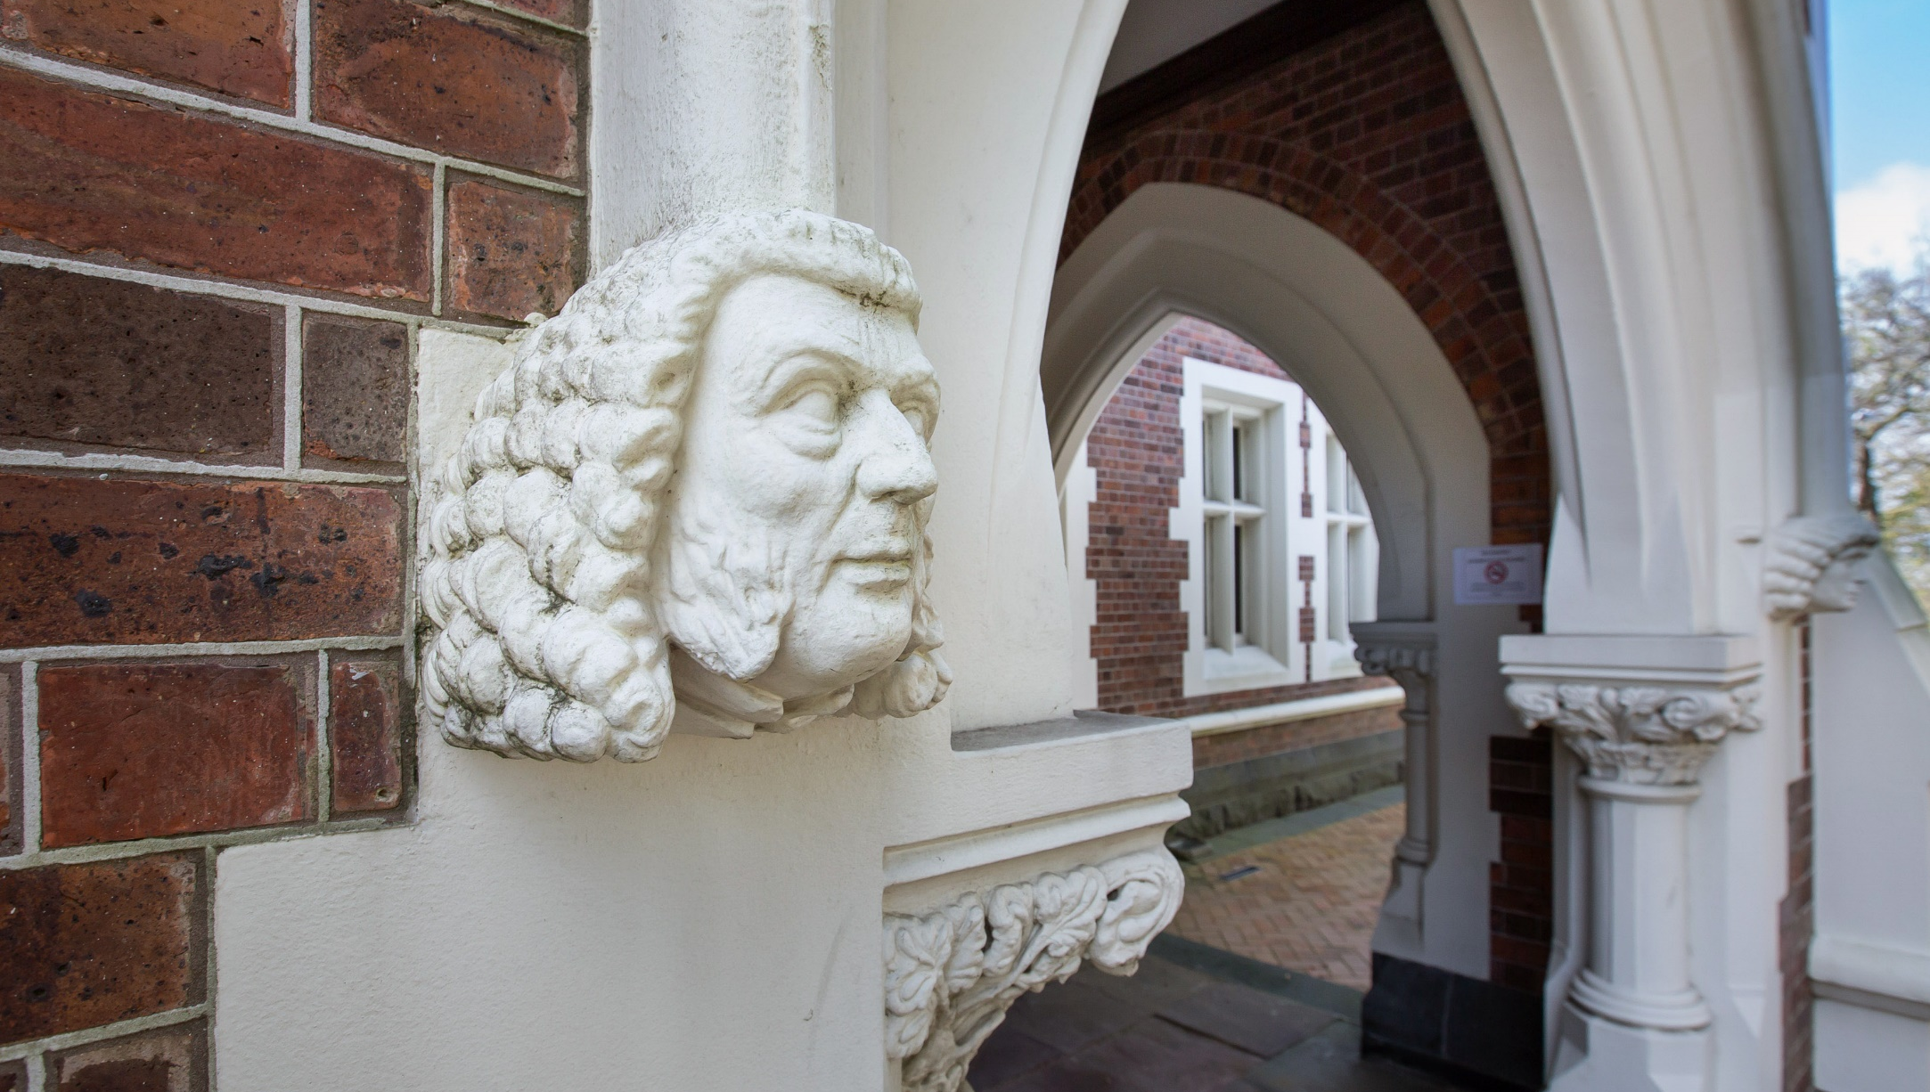
LLB(Hons) ELIGIBILITY
Students must have completed ALL Part II Law courses
Students with a 75% average or more over ALL law courses will be invited to transfer to the honours programme
Students who do not get into Honours by invitation at the end of Part II may apply in subsequent years.
Additional 60 points: Students must meet the honours grade requirement and seminar spaces are subject to availability.

Slide 11
AEGROTAT & COMPASSIONATE CONSIDERATION
Exam preparation or exam performance impacted due to extenuating circumstances
Sit the exam if you are physically able to
See a doctor on the day of the exam if applying for consideration of exam performance
Within 7 days after the exam submit your application online

Slide 12
LLB PART II-IV STUDENTS’ CONTACT:
Emily McGowan
Student Academic & Support Adviser (Undergraduate & Equity)
Law Student Centre
Level 2, 1-11 Short Street
Phone: +64 9 923 7939
Email: e.mcgowan@auckland.ac.nz undergradlaw@auckland.ac.nz

Slide 13
If
CHILD CARE COMMITMENTS?
You can apply ahead of the general sign up for specific tutorial sessions
We will make every effort to accommodate your requests – although this may not always be workable
Contact either :
Dr Suranjika Tittawella (s.Tittawella@auckland ac.nz)
Emily McGowan (e.mcgowan@Auckland.ac.nz)

