Slide 1

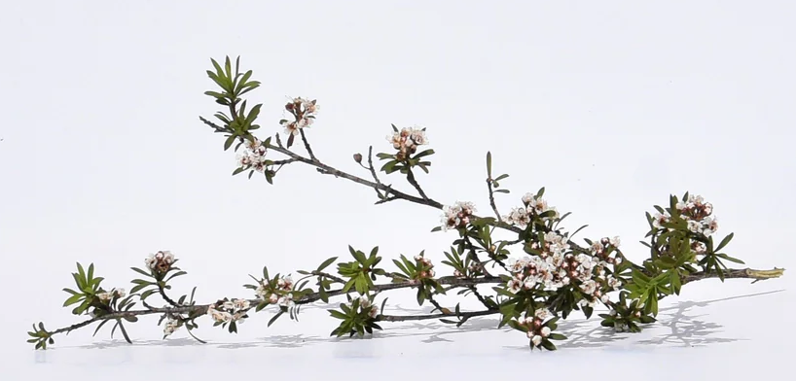
Building Māori Relationships in Community and Research
NUKA Story …
Saeid Baroutian

Slide 2


What is Research Impact?
“The contribution that research and creative practice makes to society, the environment and the economy”.
… beyond contribution to knowledge and skills in research organisations.

Slide 3

Maximising Research Impact
Why?

Slide 4
 Benefiting society
 Making research more relevant
 Making the case for public research funding
 Securing future funding
 Attracting resources

Slide 5

Pathways to Impact
Results Chain Framework

Slide 6
Resources that support research activities
Funding, Knowledge, People, Skills, Existing relationships, Facilities, Equipment
Research activities that generate new knowledge & applications
Research & Development, Engagement, Collaboration, Co-development, Learning, Experimentation, Theorising, Training
The knowledge, applications and skills developed by research activities
Publications, Presentations, Prototypes, Datasets, Patents, Services, Methods & processes, New companies, Reports, Guidelines
Mechanisms that lead to impacts by use or application of outputs
Citations, Licences, Follow-on income, Uptake of device/ therapies, Change in policy, Media coverage
Cultural, Economic, Environmental, Health & Wellbeing, Political, Scientific, Social, Technological, Training
A change to the economy, society, or environment
Source: The Impact of Research, Position paper, October 2019, Ministry of Business. Innovation & Employment

Slide 7

K Ā

Slide 8
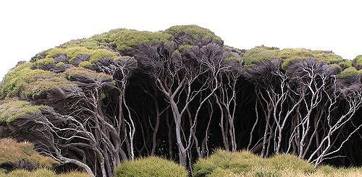
Kānuka Tree
Kānuka
Kunzea ericoides

Slide 9
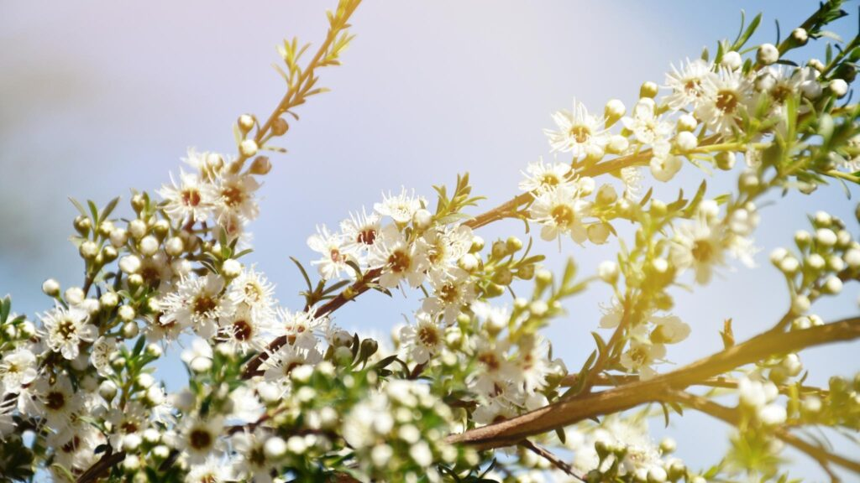
What’s the big deal about Kānuka?

Slide 10
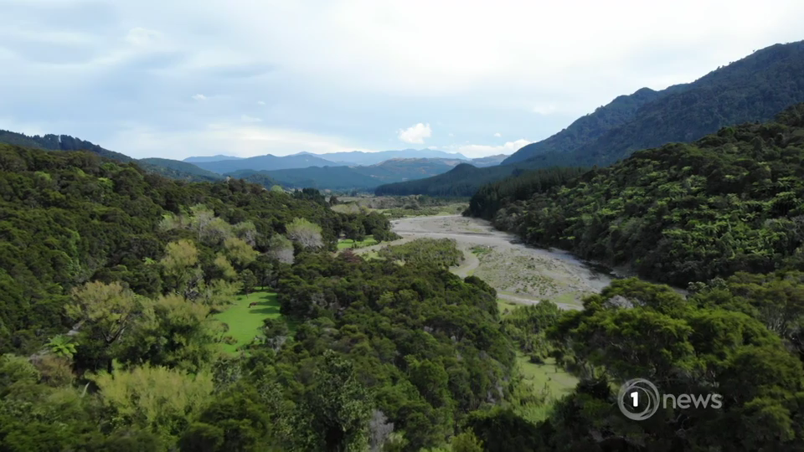
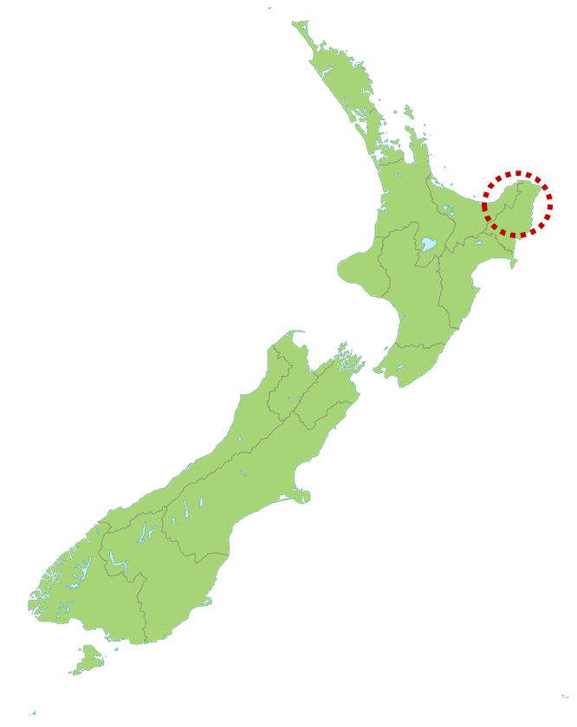
Thousands of hectares of unproductive land in East Cape of NZ
There is a notable prolific source of kānuka available on East Cape of NZ (underutilised).
Māori unemployment is usually three times higher than the general rate.
GDP in Tairāwhiti: up to 1.2%
National average: 3.1%
Māori land and resources should be used to create jobs.

Slide 11
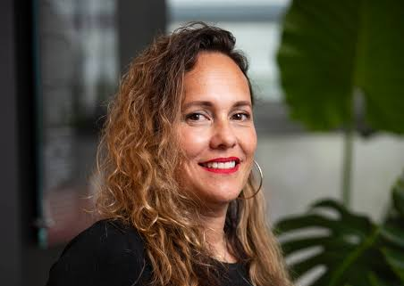
Dr Kiri Dell
(Ngati Porou)
Senior Lecturer
Business School, Management and International Business

Slide 12
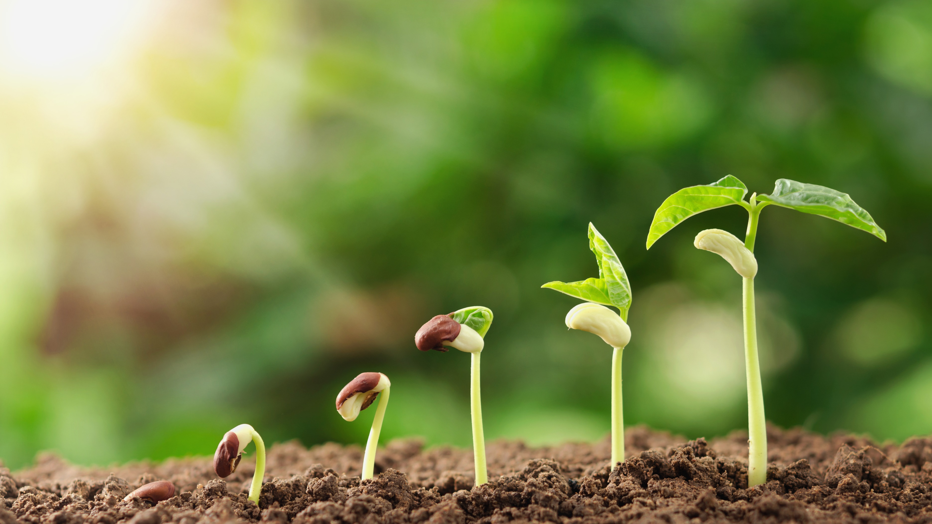
Planning process

Slide 13
Step 1: Identifying the research need
What is the challenge, opportunity, or issue?
How big is the problem?
How do we know this is a problem?
How can our research help?
How is our research different to the existing research?

Slide 14




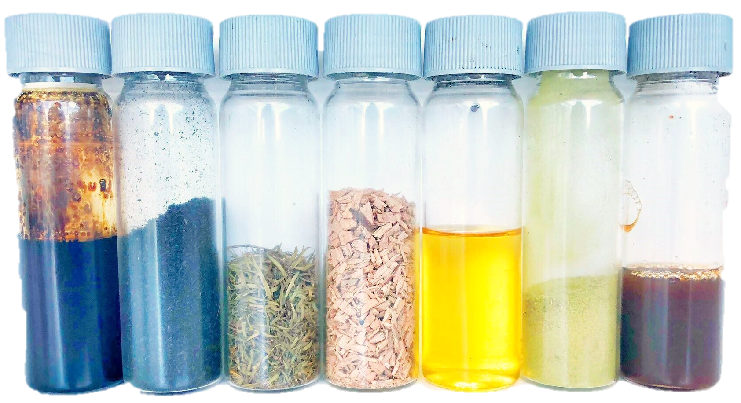
New High Value, Natural, Plant-based Products
Kānuka Terpene Rich Oil
Kānuka Biochar
Kānuka Pure Leaf powder
Kānuka Liquid Smoke
Kānuka Juice (Water-Soluble Extract)

Slide 15
Step 2: Defining our impact goal
If we are successful, what will be achieved?
What would our stakeholders say about how they have benefitted?
A new high-value industry
Employment for an isolated community
New capability, capacity, skills and networks
It would be amazing to develop a solution for the whole region, but more realistically perhaps will be able to develop it for a rural community.
Impact goals should be SMART – Specific, Measurable, Achievable, Realistic and Time-bound

Slide 16

Step 3: Mapping our stakeholders
University
Māori Community
We knew what the research need is, and we knew the potential impact. But we can’t achieve the impact alone.
Māori Landowners
Local Government
We need to engage with non-academic stakeholders to proactively make a difference.
Central Government
Product End Users

Slide 17

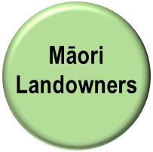




Step 4: Prioritising stakeholder engagement
High
Hard-to-reach
Influential
Easy-to-reach
Influential
INFLUENCE
Hard-to-reach
Marginal
Easy-to-reach
Marginal
Low
High
INTEREST

Slide 18
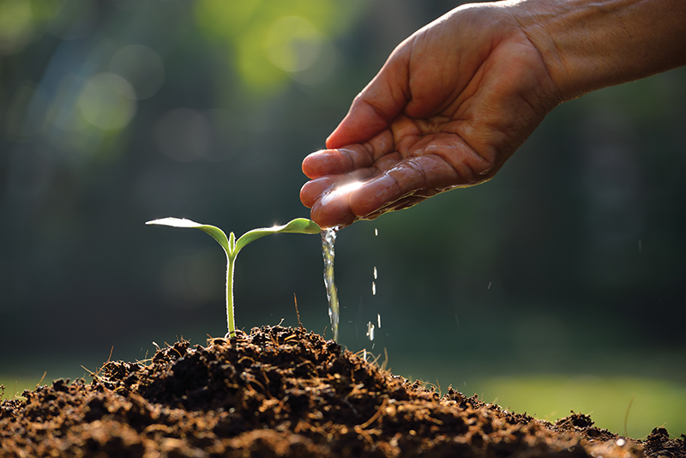
Implementation process

Slide 19
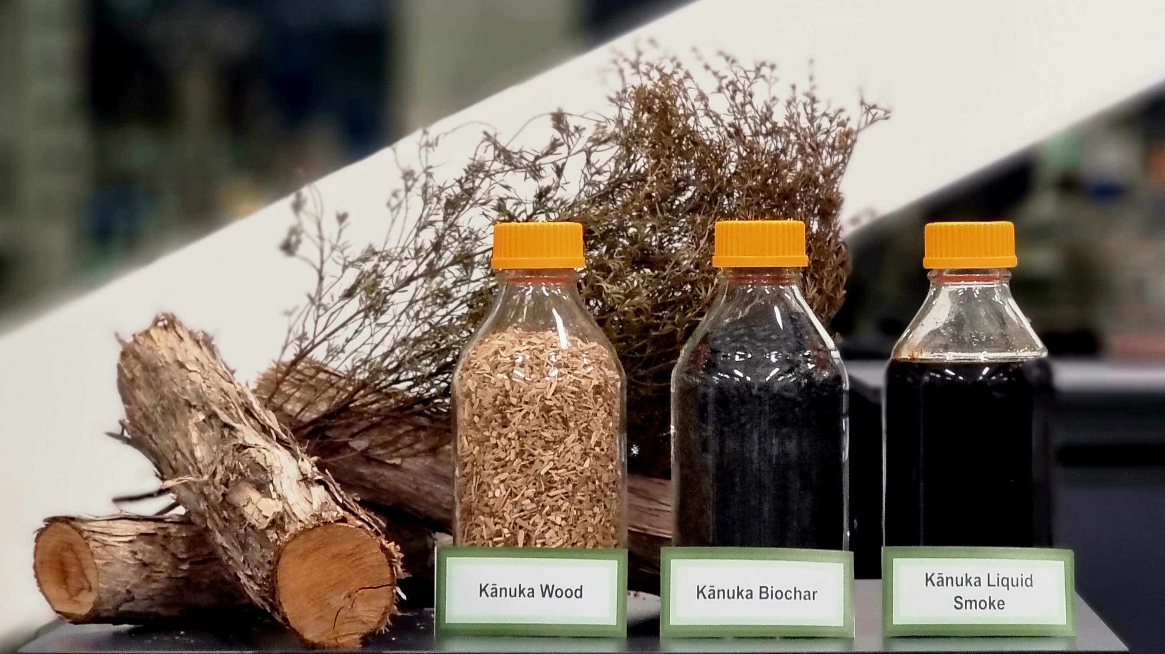
Our products

Slide 20
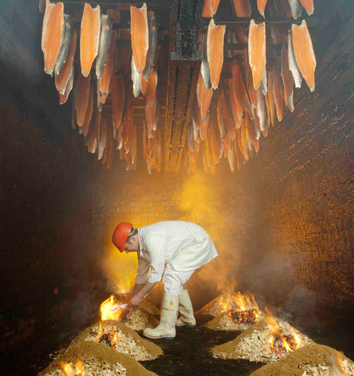
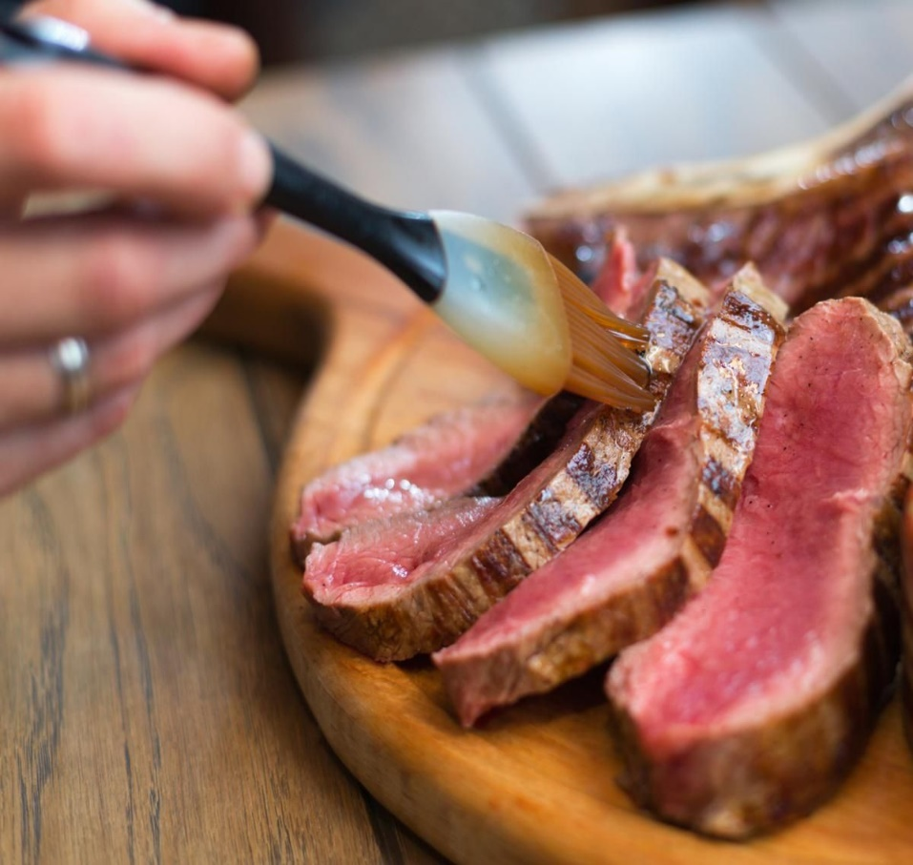
Traditional Food Smoking
Liquid Food Smoking
Time consuming
Energy intensive
Not reproducible
Difficult to standardise flavours and colour
Harmful carcinogens (PAHs)
Simpler, more sanitary and consumer friendly
Reduced time and energy – lower production cost
Highly reproducible
Easy to standardise flavours and colour
No harmful carcinogens (PAHs)
Notes:
Smoke ingredients are widely used in the meat and seafood industry. In addition to adding a very pleasant taste and aroma to food at appropriate concentrations, liquid smoke is reported to be an effective way to kill many common foodborne pathogens. Currently, smoked products are predominantly achieved by traditional flue gas smoking with wood chips or sawdust. This process is usually long and there is no precise control or flavour profile or removal of harmful carcinogens. As a result, utilising liquid smoke is safer, more energy-efficient and environmentally sustainable when compared to the traditional smoking process.

Slide 21
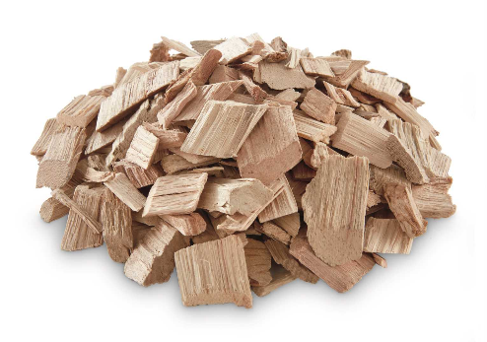
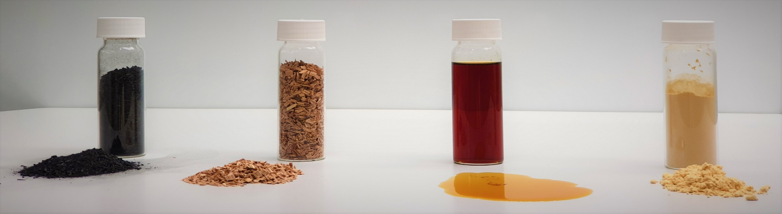

Fast Pyrolysis
Condensation
Aging
Purification
Spray Drying
Kānuka Wood Chips
Biochar
Kānuka Liquid Smoke
Kānuka Smoke Powder

Slide 22
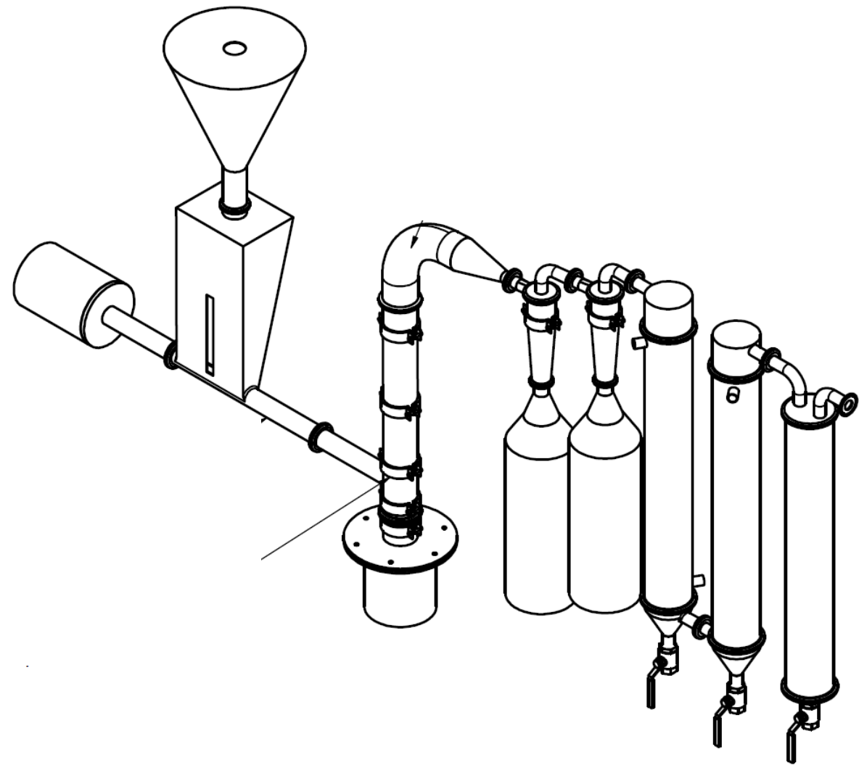
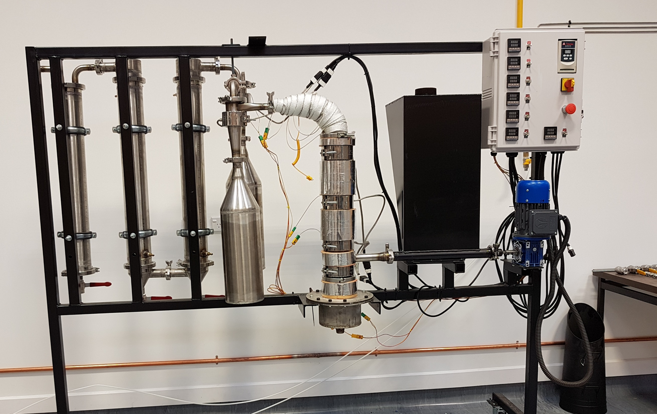

Slide 23
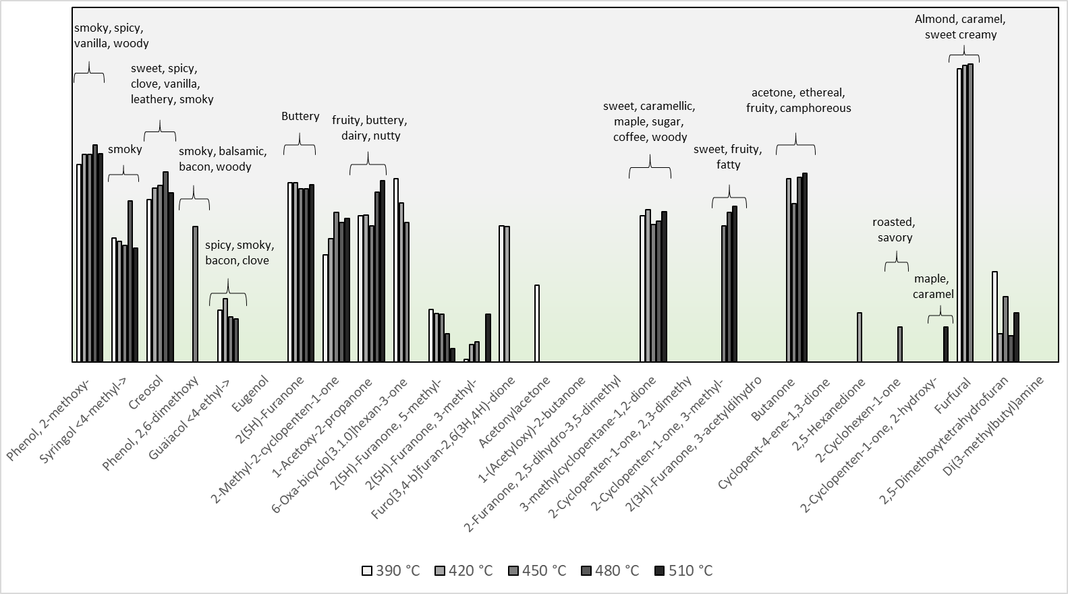
Flavour Profile
Compounds
Phenols | Phenol, 2-methoxy-
 | Syringol <4-methyl->
 | Creosol
 | Phenol, 2,6-dimethoxy
 | Guaiacol <4-ethyl->
 | Eugenol
Ketones | 2(5H)-Furanone
 | 2-Methyl-2-cyclopenten-1-one
 | 1-Acetoxy-2-propanone
 | 6-Oxa-bicyclo[3.1.0]hexan-3-one
 | 2(5H)-Furanone, 5-methyl-
 | 2(5H)-Furanone, 3-methyl-
 | Furo[3,4-b]furan-2,6(3H,4H)-dione
 | Acetonylacetone
 | 1-(Acetyloxy)-2-butanone
 | 2-Furanone, 2,5-dihydro-3,5-dimethyl
 | 3-methylcyclopentane-1,2-dione
 | 2-Cyclopenten-1-one, 2,3-dimethy
 | 2-Cyclopenten-1-one, 3-methyl-
 | 2(3H)-Furanone, 3-acetyldihydro
 | Butanone
 | Cyclopent-4-ene-1,3-dione
 | 2,5-Hexanedione
 | 2-Cyclohexen-1-one
 | 2-Cyclopenten-1-one, 2-hydroxy-
Furans | Furfural
 | 2,5-Dimethoxytetrahydrofuran
Amine | Di(3-methylbutyl)amine

Slide 24
Antioxidant Properties
Kānuka Liquid Smoke contains a high amount of natural antioxidants (50 mg antioxidant/mL of liquid smoke).
Kānuka Liquid Smoke
Commercial Liquid Smoke (Hickory, Maple, Applewood) from US

Slide 25
Antimicrobial Properties
Liquid smoke acts as antimicrobial agent, helping to preserve food and extend the shelf life of treated products.
Less than 0.1 Wt% of Kānuka Liquid Smoke can effectively inhibit microbial growth.
The Minimum Inhibitory Concentration (MIC) and Minimum Bactericidal Concentration (MBC) to inhibit microbial growth and kill bacteria are lower than other similar products.
Kānuka Liquid Smoke
Commercial Liquid Smoke (Hickory, Maple, Applewood)

Slide 26
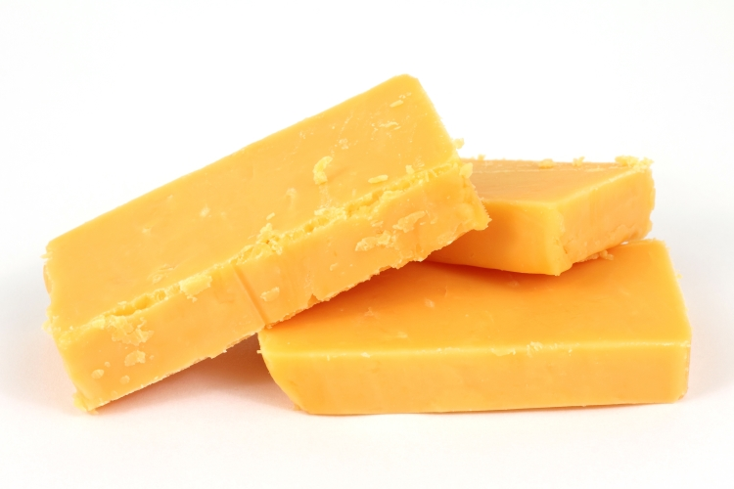
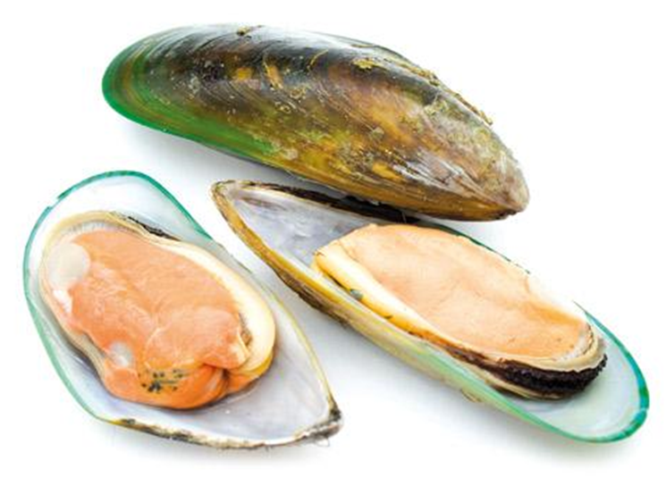
 | 10³ Log CFU/g
 | Cheddar Cheese (Refrigerated) | Liquid Smoked Cheddar Cheese (Ambient Temperature)
Week 0 | 6.5 ± 0.1 | <LOD
Week 2 | 5.4 ± 0.1 | 3.8 ± 0.4
Week 4 | 5.2 ± 0.0 | 4.2 ± 0.3
Week 6 | 6.3 ± 0.1 | 5.0 ± 0.3
Week 8 | 6.2 ± 0.1 | 6.0 ± 0.2
 | 10³ Log CFU/g
 | Mussel Meat (Refrigerated) | Liquid Smoked Mussel Meat (Refrigerated)
Day 0 | 4.5 ± 0.4 | <LOD
Day 14 | 17.9 ± 1.7 | 0.4 ± 0.1
Day 30 | 25.4 ± 1.8 | 0.9 ± 0.3
Notes:
The log CFU/g (Colony Forming Units per gram) threshold for the shelf life of food products.
A common guideline is to maintain a log CFU/g level below 10^4 (10,000 CFU/g) for total aerobic bacteria to ensure product safety and quality over the shelf life.

Slide 27
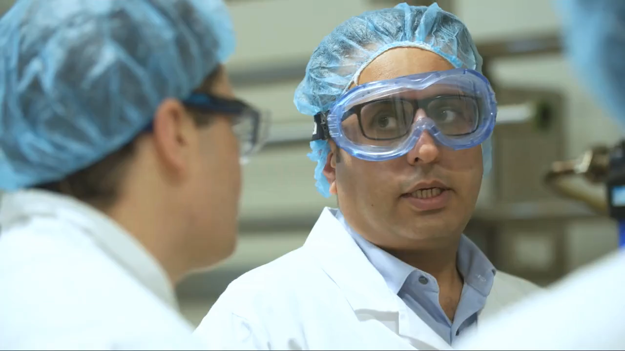
Semi-commercial production
under food grade regulations
Familiarise ourselves with the regulations
Make a food-grade product to send to customers
Further proof of concepts

Slide 28




Feedback
It’s such a beautiful flavour, and we have a customer and product lined up that we’ll be using it in.
We tested your Nuka Liquid Smoke in one of our nitrite free corned meat products in Canada. The feedback from our test team and food technologists is:
Distinctly different ‘smoke’ taste to what they were used to
Was sweet tasting
Worked very well with the meat – definite new distinct sku
Believe the North American market will like it
Thanks for sending the samples. We're happy that they would make a good replacement for our current smoke and are keen to explore purchasing from you.

Slide 29
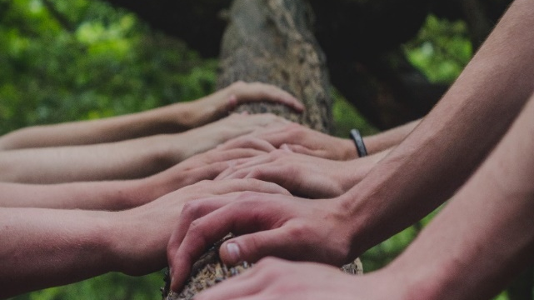
Engagement
Active engagement with the Māori community empowers collective voices, ensuring that our solutions are inclusive, relevant, and genuinely impactful.

Slide 30
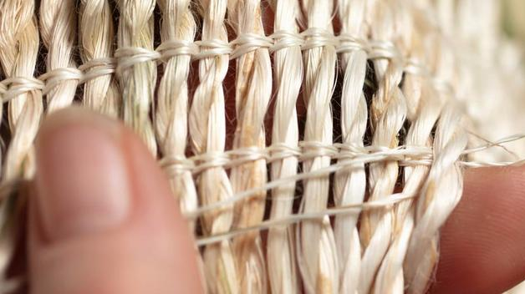
The Māori approach to collaboration is deeply rooted in cultural values and principles that emphasise relationships and engagement
Some key aspects of the Māori approach to collaboration:
Whakawhanaungatanga (Building Relationships)
Koha (Reciprocity)
Collective Decision-Making
Tikanga (Customs and Protocols)
Holistic Well-Being

Slide 31
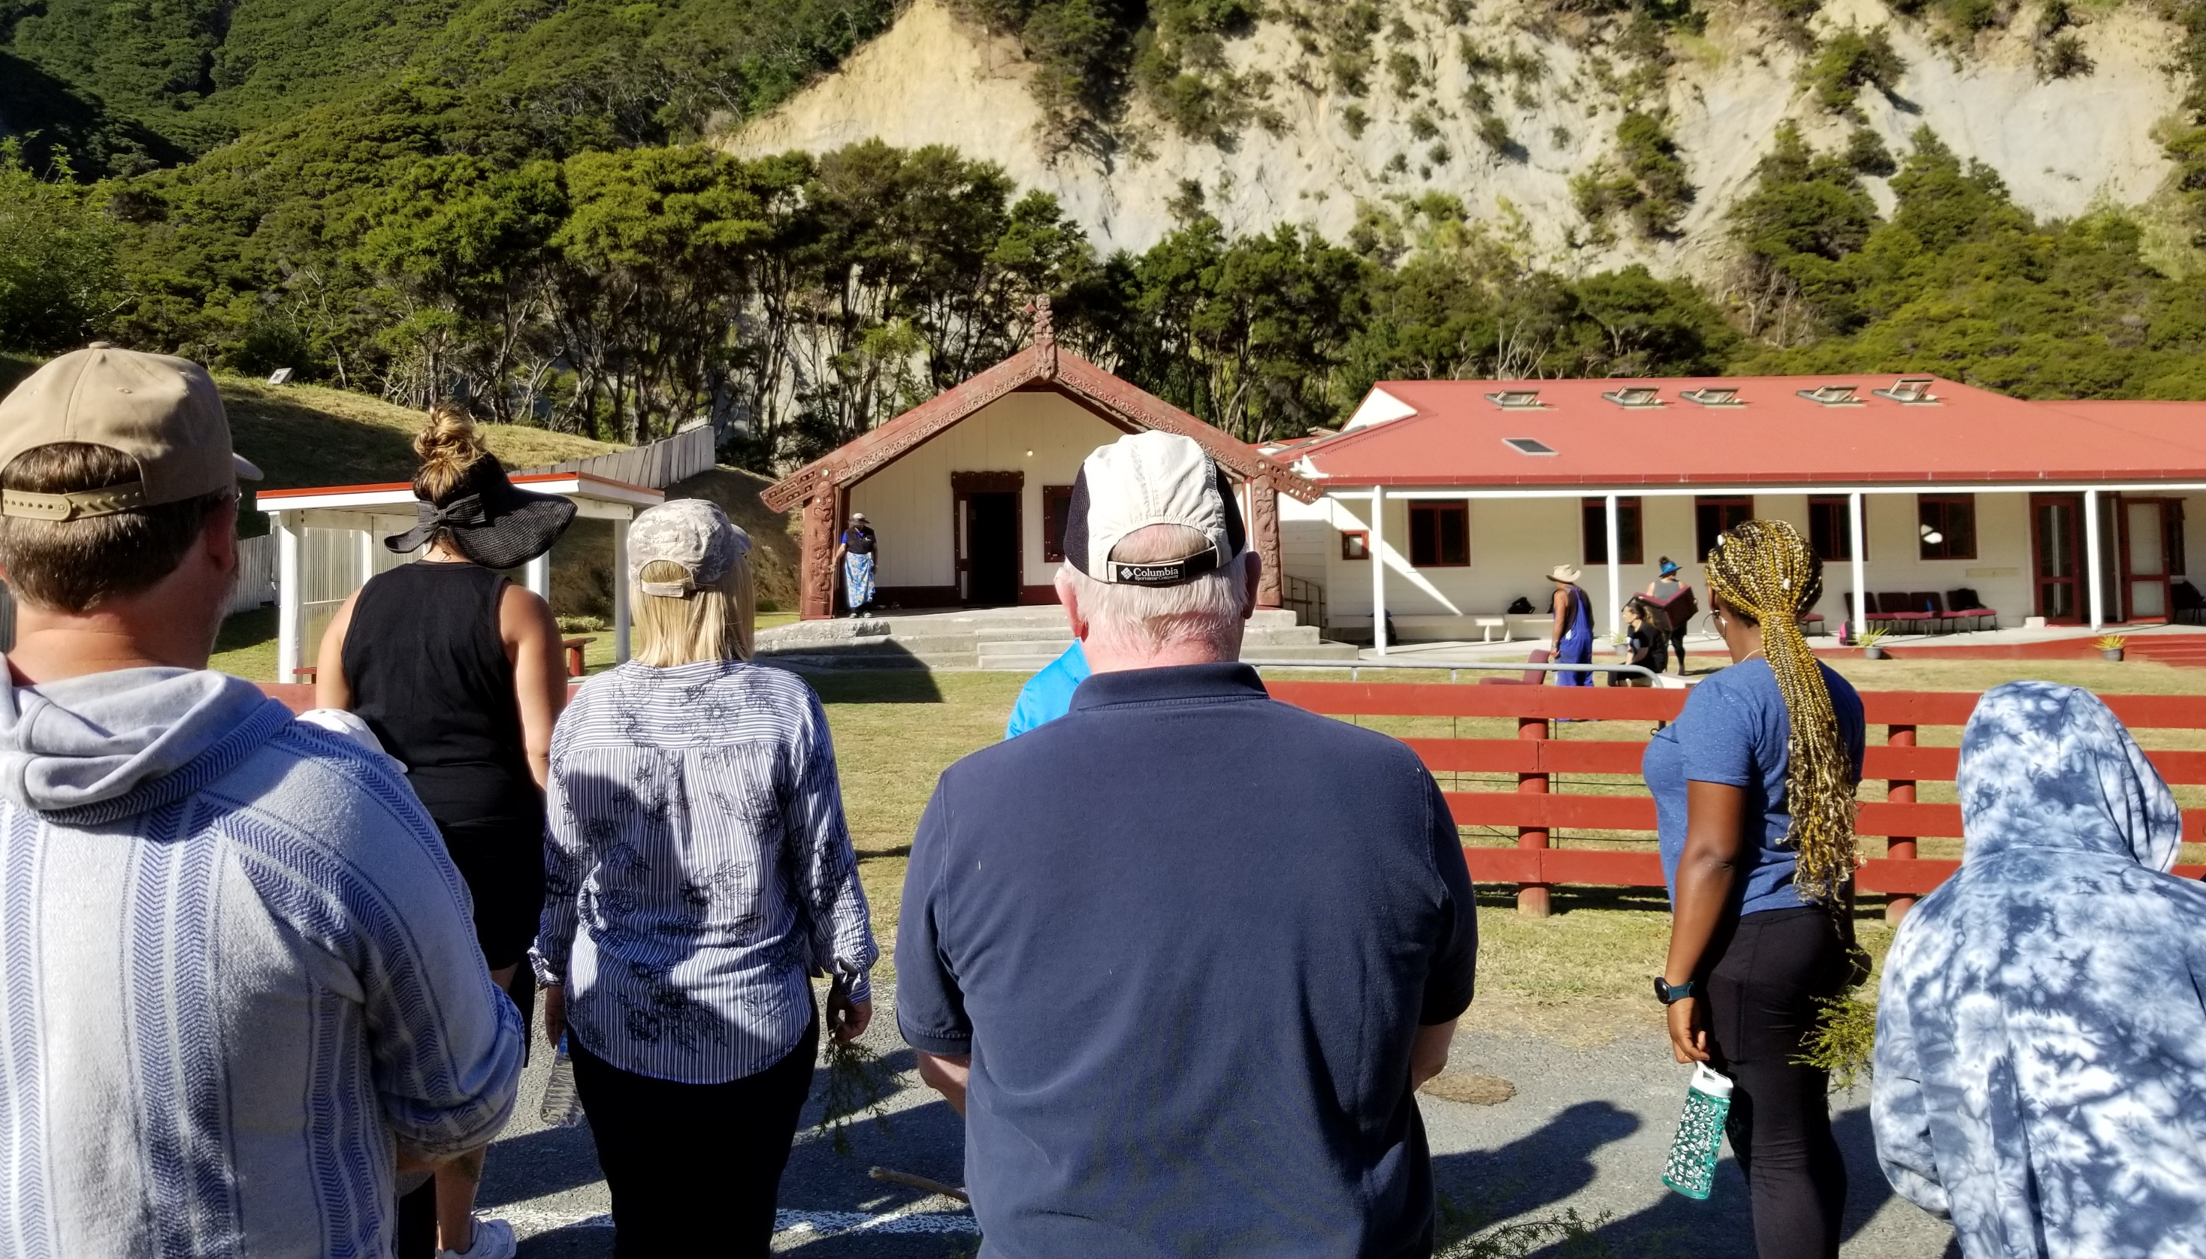
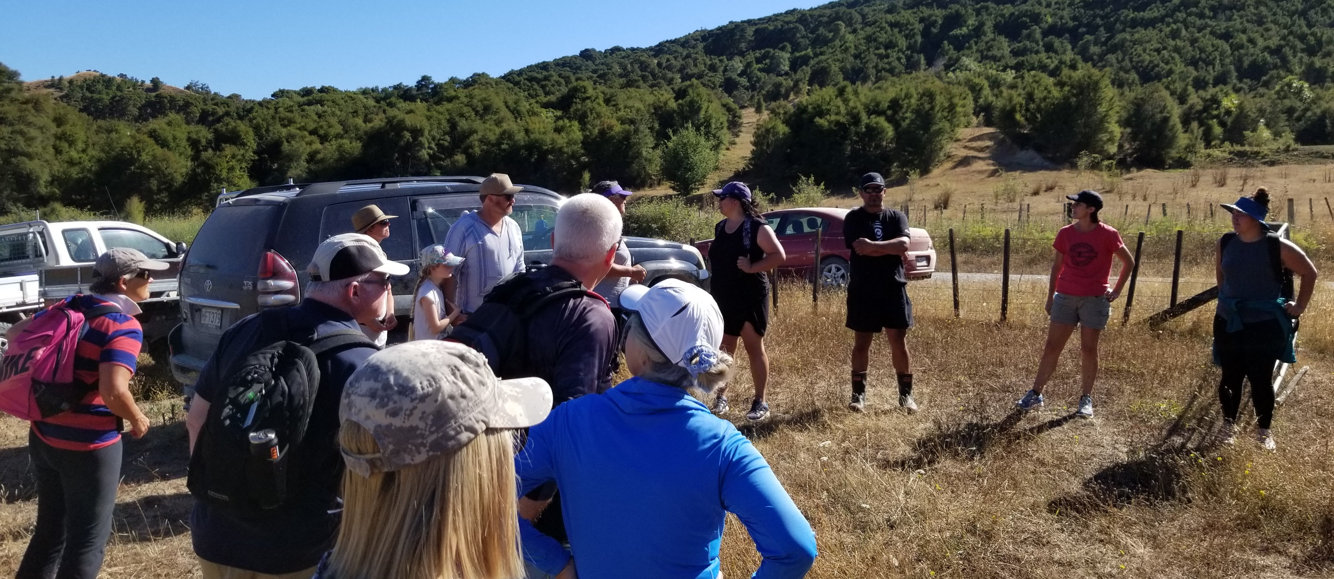
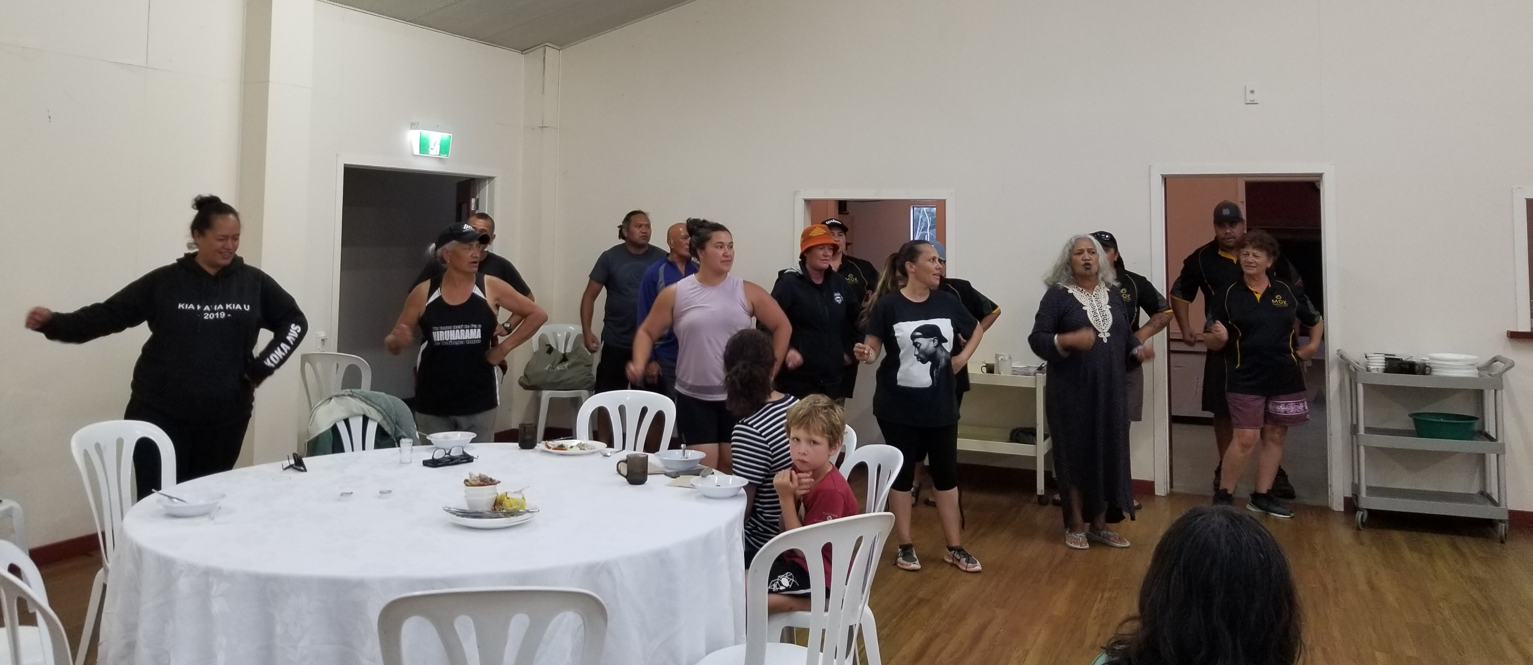
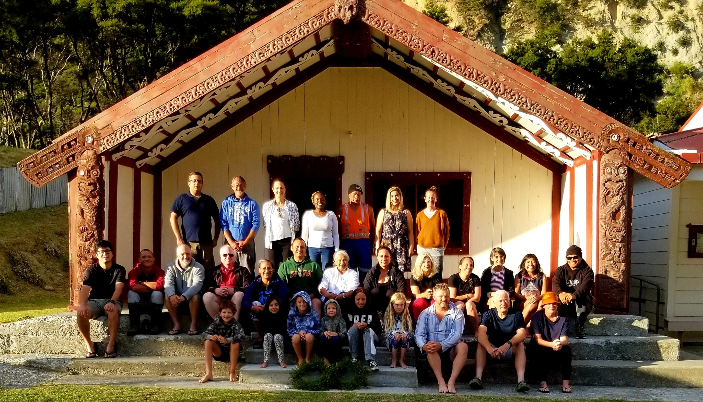
Hui in Whareponga valley, Ruatoria

Slide 32
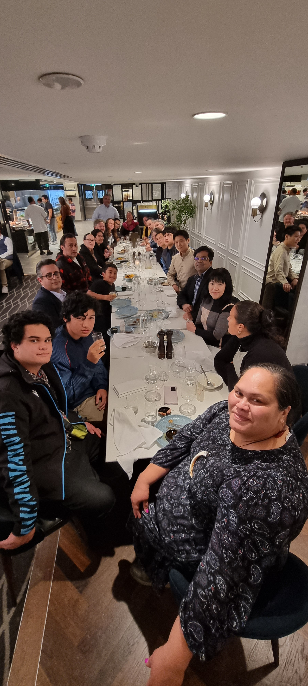
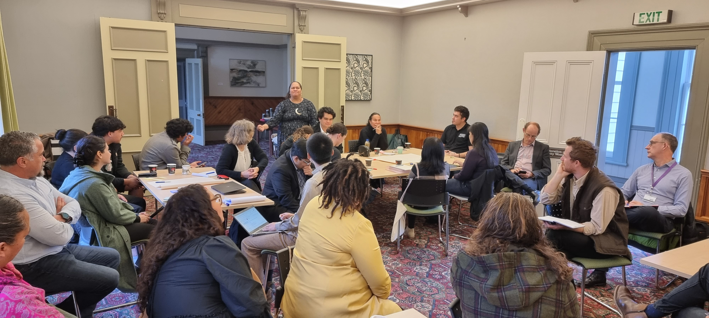
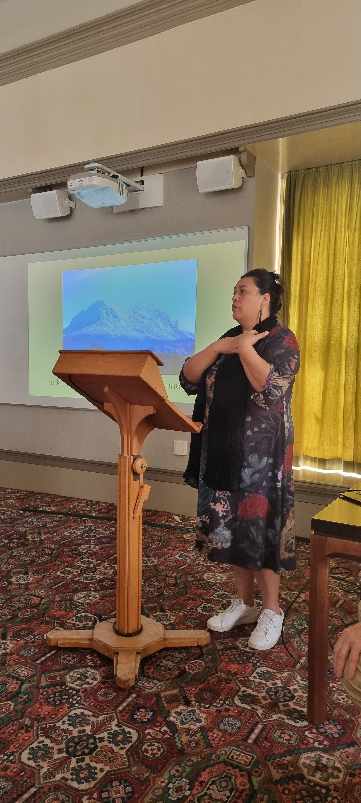
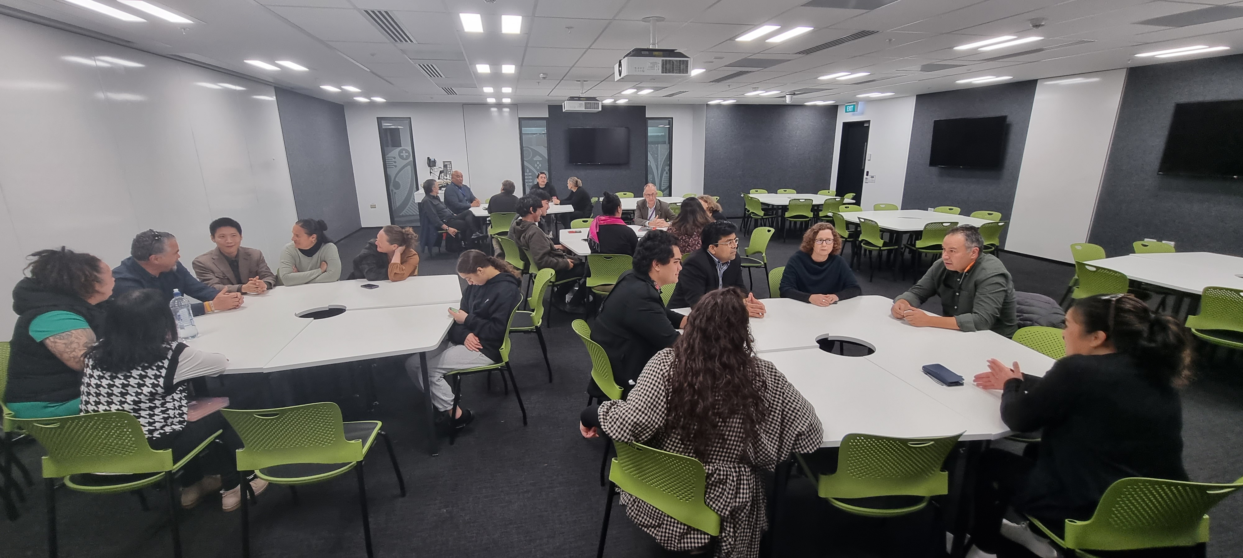
Hui in Auckland

Slide 33
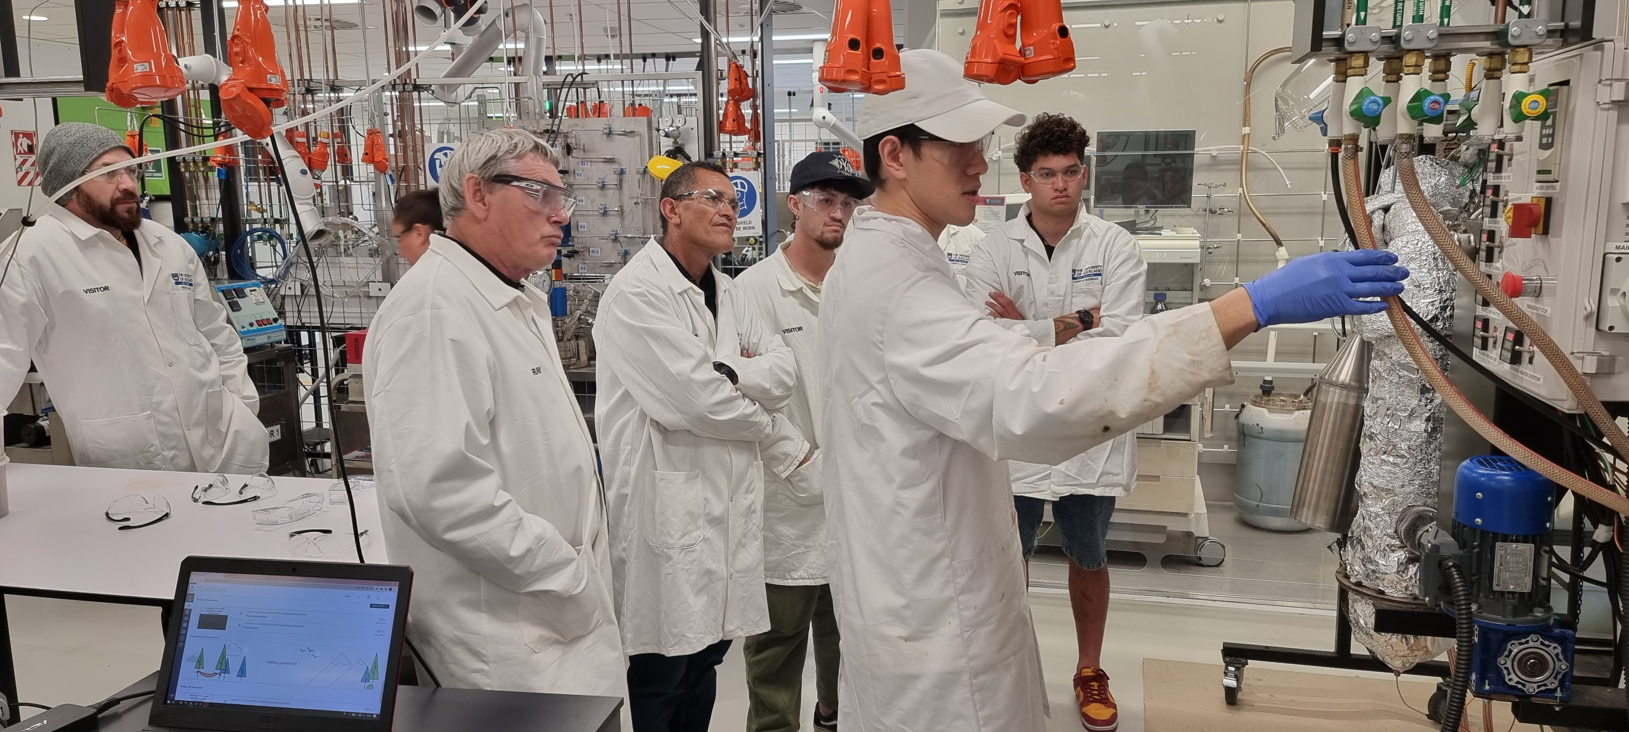
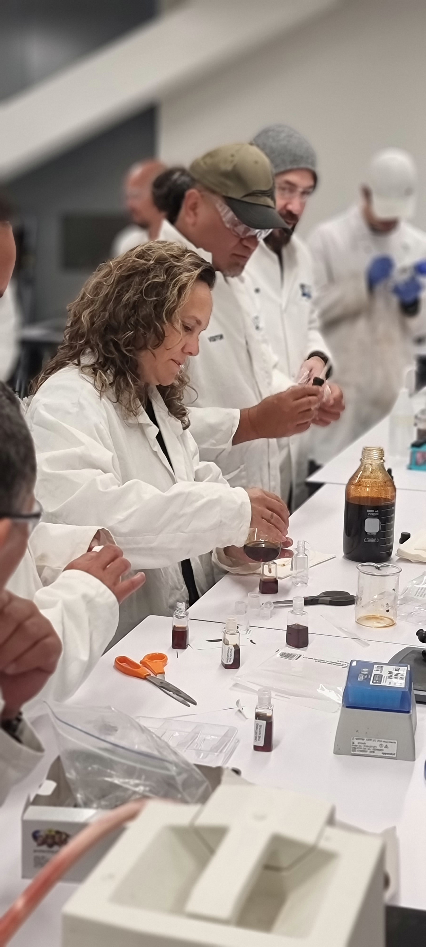
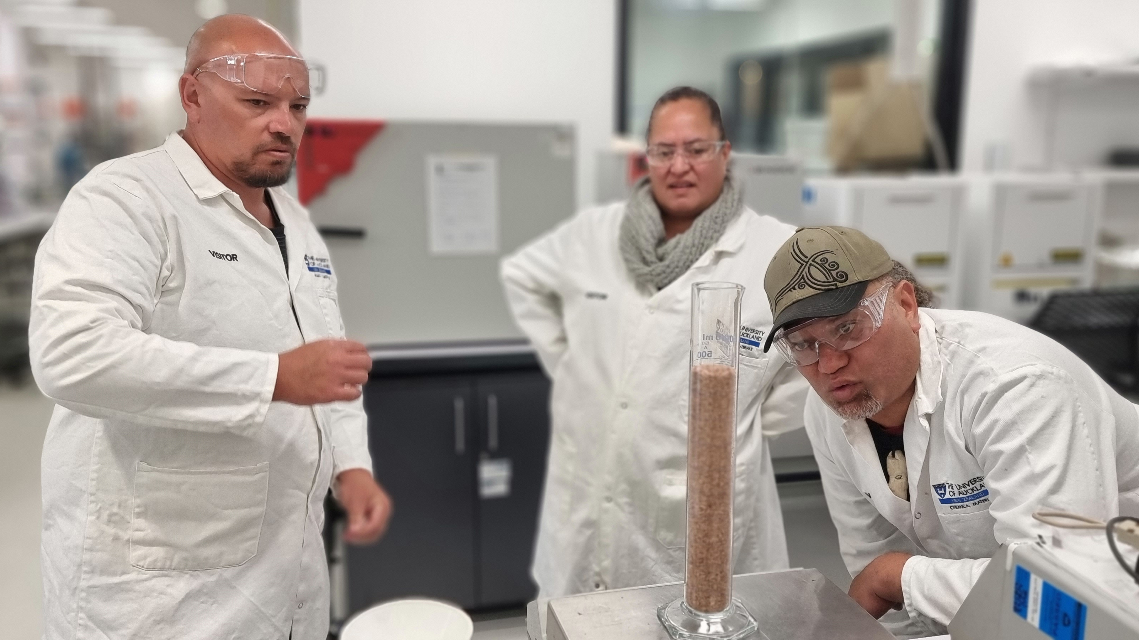
Research activities and training

Slide 34
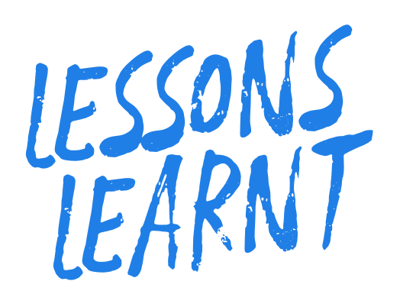
The research and development process must be intertwined with the relationship-building process. Build the relationship before focusing on the work.
Pace is important - People might say this has taken a long time, but we purposely haven’t rushed it.
Building engagement is a step-by-step process. We needed that time to understand each other, especially for me to learn the culture and to build relationships.
Plan together from the start.
Share decision-making.
Share findings.
Value each others' contribution and knowledge.
Collaborate as equal partners.
Be open.
Be patient.
Be flexible.
Be transparent.
The community needs a bridging person, because universities and academics aren’t easy to understand by communities.
As a non-Māori person, I think the most important thing is to improve our understanding of Māori approaches to knowledge and collaboration.
We need to use a highly collaborative and conversational approach.

Slide 35
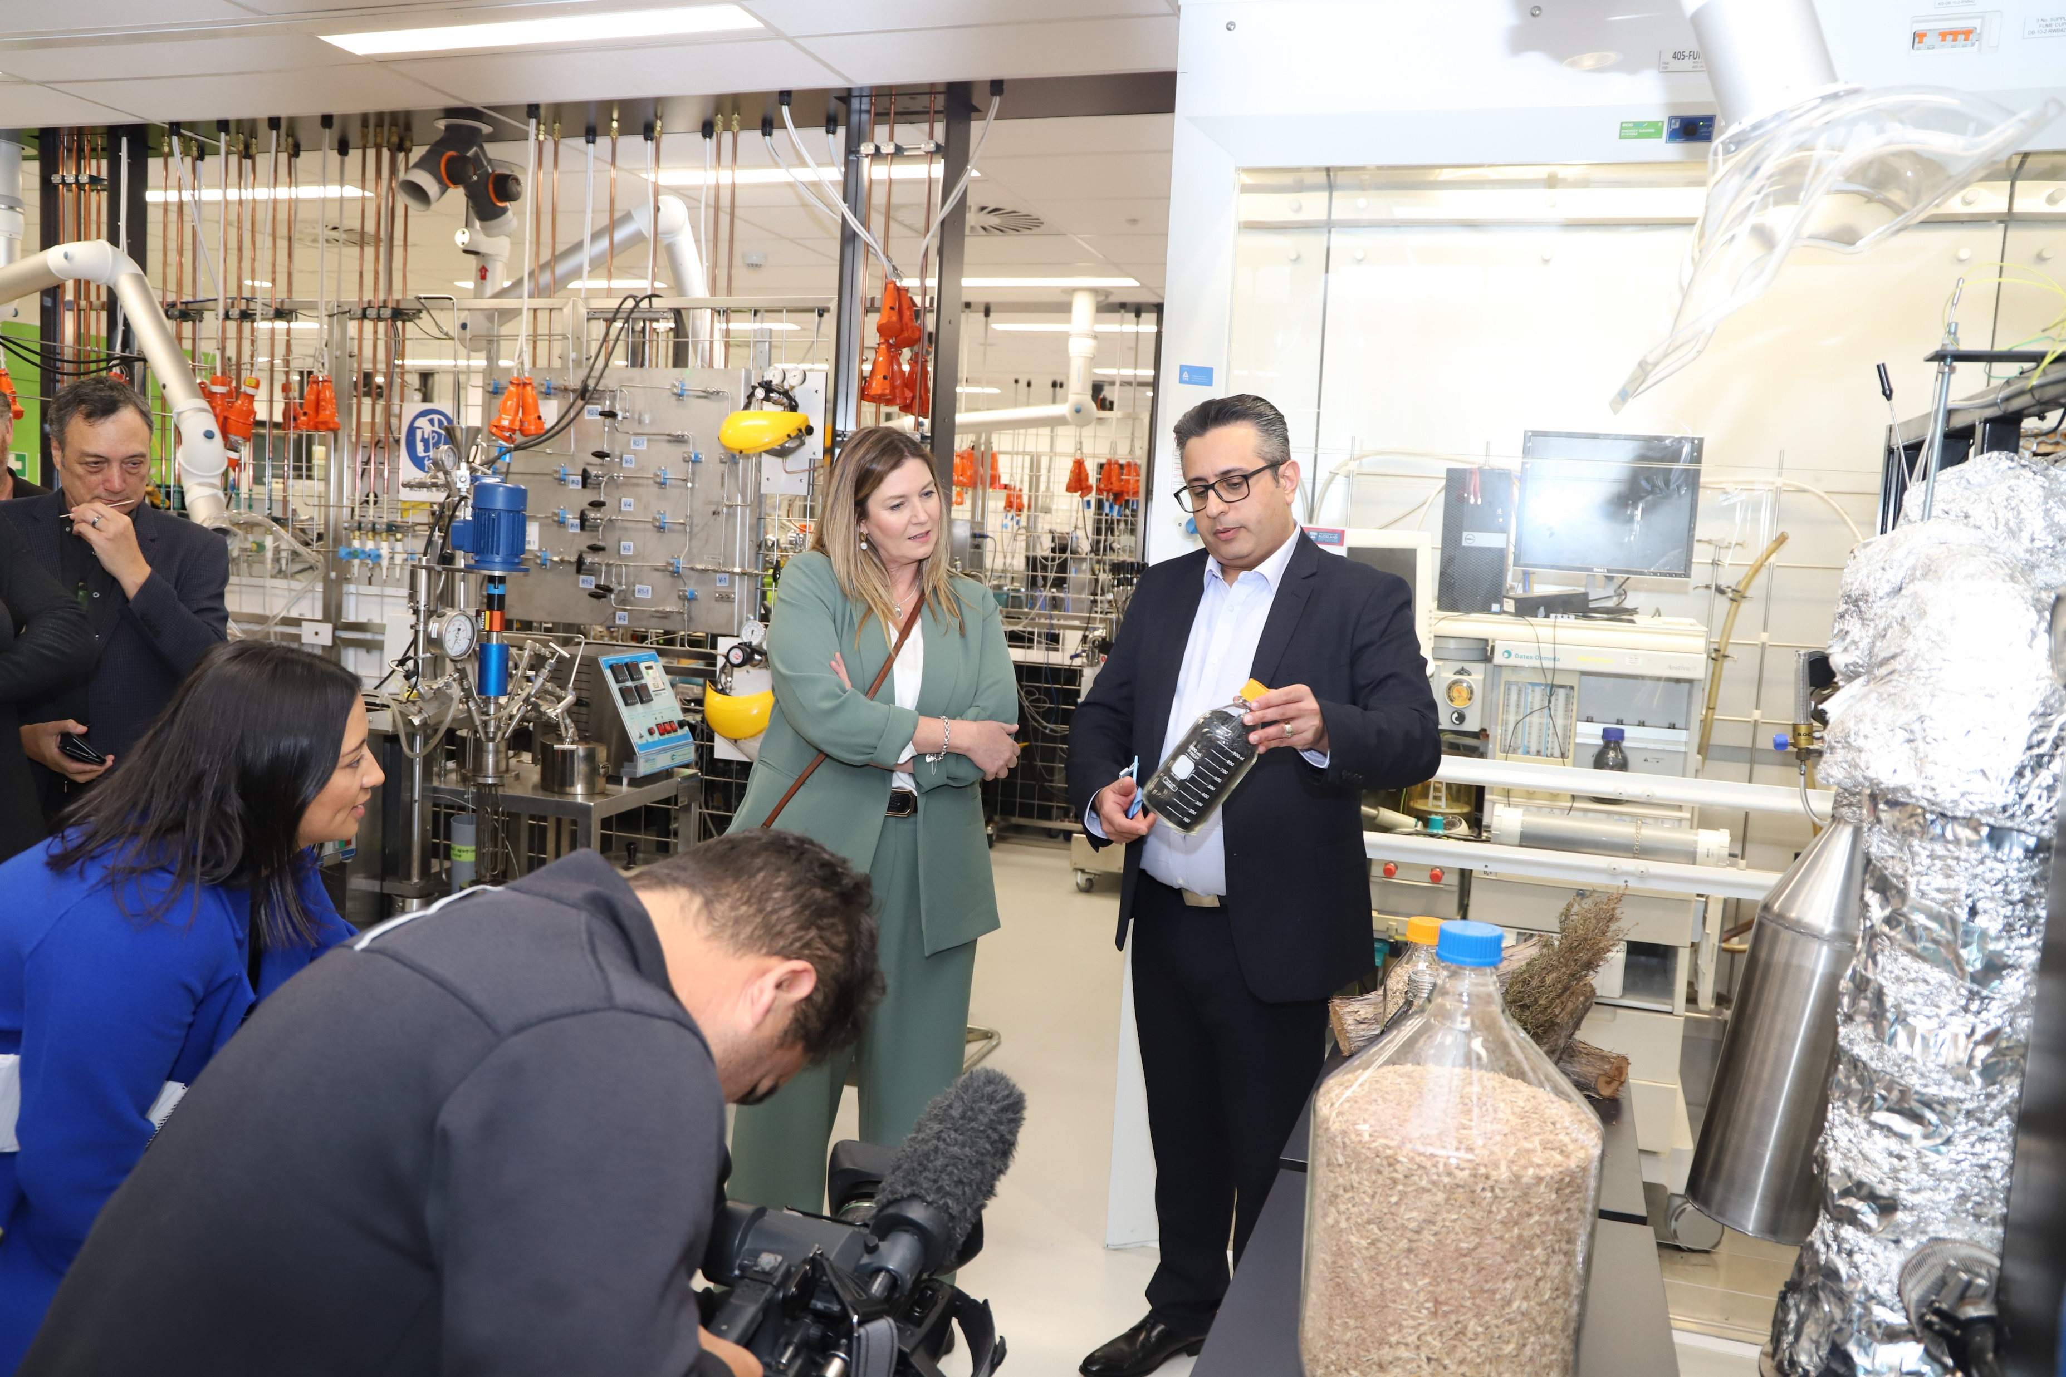

Next step: Scale up & Commercialisation

Slide 36
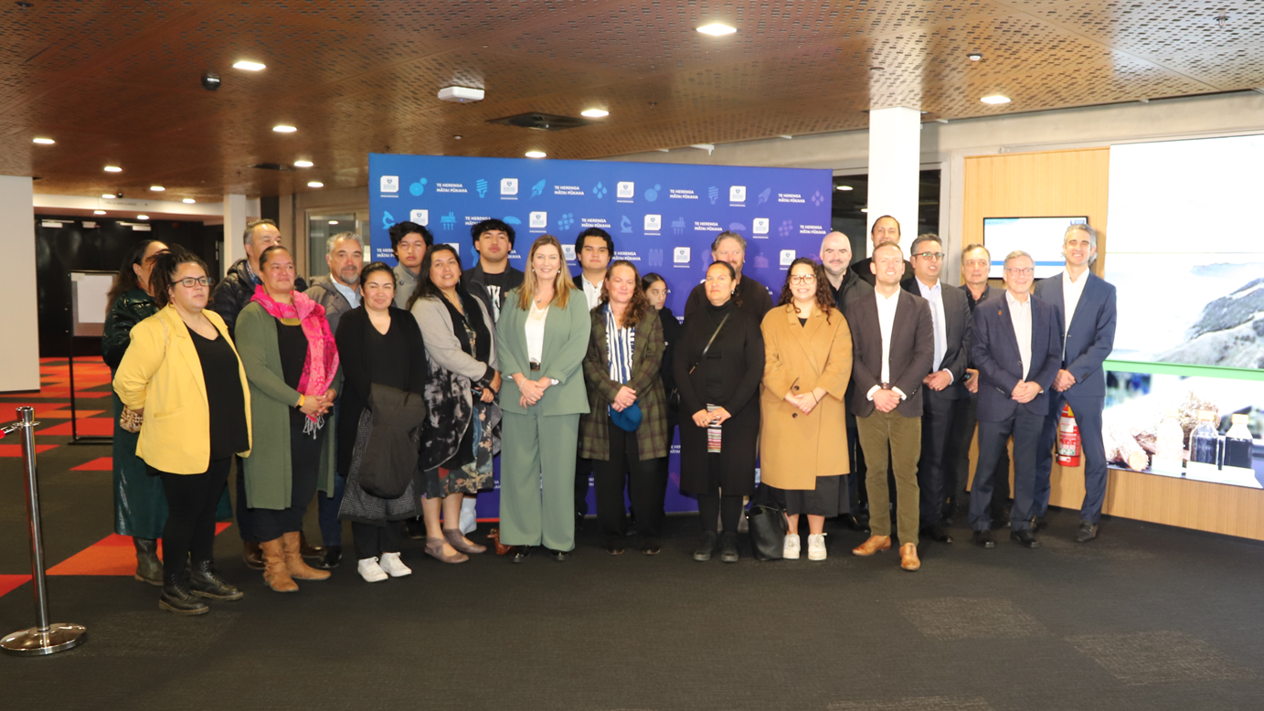
Next step: Scale up & Commercialisation

Slide 37


Funding from:
Expertise: Chem Eng., Business, Food Eng, Māori engagement
Identify opportunity to build on new resource utilisation pathways
Conversations and relationship-building with Māori community on their aspirations and perspectives
Proof of concept through lab-scale experimentation
Process design, optimisation, TEA, LCA
Semi-commercial production trials, training
Scale up
Publications
Licence
Novel products & Prototypes
Wānanga and hui
Postdoc, PhDs, Masters
Input to other research
New Charitable Trust and Start-up company
Uptake of technology
Media coverage
More cross-disciplinary collaboration (Engineering-Business-Māori community)
Capabilities (Postdoc, PhDs, Masters)
Capabilities (Māori community)
A new high-value industry
Employment for an isolated community
Strengthened capability, capacity, skills and networks between Māori and the science and innovation system

Slide 38
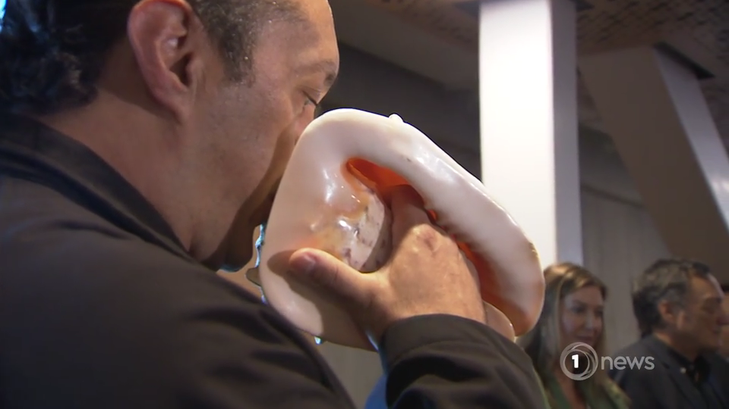
The emotional response from the community truly highlighted the project's real impact.
Thank You!

Slide 39


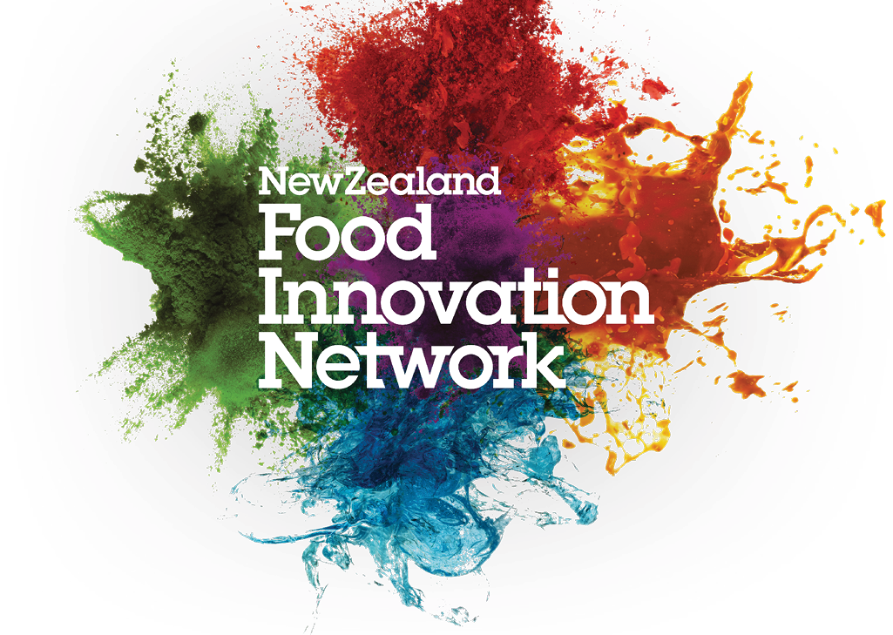


Aacknowledgement
Māori Community of Ruatoria
Research Team
Design/Scale Up Team
Dr Kiri Dell
Dr Xing Xin
Dr Sinemobong Essien
Amy Bissett
Adrian An
Wendy Zhao
Oliver Dube
Indhuja Devadas
James Li
Alex Radley
Mike Sly
Technical Support
Ray Hoffmann
Matthew Sidford
Frank Wu
Laura Liang
Peter Martin
Stephen Warrington
Claire Bennet
Collaborators
Engagement Support
Prof Brent Young
Dr Isuru Udugama
Dr Sanaz Ghoreishi
Prof Jun Lu
A/Prof Simon Swift
Catherine Dunphy
Steven Roberts
Michael Steedman
Tui Kaumoana Steedman
Dion Peita
Hone Thorpe
Chris Ford
Analeise Murahidy

